Slide 1
Creating Your Own Census Tract-Level SEER*Stat Databases - NAACCR Version 22
NAACCR Webinar January 30, 2023
Chris Johnson, Cancer Data Registry of Idaho
Steve Scoppa, Information Management Services, Inc.

Slide 2
Acknowledgments and Disclaimer
This project was funded in whole with Federal funds from the National Cancer Institute, National Institutes of Health, Department of Health and Human Services, under Contract No. HHSN261201800006I and the Centers for Disease Control and Prevention, Department of Health and Human Services, under Cooperative Agreement NU58DP007160, to the Cancer Data Registry of Idaho, Idaho Hospital Association.
The findings and conclusions in this presentation are those of the authors and do not necessarily represent the official position of the Centers for Disease Control and Prevention or the National Cancer Institute.

Slide 3
Learning Objectives
You will learn how to create a local SEER*Stat database using census tract 2010 geography
You will be reminded of NCI/Woods & Poole census tract population estimates developed for all states; these now cover 2006-2020
You will learn how to calculate cancer incidence rates by census tract using SEER*Stat
You will learn how to calculate cancer incidence rates by census tract attributes such as NAACCR Poverty Code, NAACCR/NCI cancer reporting zone, and CDC sub-county area, and more

Slide 4
Why is this important?
Cancer Cluster Analysis
  CDC/ATSDR 2022 guidance document: Guidelines for Examining Unusual Patterns of Cancer and Environmental Concerns
  Environmental Health
Social Determinants of Health
  Health Disparity/Health Equity
  Structural Determinants
Local Health Data to support cancer control and planning

Slide 5
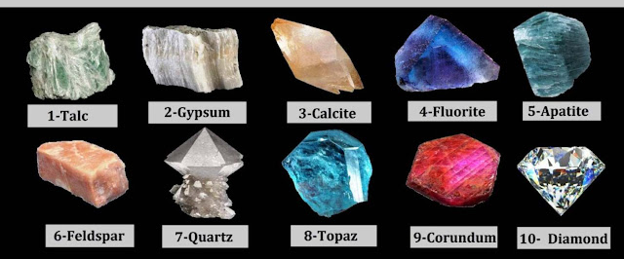
Hardness Scale
Notes:
We are going to be honest that this process is not the easiest. Maybe more like quartz than gypsum. We tried to make the instructions comprehensive, so that if you follow them step-by-step, you will be successful. But quite a lot is assumed of you:
You can operate SAS
You have some knowledge of NAACCR XML
You can operate SEER*Prep and SEER*Stat

Slide 6
Outline
Part 1. SAS program to create Incidence file, Population file, and Census tract attributes file for SEER*Prep
Section A – Population
Section B – read the Incidence file
Section C – Census Tract Attributes
Section D – write the Incidence files for SEER*Prep
Part 2. SEER*Prep: create census tract attributes database
Part 3. SEER*Prep: create census tract incidence database
Part 4. Hand-edit database.ini file to link attributes database to incidence database
Part 5. Analysis in SEER*Stat
Notes:
Instead of 3 SAS programs like last year, there is just one.

Slide 7
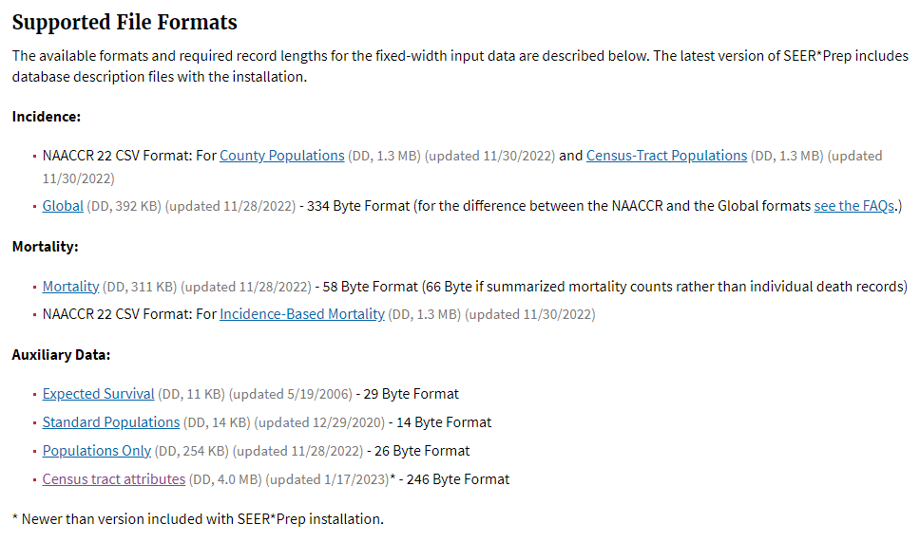
https://seer.cancer.gov/seerprep/
SEER*Prep
Install latest version of SEER*Prep (3.0.1)
Get latest Census Tract Attributes SEER*Prep .dd file from:
https://seer.cancer.gov/seerprep/format.html

Slide 8
Part 1 – SAS program to create Incidence file, Population file, and Census tract attributes file for SEER*Prep
SAS Demo:
Local census tract SEERstat db from Nov 22 submission file.sas
    Read the instructions in the SAS program and run it.

Slide 9
Section A – Population File
Download U.S. Census Tract Population Data from https://seer.cancer.gov/censustract-pops/
  These population estimates were produced by the Woods & Poole Economics, Inc. under contracts with the National Cancer Institute.
  For more information, harken back to the 2021 NAACCR Summer Forum. Materials are available here: https://www.naaccr.org/gis-resources/
    Denominators for Small Area Analysis, Tackling the Intractable Problem of Tract-level Analysis
SAS Demo: Section A – Population
    Read the instructions in the SAS program and run it.
Notes:
Todd Gibson (IMS) can answer detailed questions you may have regarding the population file.

Slide 10
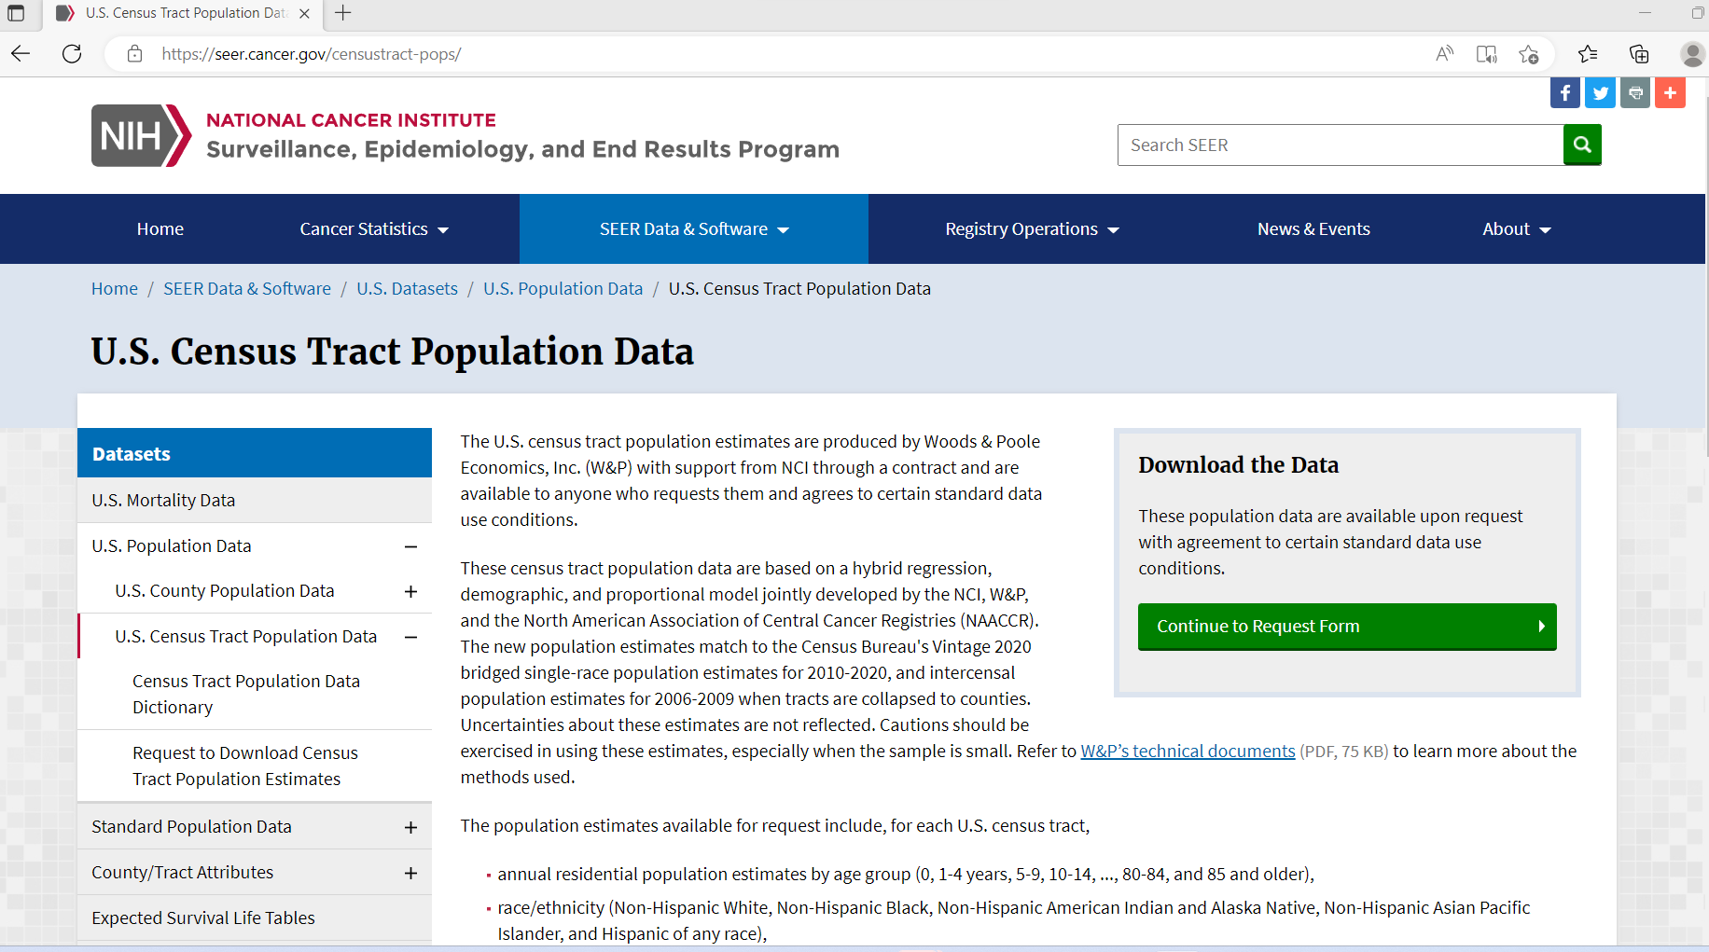
Notes:
If you downloaded the census tract population dataset before, do it again, as it was updated with 2020 populations last week.

Slide 11
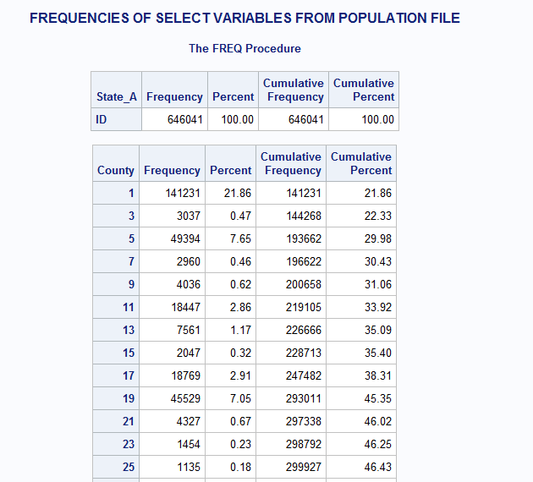

Slide 12
Section B – read the Incidence file
“Local census tract SEERstat db from Nov22 submission file.sas”
  This harnesses the “ReadWrite_NAACCR_22_XML_tidy_<date>.sas” code and instructions posted here: https://www.naaccr.org/analysis-and-data-improvement-tools/#TRANSLATION
  Please see this March 24, 2021 NAACCR webinar: https://education.naaccr.org/products/sassafras-reading-and-writing-naaccr-v21-xml-using-sas for additional instructions on how to use the SAS code.
  You can use your NPCR or SEER data submission file from Nov 2022; both have census tract values. You may or may not be able to use your NAACCR data submission file, depending on whether you included census tract.
  The SAS program will convert the NAACCR v22 XML file into CSV files, which can be read by SEER*Prep 3.0.1+.
  SAS Demo: Section B
    Read the instructions in the SAS program and run it.

Slide 13
Section C – Census Tract Attributes
Download Time-dependent Census Tract Attributes from https://seer.cancer.gov/seerstat/variables/countyattribs/census-tract-attribs.html
(Either EXE or GZ. You will work with the unzipped flat file.)
IMPORTANT – The file format was changed on August 5, 2022. You may need to download the file again.
SAS Demo: Section C
    Read the instructions in the SAS program and run it.
Notes:
Todd Gibson (IMS) can answer detailed questions you may have regarding the census tract attributes file.

Slide 14
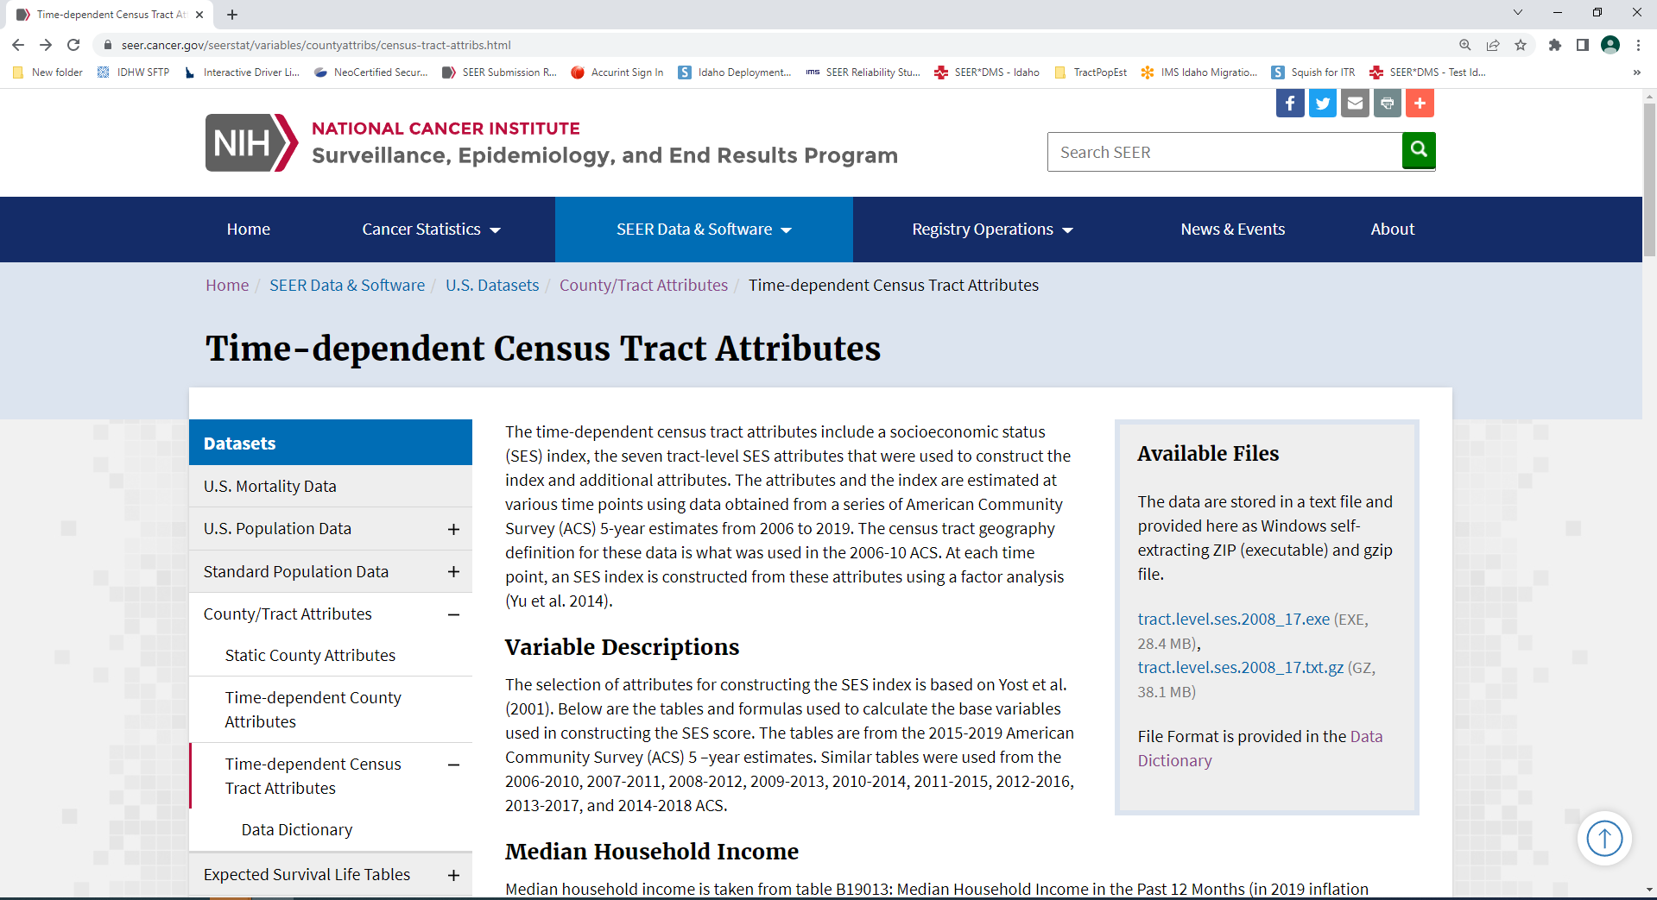
Notes:
Attributes cover 2008-2017. These will not be updated soon. We copy 2008 to 2006 and 2007. Also copy 2017 to 2018-2020. For 2010 geographies, there will be one update at some point for 2018-2020 data. Also in the future, there will be new attributes that correspond to 2020 Census Tract geography.

Slide 15
Section D – write the Incidence files for SEER*Prep
SAS Demo: Section D
    Read the instructions in the SAS program and run it.

Slide 16
Part 2 – SEER*Prep: create Census Tract Attributes Database
Launch newer/newest SEER*Prep 3.0.1+
In SEER*Prep, File -> Open -> ctract.attributes.d01172023.dd
  Add the Input .TXD File you created in Part 3.
  In the right-hand window, double-click on the field “State-county-tract recode”
  Click the Edit button
  In a text editor, open state.county.tract.recode.txt, which you also created in Part 3.
  Copy all of the text from the text editor into the Format box
  Click the OK button, then the next OK button
  Click the red Check icon or Execute -> Verify Data
    Click Yes to continue when the Warning about Large Formats pops up
    Save the Verify Report and make sure there are no surprises that warrant your attention
  Click the Lightning Bolt icon or Execute -> Create File
    Click Yes to continue when the Warning about Large Formats pops up
    Save the Run Report and Do not exclude any records
  Close SEER*Prep

Slide 17
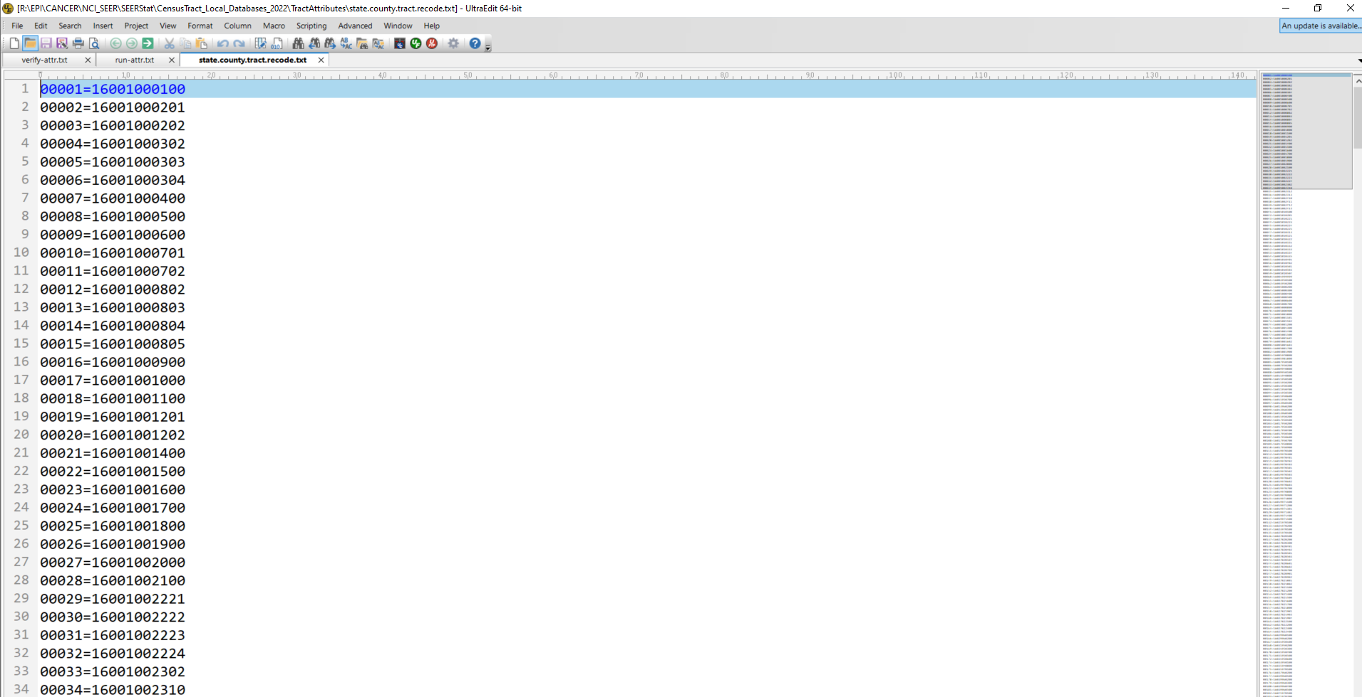
Notes:
Screen shot of state-county-tract.recode.txt. Values are specific to each database because of pattern of missing tract within county.

Slide 18
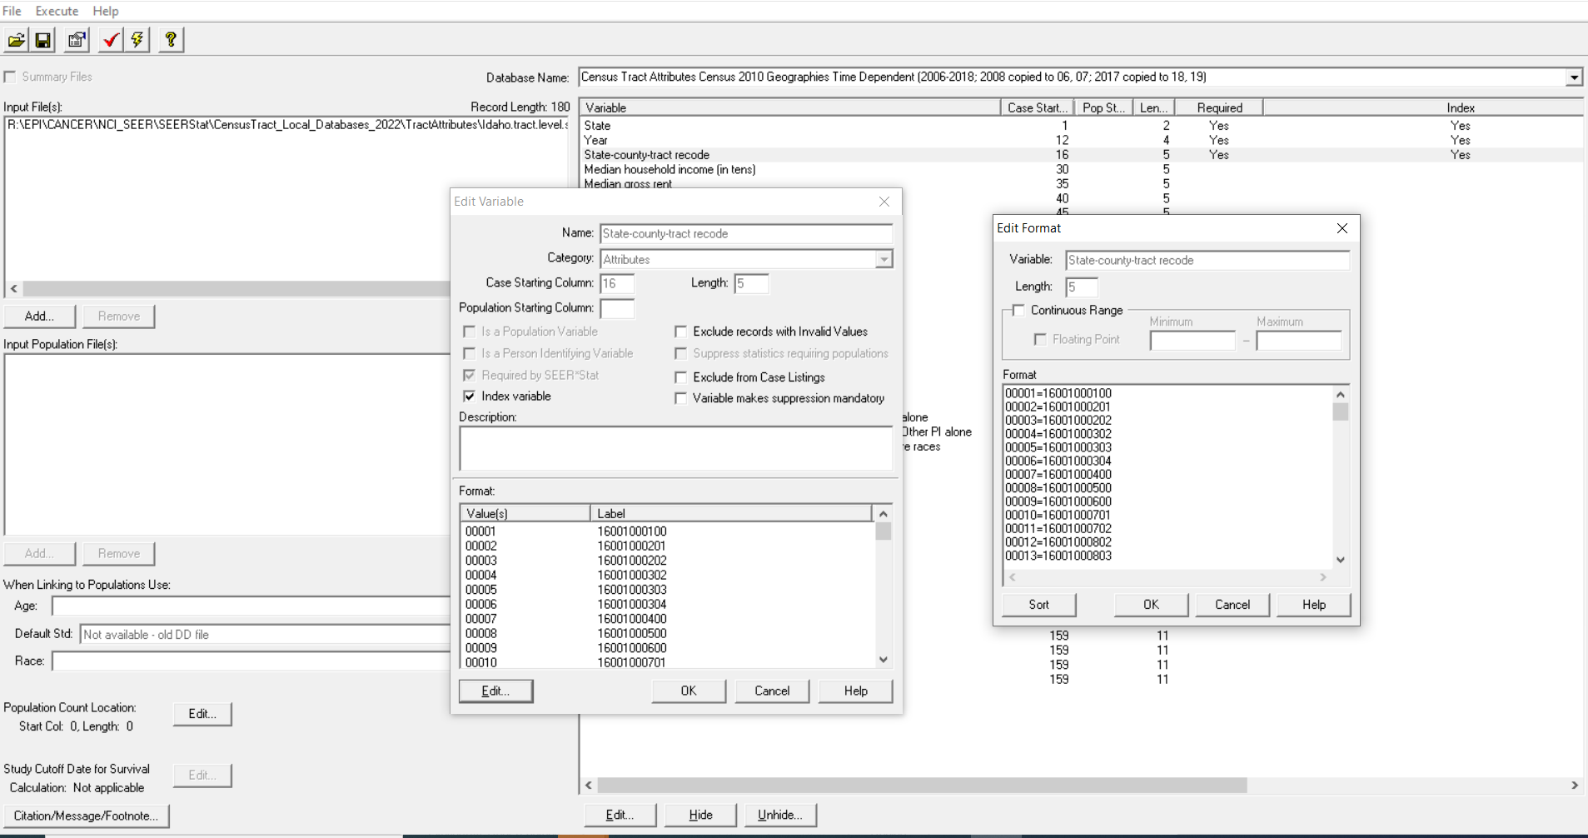
Notes:
Screen shot of pasting the state-county-tract.recode.txt values into the format in SEER*Prep.

Slide 19
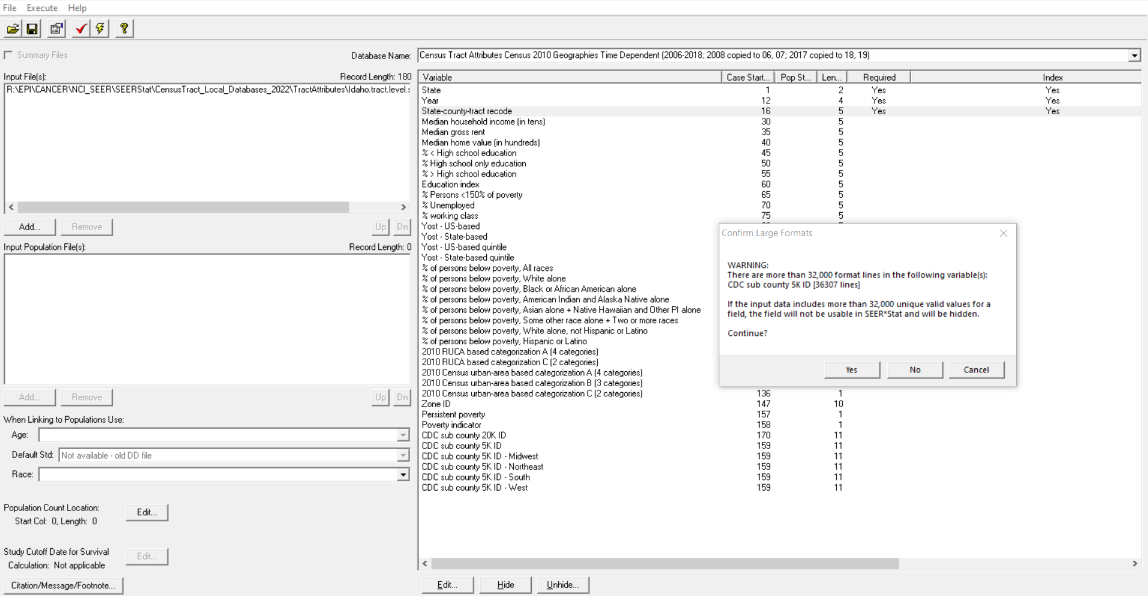
Notes:
There will be a warning message because of the large number of format lines. For individual states, it is safe to ignore this message. Click Yes and move on.

Slide 20
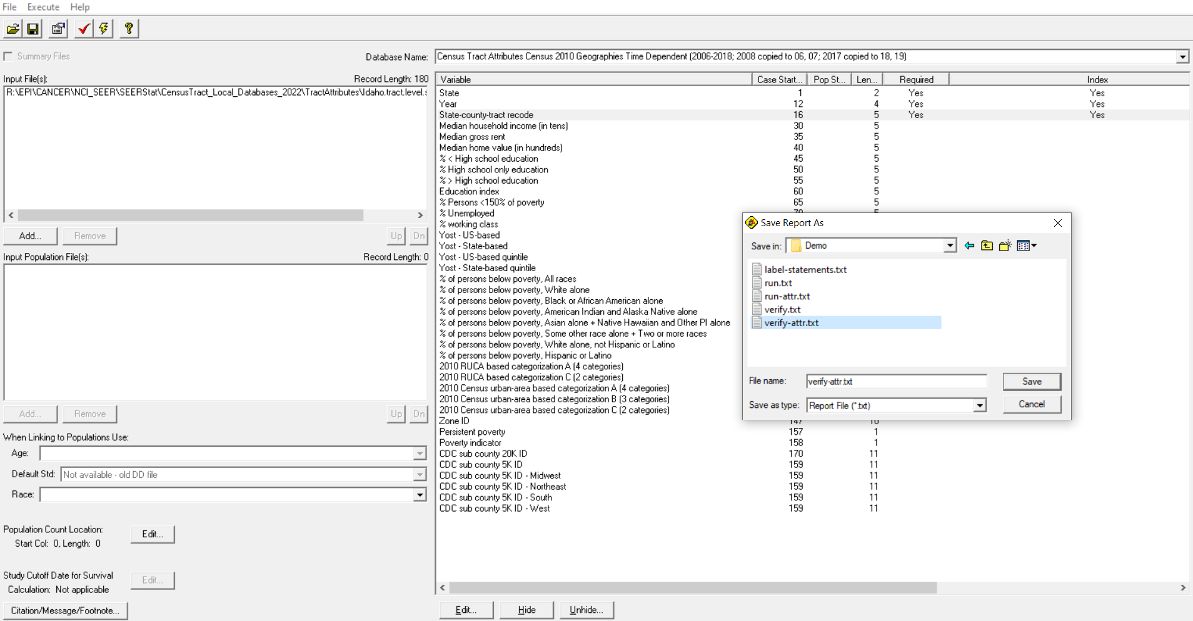
Notes:
Screen shot of Save Verify Report.

Slide 21
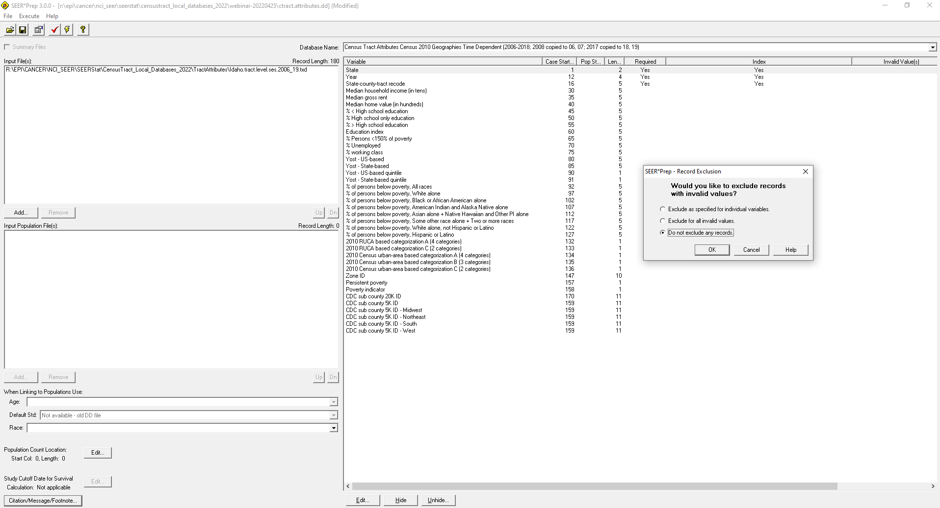
Notes:
Screen shot of Run. Do not exclude any records.

Slide 22
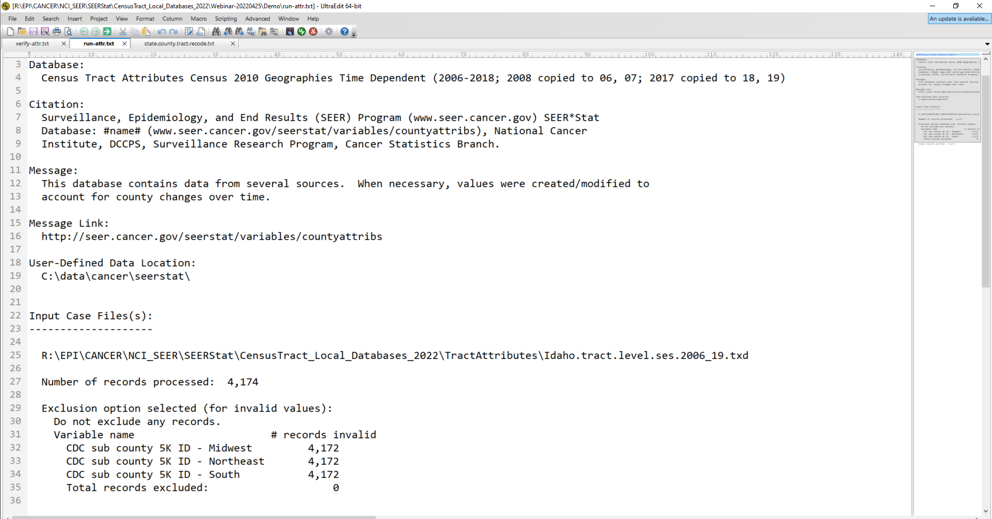
Notes:
Screen shot of Run Report. Note that Idaho is in the West region for the CDC sub-county 5K geography. That means the values are invalid for the other regions, Midwest, Northeast, and South.

Slide 23
Part 3 – SEER*Prep: create Census Tract Incidence Database
Launch newer/newest SEER*Prep 3.0.1+
In SEER*Prep, File -> Open -> naaccr22.tractpops.csv.d11302022.dd
  Add the Input .CSV File(s) you created in Part 1. If you have > 300,000 incidence records, there will be more than 1 file.
  Add the Input Population .TXD File you created in Part 2.
  Modify the Study Cutoff Date for Survival and Citation/Message/Footnote as you like.
  Hide variables not In Data – if you like.
  Add a variable for Breast Cancer Molecular Subtype (2011+) [mol_subtype]
    1=HR+/HER2-
    2=Triple negative
    3=HR+/HER2+
    4=HR-/HER2+
    5=Unknown or Borderline
    9=Not applicable

Slide 24
Part 3 – SEER*Prep: create Census Tract Incidence Database
  Click the red Check icon or Execute -> Verify Data
    Click OK to the Warning about DD Variables without Column ID
    Click OK to the Warming about Columns IDs not found in the DD
    Save the Verify Report and make sure there are no surprises that warrant your attention
  Click the Lightning Bolt icon or Execute -> Create File
    Click OK to the Warning about DD Variables without Column ID
    Click OK to the Warming about Columns IDs not found in the DD
    Save the Run Report and Do not exclude any records
  Close SEER*Prep

Slide 25
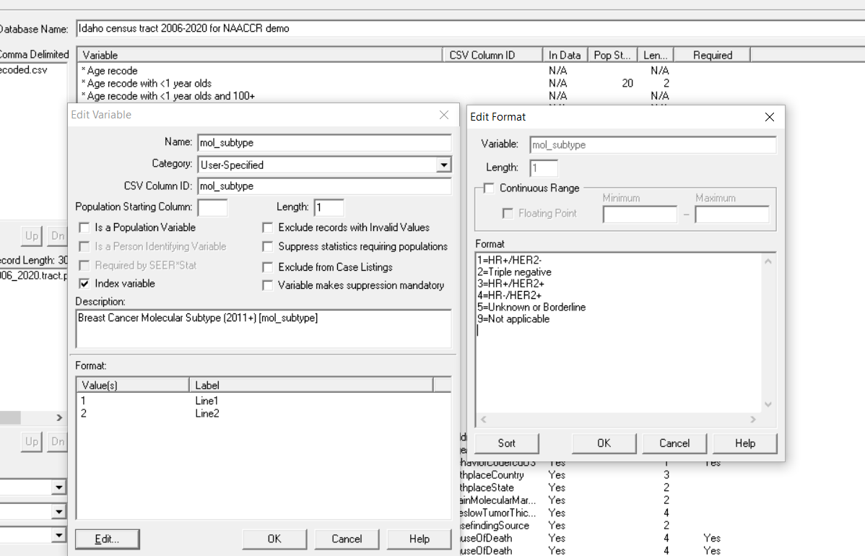
Notes:
How to Add a Field in SEER*Prep.

Slide 26
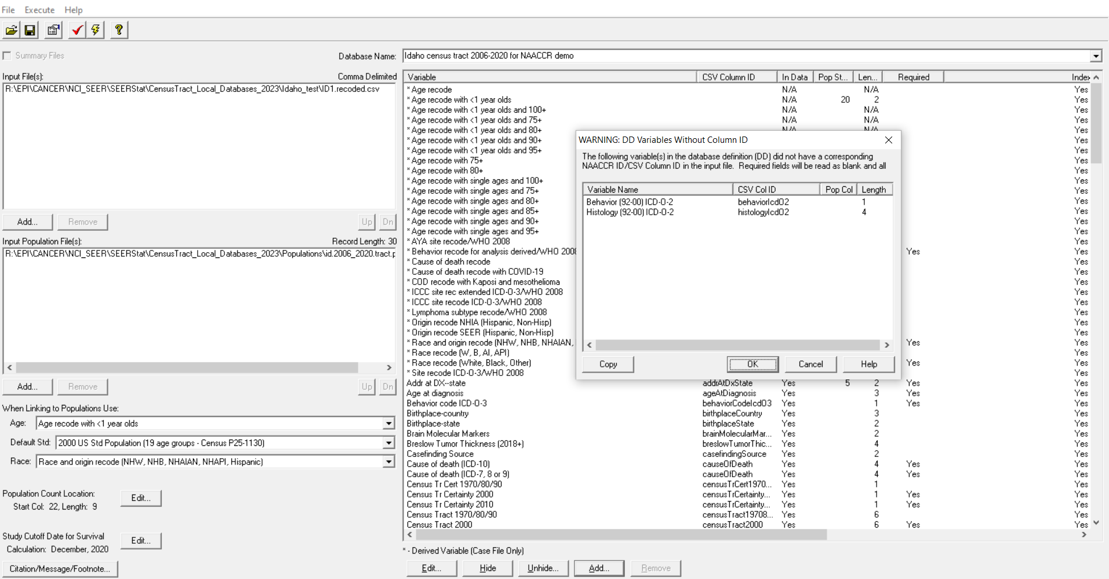
Notes:
Example of Warning message for Verify Data.

Slide 27
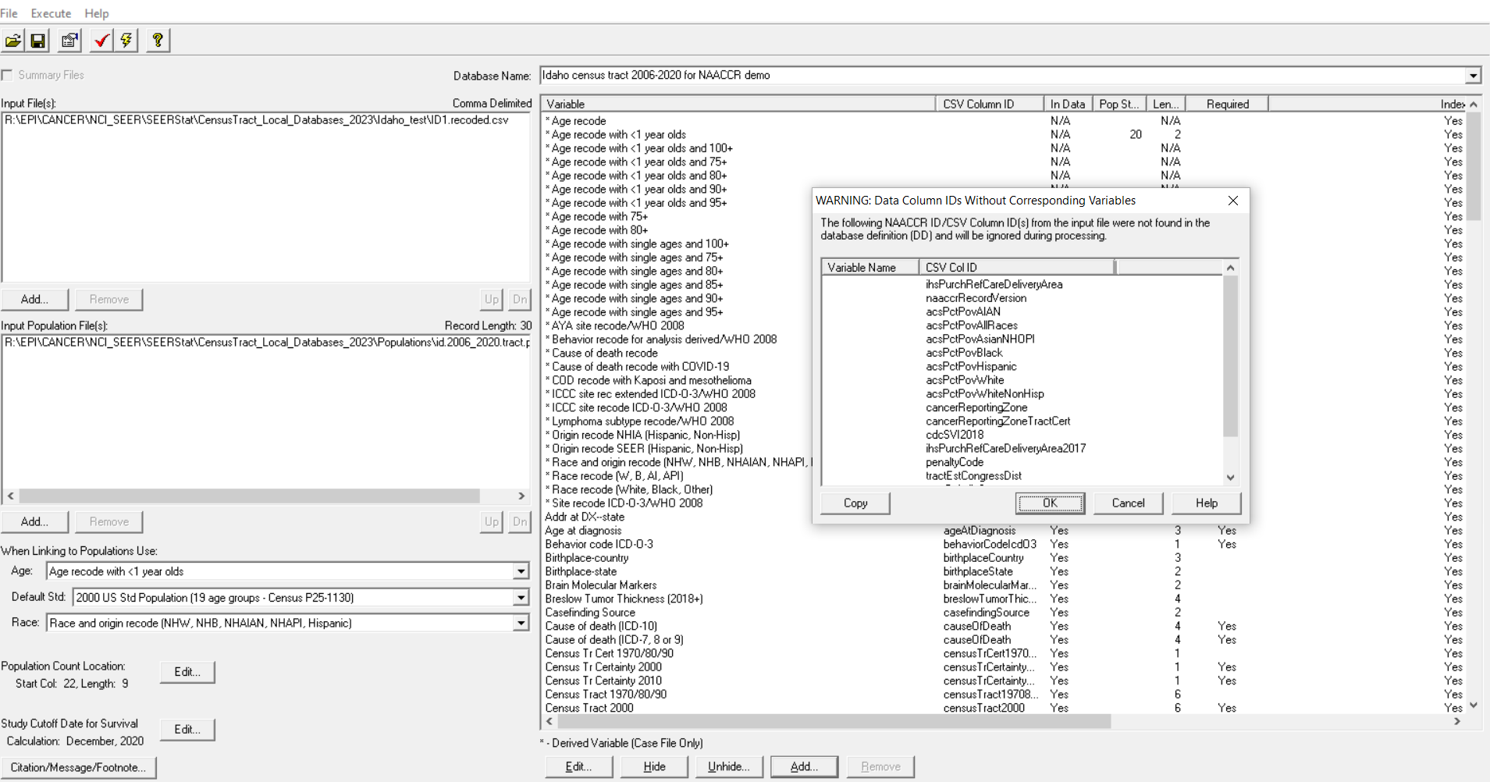
Notes:
Example of Second Warning message for Verify Data.

Slide 28
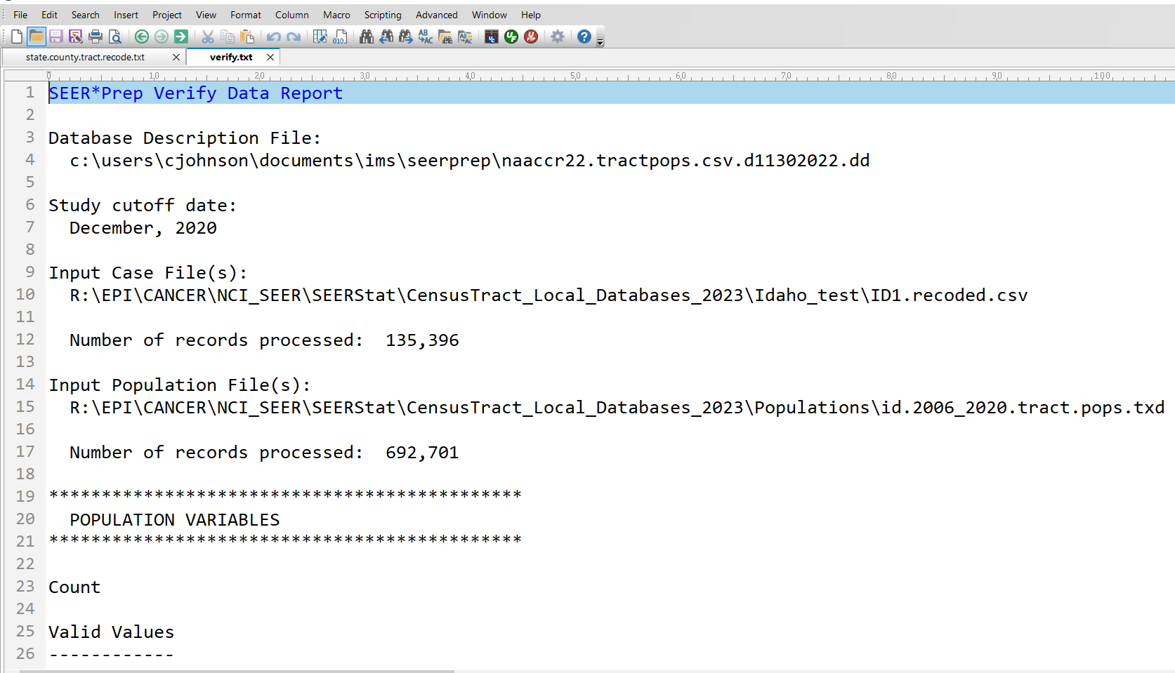
Notes:
SEER*Prep Verify Data Report

Slide 29
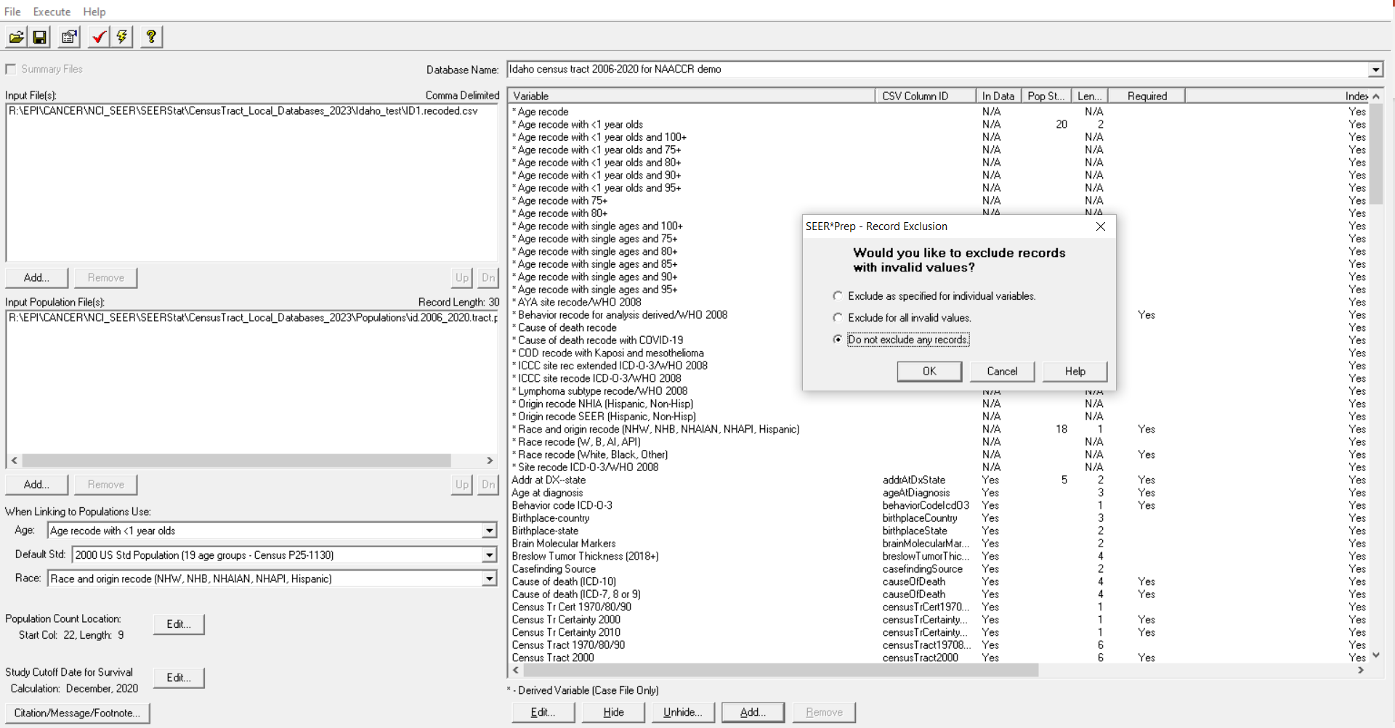
Notes:
SEER*Prep Create Database. Do not exclude any records.

Slide 30
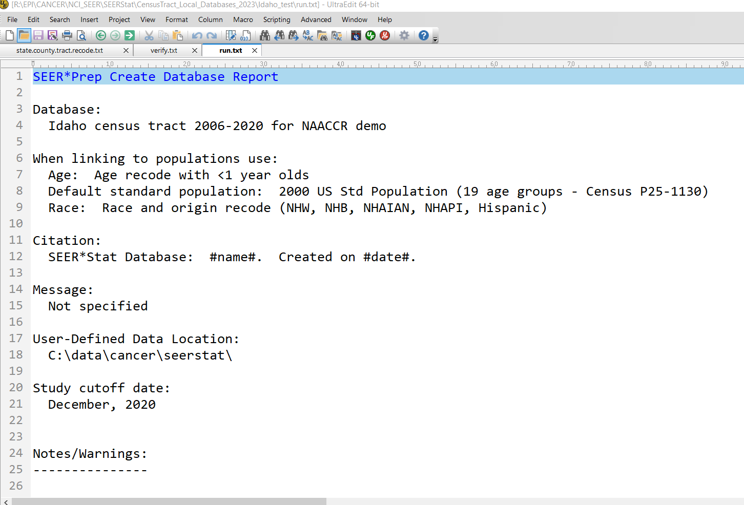
Notes:
SEER*Prep Create Database Report

Slide 31
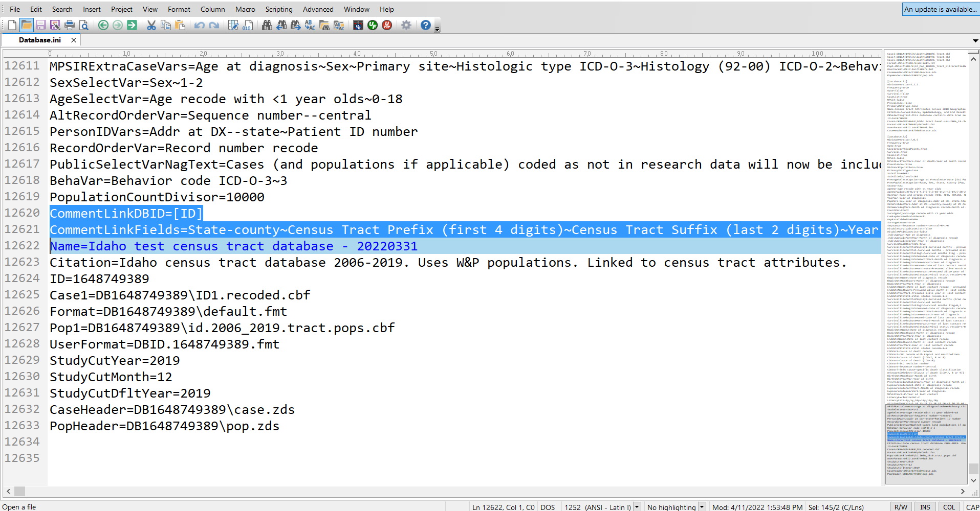
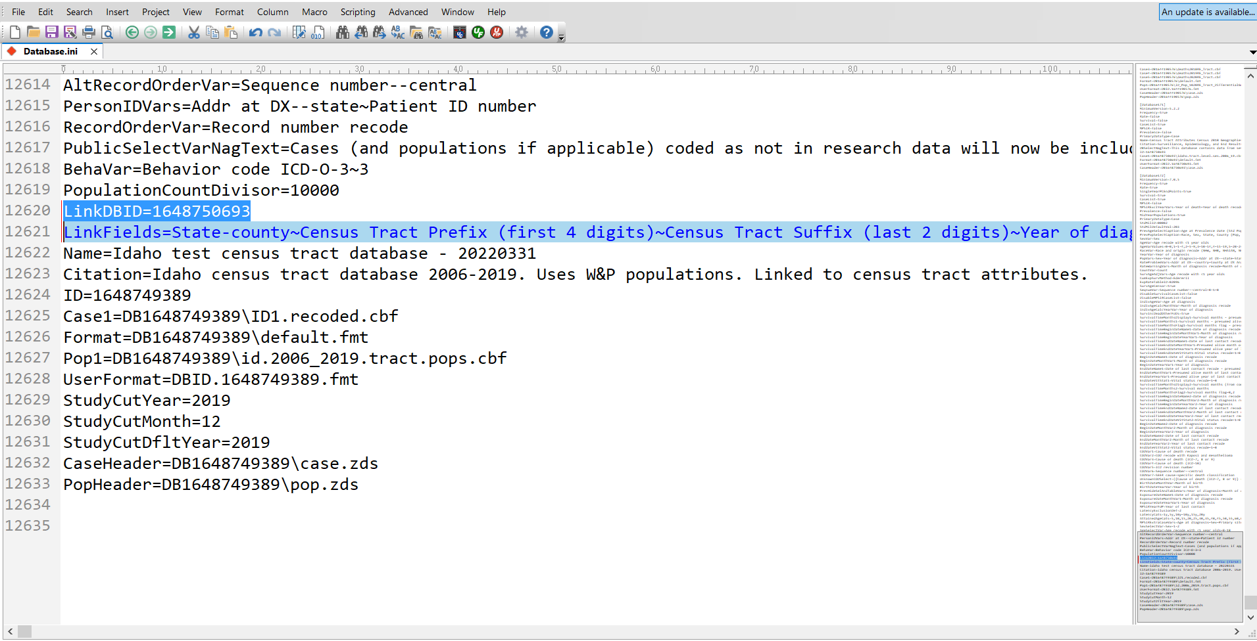
Part 6. Hand-edit database.ini file to link attributes database to incidence database
Notes:
Delete the word “Comment” from the incidence db in 2 places. Input the ID for the census tract attributes database in the LinkDBID= field.

Slide 32
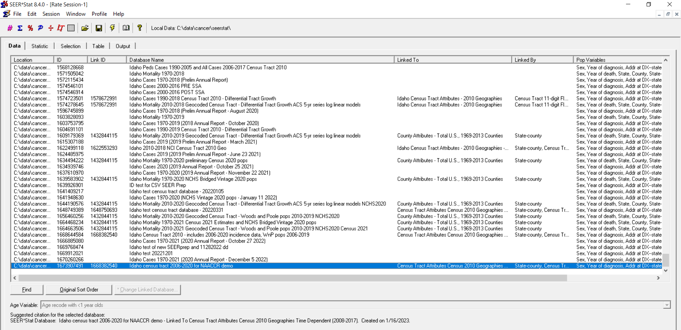
Part 7. Analysis in SEER*Stat
Notes:
Work through the tabs in SEER*Stat like you normally would. Select the census tract incidence database you just created. Note that it is linked to the census tract attributes database you also just created.

Slide 33
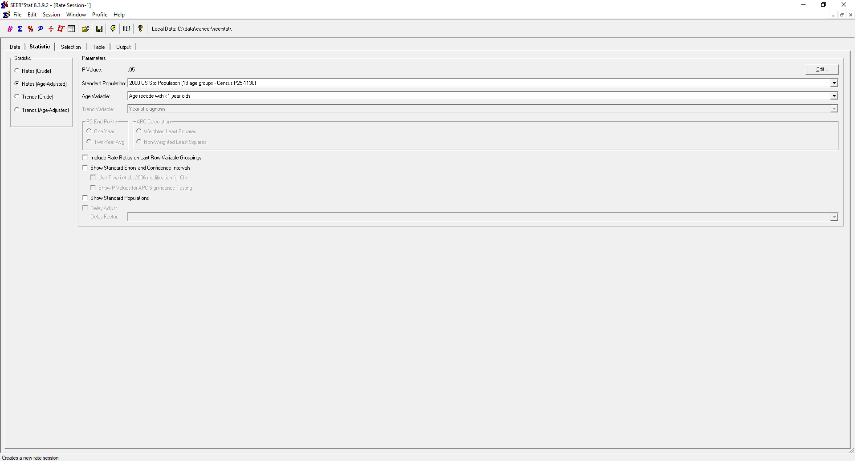
Notes:
For this example, we will calculate age-adjusted rates.

Slide 34
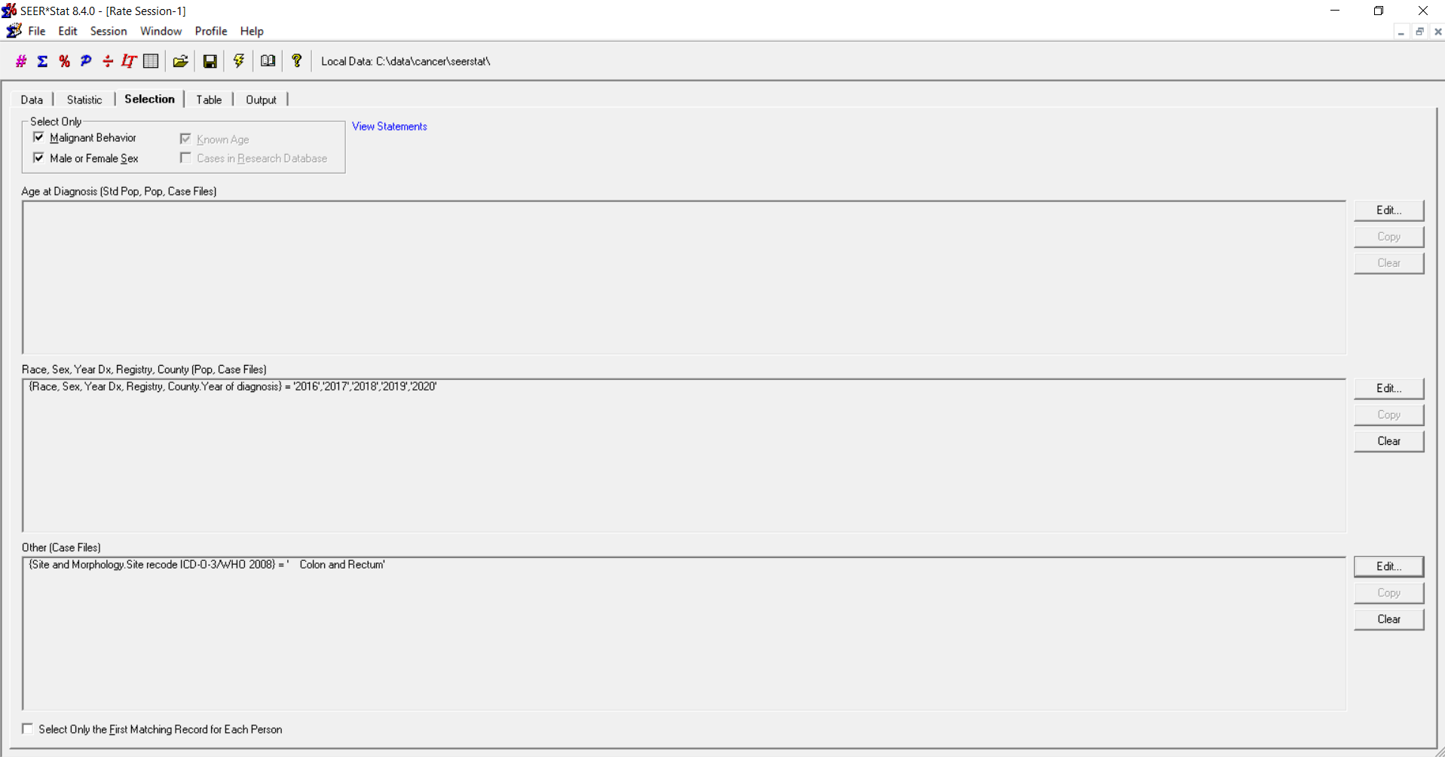
Notes:
We are selecting the latest 5 years of colorectal cancer cases.

Slide 35
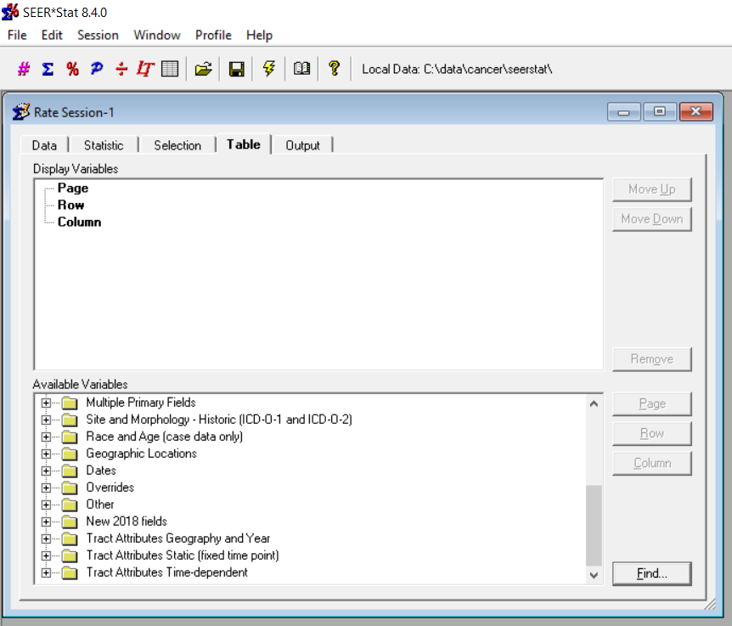
Notes:
Note the three categories from the Census Tract Attributes Database:
Tract Attributes Geography and Year
Tract Attributes Static (fixed time point)
Tract Attributes Time-dependent

Slide 36
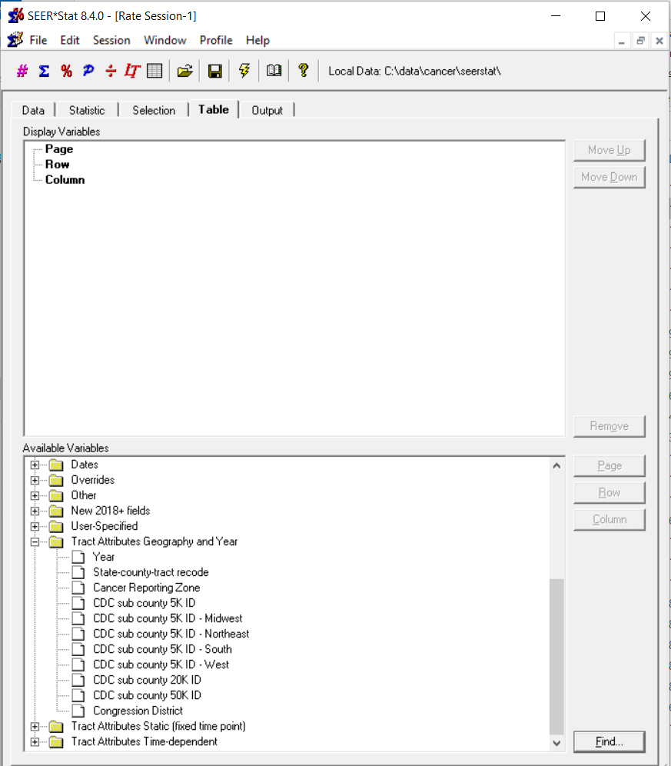
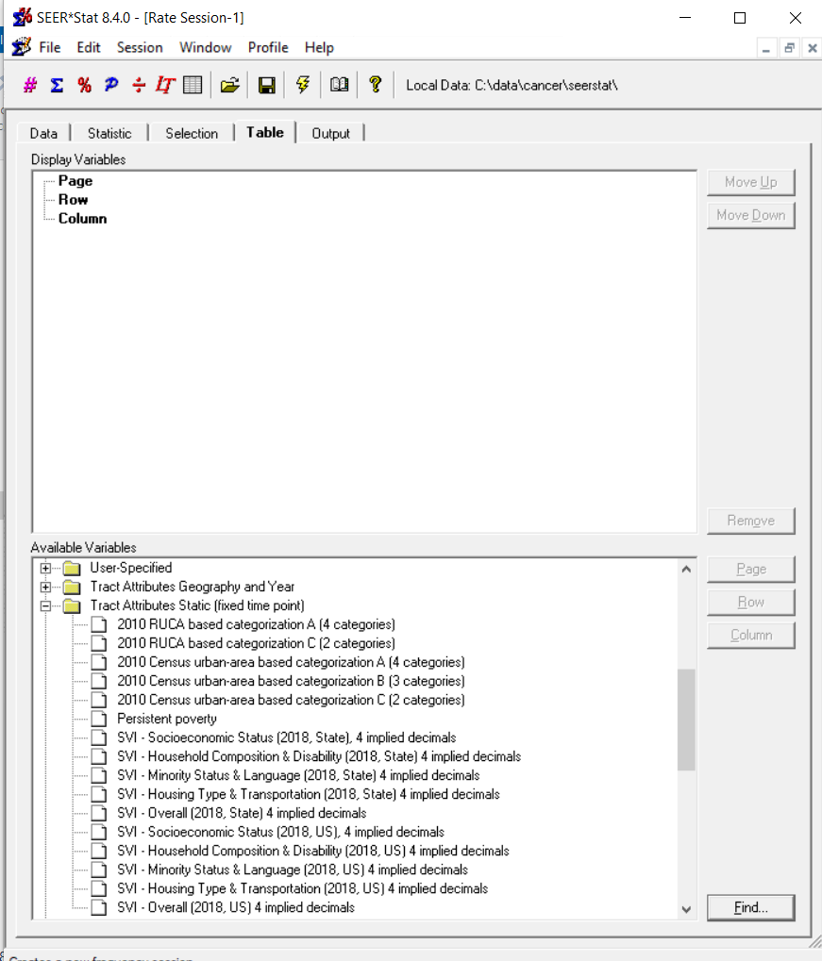
Notes:
Look at the left side of your screen. The individual census tracts are in the field “State-county-tract recode” – which is listed under the Tract Attributes Geography and Year category.
This category also includes the Cancer Reporting Zone; CDC Sub-County 5k, 20k, and 50k geographies; and tract-based Congressional District.
On the right side of your screen are the Static Tract Attributes. The static attributes include urban/rural area designations, an indicator for tracts with persistently high poverty, and social vulnerability index items..

Slide 37
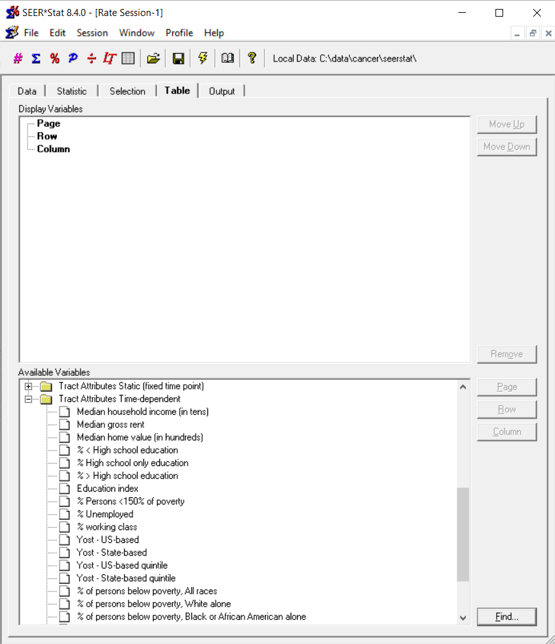
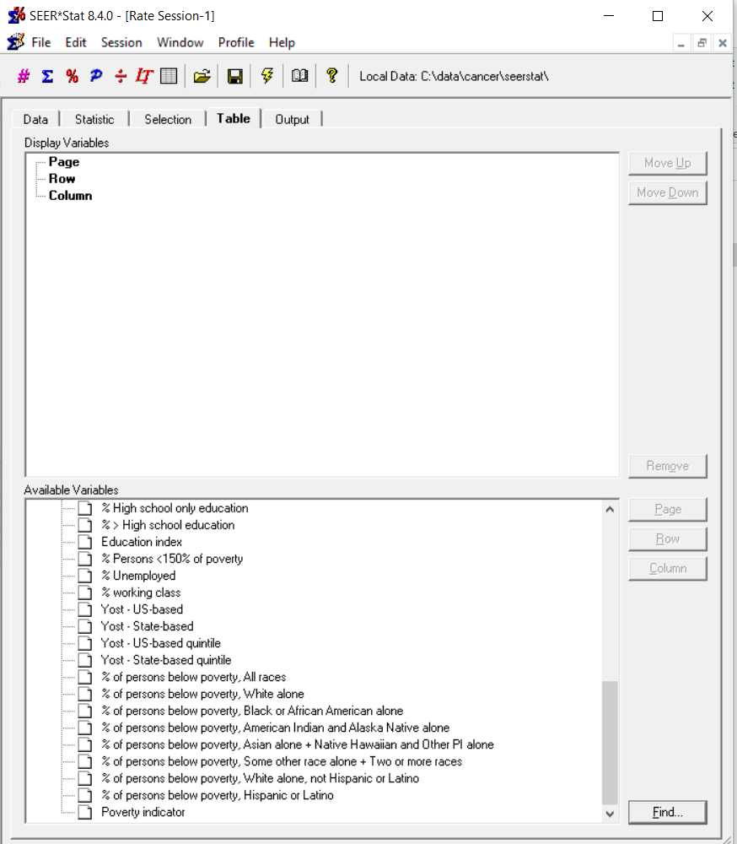
Notes:
The Time-Dependent Tract Attributes are shown on the bottom parts of both screens. The combined screens show the whole list, with some overlap.

Slide 38
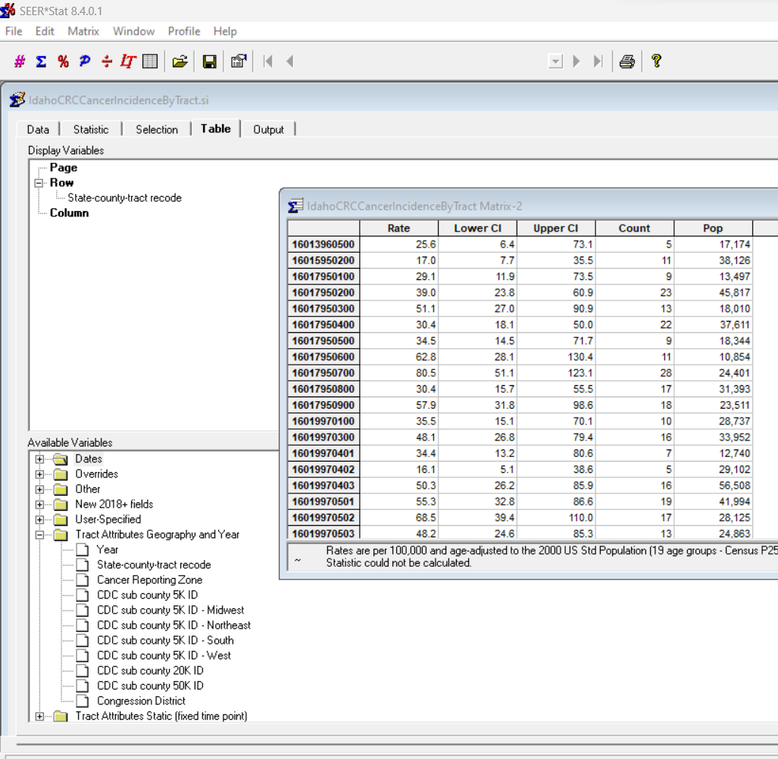
Incidence Rates by Census Tract
Notes:
On the Table tab, we selected “State-county-tract recode” as the row variable. The results matrix shows census tract-level colorectal cancer incidence rates for 2016-2020. For those of you who perform cancer cluster investigations, this is your ticket to calculating rates at the census tract level. You could use the results as input into SaTScan or GIS or whatever process you use for reviewing rates as part of a cancer cluster investigation.
The confidence intervals show considerable overlap – mostly – but also some census tracts with significantly higher and lower incidence rates.

Slide 39
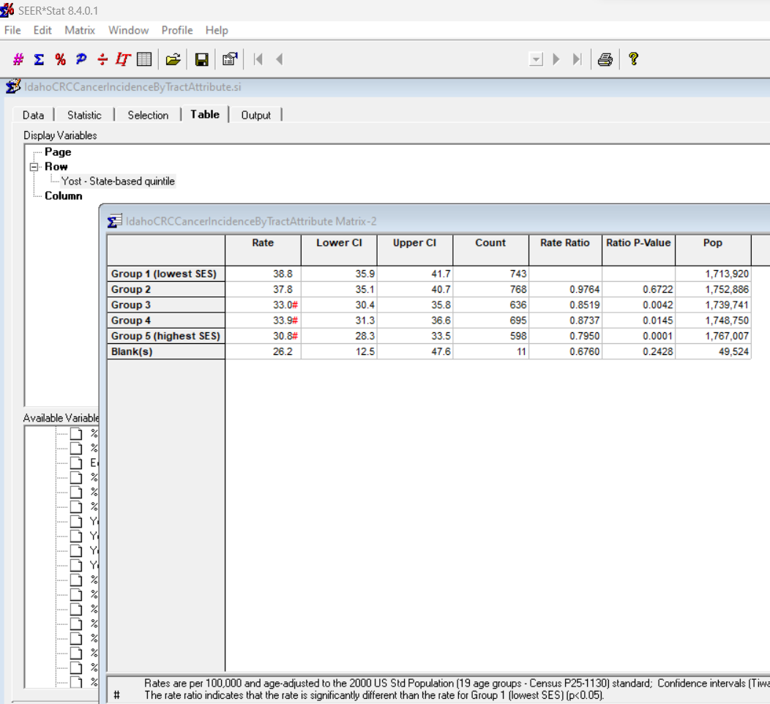
Incidence Rates by Census Tract Attributes: Yost – State-based quintile
Notes:
For the second example, we selected “Yost – State-based quintile” as the row variable. You can see that colorectal cancer incidence is lowest in the high SES group and highest in the low SES group.

Slide 40
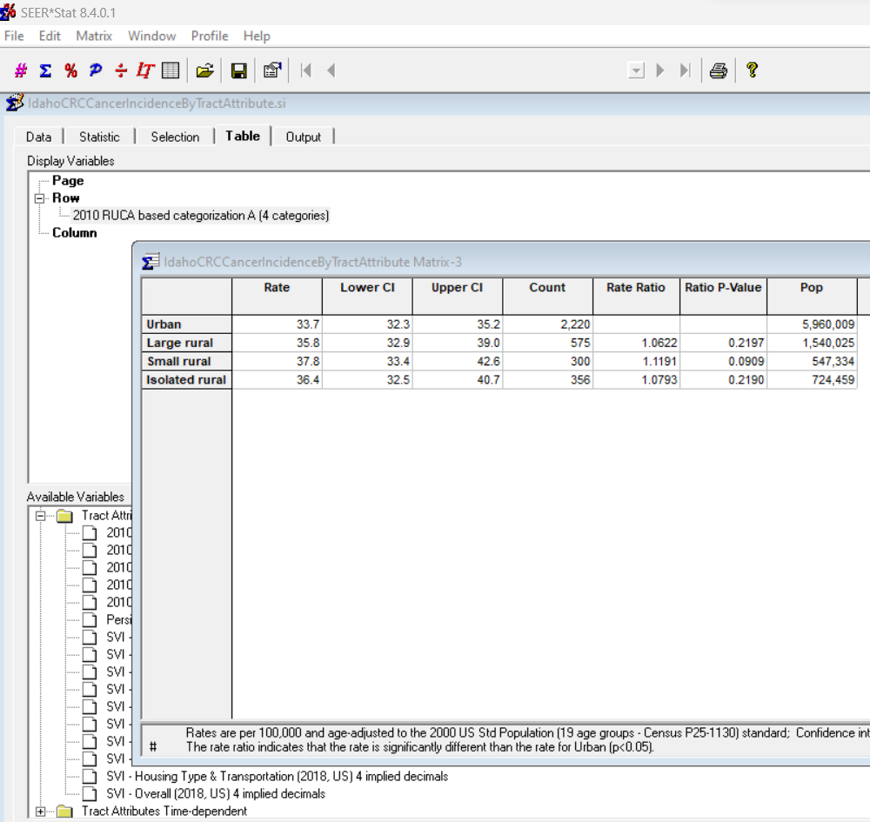
Incidence Rates by Census Tract Attributes: 2010 RUCA categories
Notes:
For the third example, we selected “2010 RUCA-based categorization (4 categories)” as the row variable. RUCA stands for Rural Urban Commuting Area and is a measure of urbanicity/rurality.

Slide 41
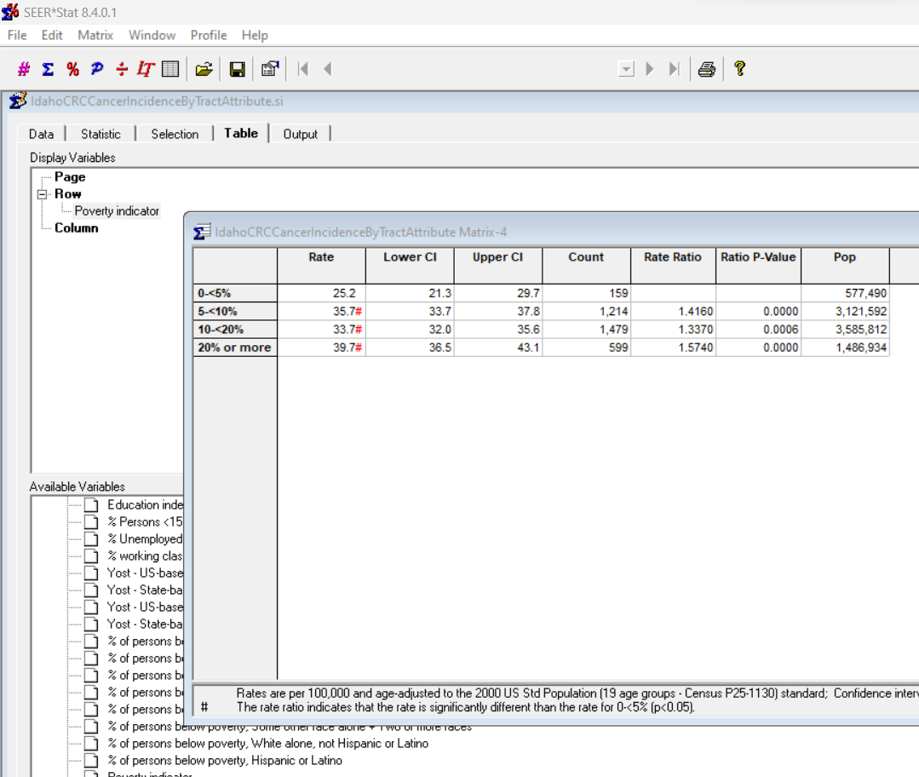
Incidence Rates by Census Tract Attributes: NAACCR Poverty Indicator
Notes:
For the fourth example, we selected the NAACCR Poverty indicator variable as the row variable.

Slide 42
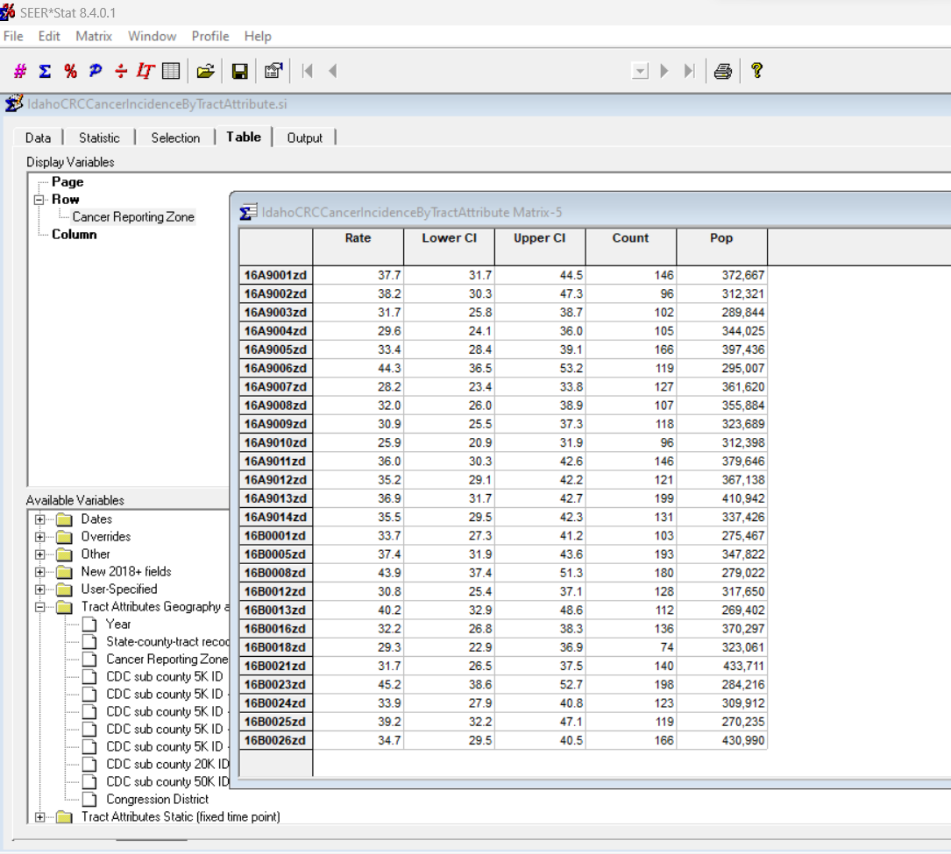
Incidence Rates by Census Tract Attributes: NAACCR/NCI Cancer Reporting Zone
Notes:
For the fifth example, we selected the NAACCR/NCI Cancer Reporting Zone as the row variable. You can easily export the results to be used in a mapping/GIS application.

Slide 43
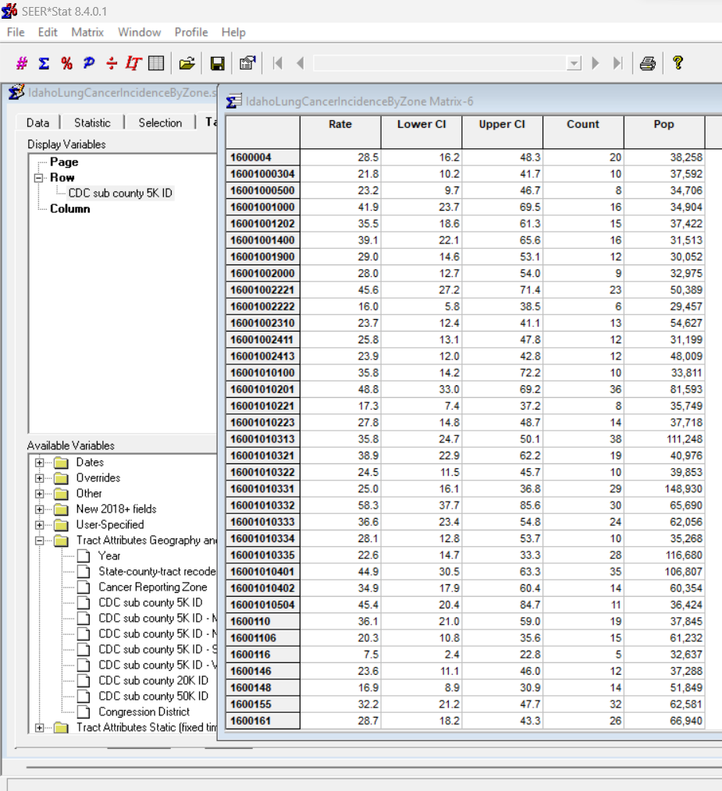
Incidence Rates by Census Tract Attributes: CDC EPHT Sub-County 5k
Notes:
For the final example, we selected the CDC Environmental Public Health Tracking Sub-County 5k geography. If you participated in the Sub-County Cancer Pilot, this is an easy way to calculate crude and age-adjusted cancer incidence rates for these areas. Again, you can easily export the results to be used in a mapping/GIS application.

Slide 44
Other considerations…
How good is your geocoding of rural areas?
What proportion of your records are geocoded based on ZIP Code?
Should you be limiting analysis to high-quality geocoded cases?
  Census Tract Certainty 2010
  GIS Coordinate Quality
  Micromatch status (NAACCR geocoder batch process and SEER*DMS users now, Volume 2 some day)
  (All of these will be more user-friendly in future – NAACCR WG working on it…)
Should you be performing sensitivity analysis?
  All cases versus high-quality geocoded cases, urban versus rural…
Manual geocoding correction via MIGeocorrect Tool (part of NAACCR geocoder)
  Improve geocoding of low-quality geocoded cases

Slide 45
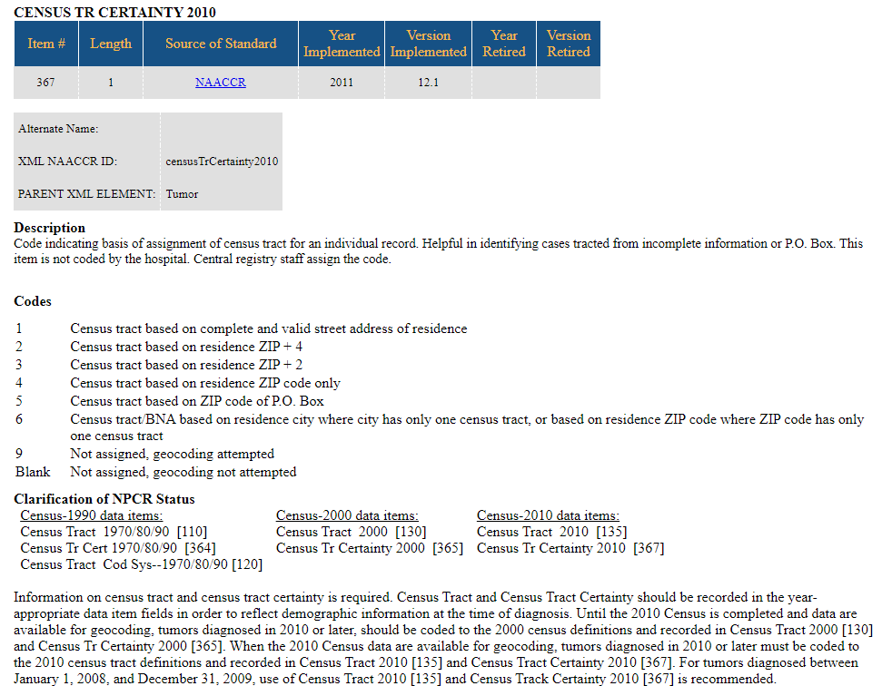
Census Tract Certainty 2010

Slide 46
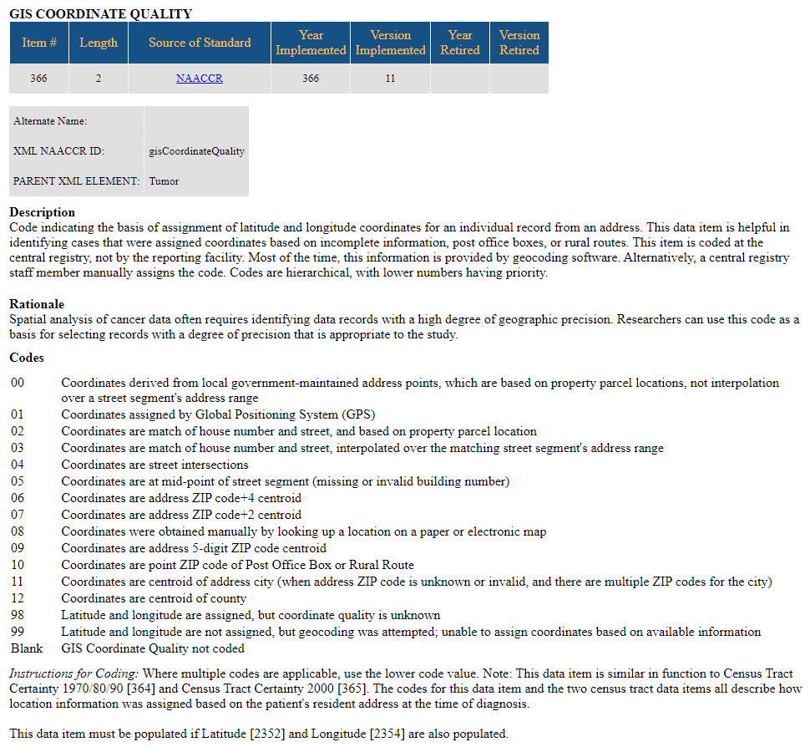
GIS Coordinate Quality

Slide 47
Micromatch Status
Coming in future…

Slide 48
SAS vs. File*Pro for input into SEER*Prep
For census tract databases, probably will need to continue to use SAS.
For county databases, Fabian Depry (IMS) is working on a solution in File*Pro.

Slide 49
Now that you have those census tract cancer incidence rates…
NAACCR Talk February 6, 2023
NCI Geospatial Tools and Resources: State Cancer Profiles and GIS Portal for Cancer Research
“Please join us for a NAACCR Talk focused on NCI's interactive geospatial tools that are useful for characterizing areas of the country in terms of cancer incidence, mortality, screening frequency, risk factors, socio-demographic and environmental variables relevant to cancer.”
“This presentation will introduce two resources of geospatial tools for visualization of population-based cancer statistics at NCI: (1) State Cancer Profiles, an interactive mapping engine designed to provide a geographic profile of cancer with a combination of maps, charts, tables, and graphs presenting the latest available cancer statistics and other relevant data; and (2) GIS Portal for Cancer Research, a more comprehensive resource of geographically referenced cancer statistics, social and environmental data, several interactive tools, and knowledge related to geographic disparities in cancer burden.”

Slide 50

Thank you!
cjohnson@teamiha.org
seerstat@imsweb.com

