Slide 1
Global patterns & trends in early-onset colorectal cancer
Rebecca Siegel, MPH
NAACCR-IACR
June 12, 2019
Notes:
Good morning. I’m happy to be here to share results from a study on global patterns & trends in EO CRC that we’ll be submitting soon for journal publication. But this is still a work in progress, so I’d appreciate any feedback on data presentation and interpretation.

Slide 2
Outline
Background
Methods
Results
Summary/limitations
Notes:
I’ll start with a few background slides to provide context for the study, then briefly describe data sources and outcome measures, followed by results and conclusions.

Slide 3
Trends in CRC incidence in the US by age, 1975-2016
50+ years
Men
50%
Women
Notes:
This figure depicts CRC incidence trends in the US from 1975-2016 among men/women 50 and older. Incidence rates have declined by 50% since the mid-80s because of changing patterns in risk factors and the uptake of screening.

Slide 4
Trends in CRC incidence in the US by age, 1975-2016
20-49 years
50+ years
Men
Men
Women
Women
55%
Notes:
In contrast, the incidence trend in young adults has increased by 55% since the mid-90s for reasons that are unknown. And this is the age group I’ll be focusing on today. Although rates are slightly higher in men than in women, the trends are quite similar, enabling us to combine men and women in our analyses to improve statistical power. Colorectal cancer is the leading cause of cancer death in the US in this age group.

Slide 5
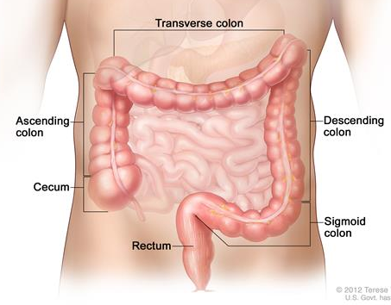
Incidence trend in <50 years in the US by tumor subsite
Proximal colon
5.4
Rectum – APC, 2.5 since 1991
2.6
Distal colon – APC, 1.8 since 1994
Proximal colon – APC, 0.9 since 1996
Notes:
Surveillance studies of US data have provided clues about what might be causing the increase, one of these being differences in the trend by anatomic subsite. There’s been a much smaller increase in incidence for tumors developing in the proximal colon, indicated in green, than for tumors in the distal colon or rectum. In fact the rate of rectal cancer has doubled.
Although colon and rectal tumors have much in common, they also differ in many ways, including in their clinical and biologic characteristics, response to drugs, prognosis, and some risk factor differences.

Slide 6
Early-onset CRC trends in the US by race/ethnicity, 1995-2015
Non-Hispanic White
Non-Hispanic Black
Hispanic
Asian/Pacific Islander
Colon
Cases per 100,000
1995-2001, APC =2.2*
2001-2013, APC = 1.0*
2013-2015, APC = 3.7*
1995-1999, APC = 4.4*
1999-2015, APC = -0.4*
1995-2003, APC = 2.0*
2003-2015, APC = -0.2
1995-2015, APC = -0.1
Rectum
Cases per 100,000
1995-2000, APC = 5.1*
2000-2015, APC = 2.1*
1995-2015, APC = 1.1*
1995 -2015, APC = 1.2*
1995-2015, APC = 0.4
Siegel et al. JNCI 2019
Notes:
There’s also variation in the trend by race/ethnicity. This slide shows trends based on NAACCR data from 1995-2015 for 4 broadly defined racial/ethnic groups for colon cancer on the top and rectal cancer on the bottom. Over the past 2 decades, rates of colon cancer increased in non-Hispanic whites, decreased slightly in non-Hispanic blacks, and were stable for Hispanics and APIs, whereas rectal cancer incidence increased in all groups except APIs, but at a magnitude twice as rapid in whites as in blacks or Hispanics.

Slide 7
Changes in early-onset CRC by state, NHW, 2006-2015
40/47 states
AAPC=Average annual percent change in incidence rates during 2006 to 2015
Siegel et al. JNCI 2019
Notes:
We recently reported geographic variation in the trend as well. This map shows state differences in the average annual percent change in CRC in NHWs over the past 10 data years. Incidence rates significantly increased in 40/47 states with available data and were otherwise stable, with the steepest increases mostly in western states where healthier lifestyles prevail, so this was a surprising finding.
Rates among blacks and Hispanics increased in just a handful of states and was confined to rectal tumors.

Slide 8
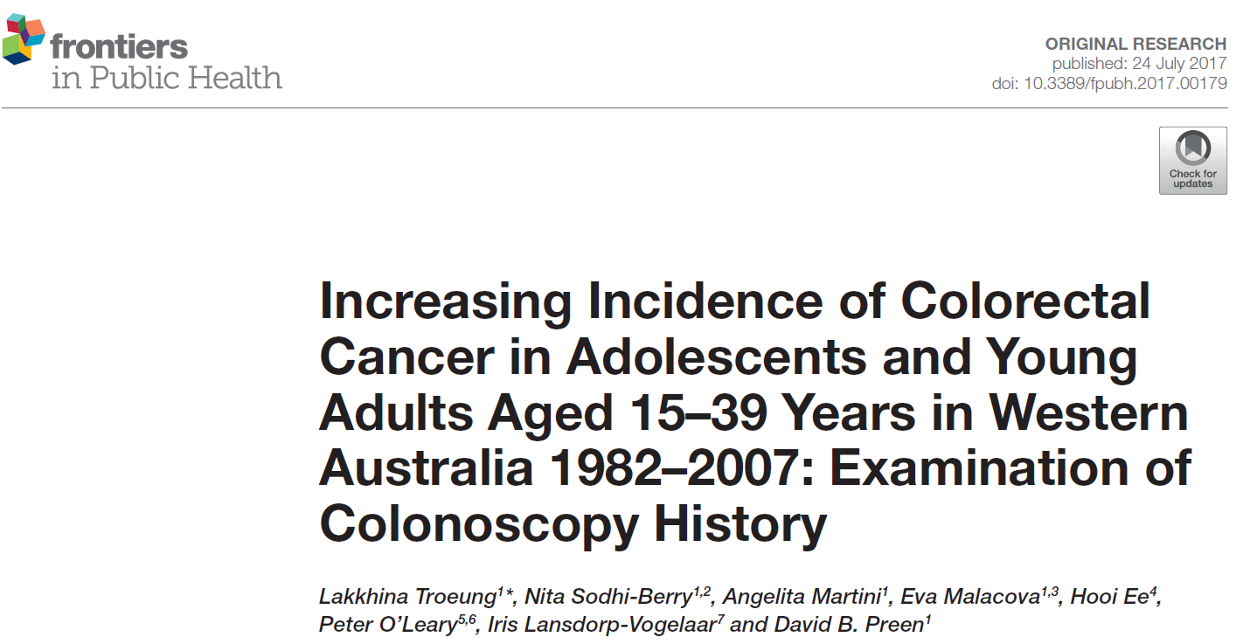
Early-onset CRC beyond the US: by country
Notes:
Increases in EO CRC have also been reported in other high-income countries, including Australia,

Slide 9
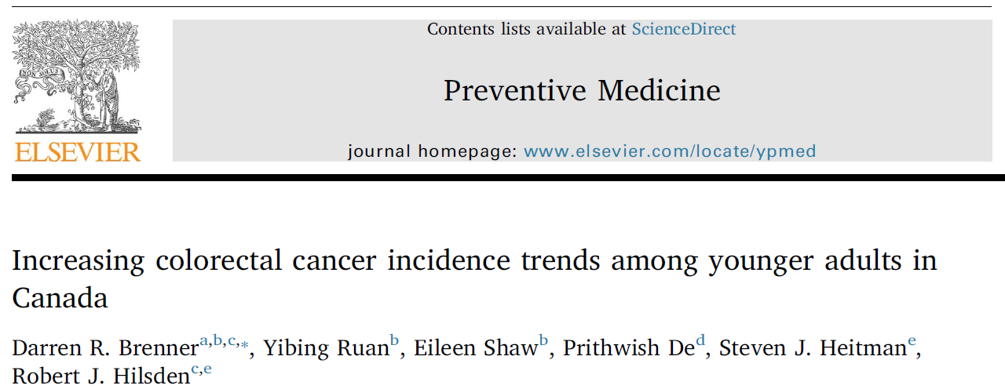
Early-onset CRC beyond the US: by country
Notes:
Canada

Slide 10
Early-onset CRC beyond the US: by country
Notes:
And Norway.

Slide 11
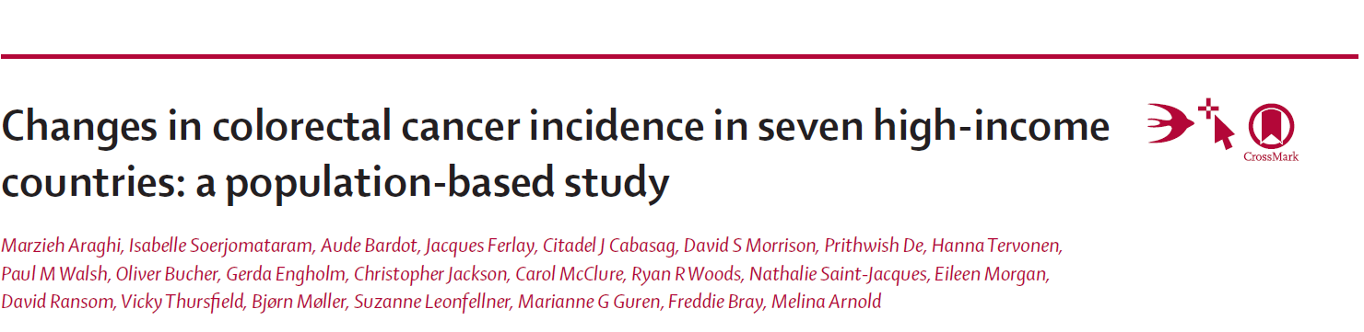
Early-onset CRC beyond the US
Notes:
And more recently multi-country analyses have presented early-onset CRC trends for specific regions or income level. However, there’s been no comprehensive global analysis of trends in CRC by age through 2012, which is the most recent data available.

Slide 12
Global patterns and trends in colorectal cancer incidence in young adults: Methods
Data sources
Cancer Incidence in Five Continents (CI5plus)
41 countries, earliest available data through 2012
Supplemental data from registries in Australia (2015), Iceland (2017), US (2015), New Zealand (2016)
Population
Adults aged 20+ years, stratified by age (<50 vs 50+)
Outcome
Colorectal cancer, stratified by subsite (colon, rectum)
Measures
Age-standardized (1960 Segi world std pop) incidence rate
Average annual percent change (AAPC) in CRC incidence rate during past 10 years
Notes:
To fill this gap, we analyzed high-quality data on colorectal cancer incidence from IARC’s Cancer Incidence in Five Continents, as well as supplemental sources from Australia, Iceland, the US, and New Zealand to take advantage of more contemporary available data. We calculated age standardized incidence rates and the average annual percent change in rates during the most recent 10 available data years – which was 2003-2012 for most countries, based on joinpoint analysis, separately for ages 20-49 years and 50+ years. We also examined trends by anatomic subsite, but there isn’t time today to share those results.

Slide 13
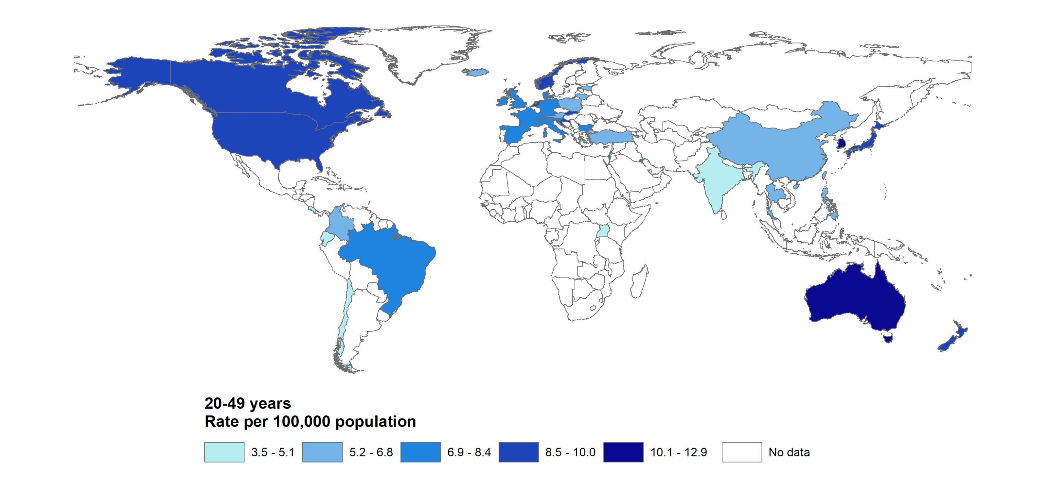
Early-onset (20-49 years) CRC incidence rates, 2008-2012
10.0
10.0
12.9
3.8
3.5
3.8
11.2
Notes:
This map shows age-standardized average annual incidence rates for early-onset CRC during 2008-2012 for the 41 countries with available data. The highest rates in South Korea, Australia, the US and Slovakia the lowest rates are in India, Uganda, and Chile. The pattern is quite similar to that in older adults although the highest rate is in Slovakia. What is also apparent in this map is the enormous lack of data for low- and middle-income counties.

Slide 14
Declines in early-onset CRC
20-49 yrs
Notes:
In terms of the trend, EO CRC declined from 2003-2012 in only 3 of the 41 countries – Austria, Italy, and Lithuania – all by about 1% per year. Notably, Austria screens for CRC beginning at age 40, and Italy beginning at age 45, and both countries initiated screening in the early 80s, well before other countries. The only other country except Japan screens aver risk individuals before 50 except Japan, and the US as of last year.

Slide 15
Declines in early-onset CRC
20-49 yrs
50+ yrs
Notes:
Rates in older adults in these countries also declined in Austria and Italy, but increased in Lithuania.

Slide 16
Where is incidence of
early-onset CRC increasing?
Notes:
Among the remaining 38 countries, rates of EO CRC were stable in 19, or half, and increased in the other half, which are shown here ranked based on the magnitude of the average annual percent change in the past 10 data years. The most rapid increases – about 4% per year – were in Korea, New Zealand, and Cyprus. And recall that Korea already has the highest incidence rate.

Slide 17
Countries where CRC incidence is also increasing
in ages 50+
Notes:
In 11 of these countries, CRC incidence is also increasing in older adults, so the trend is consistent across age. Half of these are high-income countries.

Slide 18
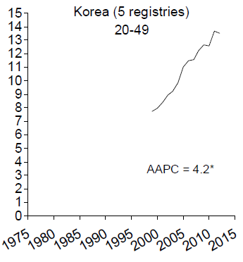
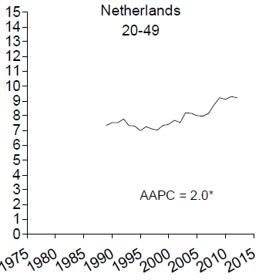
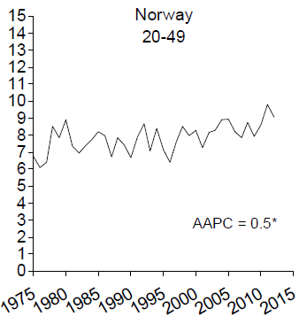
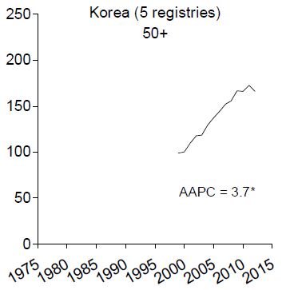
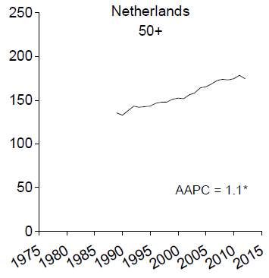
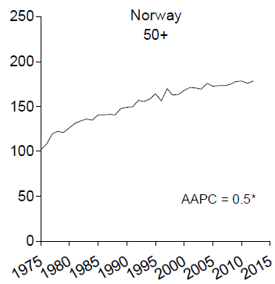
High-income countries with increasing rates in both age groups
Rate per 100,000
20-49 yrs
50+ yrs
Rate per 100,000
Notes:
And here I’ve highlighted 3 high-income countries with increasing rates in both age groups. Korea, on the far left, has both the highest rates and the steepest increase in young adults, and also among the highest rate and steepest increase in ages 50+. Rates in the Netherlands increased by 2% per year in adults under 50 and 1% per year in older adults, although the most recent jp is stable for 50+. Rates are increasing in Norway at the same slow pace in both age groups.
Netherlands late to screening game, with organized program begun in 2014.

Slide 19
CRC incidence in ages 50+
stable
decreased
Notes:
In the remaining 8 countries where EO disease increased, rates in ages 50 and older are either stable, as in UK, Denmark, and Slovenia, or declining, as in NZ, Canada, Australia, US, and Germany. Thus, in these countries incidence is uniquely increasing in young adults.

Slide 20
Unique rise in early-onset CRC: Oceania & N. America
Rate per 100,000
20-49 yrs
50+ yrs
Rate per 100,000
Notes:
Here are trends for the 4 countries located in Oceania and N America– with AAPCs in young adults ranging from 2.1 in the US to 4 in N. Zealand, and are in striking contrast to the fairly rapid declines in older adults. Notice that in all 4 countries, rates of EO disease were declining prior to the uptick that began in the mid-1990s.

Slide 21
Unique rise in early-onset CRC: Europe
20-49 yrs
50+ yrs
Notes:
The other 4 countries are in Europe, where we only had data prior to the 1990s in Denmark, where you do see the same early downturn, and Slovenia, where the trend has been a slow consistent increase since the mid-80s. The trend in older adults in Slovenia is also inconsistent with the other that in the other 7 countries. With the exception of the UK, the rise in EO disease in European is less steep than in the countries in the previous slide, and the incidence rates themselves are also lower.

Slide 22
Summary of early-onset CRC global trends
Austria, Italy, and Lithuania (vs 11 countries in 50+)
Notes:
In summary, incidence rates of CRC in young adults are declining in Austria, Italy, and Lithuania.

Slide 23
Summary of early-onset CRC global trends
Austria, Italy, and Lithuania (vs 11 countries in 50+)
19/41 countries
Notes:
But increasing in half of the remaining 38 countries where data are available.

Slide 24
Summary of early-onset CRC global trends
Austria, Italy, and Lithuania (vs 11 countries in 50+)
19/41 countries
most rapid in Korea (AAPC=4.2), where rate is already highest (12.9/100,000)
Notes:
The most rapid increase is in Korea, which already has the highest rate.

Slide 25
Summary of early-onset CRC global trends
Austria, Italy, and Lithuania (vs 11 countries in 50+)
19/41 countries
most rapid in Korea (AAPC=4.2), where rate is already highest (12.9/100,000)
8 → decline/stable trend in 50+
New Zealand Denmark
Australia Germany
Canada Slovenia
US UK
Notes:
Incidence is uniquely increasing in young adults in 8 countries with the uptick in most beginning in the mid-1990s and preceded by declining rates.

Slide 26
Limitations
Data limited to 41 mostly high- or middle-income countries
Incidence sometimes based on <100% population coverage
Contemporary data (since 2012) lacking for most countries
Inability to exclude appendix
Notes:
This study is limited by the lack of availability data for most low- and middle-income countries. Even for the 41 countries with data available, many reflect less than 100% pop coverage and 2012 is the most recent year, meaning contemporary patterns are unknown. And with the CI5 data we were unable to exclude appendix.

Slide 27
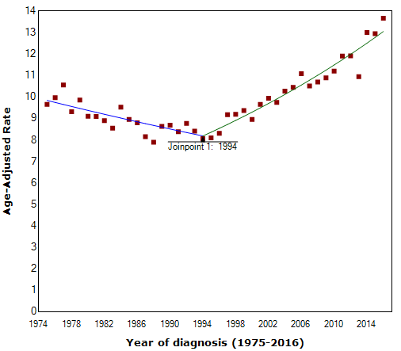
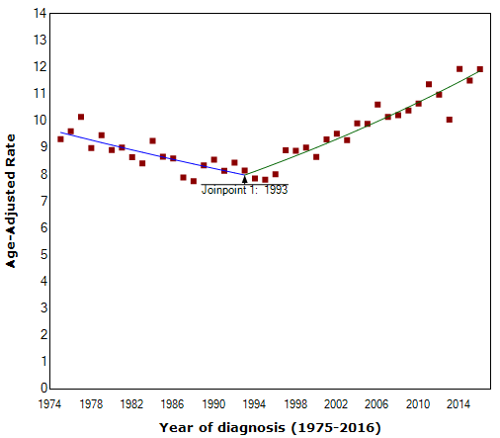
Influence of appendix on rates of early-onset CRC in the US
including appendix
excluding appendix
1994-2015
APC = 2.1*
1993-2015
APC = 1.7*
Notes:
Appendix has been grouped with the colon in surveillance data historically because of it’s anatomic proximity, but it is increasingly recognized as a distinct and different neoplasm. In addition, rates of appendiceal cancer are increasing rapidly in the US, Netherlands, and probably many other high-income countries, so their inclusion in our analysis has a fairly large influence on the APCs. This slide shows the trend for EO CRC in the US including appendix on the left and excluding it on the right. With appendix, the magnitude of the APC is larger and the joinpoint even changes.
Increase likely due to increased awareness/improvements in classification (in 1990 WHO emphasized differentiation b/t ovarian and appendiceal tumors, which are often confused); increased detection via colonoscopy and CT imaging; declines in appendectomy; other causes? Increases in both localized and distant stage, and across age.

Slide 28
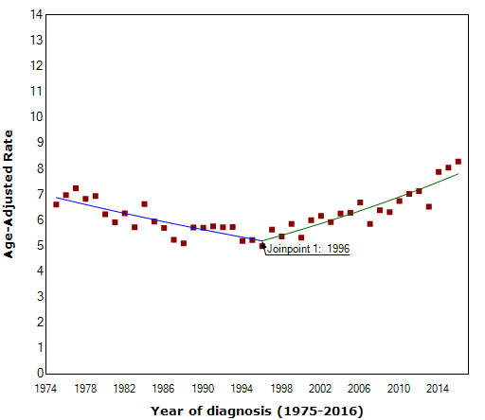
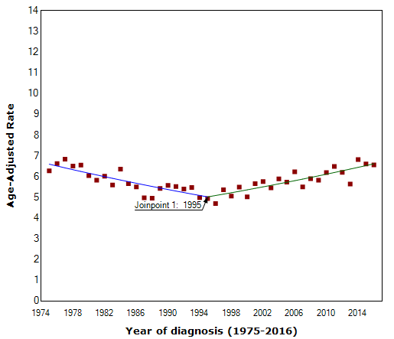
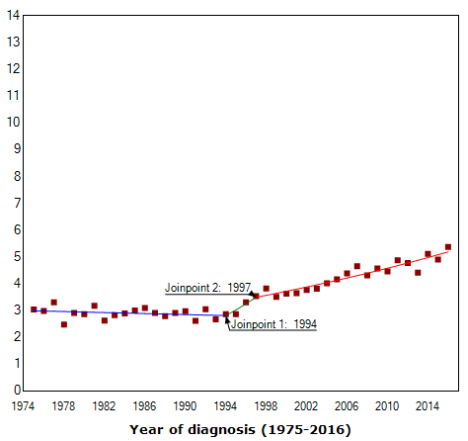
Influence of appendix on rates of early-onset colon in the US
Colon
including appendix
Colon
excluding appendix
Rectum
1996-2016
APC = 2.1*
1995-2016
APC = 1.3*
1997-2016
APC = 2.1*
Notes:
This issue is even more pertinent in analyses by anatomic subsite because the APC for colon including appendix is the same as that for rectum, whereas it is half the magnitude when appendix is excluded. Most global studies of CRC include appendix, but when it is excluded, the increase in early-onset disease outside the US also appears to be driven by rectal tumors.

Slide 29
Cancer registry staff worldwide
Collaborators
Ahmedin Jemal, DVM, PhD
Lindsey Torre, MSPH
Isabelle Soerjomataram, MD, MSc, PhD
Thomas Weber, MD
Richard B. Hayes, DDS, MPH, PhD
Freddie Bray, MSc, PhD
Notes:
First and foremost, I’d like to thank cancer registry staff everywhere; without your hard work and dedication there would be no cancer surveillance and this and other important emerging trends would remain unknown. I’d also like to thank my collaborators on this project, listed here…

Slide 30
Thank you!

Slide 31
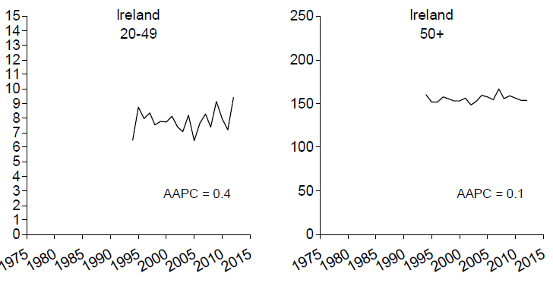

Slide 32
Countries where CRC incidence in ages 50+ is declining or stable
Hi-income | Middle-income |  | Low-income
US | Philippines |  | Uganda
Canada | Brazil
Australia | Croatia
New Zealand Germany | China
Austria
Italy France
Switzerland
Israel
Denmark
Slovenia
UK
Chile
Ireland
Malta
Notes:
Highest screening rates in Europe were in Austria, Germany, France, and Switzerland as of 2004/5.

Slide 33
Countries where CRC incidence in ages <50 is increasing
Hi-income | Middle-income | Low-income
US | Philippines | Uganda
Canada | Brazil
Australia | Croatia
New Zealand | China
Germany Austria
Italy France
Switzerland
Israel
Denmark
Slovenia
UK
Chile
Ireland
Malta

Slide 34
 | Hi-income | Middle-income
N. America/Oceana | US
 | Canada
 | Australia
 | New Zealand
Latin America |  | Ecuador
 |  | Costa Rica
Europe | Austria
 | Italy
 | Lithuania
 | Cyprus
 | Denmark
 | Germany
 | Iceland
 | Netherlands
 | Norway
 | Slovenia
 | Slovakia
 | UK
Asia | South Korea | India
 |  | Thailand
 |  | Turkey
Where are trends in
early-onset CRC changing?
AAPC:
Positive (increase)
Negative (decrease)
Notes:
The primary research question in this study is where are rates of early-onset CRC changing, and is this trend different from what is happening in older adults. This slide shows the countries where the AAPC during the past 10 years of data indicated a statistically significant increase – in red – or decrease – in green. Rates are stable for those countries included in the study but not shown here. Rates are decreasing in Austria, Italy, and Lithuania – all by about 1% per year – while rates are increasing in 19 countries.

Slide 35
Countries where CRC incidence is increasing across age
Hi-income | Middle-income
Iceland | Costa Rica
Cyprus | Ecuador
Netherlands | Turkey
Norway | Thailand
Korea | India
Slovakia

