Slide 1
Costs and Resources used by Population-Based Cancer Registries in the U.S.-Affiliated Pacific Islands
Patrick Edwards, MSc
NAACCR/IACR Combined Annual Conference
Vancouver, BC, Canada
June 13, 2019

Slide 2
Contributors
PRCCR
Lee E. Buenconsejo-Lum
Youngju Jeong
RTI
Sujha Subramanian
Patrick Edwards
CDC
Janos Baksa
Florence Tangka
Paran Pordell
Mona Saraiya

Slide 3
Outline
Background & Motivation
Project Objectives
Methods of Web-Based Cost Assessment
Results
Conclusions & Implications

Slide 4
Background & Motivation

Slide 5
Background
The Pacific Regional Central Cancer Registry (PRCCR) was established in 2007 in response to the lack of high-quality data collection in the USAPI region.
The PRCCR faces many unique challenges in monitoring the Pacific Region’s cancer burden, including limited resources, geography, and variation in infrastructure/capacity across the jurisdictions.
No study has been conducted on the specific economic costs incurred by central and jurisdictional cancer registries located in the USAPI.

Slide 6
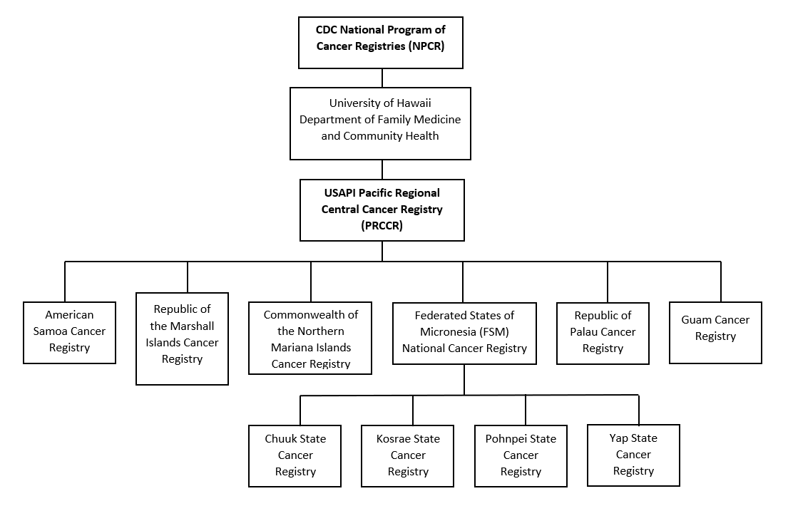
Structure of the U.S.-Affiliated Pacific Islands’ Central and Jurisdictional Registries

Slide 7
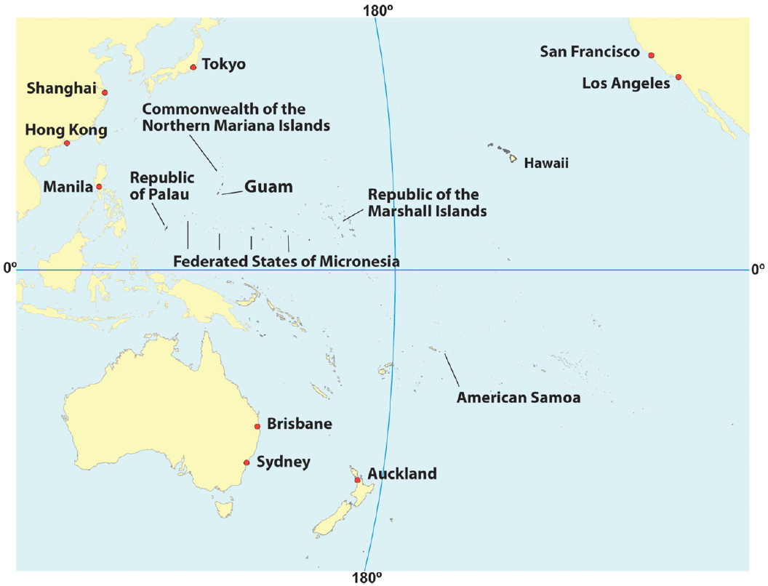
US-Affiliated Pacific Islands Registries’ Coverage Area

Slide 8
Age-standardized incidence (per 100,000) for the five major cancers of each sex in the U.S.-Affiliated Pacific Islands, 2007-2014

Slide 9
Need for Costing
Identify sources of support
Assess cost drivers
Operational improvements
Comparative cost data
Budget planning
Sustainability

Slide 10
U.S. NPCR Registries’ Cost per case by case volume
Data from 40 NPCR registries. Excludes data from registries in states also supported by SEER (CA, GA, LA, KY, MI, NJ, WA). Also excludes data from PIJ due to low case volume.

Slide 11
Project Objectives
To estimate jurisdictional, central, and overall cost
Per cancer case registered
Per inhabitant served by cancer registry
To identify sources of support (monetary and nonmonetary) for cancer registries’ operations
To estimate the distribution of registry resources that goes towards budget categories and various cancer registry activities
To identify potential barriers and facilitators to registry operations

Slide 12
Methods

Slide 13
Methods
Tool development
Developed a web-based costing tool (IntRegCosting Tool)
Pilot tested costing tool among international registries
Training
Series of webinars; User’s Guide
In-person meeting to introduce staff to costing assessment
Data collection
Detailed cost information reported for 11 USAPI registries for a one-year time period
Quality review & analysis
Data validations
Generation of activity-based costs & other outputs

Slide 14
IntRegCosting Tool
The Web-based IntRegCosting Tool was designed to collect and analyze data on the costs of population-based cancer registries all around the world.
Registry staff were able to input information directly into the Web tool relating to their resources and registry operations and received instant summary reports.
This tool was used to help registries assess their resources required for operation, which can support planning and funding decision making.
The tool was funded by CDC and builds on our experiences and lessons learned from multiple rounds of data collection in the US and in international settings.

Slide 15
Data entry modules
Registry Operations
Registry Background
Funding Sources
Personnel
Registry Personnel
Personnel Activities
Other Costs
Computers, Travel, Training, and Other Materials
Software
Data Collection Approach
Narrative Feedback
Other Personnel
Overhead & Administrative

Slide 16
Timeframe
Costs were collected for a 1-year time frame:
June 30, 2016 through June 29, 2017.
Registries provided the number of cancer cases that were reported during 2014.
Costs were reported for all 11 registries, although only the registries that performed data collection (all except PRCCR and FSM) reported cancer cases.

Slide 17
Cost-allocation to cancer registry activities
Management | Liaising with stakeholders | Outreach
Training of registry staff | Training of others by registry staff | Data collection/abstraction
Case consolidation & matching | Data entry | Data validation
Database management | Developing analytic files | Data analysis/reporting
Formal reporting requirements | Quality control | Death certificate clearance
Sharing cases | IT support | Electronic case reporting and data encryption
Automatic casefinding using electronic linkages | Linking records to other databases | Implementing a cancer inquiry response system
Research studies and advanced analysis using registry data | Publications | Active follow-up

Slide 18
Costing Tool Outputs
Distribution of total registry resources by budget category
Distribution of total registry resources by source type
Distribution of total registry resources by specific & broad activities along with by fixed and variable costs
Cost per cancer case registered and cost per inhabitant served by registry
General registry characteristics

Slide 19
Results

Slide 20
Characteristics of the U.S.-Affiliated Pacific Islands PBCR
 | American Samoa | Republic of the Marshall Islands | Commonwealth of the Northern Mariana Islands | PRCCR - Central | Republic of Palau | FSM National | Pohnpei State, FSM | Chuuk State, FSM | Kosrae State, FSM | Yap State, FSM | Guam
Host institution type | Health Dept. | Health Dept. | Health Dept. | Uni. | Health Dept. | Health Dept. | Health Dept. | Health Dept. | Health Dept. | Health Dept. | Uni.
Population covered | 55,519 | 53,158 | 53,883 | 0 | 20,518 | 0 | 35,981 | 48,651 | 6,616 | 11,376 | 159,358
Area covered (sq KM) | 199 | 181 | 464 | 2,550 | 465 | 7,006 | 346 | 701 | 110 | 118 | 540
Cancer cases processed (2014) | 7 | 67 | 82 | 0 | 27 | 0 | 46 | 7 | 5 | 29 | 289
Full-time equivalents | 1 | 1 | 1 | 2.84 | 1.6 | 1 | 1 | 1 | 1 | 1 | 2.52
Total sources | 3 | 5 | 3 | 11 | 3 | 4 | 6 | 3 | 3 | 7 | 6

Slide 21
U.S.-Affiliated Pacific Islands Registries’ Resources by Source

Slide 22
Resources by Budget Category

Slide 23
Distribution of Resources by Cancer Registry Activity

Slide 24
Cost per Case & Cost per Inhabitant
 | American Samoa | Republic of the Marshall Islands | Commonwealth of the Northern Mariana Islands | Republic of Palau | FSM |  |  |  |  | Guam | USAPI Total*
 |  |  |  |  | Total* | Pohnpei State | Chuuk State | Kosrae State | Yap State
Cancer Cases | 7 | 67 | 82 | 27 | 87 | 46 | 7 | 5 | 29 | 289 | 559
Inhabitants | 55,519 | 53,158 | 53,883 | 20,518 | 102,624 | 35,981 | 48,651 | 6,616 | 11,376 | 159,358 | 445,060
Cost per Case | $7,080 | $476 | $692 | $1,713 | $1,497 | $581 | $2,265 | $4,927 | $889 | $799 | $1,413
Cost per Inhabitant | $0.89 | $0.68 | $1.00 | $2.25 | $1.27 | $0.74 | $0.33 | $3.72 | $2.27 | $1.45 | $1.77

Slide 25
Key Findings
The total cost per case across all registries was about $1,413
The total cost per inhabitant was about $1.77
The USAPI likely faces higher costs per case than other registries because of their unique circumstances as island territories.

Slide 26
Potential Factors Affecting Registries’ Operations
Internal barriers and facilitators
Volume of cases | Low case volume makes it more difficult to achieve economies of scale.
Data abstraction methods | Widely paper-based methods because of a lack of implementing electronic methods.
Quality of data | Lack of complete case reporting in some jurisdictions.
Staff expertise | Technical expertise needed to improve or begin use of more electronic reporting.
Organizational structure | Resources spread across many satellite registries with large administrative resource needs.
External barriers and facilitators
Geographic coverage | Travel and data collection are costly across large geographic area.
Funding | Funding supports improvements in registry capacity and training programs.
IT support and technical assistance | Further technical assistance can improve capabilities in electronic reporting.
Partnerships | Partnerships are crucial for helping synergize efforts and seeking additional resources.

Slide 27
Conclusions
The burden of surveilling a geographic area almost twice the size of the continental United States requires substantial resources to support a large number of satellite registries.
Each registry faces significant fixed costs, including rent for office space and equipment.
Another primary factor driving the higher cost per case among the USAPI registries is likely the small number of cancer cases processed within the USAPI.

Slide 28
Policy Implications
Building capacity
More intensive training
On-site technical assistance
Partnerships (WHO Pacific Hub)
Electronic methods

Slide 29
Project Limitations & Strengths
Limitations
Estimation of indirect costs
Retrospective data collection
Strengths
Use of a validated web-based costing tool
Inclusion of indirect costs and in-kind contributions
Cost and factors entered directly by registry representatives

Slide 30
Thank you to the USAPI cancer registrars and their administrative colleagues for contributing detailed time and cost information for this study!

Slide 31
More Information
Patrick Edwards, MSc
Health Economist
pedwards@rti.org
Lee Buenconsejo-Lum, MD
PI, PRCCR
lbuencon@Hawaii.edu
Sujha Subramanian, PhD
Fellow
Ssubramanian@rti.org
Florence Tangka, PhD
Senior Health Economist
Ftangka@cdc.gov

