Slide 1
Utilization of Microsatellite Instability Testing and Associated Factors among Colorectal Cancer Patients
Xiao-Cheng Wu, Mary Anne Lynch, Lili Bao, Bent Mumphrey, Meijiao Zhou, Meichin Hsieh, Jordan Kalitz
2019 NAACCR Annual Conference
June 13, 2019

Slide 2
Background
Microsatellite Instability (MSI) test is used to diagnose Lynch syndrome and predict prognosis and responses of colorectal cancer (CRC) to chemotherapy¹.
In 2015, the NCCN Clinical Practice Guidelines - Genetic/ Familial High-Risk Assessment: Colorectal have recommended MSI test for all CRC patients under age 70.
Although this test has been a data item collected by hospital and central cancer registries in the US since 2010, its completeness is uncertain, which limits uses of MSI data at the population level.
¹ Clin Adv Hematol Oncol. 2018 Nov;16(11):735-745.

Slide 3
Background
As MSI test is performed on CRC tumors removed at surgery or on colonoscopy biopsy, pathology reports are the primary source of this data.
Currently, electronic pathology (e-path) reports including subsequent addendums, cover over 95% of cancer cases in Louisiana.
Large coverage of e-path reporting makes it possible to assess and enhance the completeness of the MSI data.

Slide 4
Background
The following facts further triggered our interest in MSI data:
Our recent study¹ identified significantly higher early-onset CRC incidence rates in the Cajuns area than the US, leading to speculation of a possible founder effect of hereditary CRC in the population.
The new initiation “Taking Aim at Cancer in Louisiana” targets CRC cancer to improve early detection and reduce mortality rates.
We are interested in identifying patients with hereditary cancers² to help hospitals with genetic referrals for cancer patients and their relatives.
¹ Clin Transl Gastroenterol. 2014 Oct; 5(10): e60. ² Gut Liver. 2016 Mar; 10(2): 220–227.

Slide 5
To assess the completeness of MSI data routinely collected for microscopically confirmed CRC cases.
To evaluate the role of e-path reports in supplementing MSI data.
To describe the use of MSI test among CRC patients in clinical practice and identify sociodemographic factors related to its use.

Slide 6
Methods
Data source: LTR
Eligibility criteria
Patients diagnosed with microscopically confirmed colorectal cancers¹ in 2016; C181 excluded
Age < 70 years at diagnosis
Louisiana residents
Not lymphoma or endocrine cancers
Not death clearance only cases
Not autopsy only cases
¹ SEER site recodes for CRCs: https://seer.cancer.gov/siterecode/icdo3_dwhoheme/index.html

Slide 7
Methods
MSI test:
4 different mismatch repair genes are responsible for
correcting mutations in the DNA.
If one of these genes is mutated, small errors in the
DNA remains unrepaired leading to an expansion/ reduction in repetitive sequences in the DNA, which is termed MSI.
IHC (immunohistochemical staining)
The MSI test has now largely been replaced by IHC on the tumor tissue, which detects the presence/absence of the 4 protein products coded by the four mismatch repair genes.

Slide 8
Methods
Electronic pathology reports (E-path) of reportable cancer cases routinely transmitted to LTR: imported
into SEER*DMS and linked to the corresponding
cancer records as source records.
E-path reports with no mention of reportable cancer but matched to prior cancer patients routinely transmitted
to LTR named “e-path forwarding”: stored outside of SEER*DMS.

Slide 9
Eligible CRC cases from SEER*DMS
MSI done
MSI coded as not collected (998), not done (998), or unknown (999)
Reviewed E-path reports of CRC cases
Reviewed path reports from E-path forwarding
MSI
Not done
QA audit
Notes:
Not applicable: information not collected (code=988)
Test ordered, results not in chart (code=997)
Test not done (code=998)
Unknown or no information (code=999)

Slide 10
Results
1,409 eligible CRC cases diagnosed in 2016 among those under age 70 years in Louisiana.
*
Data Source | MSI and/or IHC Test
 | Yes | No | Unknown
LTR routine coded data | 24.8% | 34.4% | 40.9%
LTR routine data + Pathology Reports | 42.7% | 55.2% # | 2.1% &
LTR routine data + Pathology Reports + e-path forwarding + EMR $ | 43.3% | 54.7% | 2.1%
# If not identifying MSI/IHC from pathology reports in the attached source records, we assume no MSI test.
& No pathology reports in the attached source records. $ only 20% of unknown MSI cases.

Slide 11
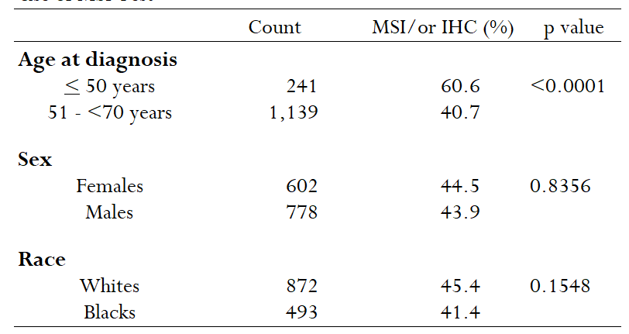
Disparities in Use of MSI/or IHC Test by Sociodemographic Factors among CRC Patients Under Age 70 Years in Louisiana, 2016

Slide 12
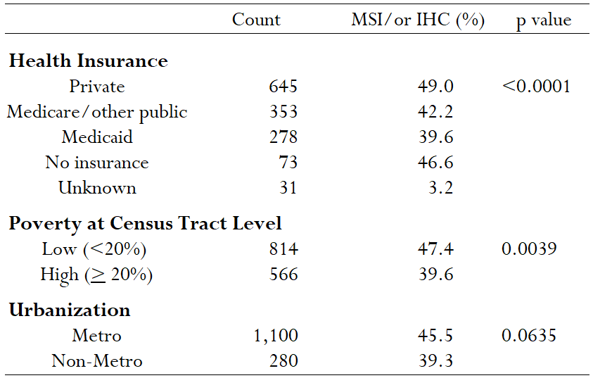
Disparities in Use of MSI/or IHC Test by Sociodemographic Factors among CRC Patients Under Age 70 Years in Louisiana, 2016

Slide 13
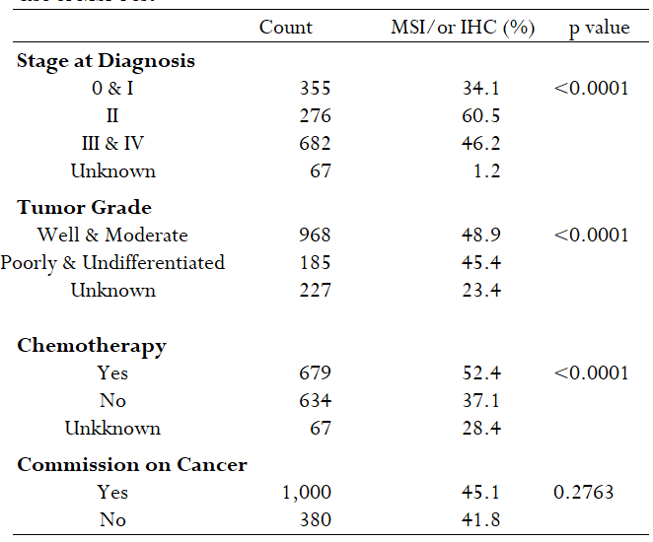
Disparities in Use of MSI/or IHC Test by Clinical Factors among CRC Patients Under Age 70 Years in Louisiana, 2016

Slide 14
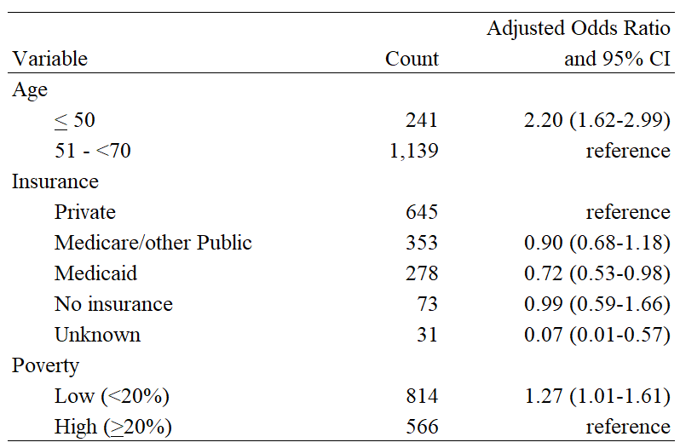
Sociodemographic Factors Significantly Associated with MSI/or IHC Test among CRC Patients Under Age 70 Years in Louisiana, 2016
Covariates included in the multivariable Logistic model: Age, insurance, poverty, stage, and tumor grade.

Slide 15
Discussions/Conclusions
As MSI is not required data field, it is incomplete in the registry routine database.
The completeness of MSI data can be significantly improved after supplementing such data from path reports, especially for registries with large coverage of e-path reporting.
The MSI result is most likely found from addendums of path reports; sometimes, the result is found from subsequent path reports with no mention of cancer, indicating the importance of addendums and the e-path forwarding.

Slide 16
Discussions/Conclusions
Manually reviewed electronic medical records for sub-set of cases with MSI/or IHC coded as unknown and found we missed the path reports of MSI test for a small proportion of cases.
Need to work with E-path vendors to identify root causes of missing reporting as all the MSI/or IHC test requests go through path labs to send specimens.
Our data show low SES patients are less likely (p<0.01) to receive the guideline-recommended MSI test than their high SES counterparts, indicating the intervention needs to reduce the disparity.

Slide 17
Implication and Future Direction
As medical care is marching into the precision medicine era, tumor markers play a more and more essential role in diagnosing and treating cancer patients.
To keep up with the pace of medical advancement, cancer registries need to identify methods to collect biomarker data completely and effectively.
E-path reporting has opened a door for registries to achieve higher goals. Developing innovative means to extract such data semi-automatically or automatically from e- path reports is a direction to go, which will enhance registries’ ability to collect more biomarker data timely and accurately.

Slide 18
Acknowledgement
NCI-SEER and CDC-NPCR for their funding and technical support on our registry operations and implementation of electronic pathology reporting.

Slide 19
Thank You!

Slide 20
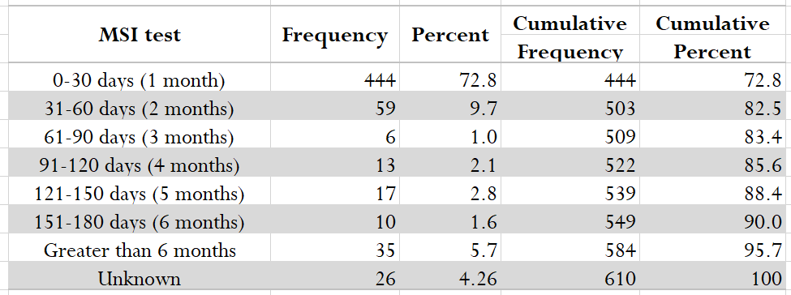
Frequencies of MSI/or IHC Test by Months from Diagnosis CRC Patients Under Age 70 Years in Louisiana, 2016

