Slide 1
Quantifying the Risk of Second Primary Melanoma in California, 2000-2015
Eric Stewart
Cancer Registry of Greater California, Public Health Institute, University of California, Berkeley

Slide 2
Outline
Background
Objective/Purpose
Methods
Results
Discussion

Slide 3
Background

Slide 4
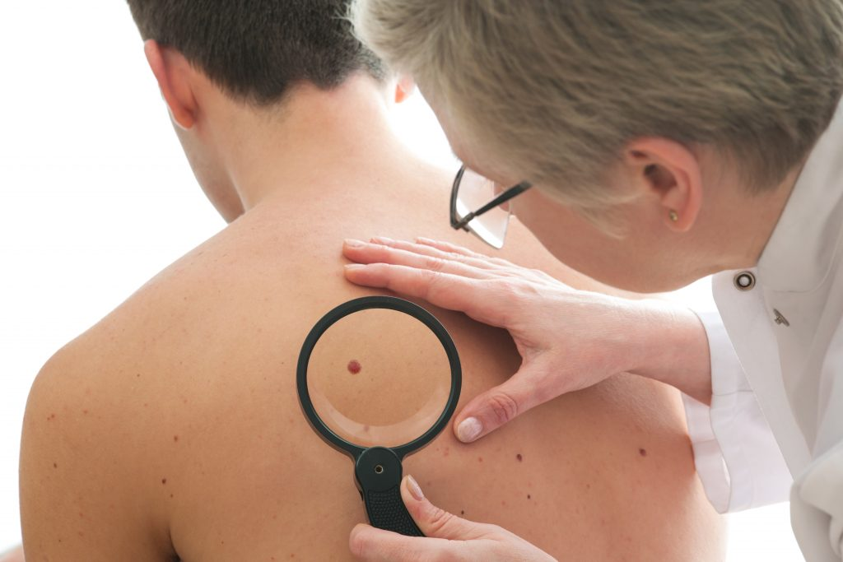
Inspiration for research
Spoke with dermatologist
Wanted information to give to patients after melanoma diagnosis
Was having difficulty getting patients to return for skin examinations
Post-treatment guidelines: skin examinations every 3 to 6 months for up to 3 years depending on tumor characteristics
Notes:
- Survival for distant disease much worse: 5-year: 64%, 10-year: 17%

Slide 5
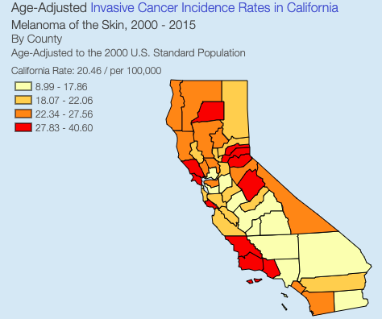
Melanoma in California
Ranks 6th in incidence among all malignancies
Disproportionately affects non-Hispanic white population
Notes:
-NHW Males 3rd most common, Females 5th most common

Slide 6
Second Primary Melanoma
Primary cutaneous melanoma is highly curable if diagnosed at an early stage
Overall 5-year survival: 92%
Overall 10-year survival: 89%
Because of high survival, melanoma survivors are susceptible to subsequent malignancies including second primary melanoma (SPM)
Notes:
- Survival for distant disease much worse: 5-year: 64%, 10-year: 17%

Slide 7
Current literature
Done using SEER 9 database from 1973-2006
Found 9-fold excess risk of SPM
Found tumor thickness to be associated with risk

Slide 8
Current literature
Done using data from Queensland Cancer Registry
Also found excess risk of SPM
Focused on anatomical site of diagnosis
Many other studies looking at risk of second primary malignancy/melanoma

Slide 9
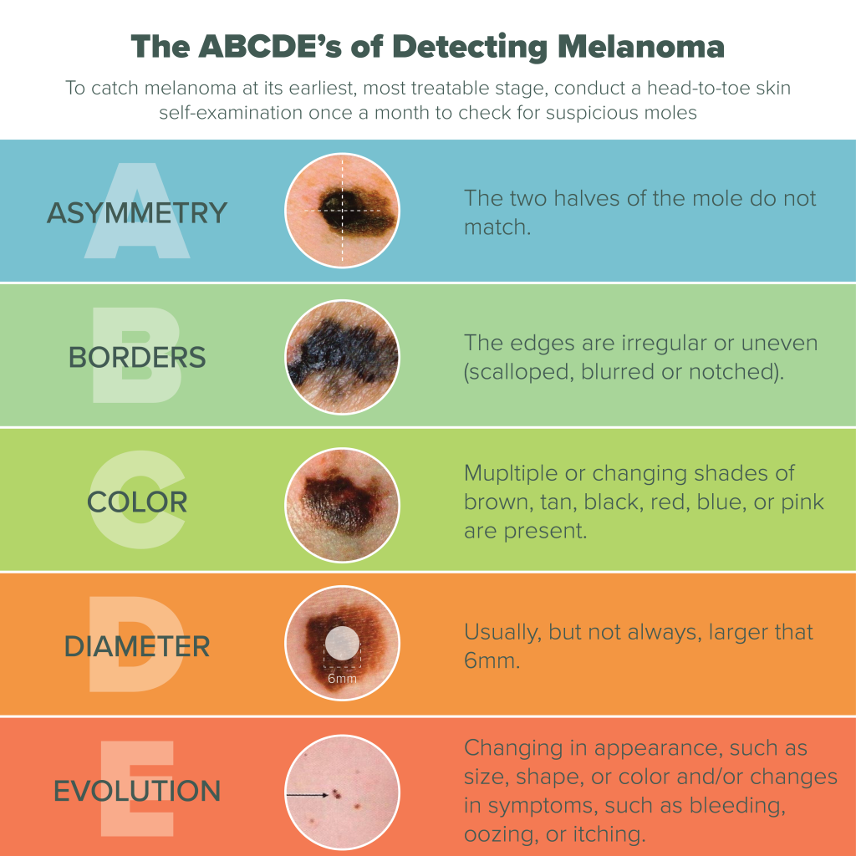
Objectives
Aim 1: Quantify the risk of SPM in California population
Aim 2: Identify patient characteristics with greatest risk of SPM
Public health Aim 3: Create materials to aid physicians in their effort to catch disease earlier/prevent further incidence (brochure)

Slide 10
Methods

Slide 11
Selection Criteria
Patients identified using data from California Cancer Registry
Study population:
2000-2015 year of diagnosis
All ages
Invasive disease only
Exclusion:
DCO and autopsy only cases
Patients that were diagnosed with SPM within 2 months of initial melanoma diagnosis, or died within 2 months of initial diagnosis
Notes:
- Exlcusion of 2 months → could bias results b/c of underlying genetic predisposition

Slide 12
Selection Criteria (con’t)
Diagnosed with first primary cutaneous melanoma
ICD-O-3 sites: C44.0-C44.9
Histologies: 8720-8790

Slide 13
Analysis
Descriptive statistics calculated using SAS
SEER*Stat software was used to calculate standardized incidence ratios (SIRs)
SIR measures observed/expected cases
Used as an estimate for relative risk
Observed case counts were obtained from the registry
Expected case counts were obtained by direct standardization with the 2000 census population using a SEER 18 registry rate file

Slide 14
Results

Slide 15
Characteristics of patients with malignant melanoma in California by primary tumor status, 2000-2015
 |  | Single Primary | % | Multiple Primaries, MM + Other Cancer | % | Multiple Primaries, MM + MM | % | Total | %
 |  | (n = 73,385) |  | (n = 11,574) |  | (n = 3,901) |  | (n = 88,860)
Sex
 | Male | 40,841 | 55.7 | 7,373 | 63.7 | 2,658 | 68.1 | 50,872 | 57.2
 | Female | 32,544 | 44.3 | 4,201 | 36.3 | 1,243 | 31.9 | 37,988 | 42.8
Age |  |  |  |  |  |  |  |  | 0.0
 | <50 | 22,827 | 31.1 | 1,615 | 14.0 | 848 | 21.7 | 25,290 | 28.5
 | 50-59 | 16,645 | 22.7 | 2,452 | 21.2 | 800 | 20.5 | 19,897 | 22.4
 | 60-69 | 14,907 | 20.3 | 3,231 | 27.9 | 926 | 23.7 | 19,064 | 21.5
 | 70-79 | 10,714 | 14.6 | 2,797 | 24.2 | 791 | 20.3 | 14,302 | 16.1
 | 80+ | 8,292 | 11.3 | 1,479 | 12.8 | 536 | 13.7 | 10,307 | 11.6
Race |  |  |  |  |  |  |  |  | 0.0
 | Non-Hispanic White | 61,021 | 83.2 | 10,777 | 93.1 | 3,631 | 93.1 | 75,429 | 84.9
 | Non-Hispanic Black | 220 | 0.3 | 34 | 0.3 | 8 | 0.2 | 262 | 0.3
 | Hispanic | 4,431 | 6.0 | 431 | 3.7 | 131 | 3.4 | 4,993 | 5.6
 | Asian/Pacific Islander | 722 | 1.0 | 77 | 0.7 | 21 | 0.5 | 820 | 0.9
 | American Indian | 188 | 0.3 | 30 | 0.3 | 6 | 0.2 | 224 | 0.3
 | Other/Unknown | 6,803 | 9.3 | 225 | 1.9 | 104 | 2.7 | 7,132 | 8.0

Slide 16
Characteristics of patients with malignant melanoma in California by primary tumor status, 2000-2015 (con’t)
 |  | Single Primary | % | Multiple Primaries, MM + Other Cancer | % | Multiple Primaries, MM + MM | % | Total | %
 |  | (n = 73,385) |  | (n = 11,574) |  | (n = 3,901) |  | (n = 88,860)
SES
 | Lowest | 5,178 | 7.1 | 646 | 5.6 | 246 | 6.3 | 6,070 | 6.8
 | Lower-Middle | 9,833 | 13.4 | 1,476 | 12.8 | 473 | 12.1 | 11,782 | 13.3
 | Middle | 14,482 | 19.7 | 2,180 | 18.8 | 732 | 18.8 | 17,394 | 19.6
 | Upper-Middle | 18,966 | 25.8 | 2,947 | 25.5 | 1,031 | 26.4 | 22,944 | 25.8
 | Highest | 22,496 | 30.7 | 3,953 | 34.2 | 1,289 | 33.0 | 27,738 | 31.2
 | Unknown | 2,430 | 3.3 | 372 | 3.2 | 130 | 3.3 | 2,932 | 3.3
Site
 | Skin of head/neck | 13,600 | 18.5 | 2,691 | 23.3 | 917 | 23.5 | 17,208 | 19.4
 | Skin of trunk | 23,865 | 32.5 | 3,804 | 32.9 | 1,369 | 35.1 | 29,038 | 32.7
 | Upper limb | 18,494 | 25.2 | 3,092 | 26.7 | 951 | 24.4 | 22,537 | 25.4
 | Lower limb | 14,113 | 19.2 | 1,755 | 15.2 | 619 | 15.9 | 16,487 | 18.6
 | Overlapping Site | 59 | 0.1 | 13 | 0.1 | 2 | 0.1 | 74 | 0.1
 | Skin, NOS | 3,254 | 4.4 | 219 | 1.9 | 43 | 1.1 | 3,516 | 4.0
Histology
 | Melanoma, NOS | 40,860 | 55.7 | 6,332 | 54.7 | 2,040 | 52.3 | 49,232 | 55.4
 | SSM | 20,601 | 28.1 | 3,154 | 27.3 | 1,094 | 28.0 | 24,849 | 28.0
 | LM | 2,832 | 3.9 | 620 | 5.4 | 195 | 5.0 | 3,647 | 4.1
 | NM | 4,703 | 6.4 | 670 | 5.8 | 301 | 7.7 | 5,674 | 6.4
 | Other | 4,389 | 6.0 | 798 | 6.9 | 271 | 6.9 | 5,458 | 6.1
Stage
 | Localized | 60,938 | 83.0 | 10,242 | 88.5 | 3,372 | 86.4 | 74,552 | 83.9
 | Regional | 6,279 | 8.6 | 841 | 7.3 | 380 | 9.7 | 7,500 | 8.4
 | Remote | 3,410 | 4.6 | 172 | 1.5 | 58 | 1.5 | 3,640 | 4.1
 | Unknown | 2,758 | 3.8 | 319 | 2.8 | 91 | 2.3 | 3,168 | 3.6

Slide 17
Risk of being diagnosed with subsequent malignancies after melanoma diagnosis in California, 2000-2015
 | Time since first primary melanoma diagnosis
Subsequent Primary Site | 2-11 months |  | 1-5 years |  | 6-10 years |  | 10+ years |  | Total
 | Obs | O/E (95% CI) | Obs | O/E (95% CI) | Obs | O/E (95% CI) | Obs | O/E (95% CI) | Obs | O/E (95% CI)
All Sites | 1,936 | 2.27^(2.17-2.38) | 5,079 | 1.67^(1.62-1.71) | 3,013 | 1.44^(1.38-1.49) | 1,084 | 1.49^(1.4-1.58) | 11,112 | 1.65^(1.62-1.68)
Melanoma of the Skin | 836 | 18.60^(17.36-19.9) | 1,949 | 11.78^(11.26-12.31) | 1,074 | 8.92^(8.4-9.47) | 391 | 8.99^(8.12-9.92) | 4,250 | 11.35^(11.02-11.7)
Colon and Rectum | 96 | 1.15(0.93-1.4) | 275 | 0.94(0.83-1.06) | 155 | 0.80^(0.68-0.94) | 49 | 0.76^(0.56-1) | 575 | 0.91^(0.83-0.98)
Female Breast | 112 | 1.45^(1.2-1.75) | 334 | 1.17^(1.05-1.3) | 237 | 1.13(0.99-1.29) | 99 | 1.30^(1.06-1.58) | 782 | 1.21^(1.12-1.29)
Lung and Bronchus | 120 | 0.97(0.8-1.16) | 339 | 0.77^(0.69-0.86) | 206 | 0.69^(0.6-0.79) | 79 | 0.76^(0.6-0.95) | 744 | 0.77^(0.72-0.83)
Prostate | 217 | 1.32^(1.15-1.51) | 713 | 1.26^(1.17-1.36) | 403 | 1.12^(1.01-1.23) | 116 | 1.01(0.83-1.21) | 1,449 | 1.20^(1.14-1.27)
Urinary Bladder | 54 | 0.99(0.74-1.29) | 186 | 0.95(0.82-1.09) | 107 | 0.79^(0.65-0.95) | 43 | 0.9(0.65-1.22) | 390 | 0.90^(0.81-0.99)
Kidney and Renal Pelvis | 58 | 2.04^(1.55-2.64) | 121 | 1.17(0.97-1.4) | 70 | 0.96(0.75-1.21) | 36 | 1.4(0.98-1.94) | 285 | 1.24^(1.1-1.39)
Leukemia | 35 | 1.4(0.98-1.95) | 115 | 1.28^(1.05-1.53) | 81 | 1.27^(1.01-1.58) | 25 | 1.09(0.71-1.62) | 256 | 1.27^(1.12-1.44)
Lymphoma | 79 | 2.00^(1.58-2.49) | 182 | 1.28^(1.1-1.47) | 109 | 1.09(0.9-1.32) | 38 | 1.08(0.77-1.49) | 408 | 1.29^(1.16-1.42)
Obs, Observed cases; O/E, Observed over Expected ratio (relative risk); CI, confidence interval
Confidence intervals are 95%.
^ P < 0.05
Notes:
- Talk about vitamin D research being done

Slide 18
Risk of subsequent primary melanoma associated with characteristics of patients diagnosed with a first primary melanoma in California, 2000-2015
Males
<30 years old
Lower limb or head/neck
Nodular histology
Regional Stage
Notes:
Ran each of these and only showing the highest risk from each characteristic

Slide 20
Discussion

Slide 21
Summary of findings
Compared to the general population, melanoma survivors in California had a 1.65-times greater risk of being diagnosed with a subsequent malignancy of any type and 11.35-times greater risk of being diagnosed with a subsequent melanoma
Risk of SPM was highest among the young, men, those whose first tumor was on the head/neck or lower limb site, or who had a nodular melanoma
Female melanoma survivors 60 years and older have a unique risk profile

Slide 22
Implications
Because melanoma survivors in California had a greater risk of SPM, they should be followed more closely and be receiving standard skin examinations post-diagnosis
Survivors in highest risk subpopulations should be monitored more closely
Efforts should be made to disseminate risk information to the melanoma survivor populations

Slide 23
Limitations
US Standard population used for SIR calculation, which could introduce some bias
Misclassification of recurrence as second primary (overestimate risk)
Patients moving out of catchment area prior to subsequent diagnosis (underestimate risk)
Strengths
Population-based cancer registry study
Diverse patient population in CA
Results coincide with other similar studies

Slide 25
Acknowledgements
Rosemary Cress, DrPH
Research Program Director
SEER Principal Investigator
rcress@crgc-cancer.org
Amy Klapheke, MPH, PhD
Research Scientist
aklapheke@crgc-cancer.org
Eric Stewart
Research Associate
estewart@crgc-cancer.org

