Slide 1
Therapy-related acute myeloid leukaemia following treatment for cancer in childhood: a population-based registry study
Joanne Aitken, Danny Youlden, Cate Brown, Andy Moore
Cancer Council Queensland
Queensland Children’s Hospital
Notes:
Introduction
Acknowledge co-authors.
Perhaps mention that this study was initiated and led by clinicians, and so a nice example of a cancer registry being able to provide data to answer a clinical research question.

Slide 2
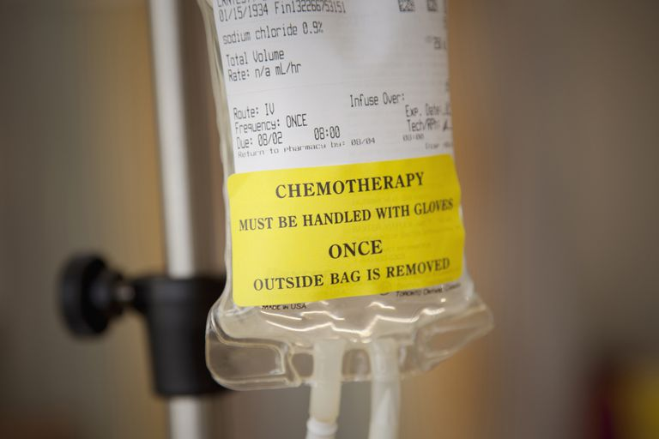
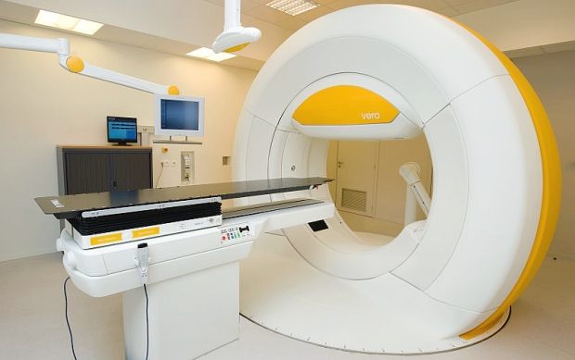
Background
t-AML occurs in patients exposed to cytotoxic chemotherapy and/or radiotherapy
Rare disease with a poor prognosis
Most of what is known about t-AML comes from studies of
adult cancer
Notes:
Background
Therapy-related acute myeloid leukemia (t-AML) is a disease where AML develops in a patient previously exposed to chemotherapy and/or radiotherapy.
In most cases, it follows the treatment of a primary malignancy but can also occur following an autoimmune condition.
Patients with t-AML are known to experience significantly inferior survival than those diagnosed with de novo AML among both adults and children.
Most studies into t-AML have been following other adult cancers.
Due to the rarity of t-AML diagnoses following childhood cancer, much remains to be studied in terms of patient characteristics and prognosis within this particular cohort group.

Slide 3
Data
Australian Childhood Cancer Registry
Includes all children (<15 yrs) diagnosed with cancer in Australia
Annual matching against the Australian Cancer Database (for later cancers) and the National Death Index
Treatment details are collected for first and subsequent cancers diagnosed <15 years of age
Notes:
Data
The study was conducted using de-identified longitudinal data from the Australian Childhood Cancer Registry (ACCR).
Information on all notified cases of cancer for children aged under 15 at diagnosis is collected from population cancer registries in each Australian State and Territory under appropriate ethics and legislative approvals.
Cases held by the ACCR are matched annually against the Australian Cancer Database and the National Death Index to ensure that all subsequent cancers diagnosed at any age are recorded in the ACCR database and that mortality status is updated.
Treatment details are also collected by the ACCR for all cancers diagnosed before 15 years of age.

Slide 4

Eligibility criteria
First primary cancer other than AML
First diagnosis between 1983 and 2012
Treated with chemotherapy and/or radiotherapy (with start date of treatment recorded)
Notes:
Eligibility criteria
The study cohort included children who were residents of Australia and who were diagnosed with a first primary cancer (other than AML) during the period 1983–2012 and treated with chemotherapy and/or radiotherapy.
Exclusion criteria were a first diagnosis of AML, the first primary malignancy was diagnosed prior to 1983, if the patient was from overseas but treated in Australia, or if the start date of treatment was not recorded.

Slide 5

Determination of t-AML
First and second cancers for the same patient were matched using a unique registry number
Any subsequent AML was assumed to be t-AML (after initiation of treatment for the first cancer)
Notes:
Determination of t-AML
Unique registry numbers were used to match first and second cancers for the same patient, with follow-up available up to December 31, 2014.
Any AML that was diagnosed subsequent to the initiation of chemotherapy or radiation for the first primary cancer was assumed to be t-AML.

Slide 6

Time at risk
Follow-up for second diagnosis available to Dec 31, 2014.
Time at risk was calculated from date of first treatment until either:
- end of the study period
- date of death
- date of diagnosis of t-AML
Maximum age at end of follow-up = 46 years
Notes:
Time at risk
For each eligible patient, time at risk (follow-up) was calculated from the date of first treatment until either the end of the study period (i.e. December 31, 2014), date of death, or date of diagnosis of t-AML, whichever came first.
The maximum hypothetical age at diagnosis for t-AML was 46 years (for a 14-year-old diagnosed with a first cancer during 1983 and then diagnosed with t-AML towards the end of 2014).

Slide 7

Analysis
Standardised incidence ratios (SIRs) calculated to measure relative risk of t-AML
Observed survival from date of diagnosis of t-AML estimated using Kaplan-Meier method
Key variables of interest:
- sex
- age group
- period of diagnosis
- type of first cancer
- treatment received (<15 years old)
Notes:
Analysis
Standardized incidence ratios (SIRs) were used to approximate the risk of developing t-AML within the study cohort, relative to the incidence of AML within the general population, matched by sex, 5-year age group, and calendar year.
Five-year observed survival was calculated from the date of diagnosis of t-AML using the Kaplan-Meier method.
Survival time was censored at either December 31, 2014 or 5 years from the date of t-AML diagnosis (whichever occurred first) for patients who remained alive at those time points.
Results were calculated for key demographic and clinical variables of interest including sex, age group, time period of diagnosis, broad type of first cancer, and treatment received. Note that treatment details for t-AML were only collected in the ACCR for patients diagnosed with t-AML before 15 years of age.

Slide 8
Study cohort
58 (0.5%) of 11,753 eligible patients were diagnosed with t-AML
Two-thirds were males; almost half aged 0-4 yrs at first diagnosis
78% t-AML cases diagnosed within 5 years of first cancer
76% t-AML cases aged <15 yrs at diagnosis of t-AML, none diagnosed after age 24 yrs
Only 8 cases of t-AML had correct morphology code (M99203)
98% of t-AML patients had had chemotherapy, 34% had also had radiotherapy
Notes:
Study cohort
11,753 eligible patients were included, of whom 58 (0.5%) were diagnosed with t-AML during the study period.
Males outnumbered females with t-AML by approximately 2 to 1.
Approximately half (47%) of those in the cohort who developed t-AML were aged 0-4 years at the time of their first cancer diagnosis
Most t-AML cases (n=45, 78%) were diagnosed within 5 years of the first primary cancer, with a median time between the commencement of treatment for the first cancer to diagnosis of t-AML of only 2.4 years (interquartile range = 1.9-4.6 years).
Although followup was available up to a maximum age of 46 years for some patients, no cases of t-AML were diagnosed after the age of 24, further emphasizing that t-AML was most likely to occur relatively soon after treatment for the original cancer.
Only 8 out of the 58 t-AML cases (14%) had a morphology code of M99203 (therapy-related AML).
All but one of the patients who went on to be diagnosed with t-AML were initially treated with chemotherapy, and one-third (n=20, 34%) also had radiotherapy.

Slide 9
Relative risk of t-AML
Characteristic | n | SIR (95% CI)
TOTAL | 58 | 45.6 (35.3-59.0)
Male | 39 | 52.7 (38.5-72.1)
Female | 19 | 35.7 (22.8-56.0)
First cancer
Blood cancer | 29 | 40.8 (28.3-58.7)
Solid tumours | 29 | 51.7 (36.0-74.5)
Treatment for first cancer
Chemotherapy | 57 | 49.0 (37.8-63.6)
Radiotherapy | 20 | 41.2 (26.6-63.9)
HSCT | 7 | 120.7 (57.5-253.2)
Notes:
Relative risk of t-AML
Patients with childhood cancer treated with chemotherapy and/or radiotherapy had an almost 50-fold increased risk of subsequently being diagnosed with AML with an SIR of 45.6
In fact, if follow-up time was capped at each person’s 25th birthday, the SIR rose to 56.0.
Twenty-year cumulative incidence was 0.7% (95% CI = 0.5-1.0%).
Despite the suggestion that males were at an increased relative risk of developing t-AML following childhood cancer compared to females, with SIRs of 52.7 and 35.7 respectively, the small number of cases available meant that the resulting incidence rate ratio of 1.48 for males to females was not statistically significant (p = 0.20).
No difference was found in the relative risk of t-AML by age group at first diagnosis (results not shown) or by type of first cancer.
Of note, the SIR for t-AML among children who received HSCT for their first cancer was more than double that of the study cohort in general, at 120.7, but this was based on only 7 cases.

Slide 10

Treatment for t-AML
t-AML treatment details were available for 44 children diagnosed <15 years
75% received chemotherapy plus either HSCT (48%) or radiotherapy (11%)
Of the 40 patients where remission status was recorded, complete remission was achieved for:
- 95% of 21 with HSCT
- 21% of 19 without HSCT
Notes:
Treatment for t-AML
Treatment details following t-AML were only available for the 44 children who were diagnosed with t-AML prior to reaching 15 years of age.
Of these patients, three-quarters received chemotherapy coupled with either HSCT (48%) or radiotherapy (11%) as part of their t-AML therapy.
The remaining 11 children (25%) had none of these treatments recorded following diagnosis with t-AML.
A large difference was found in whether complete remission was achieved depending on whether HSCT was part of the treatment or not – 95% versus 21%, respectively.

Slide 11
Survival following t-AML
71% of the 58 t-AML patients had died by 31 Dec 2104
Five-year observed survival was 31.2% (95% CI = 19.6%-43.5%)
No significant differences in survival by:
- sex (although maybe males worse)
- age at t-AML diagnosis
- year of t-AML diagnosis
- time from first to second diagnosis
- type of first cancer
Notes:
Survival following t-AML
Almost three-quarters of the cohort had died by the end of the study period. The majority of these deaths (n = 38, 93%) occurred within 2 years of t-AML diagnosis.
Five-year observed survival was 31% measured from the time of t-AML diagnosis.
No significant disparities in survival following t-AML were recorded by sex, age at t-AML diagnosis, time from first diagnosis to t-AML diagnosis, year of t-AML diagnosis, or type of first cancer, although this appeared to be at least partly due to the small number of cases available.
For example, 5-year observed survival more than double for females compared to that for males (50% vs. 23%), but the difference failed to reach statistical significance (p = 0.08).

Slide 12
Survival following t-AML by HSCT
Five-year observed survival:
HSCT = 52.4% (29.7%-70.9%)
No HSCT = 5.7% (0.4%-22.6%)
p < 0.001
Notes:
Survival following t-AML by HSCT
Our main finding was that treatment with HSCT following t-AML was associated with a survival advantage among those patients for whom this information was available (i.e., diagnosed with t-AML before 15 years of age).
Specifically, 5-year observed survival was 52% for the group who had HSCT in contrast to only 6% for children who did not receive HSCT to treat t-AML (p<0.001).

Slide 13
Conclusions
t-AML is an important late effect of childhood cancer treatment (accounts for 17% of second primary cancers following childhood cancer in Australia)
Imprecision in coding may hinder research into t-AML
Male predominance combined with possible survival disadvantage – further investigation warranted
Patients should be prepared for HSCT as soon as possible after diagnosis with t-AML
Notes:
Conclusions
In conclusion, our study provides important new insights into t-AML following childhood cancer. AML is one of the most commonly diagnosed malignancies among childhood cancer survivors, accounting for approximately one in six of all second primary cancers in Australia. Although the absolute risk was small, our finding that survivors who were treated with chemotherapy and/or radiotherapy had an almost 50-fold increased risk compared to those without cancer helps to quantify the impact that childhood cancer can have beyond the initial diagnosis.
The fact that so few potential cases of t-AML were not assigned to the correct morphology code is likely to hinder research into t-AML when relying on cancer registry data, as comprehensive treatment data are often lacking (i.e. it is not possible to distinguish t-AML from second primary de novo AML).
In contrast to our results, studies on t-AML following other adult cancers have shown a clear female predominance. It is not clear why t-AML appears to pose more of a risk among male survivors of childhood cancer and further investigation in other populations is warranted.
While our study confirms the poor prognosis associated with a diagnosis of t-AML, we found a striking five-year survival benefit when HSCTwas used to treat t-AML. Given the high mortality associated with t-AML and with our study identifying HSCT as an effective therapy, it seems prudent that children should be prepared for HSCT as soon as possible after a diagnosis of t-AML to increase their chance of survival despite the possibility of non-relapse mortality following transplant.

Slide 14
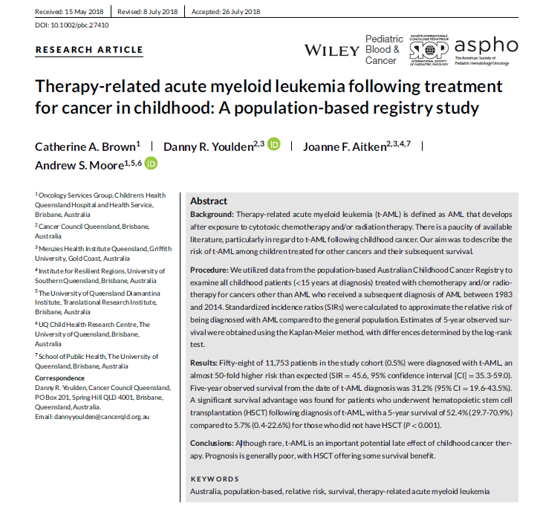
Want to know more?
Brown CA, Youlden DR, Aitken JF, Moore AS. Pediatr Blood Cancer. 2018;65:e27410
Notes:
Want to know more?
For anyone who would like further details, the full paper can be found at the reference shown here.

Slide 15

Thank you and questions?

