Slide 1
Cancer registration and its role in cancer prevention and control in China
Wenqiang Wei, Ph.D
Rongshou ZHENG
National Cancer Center/Cancer Hospital,
Chinese Academy of Medical Sciences

Slide 2
Purpose
To provide an overview of the history of cancer surveillance, current cancer burden and the role of cancer registration in cancer control programs in China.

Slide 3
History of PBCR in China
First rural registry: Linzhou County, 1959
First urban registry: Shanghai, 1961
Guideline of Cancer Registration, 1982
First volume of registration report, 1995
National Central Cancer Registry, 2002
National Cancer Registry Program, 2008-Now
Cancer Registration Management Regulation,2015

Slide 4
Progress Cancer Registration Coverage
652 population-based cancer registries covering 31 provinces
Covered 480 million Population，accounting for 35% of the whole national population

Slide 5
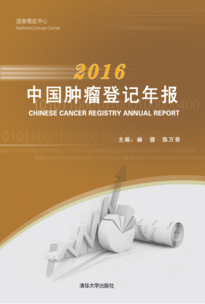
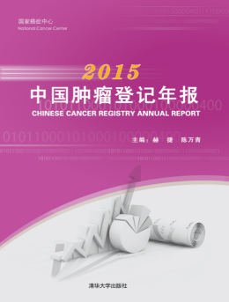
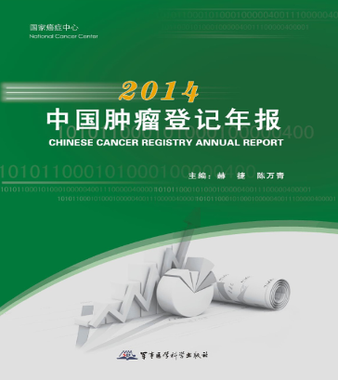
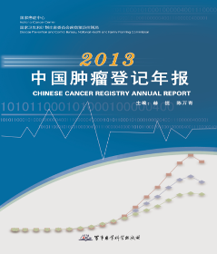
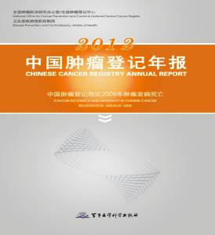
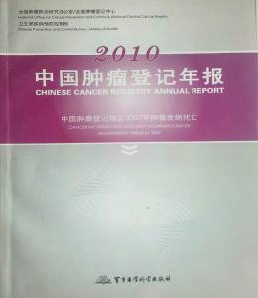
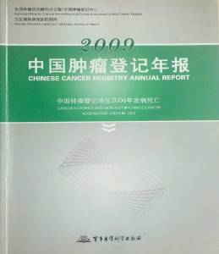
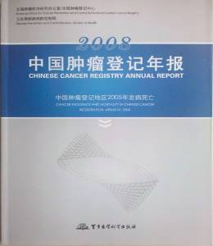
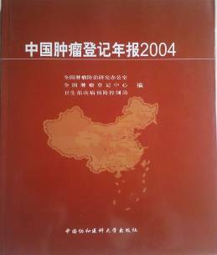
Progress Annual Cancer Registry Report
Establish a mechanism for cancer information releasing

Slide 6
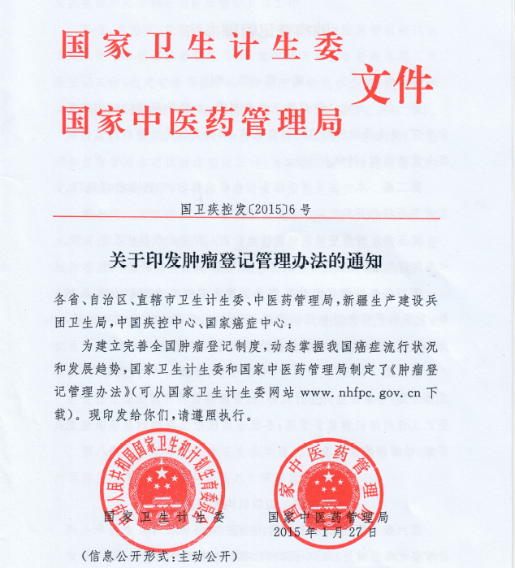
Progress Cancer Registration Management Regulation
All hospitals, medical and health institutions are required to submit cancer records to cancer registries. CDCs provide data on cause of death.
Published by National Health Commission of PRC, 2015

Slide 7
Progress Cancer Registration Management Regulation
Cancer Registry Reporting Channel
Main source
supplement source
Hospital
（Doctors）
Medical
records
Pathologist
Death surveillance
Insurance records
Police/funeral records

Slide 8
PBCR in Cancer Planning and Evaluation in China
Incidence: Prevention, planning services
Survival: Effectiveness of health care
Prevalence: Need for care
Mortality: Priorities

Slide 9
The burden of cancer in China

Slide 10
Cancer Incidence in China，2015
AREA | Gender | New Case (1000) | Crude rate (1/10⁵) | ASR(cn) (1/10⁵) | ASR (1/10⁵) | Cum. rate 0-74(%)
ALL | ALL | 3929.1 | 285.83 | 190.64 | 186.39 | 21.44
 | MALE | 2151.0 | 305.47 | 207.99 | 206.49 | 24.36
 | FEMALE | 1778.2 | 265.21 | 175.47 | 168.45 | 18.60
URBAN | ALL | 2351.7 | 304.96 | 196.09 | 191.38 | 21.81
 | MALE | 1258.7 | 319.82 | 209.14 | 207.44 | 24.26
 | FEMALE | 1093.1 | 289.47 | 185.42 | 177.64 | 19.50
RURAL | ALL | 1577.4 | 261.40 | 182.70 | 179.17 | 20.88
 | MALE | 892.3 | 287.30 | 206.04 | 204.79 | 24.46
 | FEMALE | 685.1 | 233.92 | 161.27 | 155.48 | 17.33
Estimated with 368 cancer registries, 2015

Slide 11
Cancer Mortality in China , 2015
AREA | Gender | Case (1000) | Crude rate (1/10⁵) | ASR(cn) (1/10⁵) | ASR (1/10⁵) | Cum. rate 0-74(%)
ALL | ALL | 2337.6 | 170.05 | 106.72 | 105.84 | 11.94
 | MALE | 1479.4 | 210.10 | 139.13 | 138.57 | 15.79
 | FEMALE | 858.2 | 128.00 | 75.92 | 74.81 | 8.13
URBAN | ALL | 1331.1 | 172.61 | 103.65 | 102.97 | 11.40
 | MALE | 835.4 | 212.28 | 134.08 | 133.83 | 15.03
 | FEMALE | 495.7 | 131.26 | 74.78 | 73.72 | 7.83
RURAL | ALL | 1006.5 | 166.79 | 110.76 | 109.57 | 12.65
 | MALE | 644.0 | 207.35 | 145.72 | 144.68 | 16.79
 | FEMALE | 362.5 | 123.78 | 77.43 | 76.24 | 8.52
Estimated with 368 cancer registries, 2015

Slide 12
Lifetime risk of developing cancer
SITES | Both sexes |  |  | Male |  |  | Female
 | Current Probability（%） | 1 in X |  | Current Probability（%） | 1 in X |  | Current Probability（%） | 1 in X
Oesophagus | 2.00 | 49.95 |  | 2.60 | 38.4 |  | 1.33 | 75.5
Stomach | 3.18 | 31.40 |  | 4.13 | 24.2 |  | 2.11 | 47.4
Colorectum | 3.01 | 33.19 |  | 3.24 | 30.9 |  | 2.75 | 36.3
Liver | 2.60 | 38.47 |  | 3.45 | 29.0 |  | 1.66 | 60.2
Pancreas | 0.79 | 126.06 |  | 0.81 | 123.4 |  | 0.77 | 129.1
Lung | 6.33 | 15.79 |  | 7.80 | 12.8 |  | 4.66 | 21.5
Breast | 3.48 | 28.72 |  |  |  |  | 3.48 | 28.7
Cervix | 1.23 | 81.53 |  |  |  |  | 1.23 | 81.5
Uterus | 0.81 | 124.07 |  |  |  |  | 0.81 | 124.1
Ovary | 0.66 | 152.52 |  |  |  |  | 0.66 | 152.5
Prostate | 1.33 | 75.21 |  | 1.33 | 75.2
Kidney | 0.53 | 190.10 |  | 0.61 | 164.7 |  | 0.44 | 229.5
Bladder | 0.68 | 147.23 |  | 0.98 | 101.7 |  | 0.33 | 301.4
Brain,CNS | 0.70 | 143.21 |  | 0.61 | 163.1 |  | 0.79 | 126.1
Thyroid | 0.98 | 102.16 |  | 0.47 | 212.3 |  | 1.53 | 65.5
Lymphoma | 0.64 | 157.47 |  | 0.70 | 142.7 |  | 0.56 | 178.7
Leukaemia | 0.60 | 167.81 |  | 0.64 | 155.2 |  | 0.54 | 185.0
All sites | 28.57 | 3.50 |  | 30.54 | 3.3 |  | 26.20 | 3.8

Slide 13
PBCR in Cancer Control Evaluation in China
Trends in age-standardized incidence rates in China
Male
Female

Slide 14
PBCR in Cancer Control Evaluation in China
Trends in age-standardized mortality rates in China
Male
Female

Slide 15
Cancer Patterns in China
Lung cancer, colorectal cancer increased rapidly
Digestive tract cancers still stayed at a high level
Rank | 1973-75 | 1990-92 | 2004-05 | 2014-15
1 | Stomach | Stomach | Lung | Lung
2 | Esophagus | Liver | Liver | Liver
3 | Liver | Lung | Stomach | Stomach
4 | Cervix | Esophagus | Esophagus | Esophagus
5 | Lung | Colo-rectum | Colo-rectum | Colo-rectum
Notes:
Lung cancer, colorectal cancer increased rapidly, meanwile, digestive tract cancers still stayed at a high level, this lead the cancer prevention and control facing with new challenge, and showed the coexistence of cancer patterns between developed and developing countries.

Slide 16
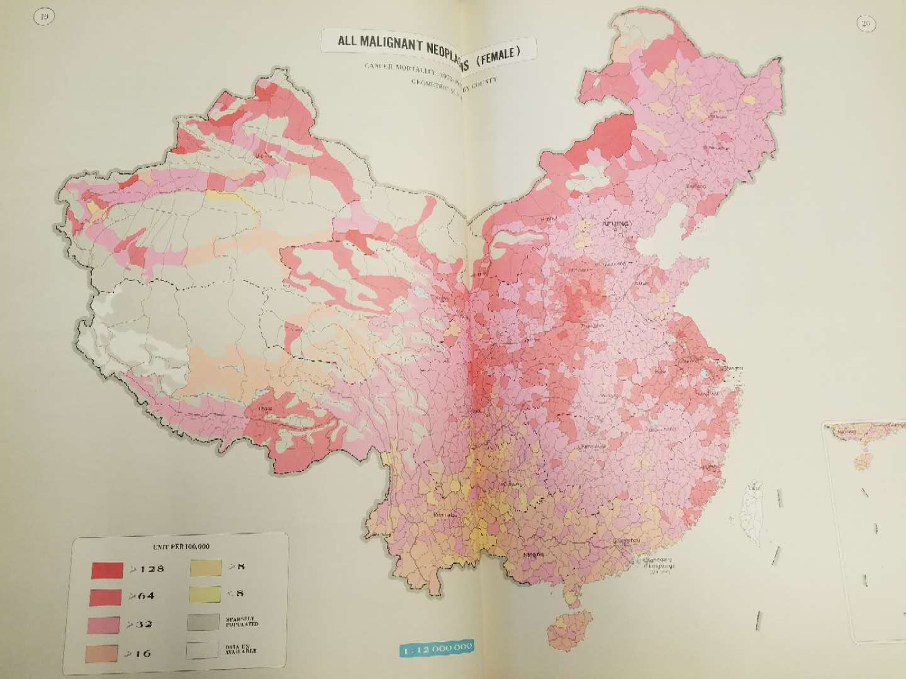
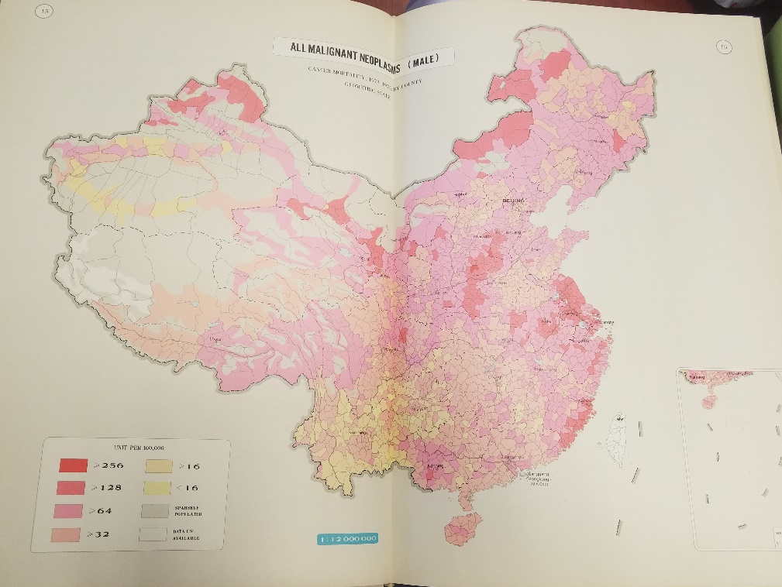
The First Retrospective Survey of Death Causes,1973-75
Cancer- A leading cause of death
Age, and regional distribution of all cancer deaths
Regions with high cancer mortality rates
Malignant Tumor Atlas of the People’s Republic of China

Slide 17
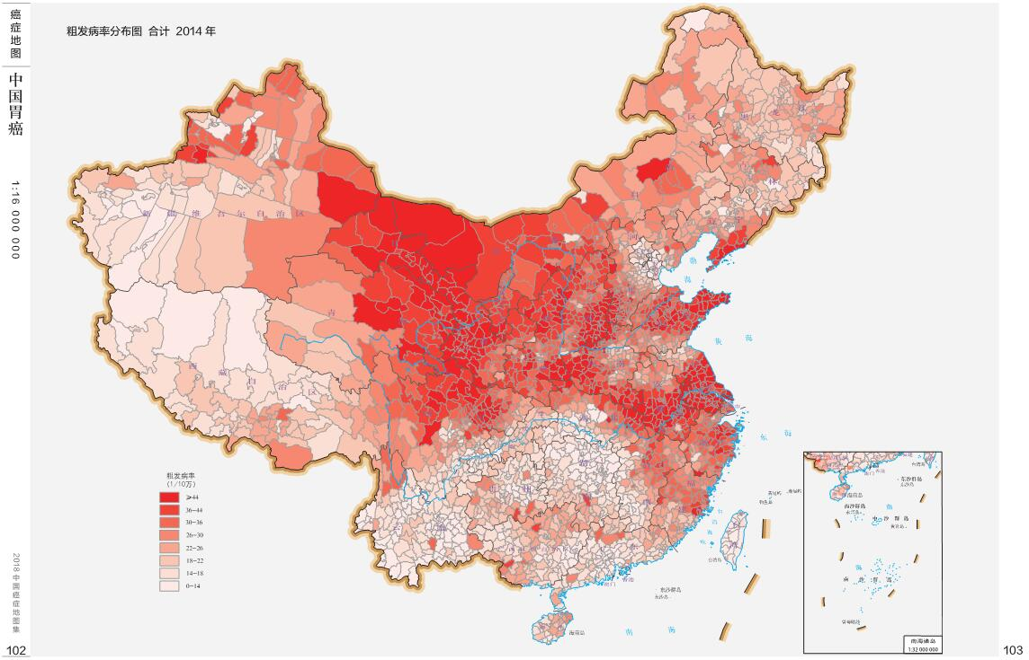
Cancer Atlas in China,2018
All sites
Stomach

Slide 18
PBCR in Cancer Control Evaluation in China
Trends in age-standardized 5-year survival in 17 registries of China, 2003-2015
Survival is an indicator of the role of the process of diagnosis and care

Slide 19
The burden of cancer in China

Slide 20
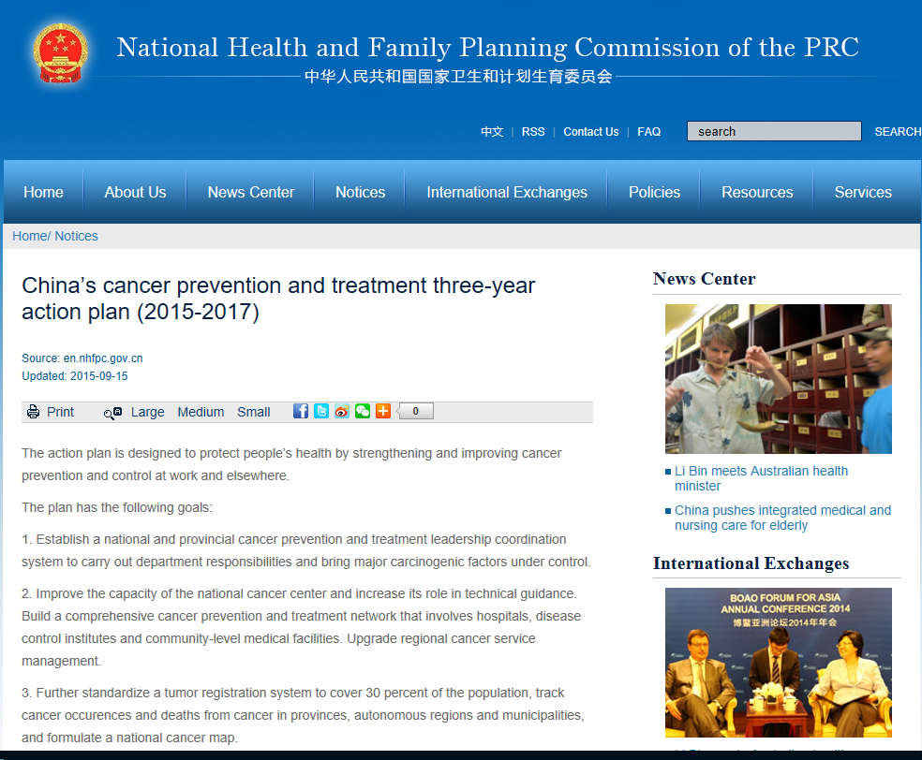
China’s Cancer Prevention and Control
Three-year Action Plan (2015–2017)
Background
The action plan is designed to protect people’s health by strengthening and improving cancer prevention and control
conduct nation-wide cancer registration and death surveillance, to monitor the incidence and mortality of cancer of the country

Slide 21
Six Goals China’s Cancer Prevention and Control Three-Year Action Plan (2015–2017)
1. Establish a national and provincial cancer prevention and treatment leadership coordination system to carry out department responsibilities and bring major carcinogenic factors under control.
2. Improve the capacity of the national cancer center and increase its role in technical guidance. Build a comprehensive cancer prevention and treatment network that involves hospitals, disease control institutes and community-level medical facilities. Upgrade regional cancer service management.
3. Further standardize a tumor registration system to cover 30 percent of the population, track cancer occurrences and deaths from cancer in provinces, autonomous regions and municipalities, and formulate a national cancer map.

Slide 22
Six Goals China’s Cancer Prevention and Control Three-Year Action Plan (2015–2017)
4. Increase knowledge of cancer prevention and treatment in 60 percent of the population, and reduce the adult smoking rate by three percent.
5. Focus on lung, liver, gastric, esophageal, colorectal, breast, cervical and nasopharynx cancers, expand cancer screening, early diagnosis and treatment coverage, and ensure 50 percent of major cancers can be diagnosed and treated at an early stage in major areas.
6. Improve standardized diagnosis and treatment of major cancers, expand cancer opportunistic screening and standardized diagnosis and treatment, gradually increase the survival rate for major cancers and reduce the overall fatality rate.

Slide 23
Ten Major Measures
China’s Cancer Prevention and Control Three-Year Action Plan (2015–2017)
1.All parties will carry out responsibilities and comprehensive measures including 13 ministries of China: Health and family planning departments，financial departments，human resources and social security and health and family planning departments，environmental protection departments，traditional Chinese medicine management departments , etc.
2. Strengthen system construction and improve service capacity. Speed up development of the national cancer center's capacity, establish a national cancer prevention and control cooperation network, and strengthen the capacity of various disease prevention and control institutes for monitoring and intervention, epidemiological investigation, and information management regarding cancer risk factors.

Slide 24
Ten Major Measures
China’s Cancer Prevention and Control Three-Year Action Plan (2015–2017)
3. Strengthen tumor information collection work. Improve the cancer registration and report system, and utilize the Cancer Registration Management Regulation.

Slide 25
Ten Major Measures
China’s Cancer Prevention and Control Three-Year Action Plan (2015–2017)
4. Promote comprehensive prevention and control of cancer risk factors.
5. Promote cancer screening, early diagnosis and treatment strategy.
6. Raise cancer diagnosis and treatment level. Strengthen cancer diagnosis and treatment capacity of medical institutions, standardize tumor treatment, and improve the patient's survival rate and life quality.
7. Promote anti-tumor medicine development and production.
8. Advance the use of traditional Chinese medicine in cancer prevention and treatment.
8. Advance the use of traditional Chinese medicine in cancer prevention and treatment.
10. Encourage the popularization of science, and raise public cancer awareness.

Slide 26
China’s Cancer Prevention and Control Three-Year Action Plan (2015–2017) Six Goals
PBCR in Cancer Planning in China
1. Establish a national and provincial cancer prevention and treatment leadership coordination system to carry out department responsibilities and bring major carcinogenic factors under control.
2. Improve the capacity of the national cancer center and increase its role in technical guidance. Build a comprehensive cancer prevention and treatment network that involves hospitals, disease control institutes and community-level medical facilities. Upgrade regional cancer service management.
3. Further standardize a tumor registration system to cover 30 percent of the population, track cancer occurrences and deaths from cancer in provinces, autonomous regions and municipalities, and formulate a national cancer map.

Slide 27
China’s Cancer Prevention and Control Three-Year Action Plan (2015–2017) Six Goals
PBCR in Cancer Planning in China
4. Increase knowledge of cancer prevention and treatment in 60 percent of the population, and reduce the adult smoking rate by three percent.
5. Focus on lung, liver, gastric, esophageal, colorectal, breast, cervical and nasopharynx cancers, expand cancer screening, early diagnosis and treatment coverage, and ensure 50 percent of major cancers can be diagnosed and treated at an early stage in major areas.
6. Improve standardized diagnosis and treatment of major cancers, expand cancer opportunistic screening and standardized diagnosis and treatment, gradually increase the survival rate for major cancers and reduce the overall fatality rate.

Slide 28
PBCR in Primary Prevention
To evaluate effectiveness of preventive interventions
To assess the observed and expected impact of HBV, HPV vaccines, and tobacco control
To identify potential risk factors of cancer

Slide 29
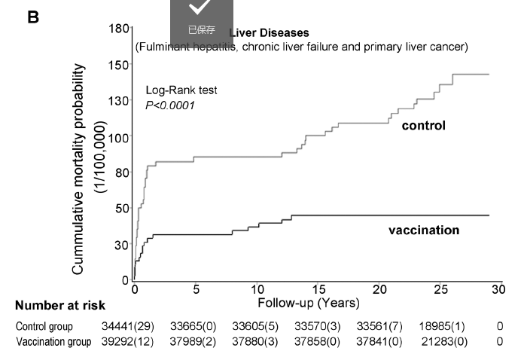
Neonatal HBV Vaccination on liver cancer prevention and other liver diseases in Qidong, China
PBCR in Primary Prevention
PLOS Medicine.2014,11:12

Slide 30
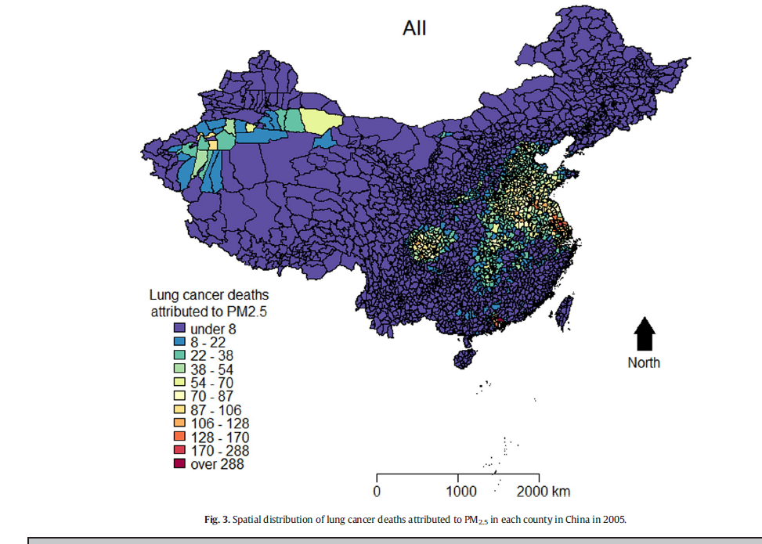
Identify Risk Factors Using PBCR
PBCR in Primary Prevention
The association between lung cancer incidence and ambient air pollution in China: A spatiotemporal analysis. Environmental Research. 2016, 144:60-65.
Lung Cancer Deaths Attributed to PM2.5 in China

Slide 31
Cancer Deaths and Cases Attributable to Lifestyle Factors and Infections in China, 2013
PBCR in Primary Prevention
Calculate Population Attributable Fraction

Slide 32
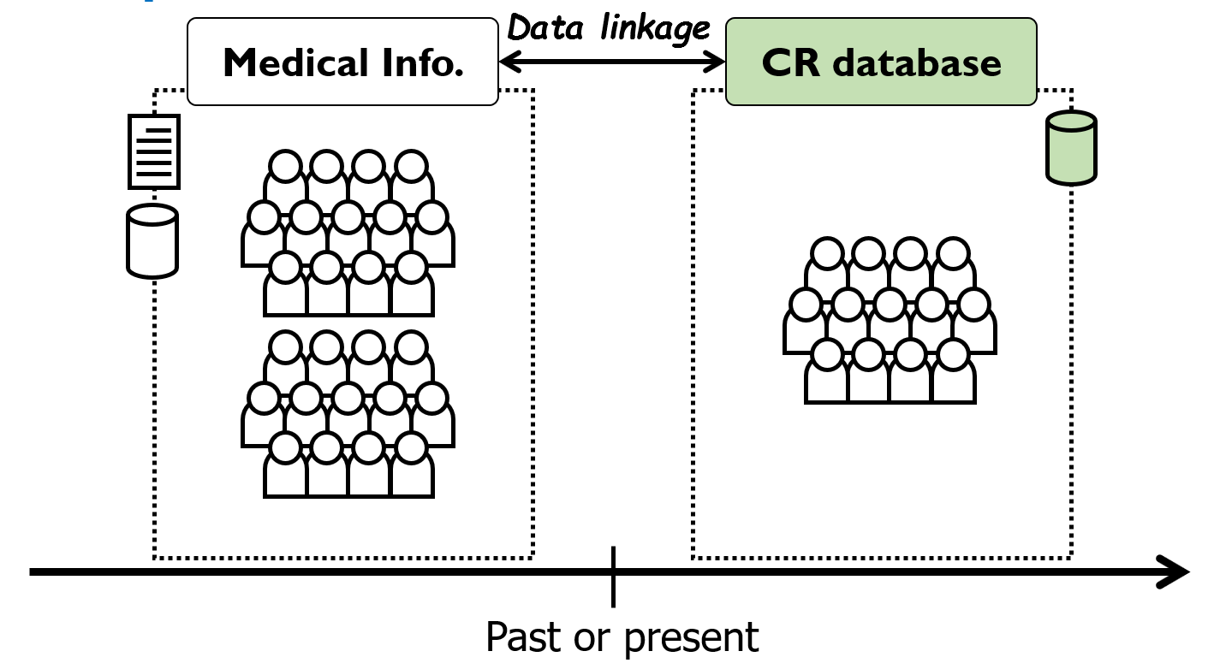
PBCR in Early Detection and Screening
Which cancer should be screened?
How screening affect cancer incidence, mortality and survival？
Who are the target population to be screened?
Identification information linkage

Slide 33
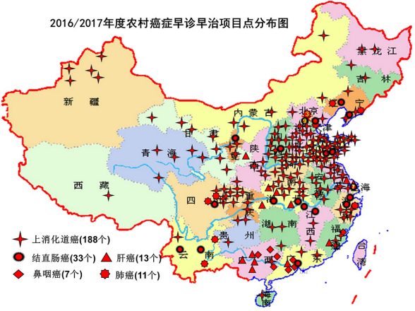
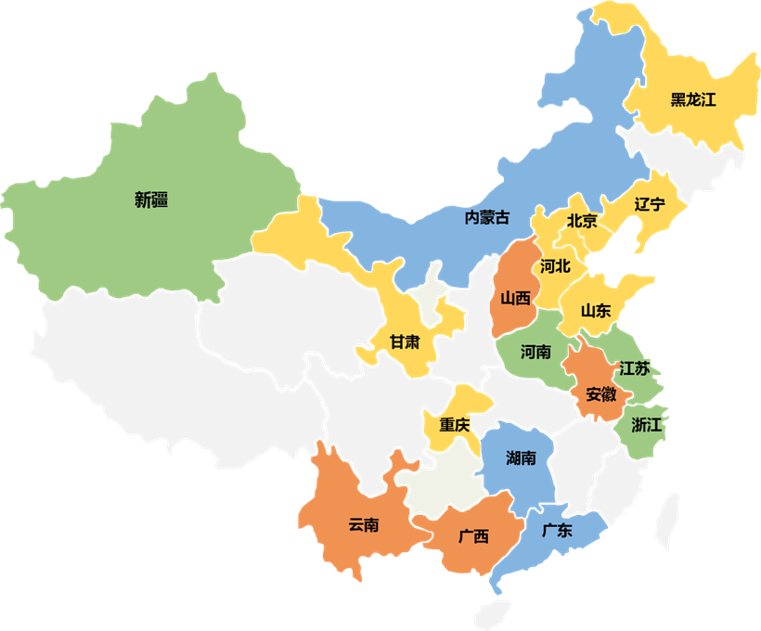
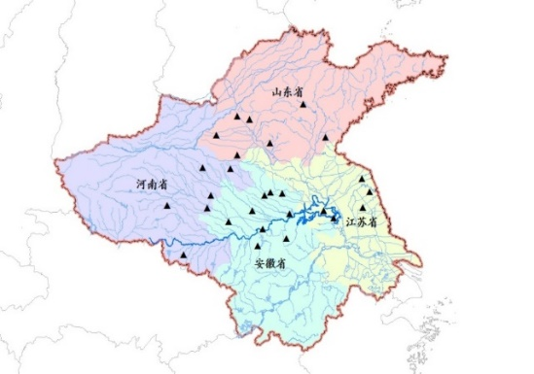
PBCR in Early Detection and Screening
Screening different cancers according to the incidence of cancers in areas
Rural
Urban
Huaihe
Lung cancer
Esophageal cancer
Liver cancer
Nasophageal cancer
Colorectal cancer
Top five cancers in urban areas: lung, liver, esophagus-stomach, colon-rectum and breast
Liver cancer
Stomach cancer
Esophageal cancer

Slide 34
PBCR in Early Detection and Screening
Compare risk of cancer in those screened and not screened.
Estimate the incidence of cancer at different intervals
The stage distribution of cancers detected by screening compared with the expected distribution
The incidence of advanced cancers, compared with the period prescreening(or an unscreened comparison group)

Slide 35
Endoscopic Screening Study in China
PBCR in Early Detection and Screening
J Clin Oncol. 2015 Jun 10;33(17):1951-7.

Slide 36
Endoscopic Screening Effect on Stage Distribution of Esophageal Cancer in China
PBCR in Early Detection and Screening
Cancer science, 2018;109:1995-2002

Slide 37
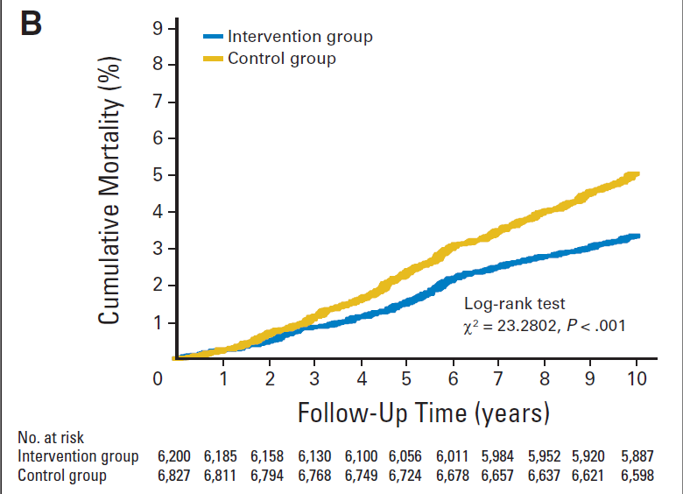
Endoscopic Screening on Effect of Esophageal Cancer Incidence and Mortality in China
PBCR in Early Detection and Screening
Journal of Clinical Oncology, 2015,33:17

Slide 38
PBCR in Evaluation of Treatment
PBCR follow up their cases in order to produce survival statistics
Comparisons of cancer survival rates to compare the effectiveness of cancer treatment in difference populations( global, within country, by region or by GDP level)
High resolution study

Slide 39
“Mid-term and Long-term Plan for Prevention and Control of Chronic Diseases in China (2017-2025)
Core Index: Reduce the premature deaths caused by major chronic diseases
2020
Reduce the premature deaths caused by major chronic diseases by 10%
Fulfilling international commitments and participating in global health governance
WHO Global NCD Index：
In 2025, reduce the premature deaths caused by major chronic diseases by 20%.
2030 Agenda for Sustainable Development:
Goal 3.4: In 2030, reduce the premature deaths caused by major chronic diseases by 33%.
2025
Reduce the premature deaths caused by major chronic diseases by 20%

Slide 40
“Mid-term and Long-term Plan for Prevention and Control of Chronic Diseases in China (2017-2025)
Core Index | Base line | 2020 | 2025 | Property
CCVD death rate（1/105） | 241.3/105 | ↓10% | ↓15% | prospective
Cancer 5 year survival （%） | 30.9% | ↑5% | ↑10% | prospective
Cancer early diagnostic rate in high-risk areas（%） | 48% | 55% | 60% | prospective
Chronic respiratory diseases death rate in population below 70 years old（1/105） | 11.96/105 | ↓10% | ↓15% | prospective
Lung function detection rate in population over 40 years old（%） | 7.1% | 15% | 25% | prospective
Management of hypertension patients（万人） | 8835 | 10000 | 11000 | prospective
Management of diabetes patients（万人） | 2614 | 3500 | 4000 | prospective
Hypertension and diabetes patients standardized management rate（%） | 50% | 60% | 70% | prospective
Annual blood fat detection rate in population over 35 years old（%） | 19.4% | 25% | 30% | prospective
TCM health management rate in population over 65 years old（%） | 45% | 65% | 80% | prospective
Residents’ health literacy level（%） | 10% | >20% | 25% | prospective
Universal health lifestyle action coverage（%） | 80.9% | 90% | 95% | prospective
The number of people who often take part in physical exercise（100 million） | 3.6 | 4.35 | 5 | prospective
Smoking rate over 15 years old（%） | 27.7% | Within 25% | Within 20% | prospective
Average daily salt intake（g） | 10.5 | ↓10% | ↓15% | prospective
National chronic disease comprehensive prevention and control demonstration area coverage（%） | 9.3% | 15% | 20% | prospective
35

Slide 41
PBCR in China
Strategy for the improvement of PBCR in China
Regulation：updated, implement, evaluate, award or punishment
Team building : national, province, local level(professional staffs)
Training: classified as different grades (eastern/middle/western; urban/rural; data quality)
Strengthening cooperation about cancer research based on PBCRs
National cancer registry system(to link with other database, e.g. vital system, national medical record system ..), will coming soon..

Slide 42
Summary
PBCR data are primary resource for planning and evaluating health services for the prevention, diagnosis and treatment of cancer in China
As a goal of “China’s Cancer Prevention and Control 5-Year Action Plan (2018–2022)”, the nationwide cancer registration system will be strengthened.

Slide 43
Thanks for your attention !
weiwq@cicams.ac.cn
Zhengrongshou@cicams.ac.cn

