Slide 1
Neighborhood archetypes for understanding disparities in prostate cancer mortality
NCI R21CA174469 to Salma Shariff Marco, PhD, MPH
Mindy C Hebert-DeRouen, PhD, MPH
@MDeRouen4
NAACCR / IACR Combined Annual Conference 2019
Notes:
Our group at UCSF, the DREAM Lab, fucses on social determinants of health within a cells to society framework, which posits that cancer disparities arise from interactions among individual-level biology and health behaviors, interpersonal factors, neighborhood-level factors and environmental exposures, instituions, policies and governments.
This project in particular is related to efforts to meaningfully characterize neighborhoods with secondary data to inform our understanding of disparities in health outcomes, characterize neighborhoods in multi-level studies, and inform hypotheses for further study and ultimately intervention on social determinants of health.
It is work that was part of a NCI R21-funded study to Dr. Salma Shariff-Marco in the DEB

Slide 2
Background
Neighborhoods and prostate cancer
Place matters
Gomez, Shariff-Marco, et al. The impact of neighborhood social and built environment across the cancer continuum: current research, methodologic considerations, and future directions. Cancer 2015.
Notes:
So place matters….
Where you live, work, and play impacts your health
Environmental exposures
material deprivation
psychosocial mechanisms (stress, social support)
Lifestyle behaviors (physical activity, diet, smoking, alcohol use)

Slide 3
Background
Neighborhoods and prostate cancer
Place matters
Gomez et al. Cancer 2015. The impact of neighborhood social and built environment across the cancer continuum: current research, methodological considerations, and future directions.
Gomez, Shariff-Marco, et al. The impact of neighborhood social and built environment across the cancer continuum: current research, methodologic considerations, and future directions. Cancer 2015.
Notes:
In a 2015 invited review for Cancer, members of our group reviewed the existing literature on neighborhood social and built environment as it relates to cancer outcomes….

Slide 4
Background
Neighborhoods and prostate cancer
Place matters
Gomez et al. Cancer 2015
DeRouen et al. Cancer Epidemiology 2018. Impact of individual and neighborhood factors on disparities in prostate cancer survival.
Notes:
In 2018, we published results from a multi-level study of prostate cancer survival in which we showed that nSES, but not individual level SES, was assoc with Pca survival in models that included both of these factors and that nSES accounted for the majority of the assoc of AA race with survival. Neighborhood SES is an index comprising census varialbes on income, education, and occupation that classifies census tracts on a linear scale 1-5.

Slide 5
Background
Neighborhoods and prostate cancer
Place matters
Gomez et al. Cancer 2015
DeRouen et al. Cancer Epidemiology 2018.
Specific social and built environment attributes associated with prostate cancer survival
Notes:
Furthermore, we examined a large suite of specific and built neighborhood attributes, such as population density, rural/urban status, walkability, and food availability.
While some were independently associated with survival, none accounted for the association of nSES and survival.

Slide 6
Background
Neighborhoods and prostate cancer
Place matters
Gomez et al. Cancer 2015
DeRouen et al. Cancer Epidemiology 2018.
Specific social and built environment attributes associated with prostate cancer survival
Limited understanding of interactions among attributes
Notes:
One of the drawbacks of examining each neighborhood attribute independently, and even using the neighborhood SES index, is that this approach gives us limited ability to understand the complex interactions among attributes of the built and social neighborhood environment.

Slide 7
Background
Neighborhoods and prostate cancer
Place matters
Gomez et al. Cancer 2015
DeRouen et al. Cancer Epidemiology 2018.
Specific social and built environment attributes associated with prostate cancer survival
Limited understanding of interactions among attributes
A single classification system can draw upon multiple attributes of social and built environments
Notes:
This and similar work motivated us to seek a single neighborhood classification system that could draw upon multiple attributes of the social and built environment that help to build a more comprehensive view of neighborhood dimensions that contribute to cancer outcomes.

Slide 8
Objectives
National Cancer Institute grant 1R21CA174469-01A1 (Salma Shariff-Marco)
Developing Neighborhood Archetypes for Understanding Disparities in Cancer
Aim 1: Develop archetypes to characterize neighborhoods in CA from a broad suite social and built environment attributes
Aim 2: Examine associations of neighborhood archetypes with breast cancer and prostate cancer mortality
Notes:
In this study, we are using latent class analyses to develop archetypes that characterize neighborhoods into a single classification system using a broad suite of neighborhood characteristics And we are examining how these archetypes are associated with cancer mortality for breast and cancer.
I will be showing you the results on prostate cancer mortality today

Slide 9
Methods
Latent Class Analysis
Identify associations among categorical indicators
Generate quantitatively distinct classes of underlying latent construct
Notes:
LATENT CLASS ANALYSIS—LCA identifies associations among sets of categorical indicators resulting in quantitatively distinct types or classes of the underlying latent construct being measured.^{7, 51, 52, 70} Missing values in the data can be accommodated in LCA modeling.⁷
ARCHETYPE--The archetype approach overcomes current challenges of evaluating multiple neighborhood features at once and enables us to combine together multiple neighborhood characteristics to categorize neighborhoods into meaningful and yet distinct types

Slide 10
Methods
Data
39 neighborhood attributes measuring multiple neighborhood dimensions for CA Census tracts
Gomez, Scarlett Lin, et al. "The California Neighborhoods Data System: a new resource for examining the impact of neighborhood characteristics on cancer incidence and outcomes in populations." Cancer Causes & Control 22.4 (2011): 631-647.
Census block groups and census tracts
2000 and 2010
Notes:
These models included 39 neighborhood attributes measuring multiple neighborhood dimensions, such as….
Demographics and household composition
Immigration
Socioeconomic status
Built environmental/walkability
Migration and commuting
The archetypes were developed for census block group and census tracts, for the census years 2000 and 2010

Slide 11
Methods
Archetype Models
5-class and 9-class models
Suite of Goodness of Fit criteria and interpretability
To examine prostate cancer mortality:
9-class model
Census tracts
Year 2000
Notes:
With a suite of goodness of fit criteria and consideration of interpretability, 5-class and 9-class models as models that best fit the data and thus these were explored further
We have been working with the 9-class model where possible, as we feel it is more robust and informative to interactions among neighborhood attributes
And with prostate cancer mortality as the outcome, we are using 2000 census tracts, as it provides increased power for our analyses

Slide 12
Neighborhood archetypes
9-class model, CA census tracts, 2000
 | Urbanicity | SES | Demographics | Age and households | Land use | Commuting and streets | Food
Upper middle-class suburb |  | High | White/API | Midlife Fewer female HH | Greenspace Recreation | Low connectivity
High status |  | High | White | Older | Greenspace Recreation |  | Healthy
New urban/ Pedestrian | Downtown |  | Diverse (non-Hispanic) | Young, Singles | Mixed use | High traffic
Mixed SES class suburb |  |  |  | Families | Some mixed use Recreation | Commuting Low connectivity | Healthy
Suburban pioneer | City | Middle | Diverse | Families, Owning | Mixed use
Rural/ Micropolitan | Rural | Low | White | Older Single HH |  | Low traffic
City pioneer | City | Lower-middle | Diverse | Older Single, female HH Rentals | Mixed use | High traffic
Hispanic small towns |  | Lower-middle | Hispanic |  | Some mixed use Less greenspace | Less commuting Low traffic | Unhealthy
Inner city | Urban | Low | Black, Hispanic | Rentals, Vacants |  |  | Unhealthy
Notes:
This tables shows down the first column the archetypes within the 9-class model. Each was named to highlight the most prominent features of that neighborhood in contrast to others.
The remainder describes how these archetypes represent several neighborhood dimensions.
It does take a little time to fully appreciate how the archetypes distinguish neighborhoods and highlight interactions among neighborhood attributes, but as an example…..
Upper middle-class suburbs and High status neighborhoods are both high SES with many White residents, lots of green and recreational facilities, but they differ in the composition of their households in that Upper-middle class neighborhoods contain more API residents, midlife (contrasted to older) residents and households headed by males
Suburban pioneer and City pioneer neighborhoods are both located in cities, but not right downtown, have racially/ethnically diverse populations, and lots of mixed land use but contrast in that Suburban pioneer neighborhoods have more families and home owners and city pioneer neighborhoods have more older residents, single residents, female HH, and renters.

Slide 13
Neighborhood archetypes
9-class model, CA census tracts, 2000
 | Urbanicity | SES | Demographics | Age and households | Land use | Commuting and streets | Food
Upper middle-class suburb |  | High | White/API | Midlife Fewer female HH | Greenspace Recreation | Low connectivity
High status |  | High | White | Older | Greenspace Recreation |  | Healthy
New urban/ Pedestrian | Downtown |  | Diverse (non-Hispanic) | Young, Singles | Mixed use | High traffic
Mixed SES class suburb |  |  |  | Families | Some mixed use Recreation | Commuting Low connectivity | Healthy
Suburban pioneer | City | Middle | Diverse | Families, Owning | Mixed use
Rural/ Micropolitan | Rural | Low | White | Older Single HH |  | Low traffic
City pioneer | City | Lower-middle | Diverse | Older Single, female HH Rentals | Mixed use | High traffic
Hispanic small towns |  | Lower-middle | Hispanic |  | Some mixed use Less greenspace | Less commuting Low traffic | Unhealthy
Inner city | Urban | Low | Black, Hispanic | Rentals, Vacants |  |  | Unhealthy
Notes:
Upper middle-class suburbs and High status neighborhoods are both high SES with many White residents, lots of green and recreational facilities, but they differ in the composition of their households in that Upper-middle class neighborhoods contain more API residents, midlife (contrasted to older) residents and households headed by males

Slide 14
Neighborhood archetypes
9-class model, CA census tracts, 2000
 | Urbanicity | SES | Demographics | Age and households | Land use | Commuting and streets | Food
Upper middle-class suburb |  | High | White/API | Midlife Fewer female HH | Greenspace Recreation | Low connectivity
High status |  | High | White | Older | Greenspace Recreation |  | Healthy
New urban/ Pedestrian | Downtown |  | Diverse (non-Hispanic) | Young, Singles | Mixed use | High traffic
Mixed SES class suburb |  |  |  | Families | Some mixed use Recreation | Commuting Low connectivity | Healthy
Suburban pioneer | City | Middle | Diverse | Families, Owning | Mixed use
Rural/ Micropolitan | Rural | Low | White | Older Single HH |  | Low traffic
City pioneer | City | Lower-middle | Diverse | Older Single, female HH Rentals | Mixed use | High traffic
Hispanic small towns |  | Lower-middle | Hispanic |  | Some mixed use Less greenspace | Less commuting Low traffic | Unhealthy
Inner city | Urban | Low | Black, Hispanic | Rentals, Vacants |  |  | Unhealthy
Notes:
Suburban pioneer and City pioneer neighborhoods are both located in cities, but not right downtown, have racially/ethnically diverse populations, and lots of mixed land use but contrast in that Suburban pioneer neighborhoods have more families and home owners and city pioneer neighborhoods have more older residents, single residents, female HH, and renters.

Slide 15
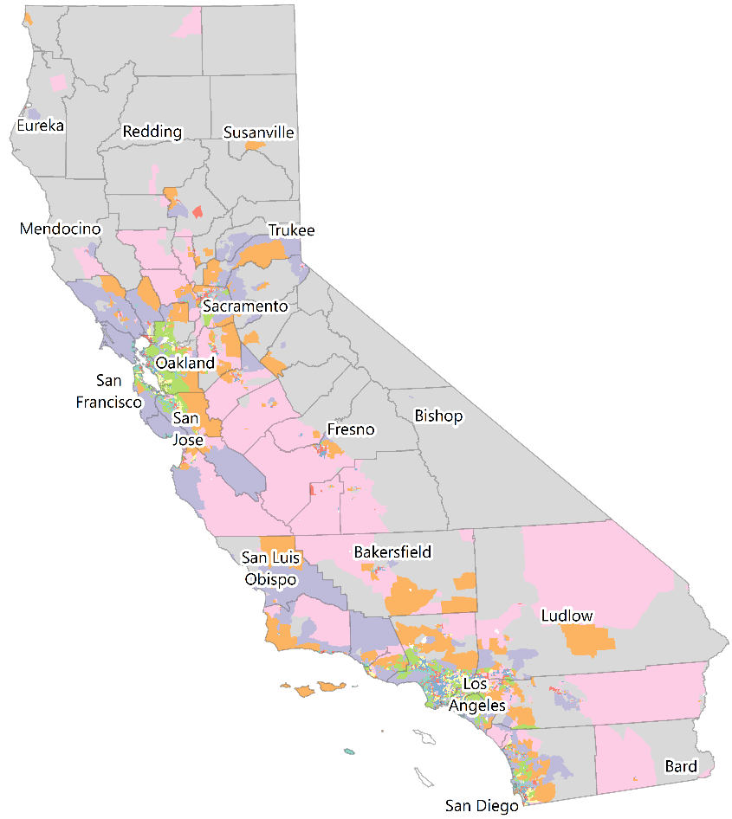
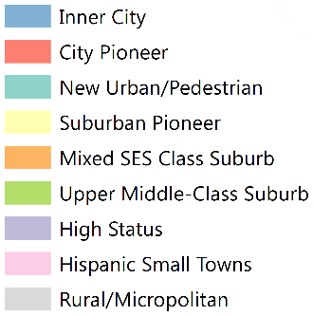
Neighborhood archetypes
9-class model, CA census tracts, 2000
Notes:
When we look at the map of the 9-class archetypes across the state, the most prominent feature of course is location of rural census tracts.
One thing that strikes me about the state map, though, is how the Hispanic small town actually breaks the rural/urban divide. Hispanic small towns can be found in both rural and urban areas, highlighting the benefit of a multi-dimensional approach to characterizing neighborhoods

Slide 16
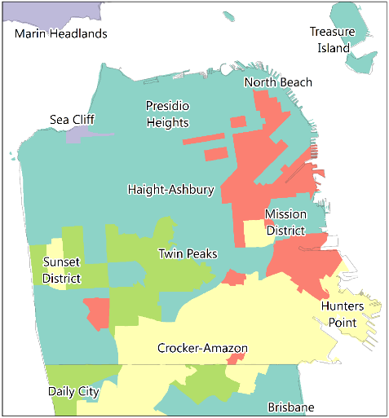
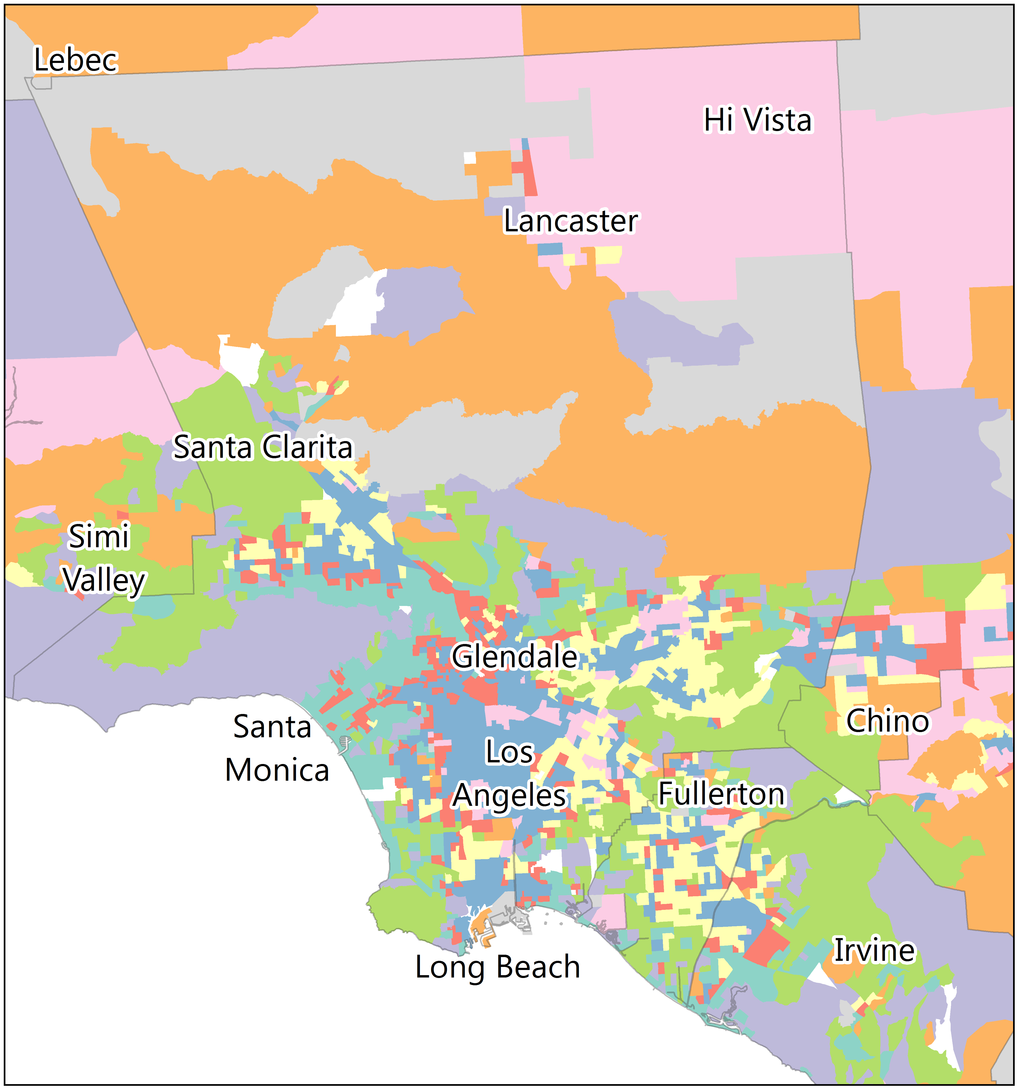
Neighborhood archetypes
9-class model, CA census tracts, 2000
Notes:
Looking a little more closely at urban areas allows us to the see the distribution of more of the archetypes
This is SF on the left, where only 5 of the 9 archetypes are represented
Los Angeles shows an Inner city central area surrounded by City and Suburban pioneer neighborhooods, and then New urban/Pedestrian neighborhoods with Suburb and High Status neighborhoods further out. Again we can see Hispanic small towns interspersed with Inner City, Suburbs, and Rural areas.

Slide 17
Methods
Prostate cancer survival
Prostate cancer cases (N=185,183)
California Cancer Registry
1996-2005
Survival analyses
Cox proportional hazards regression
Adjusted for sociodemographic, tumor, treatment characteristics, and clustering at census tract
Notes:
185,183

Slide 18
Neighborhood archetypes and prostate cancer
Distribution of neighborhood archetypes according to race/ethnicity
Notes:
Concentration of whites in rural, high status upper middle class, new urban
Concentration of API in upper-middle class, new urban, and suburban pioneer
Concentration of NH Black and Hispanic cases in Inner city, Hispanic small town, and city pioneer neighborhoods

Slide 19
Neighborhood archetypes and prostate cancer
Distribution of neighborhood archetypes according to stage at diagnosis
Notes:
Stage at diagnosis also differs by neighborhood archetype, fewer distant stage cases resided in high status and upper middle-class cases, more in inner city and city pioneer neighborhoods

Slide 20
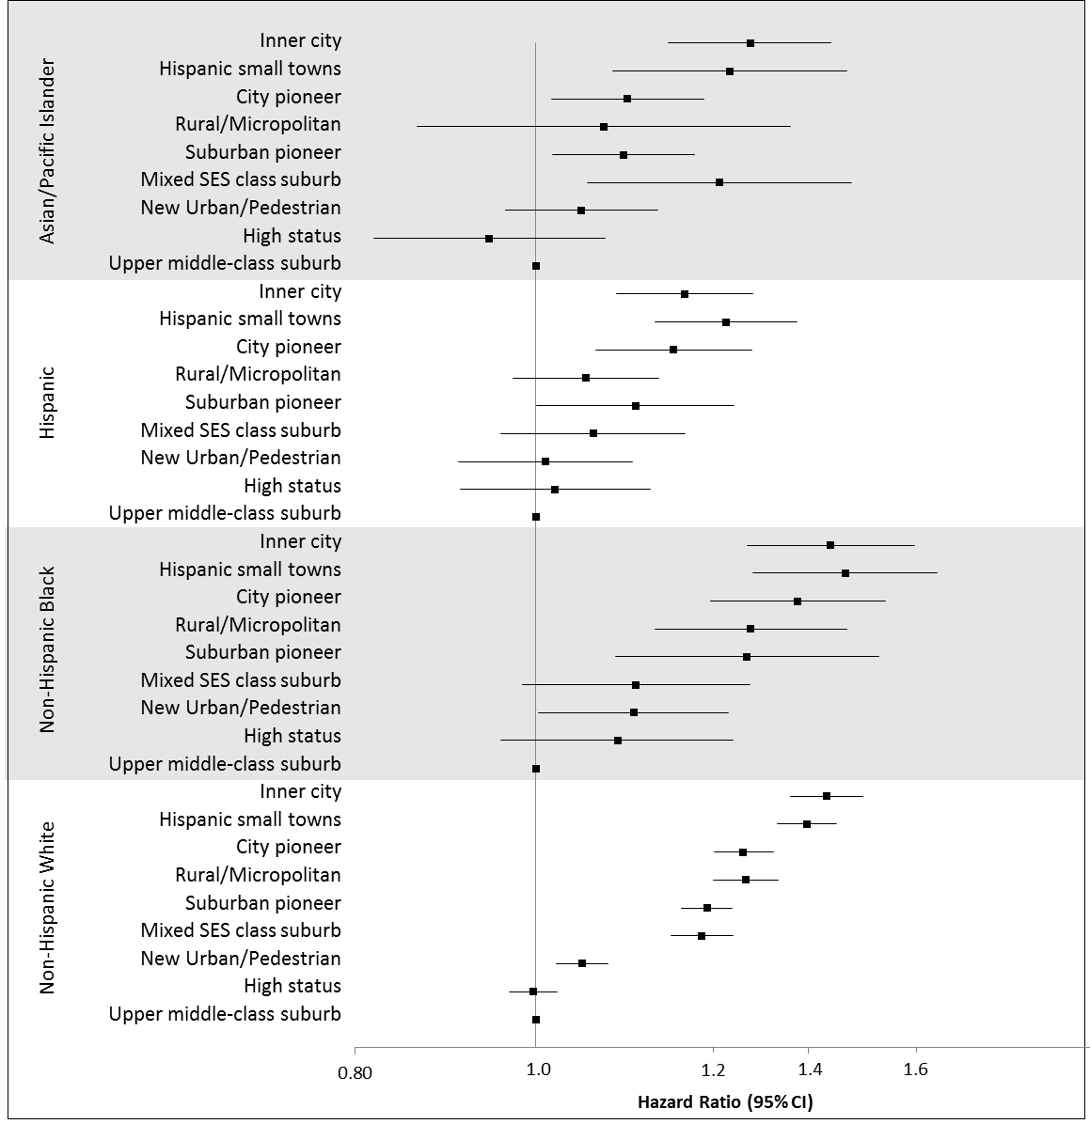
Prostate cancer survival
All-cause death
Survival differs by archetype
Notes:
Overall, survival differs by archetype

Slide 21
Prostate cancer survival
All-cause death
Survival differs by archetype
Patterns vary across race/ethnicity
Notes:
Patterns vary across race/ethnicity
And…

Slide 22
Prostate cancer survival
All-cause death
Survival differs by archetype
Patterns vary across race/ethnicity
Indicates differences in mortality over multiple neighborhood dimensions
Notes:
Effects of some neighborhoods are grouping together, but nevertheless illustrates interactions among neighborhood dimensions
For example, Inner city, Hispanic small town, City pioneer, and Rural/Micropolitan neighborohoods are all low or low-middle SES. However, Inner city and Hisp small town are distinguish from the latter by unhealthy food, and proportions of residents who are Black or Black and Hispanic, compared to White or Diverse racial/ethnic composition

Slide 23
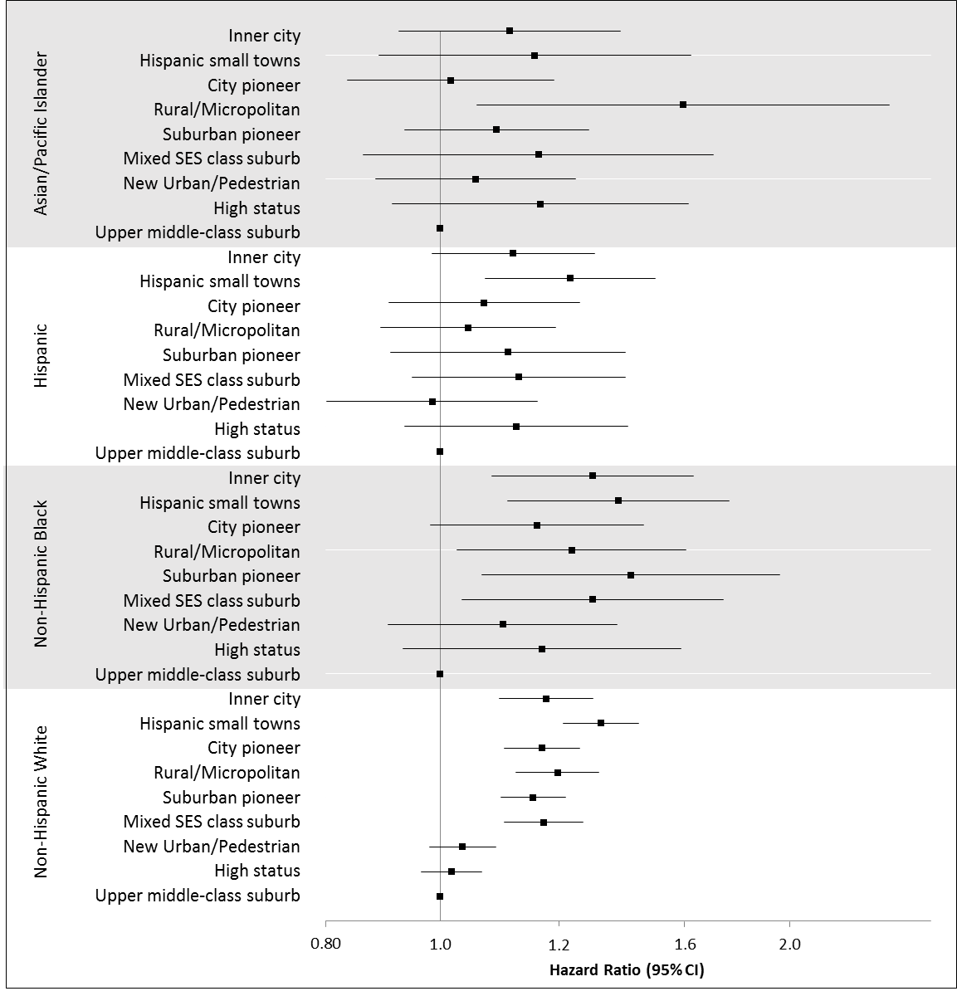
Prostate cancer survival
Prostate cancer-specific death
Less variation in effect size
Notes:
Expectedly have reduced power.
Also less variation in effect size. Among White cases, these two groups are distinguished in large part by nSES, with Hight Status and Upper-middle class neighbohroods having high SES
However, New Urban/Pedestian neighbohroods and Mixed SES class suburbs both have diversity in nSES, they are distinguished mostly by age and household composition, where New Urban/Pedestrian neighborhoods have more young singles and are situated in downtown areas.

Slide 24
Prostate cancer survival
Prostate cancer-specific death
Less variation in effect size
Notes:
However, New Urban/Pedestian neighbohroods and Mixed SES class suburbs both have diversity in nSES, they are distinguished mostly by age and household composition, where New Urban/Pedestrian neighborhoods have more young singles and are situated in downtown areas.

Slide 25
Key Findings
Identified neighborhood archetypes
Associated with mortality after prostate cancer diagnosis
Individual characteristics moderate associations of neighborhood archetypes with prostate cancer mortality
Notes:
Key Findings:
Identified 5-class and 9-class neighborhood archetypes using broad suite of social and built environment attributes at census tract and block group levels
Associated with mortality after prostate cancer diagnosis
vary by race/ethnicity

Slide 26
Next steps
Examine patterns across cancer sites
Incorporate additional neighborhood dimensions
Notes:
Next steps
Incorporate additional neighborhood dimensions
Further investigate potential explanations for these findings building on existing theories/hypotheses
structural risks associated with spatial concentration of disadvantage (e.g., accessibility of material resources, availability and type of commercial infrastructure)
racial/ethnic segregation and ethnic and immigrant enclaves (e.g., sociocultural protection and how and when that overlaps with concentrated socioeconomic disadvantage)
and importantly their inter-relationships in these archetypes

Slide 27
Acknowledgements
Salma Shariff-Marco (PI)
Margaret Weden (RAND Corporation)
Scarlett Lin Gomez
Juan Yang
Jennifer Jain

Slide 28
Thank you!
MDeRouen@psg.ucsf.edu
@MDeRouen4

