Slide 1
Lifetime risk of cancer among Alaska Native people
Sarah Nash, PhD MPH CPH
Cancer Surveillance Director
PI, Alaska Native Tumor Registry
June 13th, 2019
NAACCR/IARC Combined Meeting

Slide 2
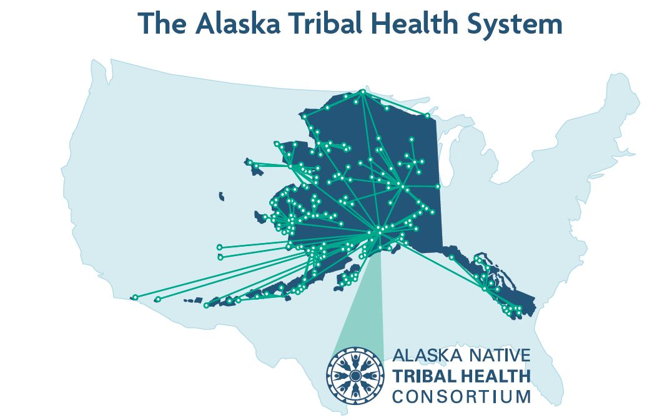
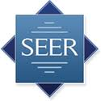
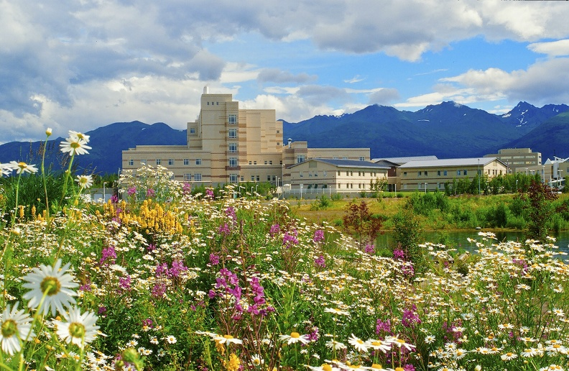
The Alaska Native Tumor Registry
Notes:
The Alaska Native Tumor Registry is a SEER special population registry, whose mission is to collect cancer surveillance data for all American Indian Alaska Native people living in the state of Alaska at the time of cancer diagnosis.
One of the other things that makes us a little different from some of the other SEER registries is that we are not located in a health department or academic center, but instead are housed at the Alaska Native Tribal Health Consortium (ANTC).
ANTHC is a consortium of 27 regional THOs. The Alaska Tribal Health System is operated by Alaska Native people for Alaska Native people, under compact from the IHS. Since our state is so large and varied, healthcare is managed by regional THOs, and then ANTHC is charged with management of statewide services. This includes cancer surveillance by the ANTR.
Because of this set up, community engagement is one of the key activities of ANTR. We spend a lot of time working with tribal health organisations, and responding to community data requests.

Slide 3
Cancer among Alaska Native people: morbidity
Years of Potential Life Lost among Alaska Native people,
2009-2013
Source: State of Alaska Bureau of Vital Statistics; Alaska Native EpiCenter Alaska Native Mortality Update 2009-2013
Notes:
These are some of the kinds of data that we share with our tribal health partners. So, just to give you a brief intro to cancer among AN people, it is a leading cause of morbiidity

Slide 4
Cancer among Alaska Native people: mortality
Between 2009-2013, cancer accounted for over 1/5 of all deaths among AN people
Source: State of Alaska Bureau of Vital Statistics; Alaska Native EpiCenter Alaska Native Mortality Update 2009-2013
Notes:
And the leading cause of mortality. Between 2009-2013, over 20% of all deaths among AN people were due to cancer.

Slide 5
Cancer incidence rates in Alaska, all sites, by race, 1996-2012
Data source: Alaska Cancer Registry

Slide 6
Cancer mortality rates in Alaska, by race, 1996-2012
Data source: Alaska Cancer Registry
Slide: Sarah Nash, Alaska Native Tumor Registry

Slide 7
A community request…
Notes:
Which brings us to the topic of today’s presentation. About a year ago, I received a phone call from one of our tribal health partners, who works for the THO representing interior Alaska. This THO is very active and interested in cancer prevention and control. We work very closely with their cancer program staff, and they invite us annual to participate in health fairs to share our data with community members, as well as to present to their clinicians on cancer-related topics. While they had seen such data as I just presented to you, they were interested to know the probability of an AN person developing cancer during their lifetime.

Slide 8
Lifetime Risk
How likely am I to get cancer during my lifetime?
Veritas Genetics
Prostate Cancer UK
Idaho Dept of Health and Welfare
Notes:
Lifetime risk is the probability that an individual will be diagnosed with a cancer during the course of his or her lifetime. Lifetime risk can show how common cancer is in a population, and is a useful metric for communicating cancer risk to the public. Here are just some lifetime risk infographics that I was able to pull from the internet…

Slide 9
Cancer risk is different between AN people and USW, other AIAN
Wiggins et al 2008
Carmack et al 2015
Notes:
Lifetime cancer statistics are not always reported for minority population groups, and have never been calculated for Alaska Native (AN) people. This is important because published USW statistics may not be relevant: we know that the pattern of cancer among AN people is markedly different than that observed among USW. In addition, while AIAN combined data are available on the SEER website, we know from other studies that incidence of many cancer sites differs markedly across Indian Country.

Slide 10
Methods
Incidence: Alaska Native Tumor Registry
Mortality: National Center for Health Statistics
Population: SEER Program
Analyses conducted using DevCan Software (NCI Surveillance Research Program)
Risk of developing or dying cancer for people born 2000-2016, by age 85 years
All sites, breast, colorectal, lung, kidney cancers
Notes:
The methods for this analysis were pretty simple. We combined incidence data from the ANTR, mortality data from the National Center for Health Statistics, and SEER population data. We We used the DevCan software (Surveillance Research Program, National Cancer Institute) to estimate lifetime risk of developing all cancers, and selected leading cancer sites, including breast, colorectal, lung, and kidney cancers, for AN people.

Slide 11
Lifetime risk of developing cancer
Cancer Site | Lifetime Risk
Lung and Bronchus | 1 in 12 | 8.6%
Colon and Rectum | 1 in 14 | 7.1%
Prostate (male) | 1 in 19 | 5.2%
Kidney and Renal Pelvis | 1 in 45 | 2.2%
Stomach | 1 in 47 | 2.1%

Slide 12
Lifetime risk of dying from cancer
Cancer Site | Lifetime Risk
Lung and Bronchus | 1 in 14 | 6.9%
Colon and Rectum | 1 in 32 | 3.1%
Prostate (male) | 1 in 70 | 1.4%
Stomach | 1 in 74 | 1.3%
Pancreas | 1 in 87 | 1.2%

Slide 13
Lifetime risk of developing cancer
Cancer Site | Lifetime Risk
Breast | 1 in 8 | 12.0%
Colon and Rectum | 1 in 12 | 8.5%
Lung and Bronchus | 1 in 13 | 7.7%
Kidney and Renal Pelvis | 1 in 64 | 1.6%
Corpus Uteri | 1 in 68 | 1.5%

Slide 14
Lifetime risk of dying from cancer
Cancer Site | Lifetime Risk
Lung and Bronchus | 1 in 18 | 5.5%
Colon and Rectum | 1 in 32 | 3.1%
Breast (female) | 1 in 40 | 2.5%
Pancreas | 1 in 88 | 1.1%
Stomach | 1 in 102 | 1.0%

Slide 15
How does this compare to USW?
Higher
Lung: 8.6% (AN) > 6.7% (USW)
CRC: 7.1% (AN) > 4.3% (USW)
Lower
Prostate: 10.8% (USW) > 5.2% (AN)
SEER Surveillance Research Program
Notes:
As expected, lifetime risk estimates varied compared to USW in similar patterns to incidence rates. Among males, lifetime risk of lung and CRC was higher among AN. Rates of CRC are 2.2 times higher among AN than USW< and rates of lung cancer 1.5 times higher. In contrast, lifetime risk of prostate cancer was lower, as incidence rates are twice as high among USW than they are among AN men.

Slide 16
How does this compare to USW?
Higher
CRC: 8.5% (AN) > 4.0% (USW)
Similar
Lung: 7.7% (AN) ~ 6.4% (USW)
Breast: 12.0% (AN) ~ 13.1% (USW)
SEER Surveillance Research Program

Slide 17
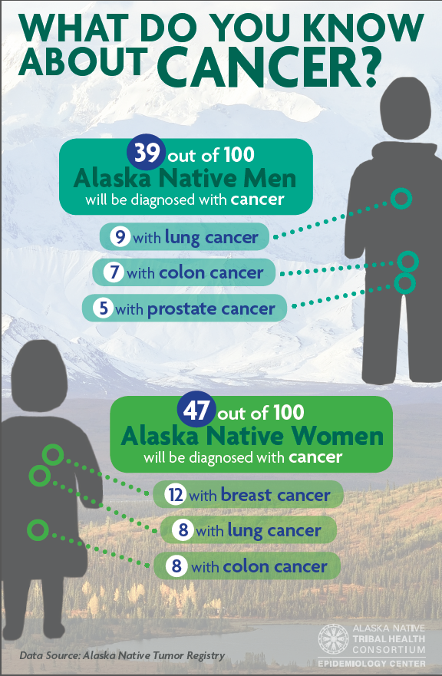
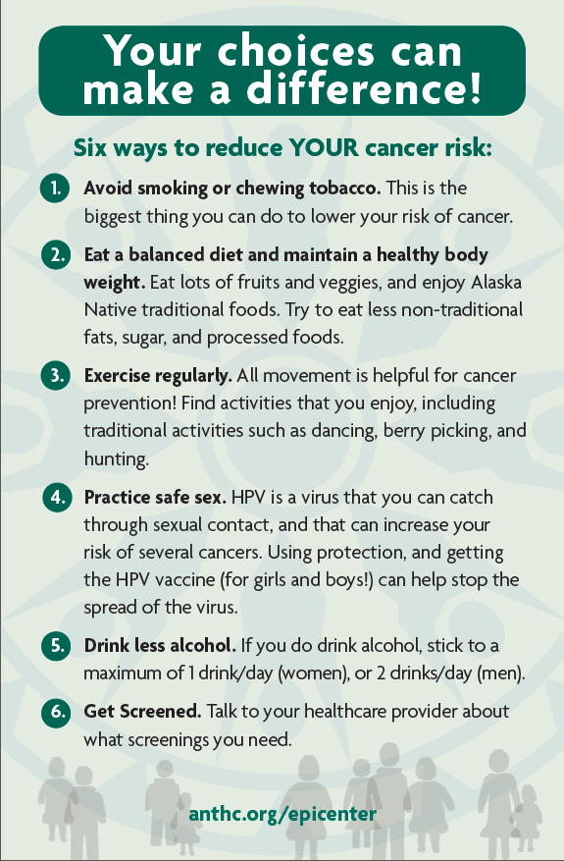
Taking the data back to the community

Slide 18
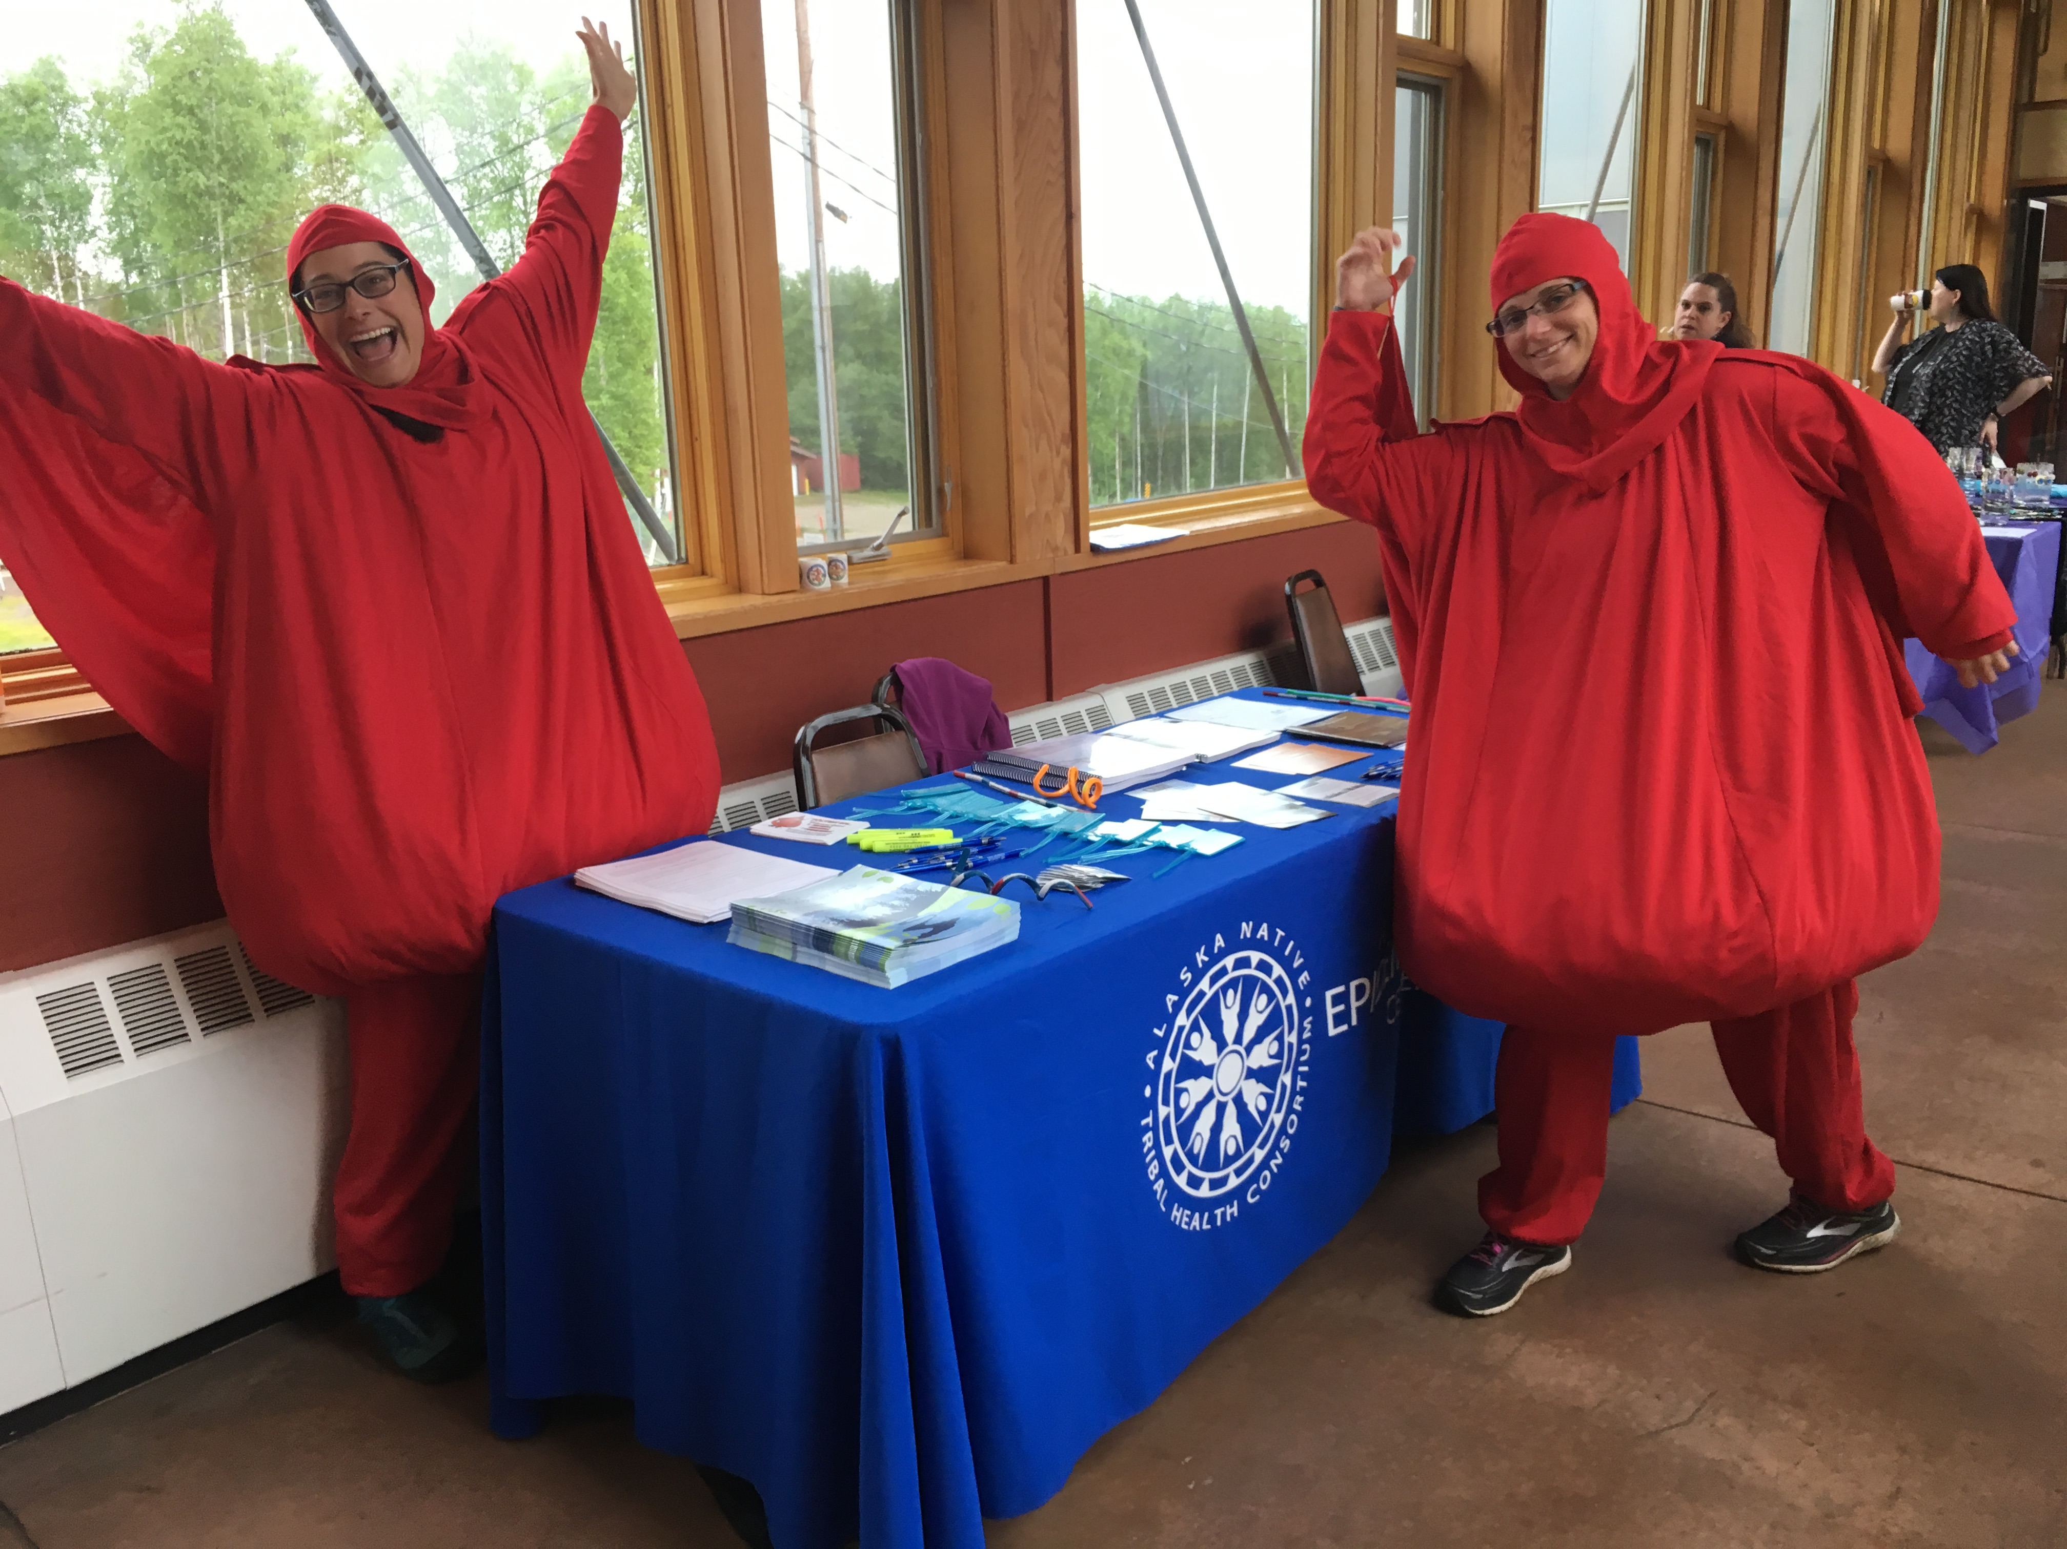
Taking the data back to the community

