Slide 1
Opportunities to Improve Place of Birth, Race, and Ethnicity with Electronic Birth Certificate Linkage
Valerie Yoder Otto
Utah Cancer Registry
Presentation for NAACCR / IACR annual conference, June 13, 2019
Acknowledgement:
Supported by the Centers for Disease Control and Prevention National Program of Cancer Registries under cooperative agreement NU58DP006320.

Slide 2
Background - Central cancer registry birthplace, race, and ethnicity variables
Monitoring cancer trends by race, ethnicity, and place of birth is important for understanding cancer disparities.
Birthplace, race and ethnicity information from hospitals may be incomplete or of unknown quality.
Notes:
Monitoring cancer trends by race, ethnicity, and place of birth is important for understanding cancer disparities. Cancer incidence in many primary sites differs by race, ethnicity, or place of birth, so we want to maintain good quality data for these items. But this information from hospitals or other sources may be incomplete or of unknown quality.

Slide 3
Background - Utah cancer registry birthplace variables
In 2017, Utah Cancer Registry had a large proportion of missing data for place of birth. Registry-wide, among reportable cases since 1973,
43% of cases were missing country of birth and
46% of cases were missing state of birth.
Death certificate was a major source of birthplace information.
Notes:
In 2017, we realized that over 40% of the reportable cases in Utah’s database were missing place of birth. Most of the information we did have came from death certificates and some from hospital abstracts, but clearly those sources were not meeting our needs.

Slide 4
Objective
To improve completeness and accuracy of cancer registry data on place of birth, race, and ethnicity through linkage to birth certificates.
Notes:
So we began a project to improve completeness of our data on place of birth, race, and Hispanic origin using birth certificates. We chose birth certificates because they contain all of the variables we were interested in, and lots of demographic information for matching. Utah Cancer Registry has been operating since 1966 and joined the SEER program in 1973, so we have to follow patients over a long period of time. If a patient died in the 1980’s and we didn’t get race or place of birth at that time, we’re not going to find it in modern data sources like electronic health records. In Utah, birth certificates are available in an electronic format back to about 1915, so we should be able to link the majority of our patients within that long time frame, as long as they were born in Utah or had a child in Utah.

Slide 5
Methods - Linkage
Established data sharing agreement with Utah Department of Health Office of Vital Statistics
Matched cancer cases to birth certificates through Utah Population Database (UPDB)
UPDB builds linkages across multiple health and vital statistics databases (supports hereditary cancer research and other research).
Shared resource of Huntsman Cancer Institute, an NCI-funded comprehensive cancer center.
Notes:
We initiated a data sharing agreement with the Utah Department of Health’s Office of Vital Statistics for birth certificate data. We took advantage of a unique data resource called the Utah Population Database at the Huntsman Cancer Institute in Utah. They link multiple databases such as drivers licenses, hospital discharge records, and vital records to maintain information on over 11 million individuals to support research in a variety of areas. We sent UPDB all of our reportable cancer case identifiers which they linked to individuals named as a parent or as a child on a Utah birth certificate. We performed quality control on the results and rejected less than 1% of their links.

Slide 6
Methods – Birth certificate variables available for linkage
Variable | Child Role | Parent Role
First and middle name | Y | Y
Current last name | Y | Y
Alias/Maiden name | Y | Y
Birth Date | Y | P
Social Security Number |  | P
Sex | Y | Y
Address |  | Y
Y – Yes
P - Partial; available for some years of birth
Notes:
We did not perform the linkage ourselves, but there are plenty of variables available on electronic birth certificates for registries to request for linkages with cancer patient identifiers. Other cancer registries may have more difficulty linking patients to their “Child” birth certificate without social security number, but since the Utah Population Database builds family pedigrees they were able to link Utah’s cancer patients to either role on a birth certificate.

Slide 7
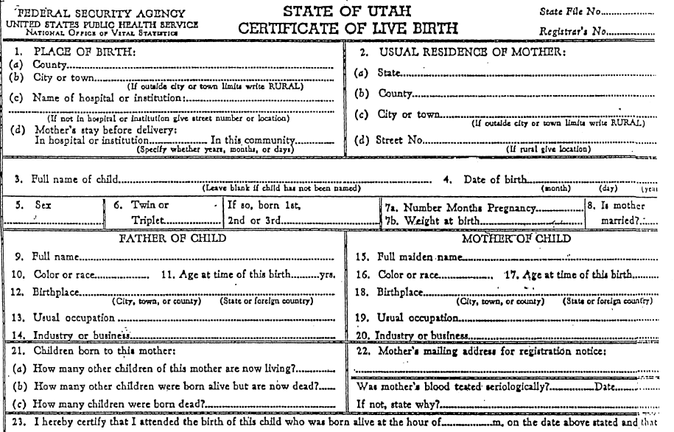
Methods - Utah birth certificate (example 1939-48)
Notes:
This is the birth certificate form used in Utah in the 1940’s. They asked for the parent’s “color or race”, did not ask for Hispanic origin, and did not specify whether the parents or a birth attendant should complete that part of the form. So it is unclear if that information is self-reported, which is generally considered the highest priority for determining race or Hispanic origin information

Slide 8
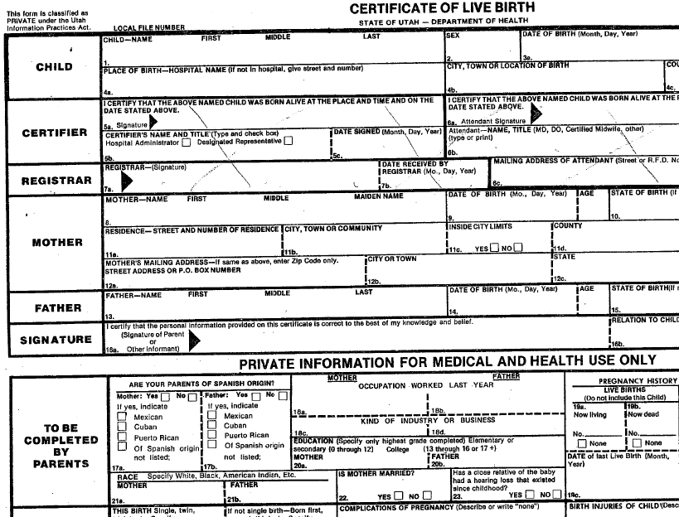
Methods - Utah birth certificate (example 1982-88)
Notes:
This is the birth certificate form used in Utah in the 1980’s. This form requests race and Hispanic origin, and does request that the parents fill out this section of the form.

Slide 9
Methods – Generating data items for cancer registry fields
Place of birth
Translated parent birth country text to country codes based on SEER coding rules
Summarized place of birth information from birth certificate and created crosstabs with prior known/unknown place of birth
Race and ethnicity
Translated parent birth certificate race and ethnicity text to race codes based on SEER coding rules and 2000 U.S. Census
Used cross tabs and kappa statistic to compare cancer registry information before linkage to information on birth certificate
Notes:
As you might have noticed on the forms, the fields for place of birth and race are free text. Checkboxes were eventually added for Hispanic origin, but that information may also be in the race free text. We created crosswalks to map the free text to coded variables and implemented rules to handle multiple birth certificates per person.
We determined the completeness of place of birth before and after the linkage.
We compared our registry’s race and ethnicity information with data from the birth certificates to evaluate agreement between the two sources.

Slide 10
Translating birth certificate race and ethnicity text to NAACCR variables - Examples
Birth Certificate Text | Race 1 | Race 2 | Spanish/Hispanic Origin
Spanish American Sp Am Spanish Am. Spanish-Amer. Irish-Spanish Spanish-Italian White(Spanish) White & Spanish | 01 White |  | 6 Spanish, NOS
Spanish & Japanese | 05 Japanese | 01 White | 6 Spanish, NOS
Utah | 99 Unknown
Ute Indian Indian-Ute Ute Ind Ute Ute Pueblo | 03 All indigenous populations of the Western hemisphere
American (White) Caucasion (Cau) White German Irish White-American | 01 White
Notes:
This is a small example of the variations in free text in the birth certificate race fields that we mapped to the NAACCR race and Hispanic origin codes. PAUSE As you can see, some very specific races and nationalities or different spellings are condensed into one code

Slide 11
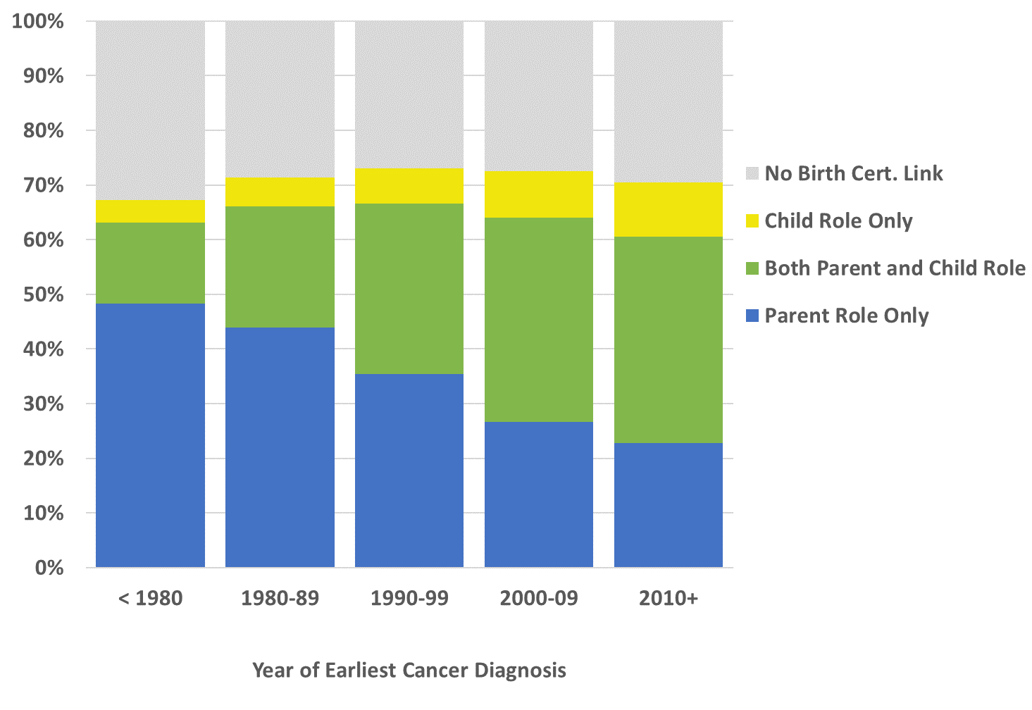
Cancer registry case linkage to birth certificates by year of diagnosis
n=19,368
n=36,858
n=53,767
n=74,265
n=64,986
Notes:
These are our linkage results by year of earliest cancer diagnosis and role on a birth certificate. Utah has nearly 250,000 patients in our database diagnosed with a reportable cancer from Utah’s SEER reference year of 1973 to 2016. 71.5% or just over 178,000 of those patients linked as a child and/or as a parent on at least one Utah birth certificate, and that linkage rate is pretty steady across all years of diagnosis in our registry database. We’re less likely to get a child role birth certificate on the patients diagnosed longer ago because they may have been born before 1915, when electronic birth certificates are available, but as we get to more recent cases we can get both roles.

Slide 12
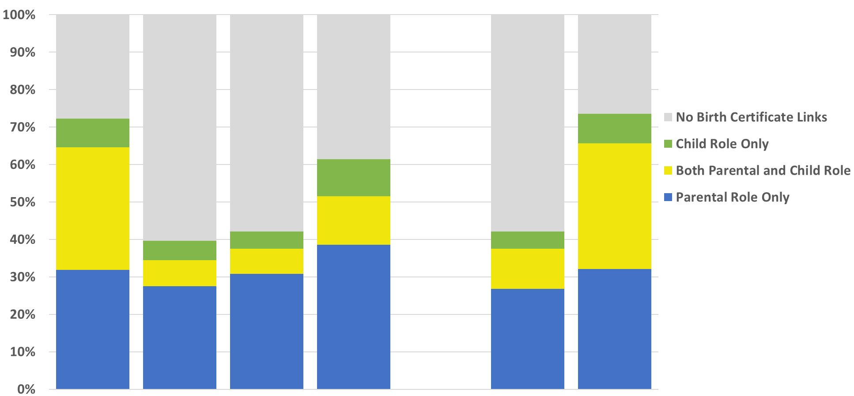
Cancer registry patient linkage to birth certificates by registry race and ethnicity
White
Black
Asian/Pacific Isl.
Amer. Ind./Alaska Nat.
Hispanic
Non-Hispanic
n=242,511
n=1,490
n=3,660
n=918
n=15,971
n=232,973
Race and Hispanic Origin
Notes:
These are the linkage results for our reportable cancer patients by race and ethnicity and role on a birth certificate; Utah is not a very diverse state but less than half of our Black, Hispanic, and Asian patients linked to any role on a birth certificate

Slide 13
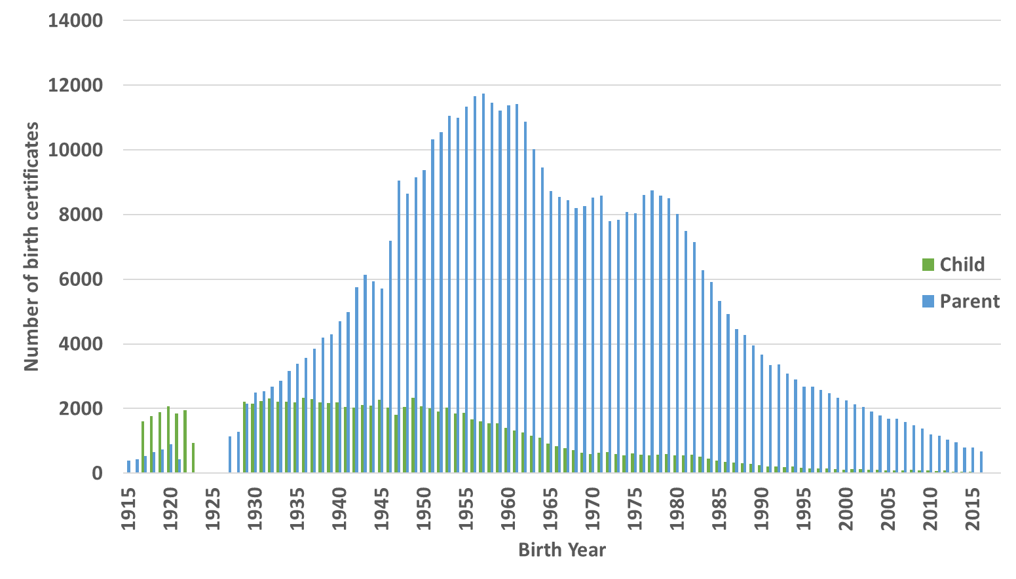
Results – Utah Cancer Registry patient linkage to electronic birth certificates
Notes:
For the patients who did link, this is the distribution of individual birth certificates they linked to by role and birth year. There were an average of 3.2 parent role birth certificates per patient. And because this was Utah with the highest birth rate in the United States, more than 10% of the patients were parents on more than 6 birth certificates.

Slide 14
Cancer registry place of birth variables and birth certificate linkage: new data and agreement
Registry place of birth before linkage |  |  | Total (n=248,944) |  | Not linked (n=70,833) |  | Linked as child (n=98,980) |  | Linked as parent only (n=79,131)
Country | State |  |  |  |  |  |  |  | Country = U.S. | Country = Non-U.S. | Country = Unknown
U.S. | Utah |  | 84,211 |  | 6,980 |  | 48,864 |  | 28,367 | 0 | 0
U.S. | Other state |  | 51,610 |  | 29,292 |  | 345 |  | 21,973 | 0 | 0
U.S. | Unknown |  | 558 |  | 219 |  | 233 |  | 106 | 0 | 0
Non-U.S. | NA |  | 6,788 |  | 4,246 |  | 47 |  | ~ | 2,494 | 0
Unknown | NA |  | 105,777 |  | 30,096 |  | 49,491 |  | 21,524 | 2,860 | 1,806
~ Counts suppressed for cell sizes fewer than five.
Agreement
Discordant
New Data
Notes:
We compared Utah Cancer Registry’s original place of birth to the new value from the linked birth certificates. CLICK We received a lot of new information on birth place from this linkage,
CLICK CLICK
2. And it also agreed well with our existing information,
CLICK CLICK
3. There were also very few discrepancies to resolve, but given how well birth place agrees with our existing data overall, we are inclined to prioritize the birth certificate’s information for the birth place variables

Slide 15
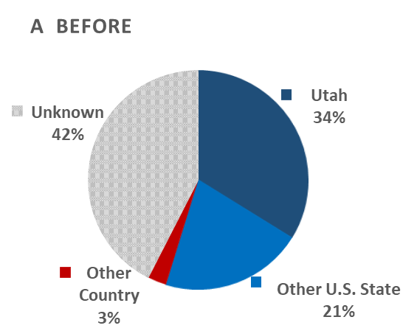
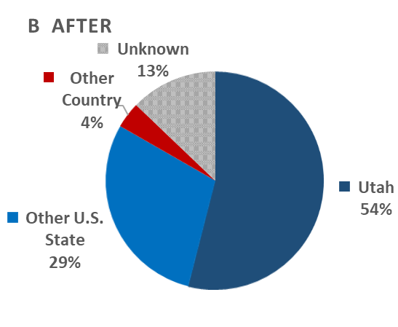
Utah Cancer Registry place of birth variables before and after birth certificate update
Notes:
We increased our known place of birth from 58% to 87% with fairly simple, straightforward logic and minimal manual reconciliation. CLICK There were few disagreements on birth place when one patient was a parent on multiple birth certificates, and little disagreement between the birth certificates and our registry’s data. This linkage was very successful for updating the state and country of birth variables in our cancer registry database.

Slide 16
Race and ethnicity of parents on Utah birth certificate form
Birth Certificate Form Year | Race/Ethnicity Fields | Race/Ethnicity Reported by
1905-1977 | Race or color | Not specified
1978-1991 | Race and ethnicity | Self-reported
1992-1996 | Race and ethnicity | Unknown
1997-2008 | Race and ethnicity | Attendant
2009-present | Race and ethnicity | Self-reported
Notes:
Then we moved on to the more complex race variables. Some birth certificate forms indicate race should be self-reported by a parent, but on others it was unclear or specified that a birth attendant should complete that section. There were also disagreements on race when one patient was a parent on multiple birth certificates, or one birth certificate may have had ethnicity while another did not. So we had to program more complex logic to pick the best birth certificate by reporter or aggregate multiple birth certificates to derive a more complete or specific race and Hispanic origin while adhering to SEER coding rules. And finally Utah’s birth certificates don’t have a field for a Child’s race, so if you want to consider patients who only have a Child role birth certificate, you would have to consider the race of both parents.

Slide 17
Birth certificate race or Hispanic origin for individuals linked as parents and previously unknown race or ethnicity
Birth Certificate Race | n
White | 278
Black | 0
Amer. Ind. / Alaska Nat. | 0
Asian or Pacific Isl. | 6
Other | ~
Unknown | ~
~ Counts suppressed for cell sizes fewer than five
Hispanic Origin | n
Hispanic | 12
Non-Hispanic | 650
Unknown | ~
Notes:
We already had fairly good completeness on our registry’s race and ethnicity variables, but we did use the birth certificates to update race CLICK on almost 300 of our previously unknown patients and Hispanic origin on over 650 patients.

Slide 18
Agreement between cancer registry race and parent race from birth certificate
 | Cancer Registry Race Variable
Birth Certificate Race | White | Black | Amer. Ind. or Alaska Nat. | Asian or Pacific Isl. | Other | Total
White | 155,312 | 84 | 82 | 164 | 32 | 155,674
Black | 100 | 415 | 2 | 2 | 0 | 519
Amer. Ind. / Alaska Nat. | 197 | 2 | 381 | 8 | 1 | 589
Asian or Pacific Isl. | 333 | 7 | 4 | 1,170 | 13 | 1,527
Other | 242 | 1 | 2 | 19 | 5 | 269
Total | 156,184 | 509 | 471 | 1,363 | 51 | 158,578
Observed agreement | 0.992
Agreement
Expected agreement | 0.967
Discordant
Kappa | 0.753
Notes:
Then we calculated agreement between our existing race values and the value derived from the linked birth certificates. Utah is not very diverse, so visually agreement looks OK in the table because there is such a large white population. CLICK And the statistics look like acceptable agreement between the two sources. CLICK CLICK However, the proportion of disagreements in non-White races is concerning. For example, of the 613 patients classified as Black by either source, only 68% agree.

Slide 19
Agreement between cancer registry Hispanic origin and parent ethnicity from birth certificate
 | Cancer Registry Hispanic Origin Variable
Birth Certificate Ethnicity | Hispanic | Non-Hispanic | Total
Hispanic | 2,113 | 745 | 2,858
Non-Hispanic | 664 | 51,735 | 52,399
Total | 2,777 | 52,480 | 55,257
Observed agreement | 0.975
Expected agreement | 0.903
Kappa | 0.737
Agreement
Discordant
Notes:
We also calculated agreement between Hispanic origin from the birth certificates and our existing data. CLICK And the statistics look like acceptable agreement between the two sources. CLICK CLICK However, again there is a concerning proportion of discordant data between our registry’s Hispanic origin variable and the value derived from the birth certificates.

Slide 20
Registry variables potentially “fillable” from Utah birth certificate
Registry Variable | Data Quality Standard or Indicator? | Available from Birth Certificate?
 |  | Child | Parent
Birthplace State & Country | CDC | Y | Y
Race | CDC, NAACCR | D | Y
Hispanic Origin | CDC | D | P
Birth Date |  | Y | P
Age | CDC, NAACCR | Y | Y
Sex | CDC | Y | Y
Date of Last Contact | CDC, SEER |  | Y
Name |  | Y | Y
Social Security Number |  |  | Y
Current address |  |  | Y
Y - Yes D - Derived from parents P - Partial; available for some years of birth
Notes:
In addition to place of birth and ethnicity, we also plan to use birth certificate information to update some other registry demographic variables such as maiden names and current addresses. We also have partially unknown dates of birth that could be improved. PAUSE

Slide 21
Summary
Place of birth
Electronic birth certificate data has tremendous value added for place of birth for central registries.
Linkage as a parent proved to be a big contributing factor.
Linkage
Utah Cancer Registry used a multi-database research resource for linkage. Other registries may have less information for linkage.
Notes:
Linking to birth certificates was overall very successful for the Utah Cancer Registry. Now that we have developed code to handle this data source, we can operationalize the process and we plan to repeat this linkage regularly. CLICK We recommend other cancer registries contact your vital records office to investigate this data source if you have holes in these demographic items. We had the Utah Population Database perform the linkage which gave us an advantage in time and coverage of the linkage, especially for linking Child role birth certificates. However, we found the Parent role birth certificates more valuable because they contain more demographic data items. And there is enough demographic information available on a birth certificate to perform this linkage internally at a cancer registry.

Slide 22
How should cancer registries use data items from birth certificate?
Easy answer if data item is previously missing or unknown. Fill from birth certificate.
What if the data item is already filled in cancer registry data, but information from birth certificate disagrees?
The central registry should to set up rules or algorithms on when to replace
A key question is whether to treat birth certificate race and ethnicity as self-reported
Be cautious proposing to review all discrepancies
Notes:
So, what do you do if your registry gets birth certificates? Start with the easy win and use them to fill in unknown data. Develop good logic and rules to minimize making decisions on each individual’s linked set of birth certificates. You also need to consider how to weight birth certificates against your other data sources and if that should vary by data item. For example, in Utah we know certain years of the birth certificate form indicate that race should be self-reported, and SEER coding rules for race list self-declared identification as the highest priority source. So if the birth certificate form in a particular year asked the parent to fill it out, we should update our database with that value. But some of the disagreements concerned us, so we may need to consider other approaches like looking into how race categories changed over time, apply old coding rules, or compare our registry’s race values by original source against the birth certificate value. We’re still developing our plan.

Slide 23
Acknowledgements
Utah Cancer Registry staff who contributed to this project:
Carol Sweeney PhD, Carrie Bateman BS, Judy Ou PhD, Mandy Giles BS, SuAnn McFadden CTR , Marjorie Carter MSPH
Utah Department of Health, Vital Statistics Bureau
Richard Oborn MPA
This work was supported by the Centers for Disease Control and Prevention National Program of Cancer Registries under cooperative agreement NU58DP006320.
The Utah Cancer Registry is also supported in part by:
NCI Surveillance, Epidemiology, and End Results Program Contract No. HHSN261201800016I
University of Utah Health
Huntsman Cancer Institute
Notes:
This project had great benefits for Utah and we hope other cancer registries consider birth certificates as a data source. PAUSE Are there any questions?

