Slide 1
Excess Hazard in the Belgian Cancer Population
Geert Silversmit
IACR2019, Vancouver
Geert Silversmit, BCR, 2019/06/12

Slide 2
Outline
Excess hazard
Method used and illustration
Results
Conclusion

Slide 3
Excess hazard (EH)
Observed/Overall Survival important cancer measure
Cancer patients have additional death hazard due to disease, compared to cancer-free persons
Total death hazard is sum of
Background hazard (as experienced by the “general population”), λ₀, and
the excess hazard due to having the cancer, λ_{e}.
λ = λ₀ + λ_{e}

Slide 4
Estimating excess hazard (EH)
For population-based studies: mostly Relative Survival approaches
BCR uses actuarial approach with Ederer II matching → step function for EH
Goal: model EH as a continuous function of time and age
Method applied: Remontet et al (Stat in Medicine, 2007) Implemented in the R function flexrsurv()
Additive total hazard
Notes:
BCR uses actuarial approach with Ederer II matching to the general population, age and time categorised in broad intervals.

Slide 5
Estimating excess hazard (EH)
Method applied: Remontet et al (Stat in Medicine, 2007) Implemented in the R function flexrsurv()
On the log(λ_{e}) scale
Splines to model time and age as continuous functions
Non-linearity (NL) and non-proportionality (NPH) can be considered
A cascade of LRT can be used to decide on NL and NPH for age
Remontet et al. advice time knots at 1 and 5 year and age knot at mean age. → for descriptive purposes optimised knot positions
Notes:
BCR uses actuarial approach with Ederer II matching to the general population, age and time categorised in broad intervals.

Slide 6
Data
Belgian Cancer Registry
Incidence period 2004-2016
Belgian residents
Vital status at 1 July 2018
Censored at 12 years of FU, too large SE
Cancer sites:
Pancreas (N=18,440)
Oesophagus (N=17,242)
Colorectal (N= 104,935)
Lung (N= 99,296)
Female Breast (N= 132,451)

Slide 7
Illustration
On Pancreatic cancer
Step function to explore, without age
Baseline λ_{e}(t) function:
Optimise time knot(s) all ages combined
Within 3 broad age groups
Decide on common set time knot(s)
Add continuous age:
Optimise age knot
Final fit
Compare weighted predicted curves with step function

Slide 8
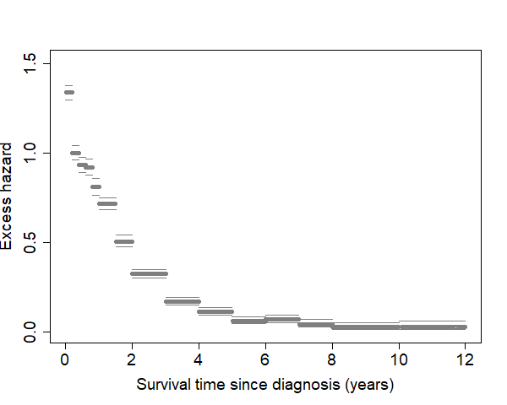
Pancreas – all ages, step function

Slide 9
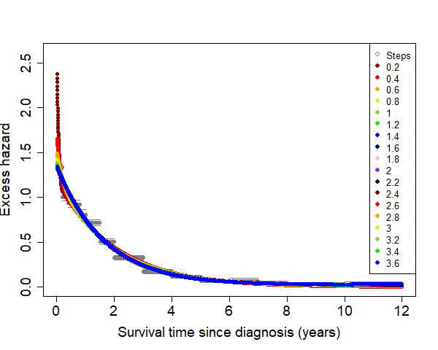
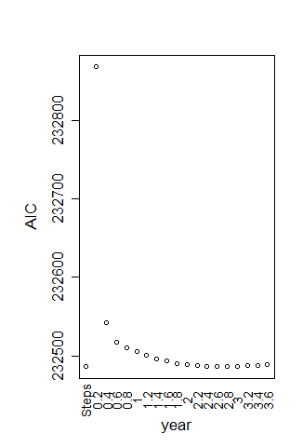
Pancreas – all ages, optimise time knot

Slide 10
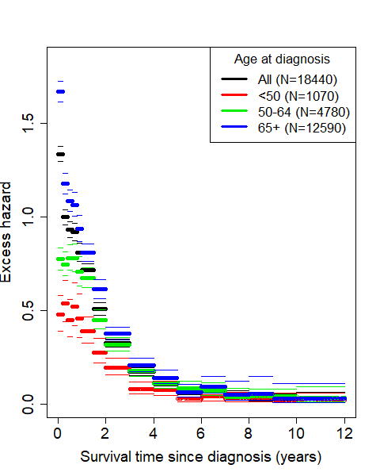
Pancreas – optimal time knot position
All ages: 2.6 year
≤49 years: 1.2 year
50-64 years: 1.4 year
65+ years: >1.2 year
→ picked 1.2 year

Slide 11
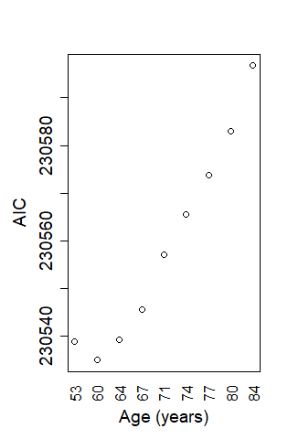
Pancreas – optimal age knot
Trying out deciles of the age at diagnosis distribution
Optimal: 60 years

Slide 12
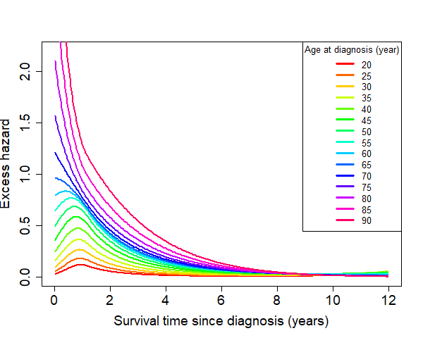
Pancreas – final results
Calculate predicted EH curves per age value

Slide 13
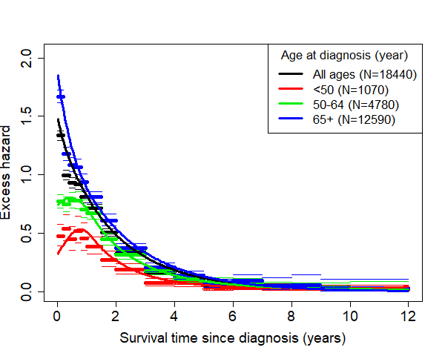
Pancreas – final results
Weighted predicted age curves, compared to step function for broad age groups

Slide 14
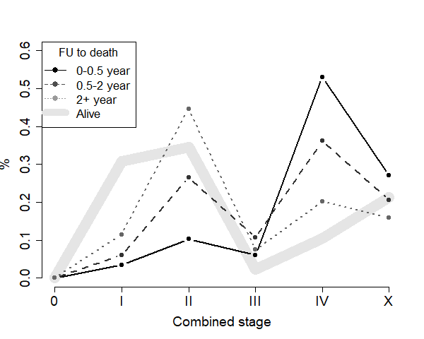
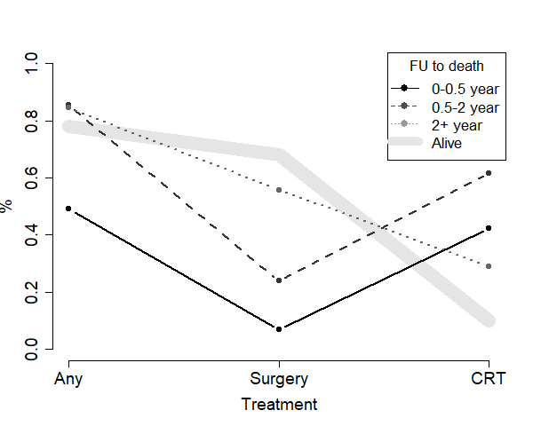
Pancreas – final results
Age at diagnosis
q1
med
q3
66
75
81
61
69
77
58
66
74
53
63
70

Slide 15
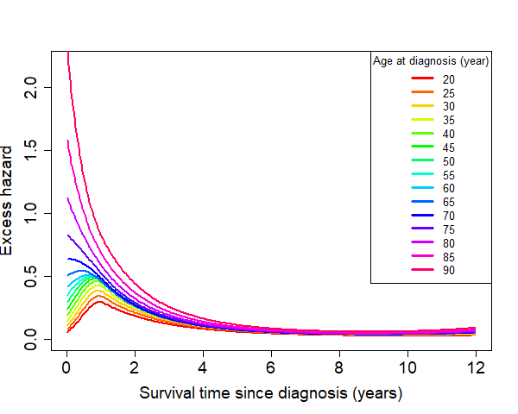
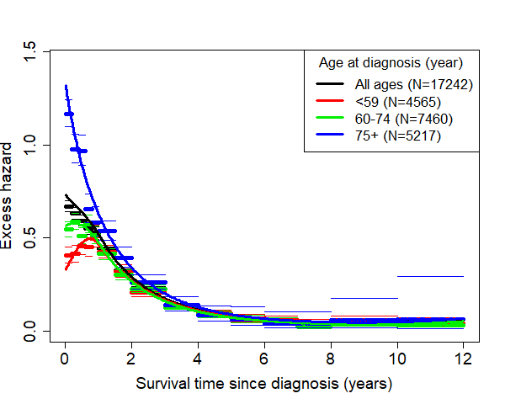
Oesophagus
1 time knot: 1.1 year
age knot: 57 year

Slide 16
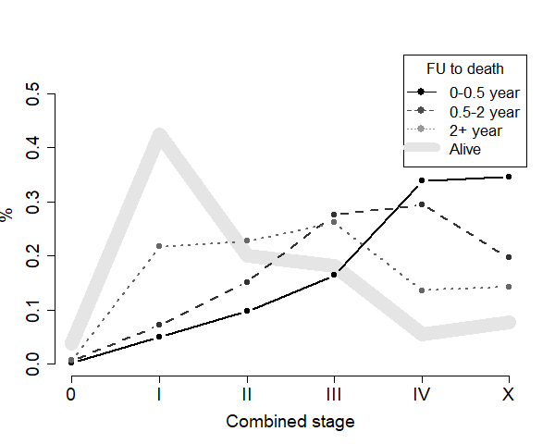
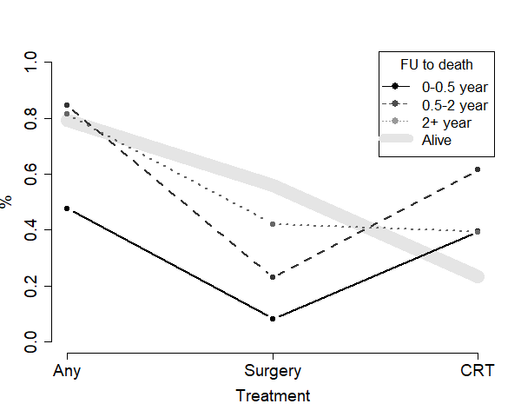
Oesophagus
Age at diagnosis
q1
med
q3
63
73
81
59
67
76
58
66
74
57
63
70

Slide 17
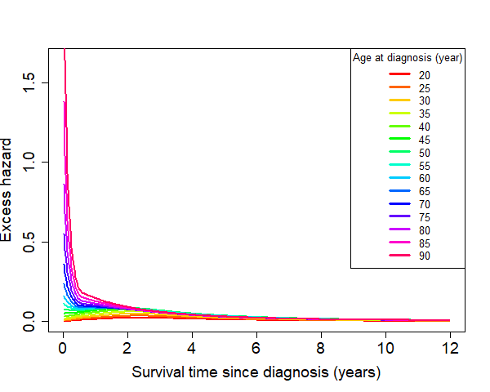
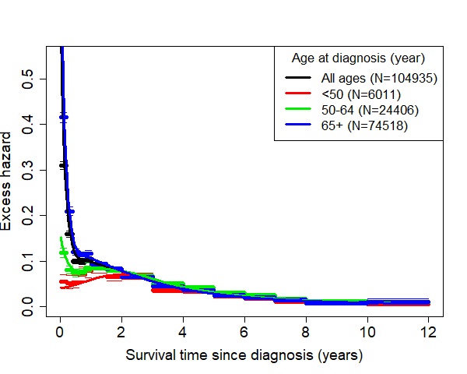
Colorectal
2 time knots: 0.6 & 3.0 year
age knot: 54 year

Slide 18
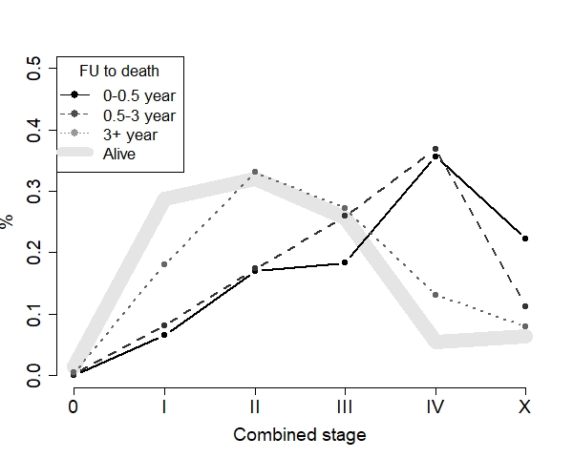
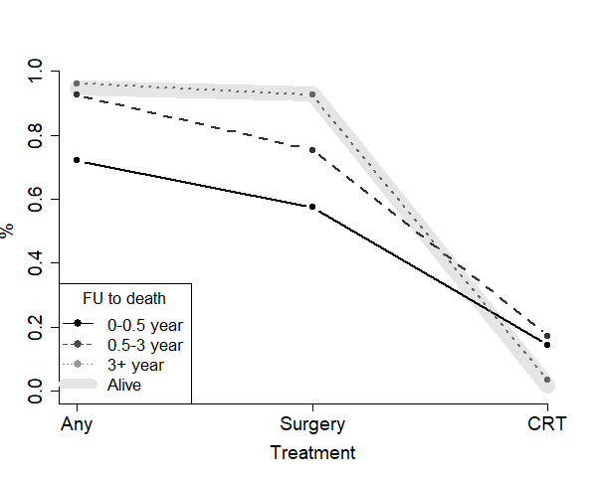
Colorectal
Age at diagnosis
q1
med
q3
73
80
85
66
75
82
67
75
81
59
67
75

Slide 19
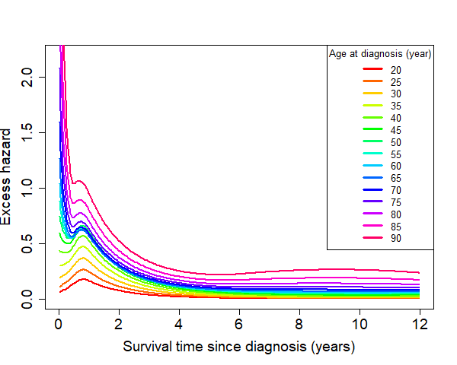
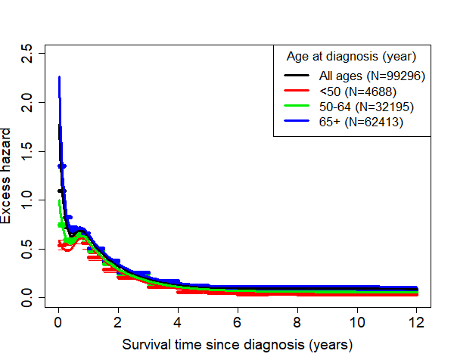
Lung
3 time knots: 0.5, 1.0 & 6.0 year
age knot: 54 year
2010-2016

Slide 20
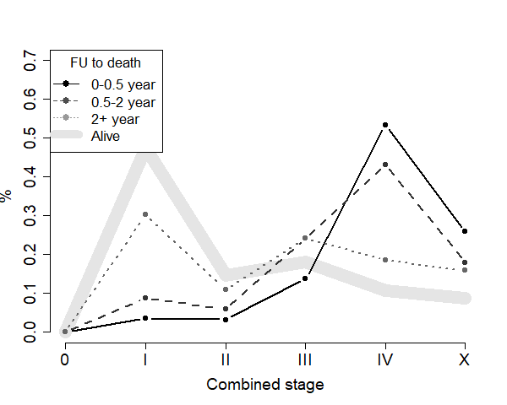
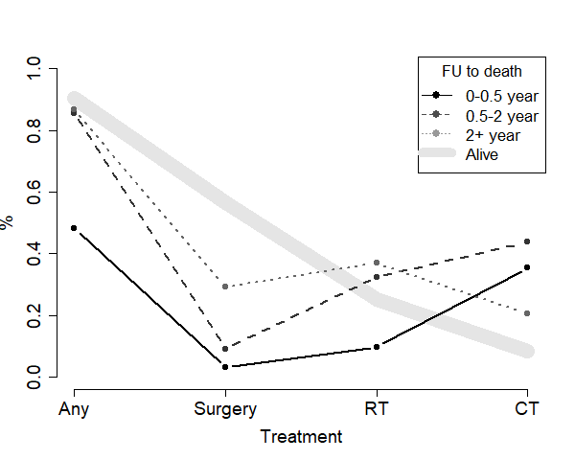
Lung
Age at diagnosis
q1
med
q3
63
72
79
60
68
75
60
68
75
57
64
71

Slide 21
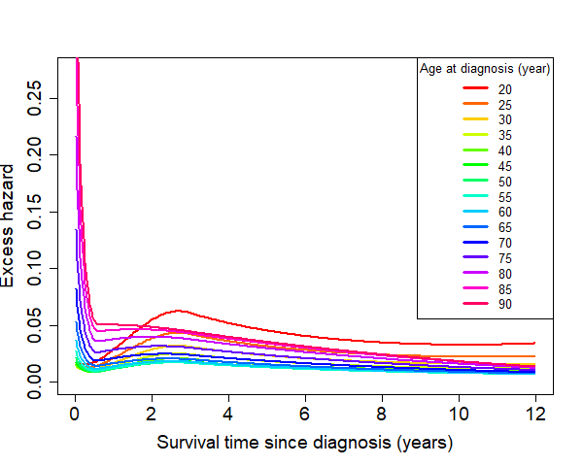
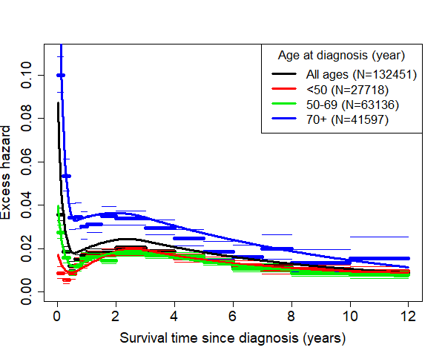
Breast
2 time knots: 0.6 & 3.0 year
age knot: 75 year
2004-2014

Slide 22
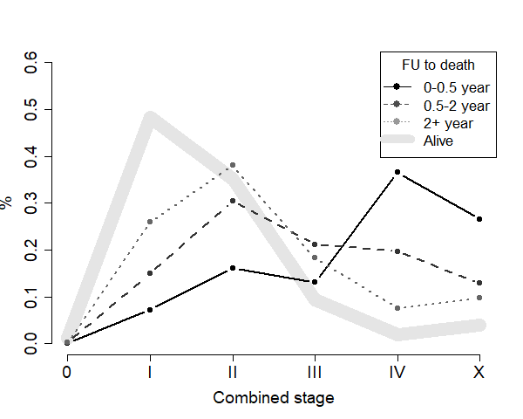
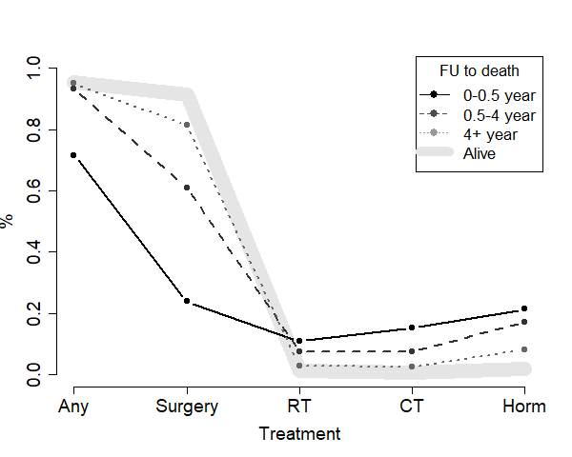
Breast
Age at diagnosis
q1
med
q3
69
79
85
62
75
83
59
72
80
50
59
68

Slide 23
Wrap up
Excess hazard as function of survival time and age
Higher EH for older patients
EH high first half year since diagnosis, decreases with time
Early deaths (<0.5 yrs):
higher fractions of advanced stage
Less treatments with curative intent
Long survivors (>2 yrs):
Staging and treatment distribution close to patients still alive

Slide 24
The end

Slide 25
Splines
Data range split in k intervals
Polynomial fit of degree l in each interval
Constrains at the knot to make function smooth, up to (l-1)^{th} derivative order
Example 1 knot at t₁, degree 2
Continuity in t₁: θ₀=0
Continuity 1st derivative in t₁: θ₁=0

Slide 26
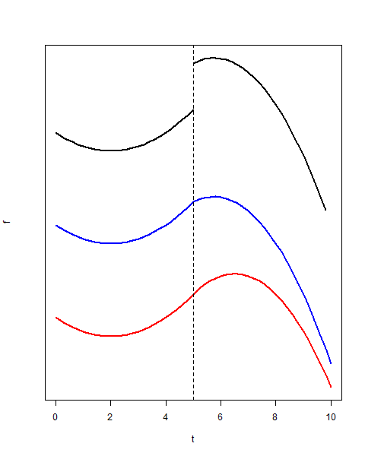
Splines
order 2
knot at t=5
black: no constraints
blue: continuity
red: 1st derivative

