Slide 1

Population Based Cancer Registry Survival Data argue for Subdivision of TNM Stage III Prostate Cancer and Merging cT2-Subcategories
NAACR- IACR, Combined Annual Conference June 9 – 13, 2019
Dr. Liesbet van Eycken

Slide 2



Background
Material & Methods
Results
Conclusion
Overview

Slide 3

Background
Why do we stage cancer?
  To aid in the planning of treatment
  To give some indication of prognosis
  To assist in evaluation of the results of treatment
  To facilitate the exchange of information and aid research
  To contribute to research
  To support cancer control activities
TNM classification:
  Maintain stability of classification over time
  Modifications based on new data on prognosis
UICC TNM Classification of Malignant Tumours, 8th edition, 2016
Eds. James D. Brierley, Mary K Gospodarowicz, Christian Wittekind
Notes:
Lancet referentie TNM

Slide 4
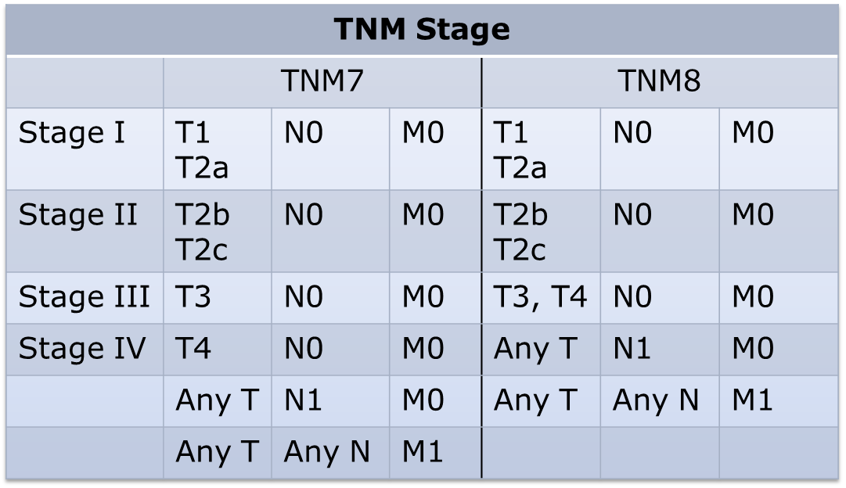
Background
TNM classification prostate cancer: changes 7th => 8th edition
  Pathological T2-category no longer subdivided in:
    pT2a: involves < one half of one lobe
    pT2b: involves > one half of one lobe
    pT2c: involves both lobes
  Clinical T2-category stays T2a, T2b and T2c
  T4N0M0 classified as stage III ⬄ stage IV in 7th edition

Slide 5
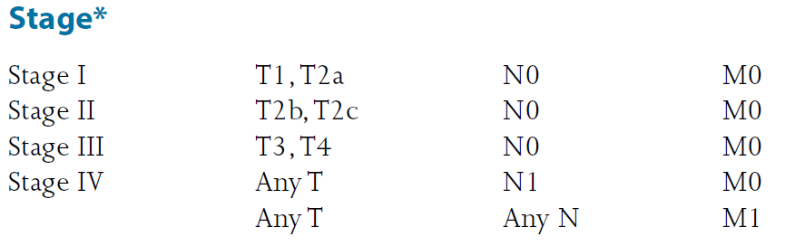
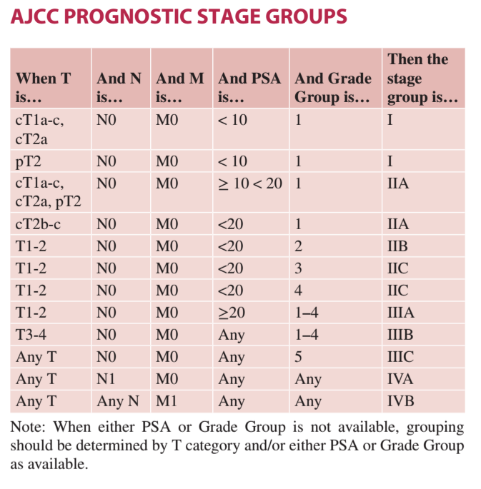
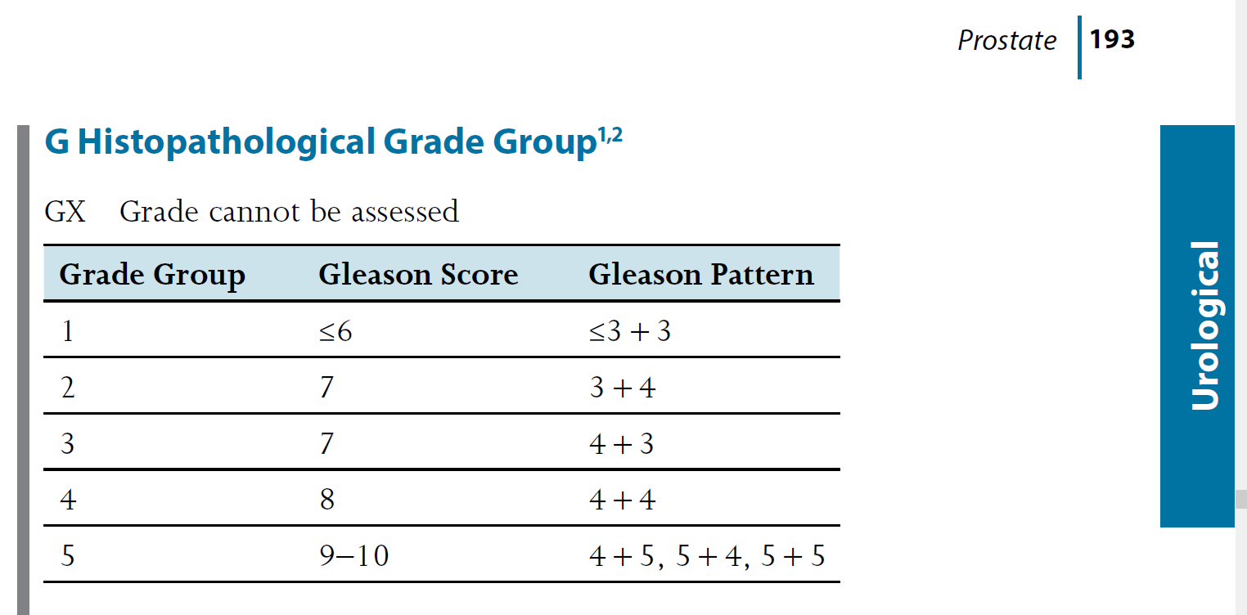
Background
UICC TNM 8th edition adopts histopathological grade groups (ISUP) and defines Stages I-IV
AJCC TNM 8th edition incorporates PSA and Grade Group in Prognostic Group (no ‘Stage’ available)
3+5 5+3

Slide 6
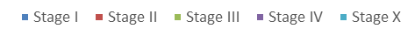
Material & Methods
All prostate cancers- 2004-2016: N=114,548
2004-2009 = TNM 6th edition
2010-2016 = TNM 7th edition

Slide 7
Material & Methods
Prostate cancer, 2004-2016: N=114,548
  T-category known & N0M0:
  c/pN1 or c/pM1:
 | T1-4 N0M0
Clinical | cT1 | 29,176
 | cT2 | 26,392
 | cT3 | 7,006
 | cT4 | 775
Pathological | pT2 | 26,963
 | pT3 | 11,240
 | pT4 | 413
 | anyT N1 M0 | anyT anyN M1
Clinical | 1,911 | 5,178
Pathological | 1,962 | 579
Notes:
70.438/114.548 = bekende cTNM

Slide 8
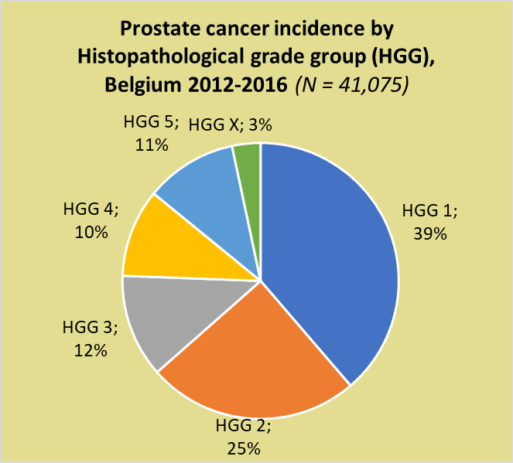
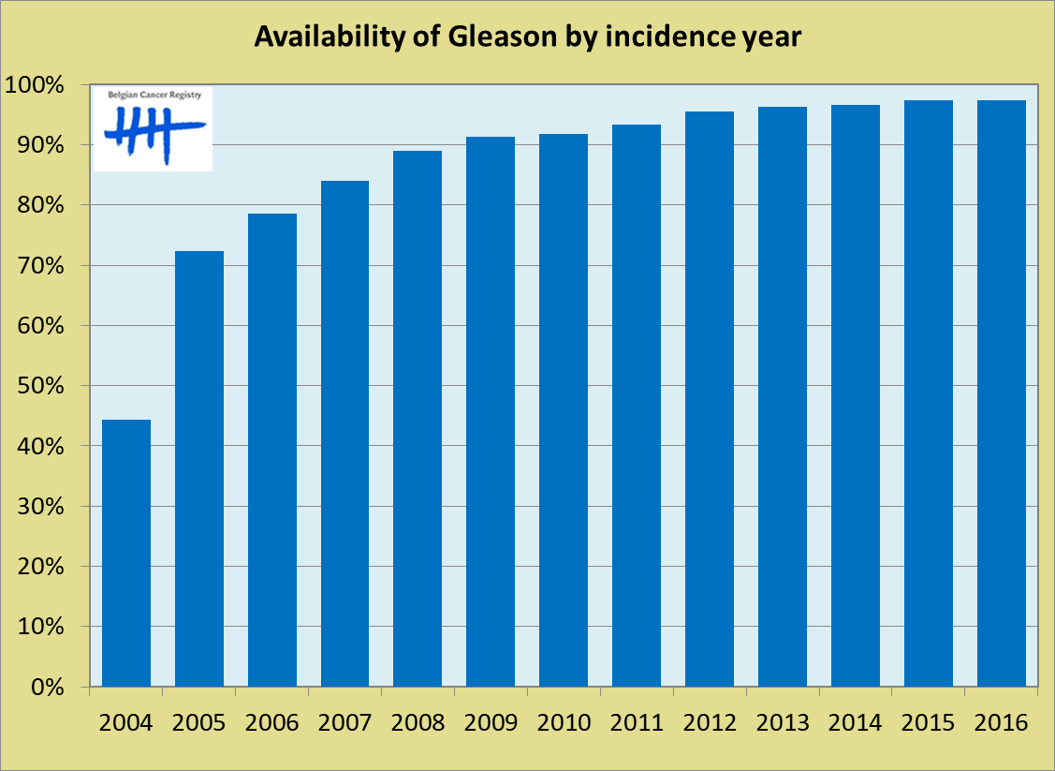
Material & Methods
2004-2016: 113,706 prostate cancer (microscopically verified)
Gleason score derived from pathology protocols with machine learning techniques
  2004-2016: 86% of information on Gleason available
  Since 2012: >95% availability => 2016: 97.4%

Slide 9
Background
Can population based survival data validate modifications in TNM classification?
Analyses:
  Relative Survival ~ stage TNM was calculated using Ederer II-method
  Independent RS estimates were compared with a 2-sided Z-test on the difference

Slide 10
1. Should we reconsider stage III in TNM8?
TNM Stage
 | TNM7 |  |  | TNM8
Stage I | T1 T2a | N0 | M0 | T1 T2a | N0 | M0
Stage II | T2b T2c | N0 | M0 | T2b T2c | N0 | M0
Stage III | T3 | N0 | M0 | T3, T4 | N0 | M0
Stage IV | T4 | N0 | M0 | Any T | N1 | M0
 | Any T | N1 | M0 | Any T | Any N | M1
 | Any T | Any N | M1

Slide 11
1. Results: reconsider stage III in UICC TNM8?
pT2N0M0
pT3N0M0
pN1M0
pT4N0M0
M1
Stage III
Stage IV

Slide 12
1. Should we reconsider stage III in TNM8?
Relative survival data pT3N0M0 and pT4N0M0
  T3N0M0 prognostically ~ T2N0M0 (10yRS 100%)
    re-classify T3N0M0 as stage II?
  T4N0M0 prognostically ~ pN1M0 (p=0.013)
    re-classify T4N0M0 as stage IV?
    or…re-define stage III: T4N0M0, AnyT N1M0?
    And keep M1 as Stage IV
Stage II
Stage III
Stage IV
Notes:
pT3N0M0 en pT2N0M0 beiden 10y RS 100%
pT4N0M0 vs pN1 wel significant verschillende groepen (p=0,013), maar toch nog grote gap met M1, daarom eerder logisch pT4N0M0 en pN1 samen te beschouwen dan pN1 en M1…

Slide 13
Grade group
 | Grade group | 5-year rel. survival | 10-year rel. survival
pT2N0M0 | 1-3 | >100% | >100%
 | 4 | >100% | >100%
 | 5 | 92% | 88%
pT3N0M0 | 1-3 | >100% | >100%
 | 4 | >100% | 94%
 | 5 | 90% | 78%
pT4N0M0 | 1-3 | 93% | 93%
 | 4 | 71% | 57%
 | 5 | 55% | 39%

Slide 14

2. Could clinical T2-category be collapsed as well?
Confirmation of collaps pT2-category based on Belgian survival data
N=26,963
N=4757
N=2049
N=18,253
p=0.054
p=0.203
p<0.001
Notes:
pT2(NOS) N0M0 niet weergegeven: N 1904 pts;10y-RS 99%
Z-test voor 2 onafhankelijke RS observaties gaf geen significant verschil tss pT2a-pT2b (p=0,0537) noch tss pT2b-pT2c (p=0,2), maar wel tss pT2a-pT2c (p<0,0001)

Slide 15
2. Is it favorable to collaps clinical T2-category as well?
Should we consider collapsing cT2-category as well?
N=26,392
N=6831
N=2611
N=5738
p=0.018
p=1
p<0.001
Notes:
cT2(NOS) N0M0 niet weergegeven: N 11,212 pts;10y-RS 104%
Z-test voor 2 onafhankelijke RS observaties gaf geen significant verschil tss cT2b-cT2c (p=1), maar wel tss cT2a-cT2c (p<0,0001) en cT2a-cT2b (p=0,01839)

Slide 16
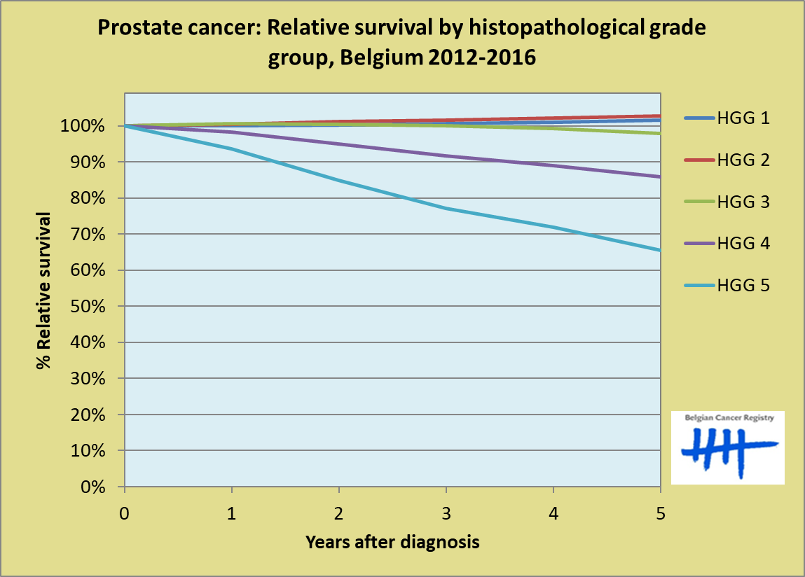
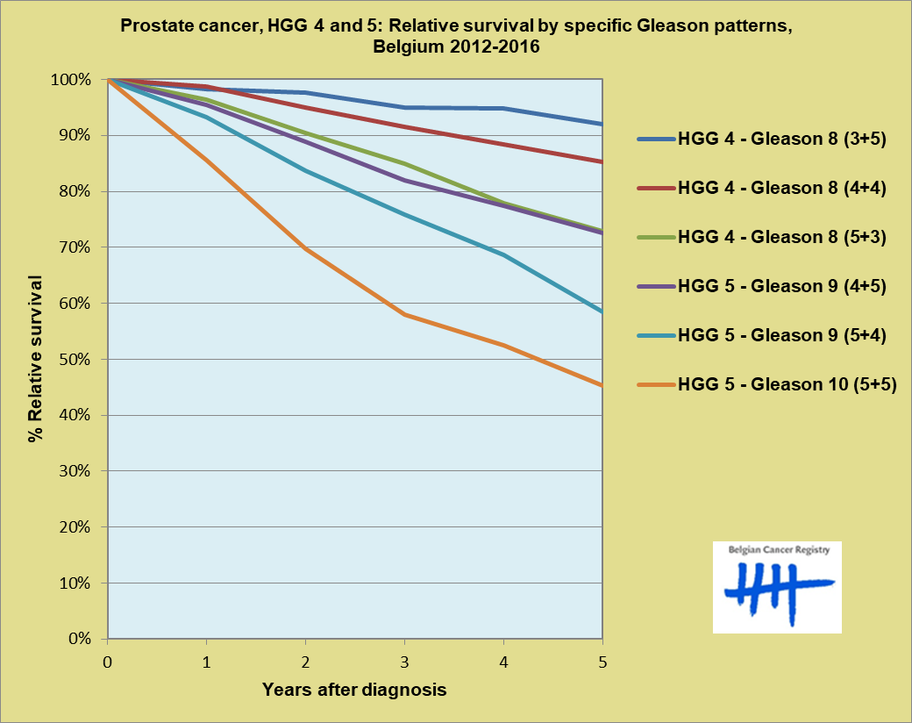
Results
, 3+5, 5+3
UICC TNM 8th edition (p 193)

Slide 17

Discussion

Slide 18
CONCLUSION
Population based data can help to evaluate changes in TNM
  Collapse pT2
  Collapse cT2 suggested
  Heterogeneity to be taken into account
T3N0M0 –T4N0M0 should be reclassified into different stages
Histopathological grade group defines best the prognostic categories
  => Integrate TNM and Grade again in stage?

Slide 19









































Thank you for your attention!
Thank you Jim Brierley
2018
2017
2016
2015
2014
2013
2012
2011
2010
2008
2007
2006
2005

Slide 20
3. Should we reconsider T1 and stage I?
Translating TNM categories to stage groups: no pathological T1/T2a-category
  stage I T1/2aN0M0 refer to clinical T1/2a
  clinical T1N0M0 is a heterogeneous group
→ stage group I does not adequately represent prognostic outcome of the selected (heterogeneous) population

Slide 21
3. Should we reconsider T1 and stage I?
Inter-operator variability of interpretation
  Clinically inapparent ↔ not palpable
  Emerging role of imaging in clinical staging of PC
T1-category represents a very heterogeneous group of PC
N=29,176
N=4897
N=2228
N=18,019
p<0.001
p<0.001
p<0.001
Notes:
cT1(NOS) N0M0 niet weergegeven: N 4032 pts;10y-RS 104%

Slide 22
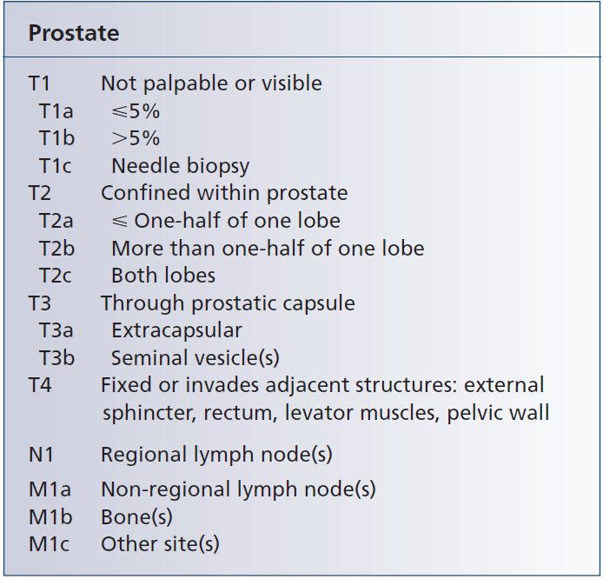
TNM 7th edition

