Slide 1
Neoadjuvant Treatment Results – Only Part of the Story, The Missing Piece
Donna M. Gress, RHIT, CTR

Slide 2
Learning Objectives
Examine what existing registry treatment data on neoadjuvant is telling researchers
Demonstrate need to quantify outcomes for all neoadjuvant treatment results
Identify options to fill in these gaps in the data

Slide 3
Neoadjuvant Treatment Results

Slide 4
3 Types of Neoadjuvant Therapy Patients
Initial treatment | Response to neoadjuvant | Further planned treatment | AJCC staging | % in Data
Neoadjuvant | Good | Surgical resection | yp | 100%
Neoadjuvant | No response | Surgery cancelled | yc | 0% Missing piece
Neoadjuvant | Excellent response | No surgery needed | yc | 0% Missing piece

Slide 5
Neoadjuvant Therapy with No Surgery
Significant issue causing incomplete data analysis
20% estimated neoadjuvant no surgery across all disease sites
90% of anal neoadjuvant cases do not have surgery
Neoadjuvant therapy gaining in popularity, some examples
Head & Neck
Esophagus/Stomach
Rectum
Neuroendocrine
Soft tissue sarcoma
Melanoma
Breast
GYN sites
Adrenal

Slide 6
Missing Piece – Only Part of the Story
Missing piece of neoadjuvant with surgery cancelled
Skewed picture of patient outcomes
Could lead to erroneous conclusions about neoadjuvant success
Affects many patient populations
Critical to capture data on missing piece
Cannot keep telling just part of the story
Complete story must be told to evaluate all treatment results
Treatment completeness quality issue

Slide 7
Future – Posttherapy yc

Slide 8
Postneoadjuvant Therapy Staging
yp: posttherapy pathological staging
Initial treatment is systemic/radiation followed by surgical resection
Systemic/radiation therapy before planned surgery is “neoadjuvant”
Documents response ONLY when patient has surgical resection
yc: posttherapy clinical staging
Following neoadjuvant therapy but before/without planned surgery
Based on physical exam, imaging, biopsies or surgical exploration
Two scenarios where yc must be used
Patient doesn’t respond to neoadjuvant, surgery cancelled
Patient responds so well, surgery no longer necessary

Slide 9
Posttherapy Clinical yc Staging
CoC intends to collect yc staging in 2021
Why is yc stage necessary?
Shows patient treatment plan initially included surgery
Shows exact level of response compared to clinical stage
Examples showing level of response
No Response
cT3 cN1 cM0
ycT4 ycN1 cM0
Exceptional Response
cT3 cN1 cM0
ycT0 ycN0 cM0

Slide 10
AJCC Stage Classifications

Slide 11
Timing Is Everything

Slide 12
Registry Cases & Applicable AJCC Stage
Case # | Treatment | AJCC Stage Classifications
 |  | Clinical c | Pathological p | Posttherapy yc | Posttherapy yp
1 | Surgery | X | X
2 | Neoadjuvant & surgery | X |  |  | X
3 | Neoadjuvant, surgery cancelled | X |  | X
4 | Systemic/radiation only | X

Slide 13
Registry Cases & Applicable AJCC Stage
Registrar never assigns >2 AJCC stage classifications
Only ask for yc when yp cannot be assigned
Provides assessment of response, which is
Difference between cTNM and ycTNM
Without yc, cannot distinguish between Rx
Different treatment for cases 3 & 4 (previous slide)
3. Neoadjuvant therapy with surgery cancelled
4. Systemic/Radiation therapy only, no surgery planned

Slide 14
Information and Questions on AJCC Staging

Slide 15
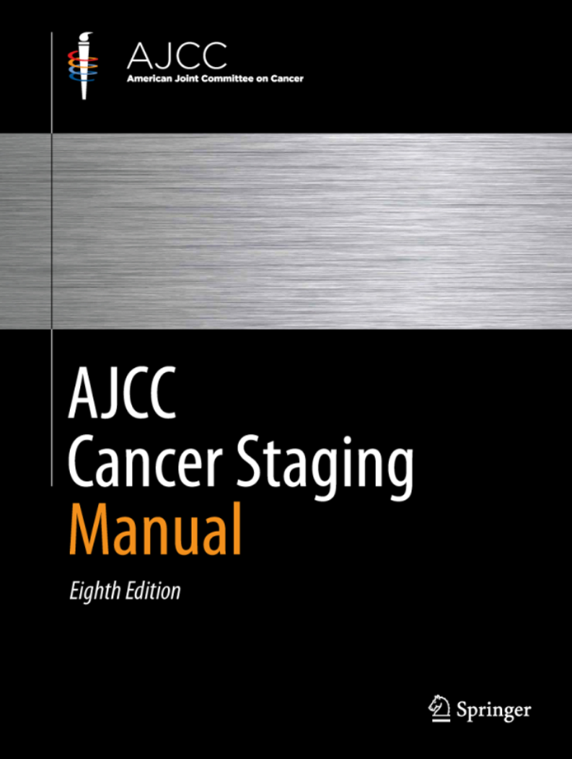
AJCC Web site
https://cancerstaging.org
General information
Education
Articles
Updates
For Registrars
Webinars with free CE hrs
Critical Clarifications
Staging Moments
Notes:
Additional info

Slide 16
CAnswer Forum
Submit questions to AJCC Forum
8th Edition Forum
7th Edition Forum will remain
Located within CAnswer Forum
Provides information for all
Allows tracking for educational purposes
http://cancerbulletin.facs.org/forums/

Slide 17
Summary

Slide 18
Summary
Evaluate effect on treatment outcomes analysis for neoadjuvant cases
Dissect concerns of missing treatment data
Understand impact on treatment data and studies
Alert data users to missing outcomes on neoadjuvant cases
Provide the missing piece by adding yc staging
Establish yc staging system is viable option

Slide 19
Thank You
Donna M. Gress, RHIT, CTR
Technical Editor AJCC Cancer Staging Manual
First Author, Chapter 1: Principles of Cancer Staging

