Slide 1
Assessing population-based cancer survival trends by using the North American Cancer Survival Index — United States, 2005–2014
Bożena M. Morawski, PhD, MPH
NAACCR/IACR Combined Annual Conference
Survival II Session – June 12, 2019
Notes:
Good morning.

Slide 2
Why use population-based all-site cancer survival?
Summary metric evaluating how well public health and healthcare systems control cancer
Prevention
Detection
Management
Notes:
Some people think that a measure of all-site cancer survival is misinformed. However, a 1-number summary metric measuring how well public health and healthcare systems prevent, detect, and manage cancer at the population level can be useful in communication with policy-makers and in evaluating health disparities.
**************************************************************
And while this summary metric is most informative when evaluated in concert with mortality and incidence,

Slide 3
Cancer Survival and…
Notes:
Whether or not you think that a one number metric is misguided, we DO use a one-number cancer survival metric in evaluating public health objectives, the primary example of which is Healthy People 2020 objectives. The current metric evaluating 5-year cancer survival in Healthy People 2020 uses data from 17 Surveillance, Epidemiology, and End Results Program registries, which cover approximately 26% of the U.S. population. The metric as it is currently constructed does not account for the distribution of primary cancer site.

Slide 4
Risk factors for cancer and primary cancer site distribution differ by geography and over time
Differentially impacts survival estimates
Reduces comparability in all-site cancer survival estimates for jurisdictions and over time
Notes:
And we know that Risk factors for cancer and primary cancer site distribution differ by geography – in our case, typically a registry – and over time

Slide 5
Risk factors for cancer and primary cancer site distribution differ by geography and over time
Differentially impacts survival estimates
Reduces comparability in all-site cancer survival estimates for jurisdictions and over time
Notes:
Which can differentially impact survival estimates

Slide 6
Risk factors for cancer and primary cancer site distribution differ by geography and over time
Differentially impacts survival estimates
Reduces comparability in all-site cancer survival estimates across jurisdictions and over time
Notes:
And reduce comparability in non-site standardized all-site cancer survival estimates across jurisdictions and over time.

Slide 7
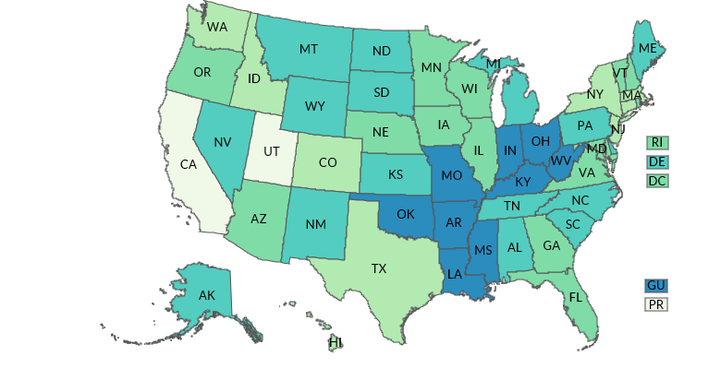
Age-adjusted prevalence of current adult smokers ― United States, 2011
CDC. BRFSS Prevalence & Trends Data. 2015.
Notes:
FOR EXAMPLE, is a comparison of non-site-standardized all-site survival in California to non-site-standardized all-site survival in Louisiana appropriate, as they have markedly different population-level risk factors for site-specific cancers, and differences in relative distributions of primary cancer sites?
This map shows age-adjusted prevalence of current adult smokers in the United States in 2011, with increasing smoking prevalence shown by increasing dark blue-green. California is in the lowest smoking category, and Louisiana is in the highest smoking category.
Smoking by Vectors Market from the Noun Project
Surfing by faisalovers from the Noun Project

Slide 8
Age-adjusted prevalence of current adult smokers ― Maine
2011 prevalence = 24.5%
2017 prevalence = 18.6%
CDC. BRFSS Prevalence & Trends Data. 2015.
Notes:
And even within registry jurisdiction, there are large changes in risk factors over time. For example, in 2011 the age-adjusted prevalence of current adult smokers in Maine was 24.5% and in 2017 it dropped to 18.6%, potentially also influencing the incidence of highly fatal lung cancers.

Slide 9
North American Cancer Survival Index (CSI)
Notes:
With this in mind, NAACCR came up with an improved 1-number summary evaluating survival, the North American Cancer Survival Index – or CSI. This metric is similar to what

Slide 10
Objectives
Use age-, sex-, and primary cancer site-standardized North American CSI
Evaluate trends in population-level U.S. cancer survival over time
Evaluate survival disparities by race and sex
Notes:
And we used this age-, sex-, and primary cancer site-standardized metric to
evaluate trends in population-level U.S. cancer survival over time
And to evaluate survival disparities by race and sex

Slide 11
Methods
CONCORD-2 Monograph

Slide 12
Registry Inclusion Criteria
U.S. NAACCR registry
Meeting Cancer in North America incidence criteria
Provided consent for project
Registry ascertained vital status using
SEER follow-up standards
National Death Index linkage through December 31, 2014
Notes:
To be included in these analyses, registries needed to be a U.S. NAACCR registry
meeting Cancer in North America incidence criteria
And to have provided consent for their data to be used in this project.
The registry also needed to ascertain vital status using either SEER follow-up standards OR
By conducting National Death Index linkage through December 31, 2014 to be included herein.

Slide 13
Case Inclusion Criteria
Diagnosed during 2005–2014
People aged 15–99 years at diagnosis
Malignant cancers per SEER 2007 Multiple Primary and Histology Coding Rules
Multiple primary cancers allowed per patient
Notes:
We included cases diagnosed during 2005 through 2014 among people aged 15 to 99 years at diagnosis.
We included Malignant cancers per SEER 2007 Multiple Primary and Histology Coding Rules, and
Multiple primary cancers were allowed per patient, and The first primary site-specific record was included in the estimating site-specific survival estimates.

Slide 14
Exclusion Criteria
Case reported via autopsy or death certificate only
Case in a live patient with no follow-up time
Notes:
We excluded cases that were only reported via autopsy or death certificate, and – among registries conducting active follow-up – cases that were alive but had no follow-up time.

Slide 15
Calculating the North American Cancer Survival Index
Weighted sums of age-standardized, site-specific relative survival ratios (RSRs)
Diagnosis and follow-up cohorts: 2005–2011, 2006–2012, 2007–2013, and 2008–2014
Weighted on relative distribution of cancers diagnosed during 2006–2008 in North America
Notes:
We calculated the north American Cancer Survival Index, which is the weighted sum of age-standardized, site-specific relative survival ratios (RSRs)
for 4 time periods of 2005–2011; 2006–2012; 2007–2013; 2008–2014
Weights were determined from the Relative distribution of cancers diagnosed during 2006–2008 in North America

Slide 16
Methods to Calculate Site-Specific Relative Survival Ratios
SEER*Stat version 8.3.5
Complete approach
Expected survival calculated Ederer II method
Age-, sex-, achieved year-, geographic area-, race-, and socioeconomic status-matched life tables
Cases right-censored at 100 years
Notes:
Site-specific relative survival ratios (RSRs) were calculated in SEER*Stat by using the complete approach
Expected survival was calculated Ederer II method from Age-, sex-, achieved year-, geographic area-, race-, and socioeconomic status-matched life tables, and cases were right=censored at an achieved age of 100 years.
SEER*Stat = (Surveillance Research Program, National Cancer Institute, Bethesda, MD).

Slide 17
Calculating the North American CSI
S$i$ = Age-standardized, site-specific 60-month RSR estimate
W$i$= Proportion sex-specific incidence counts for site category $i$
$$CSI=\sum_{i}^{∞}{SiWi}$$
$$standard error (CSI)=\sum_{i}^{∞}{√\left[\left(Si\right)2\left(Wi\right)2\right] }$$
Notes:
I’ve included formulas for the Cancer Survival Index and its corresponding standard error,
where S equals Age-standardized, site-specific 60-month RSR estimate for each cancer site
And W equals the Proportion of sex-specific incidence counts for each specific cancer site, i.

Slide 18
95% Confidence Intervals
Calculated using normal approximation on the logarithmic scale
Lower limit = CSI / exp[1.96 * $standard error (CSI)$ / CSI]
Upper limit = CSI * exp[1.96 * $standard error (CSI)$ / CSI]
Notes:
And we also calculated 95% Confidence intervals around each point estimate using the normal approximation on the logarithmic scale. Formulas for the upper and lower bounds of which are shown here.

Slide 19
Evaluation of Survival Trends
Compared 95% CIs for CSI
Time
Male and Female Sex
Black and White Race
Notes:
And finally we evaluated survival trends by comparing 95% CIs for Cancer Survival Indices
Over time
Female vs. Male sex
Black vs. White race
Race-Sex Combinations
Of Black female,
Black male,
White female, and
White male.
Line Graph by DigitalShards from the Noun Project
Biracial Couple by MRFA from the Noun Project
Male and Female by Saeful Muslim from the Noun Project

Slide 20
Results
CONCORD-2 Monograph

Slide 21
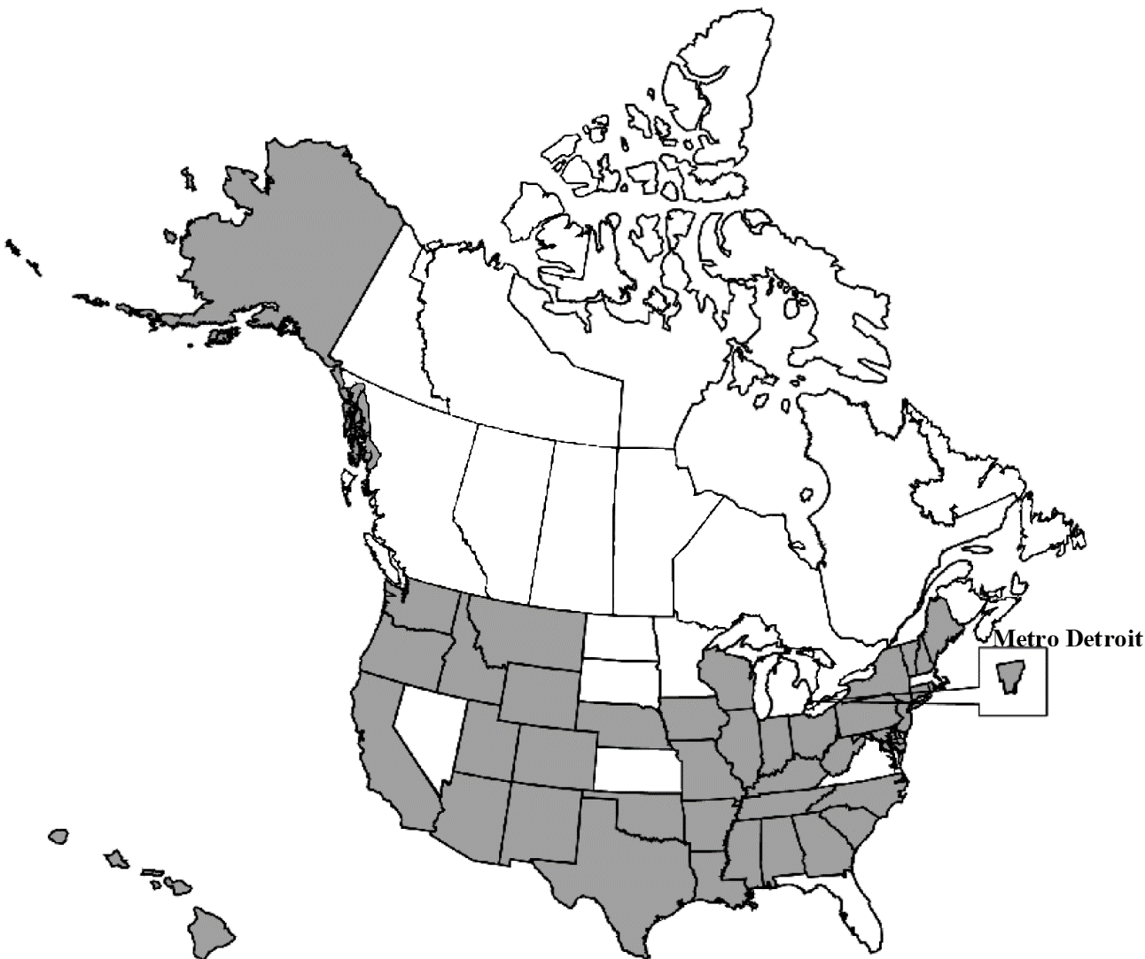
Participating Registries, 2005–2014
42 registries
41 states
1 metro area
>11.9 million cancers
~83% of U.S. population
Notes:
42 registries – comprised of 41 states and 1 metro area – contributed greater than 11.9 million cancer cases to these analyses. These data represent approximately ~83% of U.S. population.

Slide 22
Nationally, All-Site Survival is Improving
Notes:
And we have good news!
This graph shows our primary result of the North American Cancer survival index point estimate, and corresponding 95% Confidence intervals as blue bars, by diagnosis and follow-up cohort
And as measured with the Cancer Survival Index, we see that all site-survival is improving nationally, from 63.5 % of expected survival to 64.1% of expected survival.

Slide 23
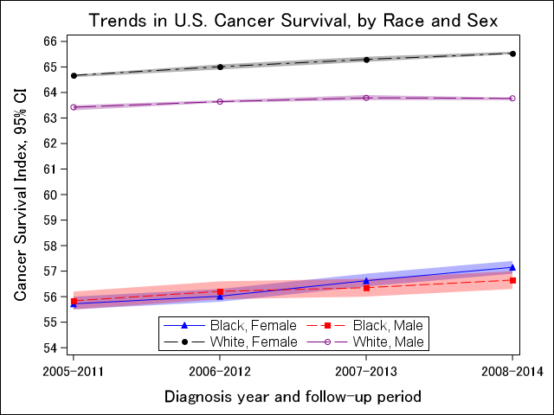
Survival Improvements Across All Sub-Populations
Notes:
We noted survival improvements across all subpopulations. The figure on the left shows trends in CSI by race-sex combinations of black men in red, black women in blue, white men in purple, and white women in black.
And the figure on the right shows the absolute difference in Cancer Survival Index between 2005-2011 and 2008-2014 by race-sex combinations. Largest survival gains were experienced by black women, with a 1.4% absolute difference in survival improvement. White females and black males each experienced a 0.8 % increase in survival, and white males experienced a 0.4 % increase in survival.

Slide 24
Gap in racial disparities is closing…
Diagnosis and Follow-up Cohort
Ratio of CSI for White People to CSI for Black People
Notes:
This graph shows… ratio of the Cancer Survival Index for whites compared to blacks. In 2005-2011 we see that whites have 15% better relative survival than backs… etc. etc.

Slide 25
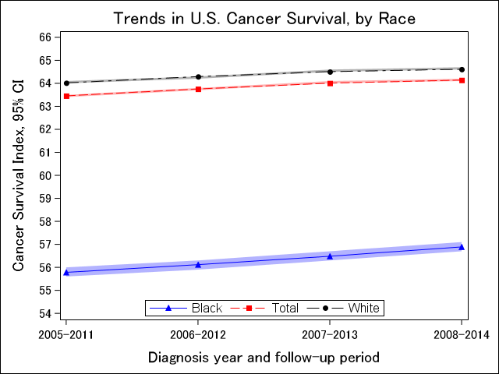
White People Experienced (Much) Better Survival than Black People
Notes:
However, White People Experienced (Much) Better Survival than Black People

Slide 26
White People Experienced (Much) Better Survival than Black People
-7.7%
Notes:
With a nearly 8% difference in survival between white people and black people for the final diagnosis and follow-up

Slide 27
CSI by Registry Jurisdiction, 2008–2014
No estimate calculated (Alaska, Wyoming, Vermont)
Notes:
As one of the advantages of the Cancer Survival Index is increased comparability across registry jurisdictions, we wanted to evaluate survival as measured by the Cancer Survival Index across participating registry jurisdictions. This map shows 2008-2014 survival by registry jurisdiction, with decreased survival show by increasingly dark purple. We see that lower survival is primarily clustered in the southeast, although there is variability across the U.S. There were too few cases to estimate survival in Alaska, Wyoming and Vermont.

Slide 28
Change in CSI by Registry Jurisdiction from 2005–2011 to 2008–2014
No estimate calculated (Alaska, Wyoming, Vermont)
Notes:
And this map shows change in survival over time across registry jurisdiction, as measured by the absolute difference in Cancer Survival Index estimates for the 2005-2011 cohort and the 2008-2014 cohorts. Increasingly dark colors indicate a larger positive change in survival. **** Compare CIs for time periods by state *** Did this previously… not sure what result was. While increasingly light colors indicate no improvements or a decrease in survival.
Again, There were too few cases to estimate survival in Alaska, Wyoming and Vermont.

Slide 29
Improvements in lung & bronchus, breast cancers driving survival improvements
 | 2005-2011 |  |  | 2008-2014
Site | N | % Cases | RSR (95% CI) | N | % Cases | RSR 95% CI
Prostate | 1,239,274 | 15.0 |  | 1,158,389 | 14.0
Breast | 1,174,407 | 14.3 |  | 1,253,929 | 15.3
Lung & Bronchus | 1,150,792 | 13.9 |  | 1,170,120 | 14.2
Colon & Rectum | 792,005 | 9.6 |  | 777,601 | 9.4
Notes:
This table shows the number of cases, % of total cases, and the site-specific Relative Survival Ratios and 95% Confidence interval among 2005-2011 estimates compared to 2008-2014 estimates.
We wanted to additionally examine changes in survival among some of the most commonly diagnosed cancers – prostate, breast, lung & bronchus, and colon and rectum – representing approximately 54% of cases.

Slide 30
Improvements in lung & bronchus, breast cancers driving survival improvements
 | 2005-2011 |  |  | 2008-2014
Site | N | % Cases | RSR (95% CI) | N | % Cases | RSR 95% CI
Prostate | 1,239,274 | 15.0 | 96.9 (96.7, 97.0) | 1,158,389 | 14.0 | 96.4 (96.3, 96.5)
Breast | 1,174,407 | 14.3 | 88.4 (88.2, 88.5) | 1,253,929 | 15.3 | 89.0 (88.8, 89.1)
Lung & Bronchus | 1,150,792 | 13.9 | 19.2 (19.1, 19.3) | 1,170,120 | 14.2 | 20.7 (20.6, 20.8)
Colon & Rectum | 792,005 | 9.6 | 64.2 (64.1, 64.4) | 777,601 | 9.4 | 63.9 (63.7, 64.1)
Notes:
We did not note a statistically significant survival improvement in Cancer Survival Index for prostate or colon and rectum.

Slide 31
Improvements in lung & bronchus, breast cancers driving survival improvements
 | 2005-2011 |  |  | 2008-2014
Site | N | % Cases | RSR (95% CI) | N | % Cases | RSR 95% CI
Prostate | 1,239,274 | 15.0 | 96.9 (96.7, 97.0) | 1,158,389 | 14.0 | 96.4 (96.3, 96.5)
Breast | 1,174,407 | 14.3 | 88.4 (88.2, 88.5) | 1,253,929 | 15.3 | 89.0 (88.8, 89.1)
Lung & Bronchus | 1,150,792 | 13.9 | 19.2 (19.1, 19.3) | 1,170,120 | 14.2 | 20.7 (20.6, 20.8)
Colon & Rectum | 792,005 | 9.6 | 64.2 (64.1, 64.4) | 777,601 | 9.4 | 63.9 (63.7, 64.1)
Notes:
We did, however, note statistically significant improvements in survival for cancers of the breast, and lung and bronchus of 0.6 and 1.5 percent, respectively.

Slide 32
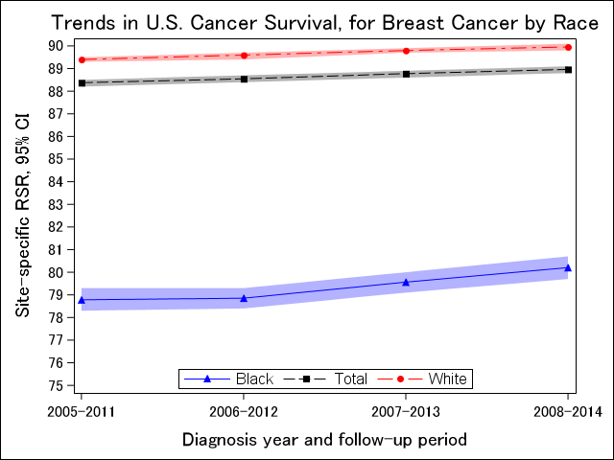
Notes:
Perhaps unsurprisingly, there were large differences in survival by race for these two primary cancer sites. Here, we see Cancer Survival Index estimates for breast cancer for black women shown in blue, and white women shown in red. With Relative Survival Ratios for whites in the 89 to 90 Cancer Survival Index range, and Relative Survival Ratios for blacks in the 78 to 80 over time.
Lung cancer – tarceva, other drugs used in community practice?
Maybe lung cancer survival better if not smoking-related.
Life tables are general, don’t account for smoking.
Lung cancer: Time 0 – all cause mortality among cancer patients. Most lung cancers here are attributable to smoking, so in general mortality will be higher among cases (lung cancer-attributable or otherwise).
Time 1 – all cause mortality among cancer patients. Higher proportion of lung cancers are NOT attributable to smoking, so all cause mortality will be lower. Fewer smoking-related cancer-attributable deaths.
Are we better off using cause specific survival for certain cancers?

Slide 33
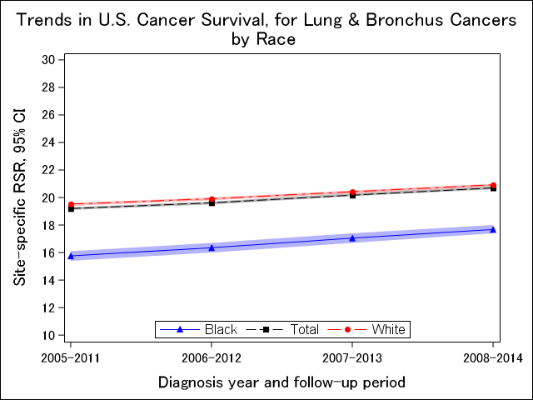
Notes:
And Relative Survival Ratios for cancers of the lung and bronchus for whites averaged about 20, and averaged approximately 17 over time among blacks.
Lung cancer – tarceva, other drugs used in community practice?
Maybe lung cancer survival better if not smoking-related.
Life tables are general, don’t account for smoking.
Lung cancer: Time 0 – all cause mortality among cancer patients. Most lung cancers here are attributable to smoking, so in general mortality will be higher among cases (lung cancer-attributable or otherwise).
Time 1 – all cause mortality among cancer patients. Higher proportion of lung cancers are NOT attributable to smoking, so all cause mortality will be lower. Fewer smoking-related cancer-attributable deaths.
Are we better off using cause specific survival for certain cancers?

Slide 34
Conclusions
CONCORD-2 Monograph

Slide 35
Conclusions
Using the North American CSI
Population-based 5-year survival improved during 2005–2014
Racial survival disparities decreased, but large disparity persisted
Differences in survival improvements by registry jurisdiction
Further evaluation of survival by jurisdiction is needed
Notes:
In conclusion, using the Cancer Survival Index we found improvements in survival in the US among cancer cases diagnosed from 2005 to 2014. We also found that racial disparities decreased, but that a large gap in survival between whites and blacks remains.
Further evaluation

Slide 36
Public health agencies might consider integrating the North American CSI in evaluation of Healthy People 2030
Notes:
Given the improvements offered by the Cancer Survival Index, Public health agencies in the united states might consider following suite with their European counterparts, and integrate the North American Cancer Survival Index into the evaluation of national public health goals, such as Healthy People 2030

Slide 37
Acknowledgements
Christopher J. Johnson, MPH – Epidemiologist, Cancer Data Registry of Idaho
Hannah K. Weir, PhD, MSc – Senior Epidemiologist, Epidemiology and Applied Research Branch, Division of Cancer Prevention and Control, National Center for Chronic Disease Prevention and Health Promotion, CDC
North America registry staff at contributing registries
This project was supported with Federal funds from the National Cancer Institute, National Institutes of Health, Department of Health and Human Services, under Contract No. HHSN261201800006I and the Centers for Disease Control and Prevention, Department of Health and Human Services, under Cooperative Agreement NU58DP006270 to the Cancer Data Registry of Idaho, Idaho Hospital Association.

Slide 38
Additional Material

Slide 39
Net survival estimators
2013 paper by Roche et al. : https://www.ncbi.nlm.nih.gov/pubmed/22961565
5-year estimates showed that errors/difference between Pohar Perme at other traditional net survival methods were generally small.
However, in good-prognosis cancers, the errors in non-standardized estimates of all classical methods were great and sometimes very important.
This was not the case for 10 and 15 year estimated.

Slide 41
Benefits to the CSI
Improved survival comparability over time and among populations
Impact of high incidence cancers better represented
More data! 42 registries are largest and most representative data set available for evaluating cancer survival

Slide 42
Relative Survival Ratio
Measure of net survival: cancer survival in the absence of competing risk
“Theoretical world” measure, à la age-adjusted rates
Proportion of observed survivors in a cohort of cancer patients Proportion of expected survivors* in a comparable set of cancer-free individuals
*Expected survival calculated using general population life tables matched to cases by age, sex, race, year, SES…
Notes:
The building blocks for the CSI are age-standardized, site specific relative survival statistics. Relative survival is a measure of net survival, which gives an idea of the excess mortality from the cancer diagnosis. It is calculated as a ratio of the observed survival in your patient cohort divided by the expected survival in a comparable set of cancer-free individuals. So we get an RSR for breast cancer, an RSR for lung cancer, an RSR for colorectal cancer, etc.

Slide 43
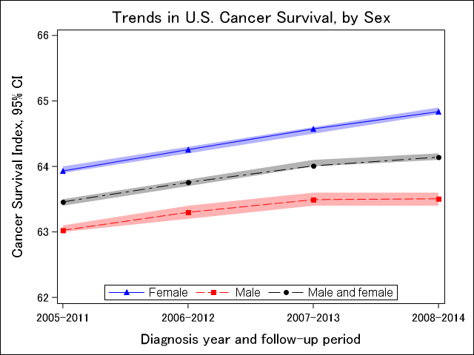
Women Experienced Better Survival than Men
Notes:
Women consistently had higher survival than men over time, and women experienced larger survival gains over time. From 2005-2011 to 2008-2014
CSI increased
Men 0.5%
Women 0.9%

Slide 44
Women Had Larger Survival Gains Over Time
2005-2011 vs. 2008-2014
CSI increased
Men 0.5%
Women 0.9%
Notes:
Want to change format of this slide

Slide 45
Decreases in cancer-related mortality
SEER U.S. Mortality Trends by Primary Cancer Site and Sex, All Races, 2007-2016
All site: -1.5%
Lung & bronchus: -2.9%
Breast: -1.7%

Slide 46
Decreases in cancer incidence
SEER U.S. Incidence Trends by Primary Cancer Site and Sex, All Races, 2007-2016
All site: -1.3%
Lung & bronchus: -2.3%
Breast: -0.1%

Slide 47
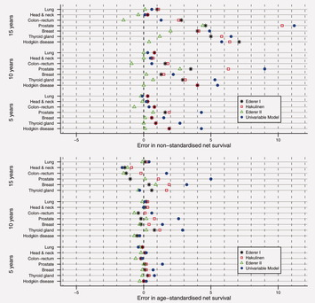
Cancer net survival on registry data: Use of the new unbiased Pohar‐Perme estimator and magnitude of the bias with the classical methods
International Journal of Cancer, Volume: 132, Issue: 10, Pages: 2359-2369, First published: 10 September 2012, DOI: (10.1002/ijc.27830)
Notes:
Errors in nonstandardized net survival estimates (top panel), age‐standardized net survival estimates (middle panel), and the elderly group net survival estimates (bottom panel) with Ederer I, Hakulinen, Ederer II and the Univariable at 5, 10 and 15 years after diagnosis. A unit on the x‐axis is a 1% point difference of an estimate obtained with a classical method minus the Pohar‐Perme estimate. The elderly group is defined as the group of patients aged over 85 for prostate cancer and over 75 for the six other sites. [Color figure can be viewed in the online issue, which is available at wileyonlinelibrary.com.]
IF THIS IMAGE HAS BEEN PROVIDED BY OR IS OWNED BY A THIRD PARTY, AS INDICATED IN THE CAPTION LINE, THEN FURTHER PERMISSION MAY BE NEEDED BEFORE ANY FURTHER USE. PLEASE CONTACT WILEY'S PERMISSIONS DEPARTMENT ON PERMISSIONS@WILEY.COM OR USE THE RIGHTSLINK SERVICE BY CLICKING ON THE 'REQUEST PERMISSIONS' LINK ACCOMPANYING THIS ARTICLE. WILEY OR AUTHOR OWNED IMAGES MAY BE USED FOR NON-COMMERCIAL PURPOSES, SUBJECT TO PROPER CITATION OF THE ARTICLE, AUTHOR, AND PUBLISHER.
Three factors that influence the magnitude of these errors are investigated: (i) the time elapsed since cancer diagnosis (the longer the follow‐up, the longer the ICM will act); (ii) the prognosis of cancer (in lethal cancers, most deaths are due to cancer, which reduces the impact of the ICM, whereas, in low‐lethal cancers, more deaths may be due to other causes); (iii) the effect of the life‐table variables (the stronger the effects of these variables on both cancer and other‐cause mortalities, the stronger the association between the two mortalities and the stronger the impact of the ICM on net survival estimation).

