Slide 1
Differences in Breast Cancer Survival by Molecular Subtypes in the United States
Nadia Howlader, PhD
National Cancer Institute
NAACCR/IACR Combined Annual Conference 2019
Vancouver, BC, Canada

Slide 2
Background
Breast cancer molecular subtypes have been defined based on gene expression profiling
The major subtypes of breast cancer are approximated by the joint expression of three tumor markers:
estrogen receptor (ER), progesterone receptor (PR) [where ER and PR status are jointly assessed as hormone receptor (HR) status], and
human epidermal growth factor receptor 2 (HER2) status
The four main molecular subtypes approximated by joint HR/HER2 status:
HR+/HER2– (i.e., approximating Luminal A subtype),
HR+/HER2+ (Luminal B),
HR–/HER2+(HER2-enriched), and
HR–/HER2– (triple-negative)

Slide 3
Background
While incidence rates of breast cancer molecular subtypes in the US are well documented¹
Effects of molecular subtypes on breast cancer–specific survival using the largest population coverage to date are unknown in the U.S. population
¹ Howlader et al. JNCI 2014; Kohler et al. JNCI 2015

Slide 4
Study Aims
First aim was to present the first report of nationally representative breast cancer–specific survival estimates by four main molecular subtypes
assessment of outcomes by subtypes after controlling for demographic/clinical features
Our second aim was to develop an imputation algorithm to fill in missing receptor status
enabling us to obtain accurate estimates of breast cancer survival in the population

Slide 5
Methods
Females with invasive breast cancer cases diagnosed during 2010-2013 and followed until December 31, 2014
SEER-18 (covering about 28% of the US population)
We begun analysis in 2010 when HER2 status was first collected in the SEER registries (ER/PR were collected from 1990 onward)
In constructing the study cohort, applied several exclusion criteria:
Death Certificate/autopsy cases (n=937)
Alive with no survival time (n=466)
Missing cause of death (n= 584)

Slide 6
Methods
We further restricted analysis to cases that were a woman's first or only breast cancer to create a more homogenous group
because a prior cancer diagnosis may affect patient prognosis
The final analytic set consisted of 196,094 females diagnosed with invasive breast cancer

Slide 7
Underlying Cause of Death (COD)
Underlying CODs were ascertained by cancer registries from death certificate codes obtained from the National Center for Health Statistics
To correct for known errors in COD attribution, the SEER program recently developed a special COD variable that maps underlying CODs to the primary cancer diagnosis¹
used this variable to assign a broad set of CODs to capture deaths due to breast cancer
¹ Howlader et al. JNCI 2010
https://seer.cancer.gov/causespecific/

Slide 8
Multiple Imputation: HER2 Status
ER, PR, and HER2 status had varying amount of missing information
16563 (8.4%) missing HER2, 7965 (4.0%) missing ER, and 8763 (4.5%) missing PR status
molecular subtypes could not be derived on16996 (8.7%) female breast cancer cases
In addition, some degree of missing data was present in the demographic and clinical variables
We used sequential regression multiple imputation technique to impute missing tumor markers and clinical/demographic variables with sporadic missingness

Slide 9
Multiple Imputation: HER2 Status
Variables included in imputation model:
Demographic variables: year of diagnosis, age at diagnosis, poverty status (county level), urban indicator (county level), race, ethnicity, registry, reporting source, marital status, insurance,
Clinical variables: ER status, PR status, AJCC 7th stage, tumor size, nodal status, Bloom–Richardson grade, histology, and surgery
In addition, we used vital status and the Nelson–Aalen estimator of the cumulative baseline hazard in imputation model as covariate
Imputed under missing at random (MAR) assumption
Used proc mi with fcs in SAS and generated 25 imputed datasets for analyses

Slide 10
Multiple Imputation: HER2 Status
We generated 25 imputations based on the rule that the number of imputations should be at least equal to the percentage of incomplete cases
Finally, we analyzed each imputed dataset separately, and then estimates were combined using Rubin’s rules

Slide 11
Results

Slide 12
Breast cancer-specific survival before imputation
Howlader et al. CEBP 2018

Slide 13
Breast cancer-specific survival before and after imputation
Howlader et al. CEBP 2018
Notes:
Notably, failing to impute cases with missing receptor status leads to overestimation of survival because those with missing receptor status tend to have worse prognostic features.

Slide 14
Breast cancer-specific survival by stage (Imputed)
Howlader et al. CEBP 2018

Slide 15
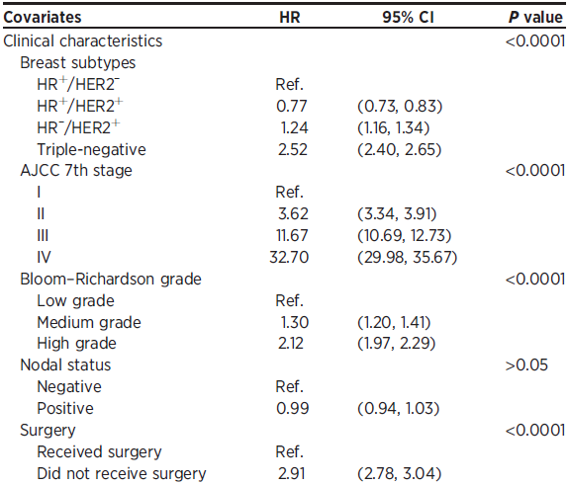
Cox Model: Breast Cancer Death By Demographic/Clinical Features
Howlader et al. CEBP 2018

Slide 16
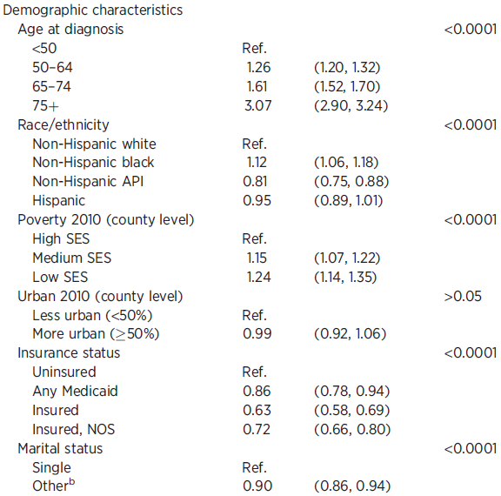
Cox Model: Breast Cancer Death By Demographic/Clinical Features
Howlader et al. CEBP 2018

Slide 17
Study Strengths
High quality population-based registry data
reliably capture breast cancer cases in their catchment areas
complete follow-up information for greater than 95% of cases, so reporting of survival is reliable
Results are more generalizable than those from single centers and clinical trials
unlikely to include representative samples of older, sicker, and low-income patients
First time using imputation algorithm to fill in missing data using population-based registry for survival analysis
failing to impute missing receptor status, we overestimate survival because those with missing receptor status tend to have worse prognostic features

Slide 18
Study Limitations
Data available in recently diagnosed cases (2010+) limiting our ability to look at long term outcomes
especially in the early part of Herceptin- era
Did not have information on breast caner risk factors, detailed treatment, individual level SES or comorbid conditions

Slide 19
Conclusions

Slide 20
Conclusions
First study to assess breast cancer survival according to molecular subtypes using the largest population coverage to date
in the modern treatment era and correcting for missing information with unknown receptor status
Breast cancer cases with HR+ subtypes are associated with the best prognosis
In contrast, women with HR-negative subtypes, especially those with triple-negative disease suffer the worst prognosis
In addition, stage is one of the most powerful factors determining survival outcomes

Slide 21
Conclusions
Among those with stage IV disease, women with HR+/HER2+ subtype (once considered a poor prognostic feature) appeared to have better survival
than women with HR+/HER2- subtype (once considered a best prognostic feature)
This remarkable divergence of survival curves is likely attributable to major advances in HER2-targeted treatment

Slide 23
Thank you! Nadia Howlader: howladern@mail.nih.gov

