Slide 1
Impact of Depression and Comorbidity on Suicide for Cancer Patients in Kentucky
Thomas Huang
Undergraduate Student, Tulane University
NAACCR/IARC Conference June 11th, 2019
Notes:
Hi, my name is Thomas. Thank you for coming to my talk today. I am here today to discuss the suicide in cancer patients, and more specifically, the importance of identifying possible predictors of suicide risk in the cancer populations.

Slide 2
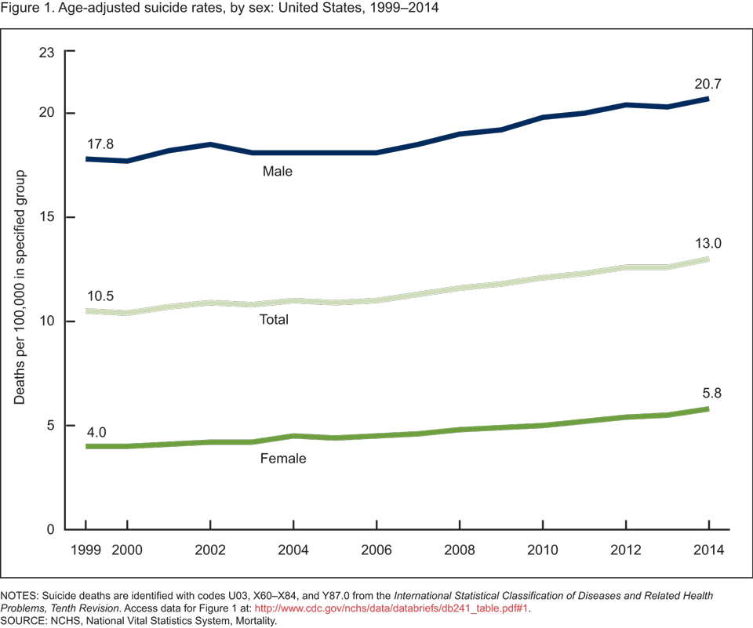
Background Information
10th overall leading cause of death in the US¹
Increased 33% from 1999 to 2017¹
Age-adjusted suicide rates between rural and urban counties from 1.4x to 1.8x.¹
¹Hedegaard et al. Suicide Mortality in the United States, 1999-2017, NCHs Data Brief (2018)
Notes:
Suicide is a very serious public health issue, and is actually one of the leading cause of death in the general populace. Suicide rates have increased in almost every state in the US since 1999 until now. The causes of suicide are multifaceted, but can be triggered by a major stressor in a person’s life. In this figure, taken from the CDC, you can see the age-adjusted suicide rate in the US of both males and females, as well as the total population. There has been an overall 33% increase in suicide rates in the US. Something else I want to emphasize is the increase in the difference between the suicide rates of rural and urban counties. Now, rural areas are even more at risk, at 1.8x the suicide rate of urban counties.

Slide 3
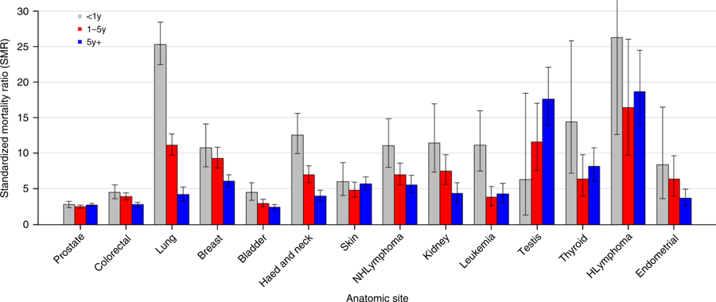
Background Information
Figure 1. SMRs of suicide among cancer patients, by subsite. Each anatomical subsite is further divided into time of suicide after initial diagnosis. Adapted from Nature Communications, 2019, Volume 10, Number 1, Page 1, Zaorsky et al.
4.4 times greater risk of suicide among cancer patients, up from two-fold risk.¹
Standardized Mortality Ratios (SMRs) are greatest among those most recently diagnosed as well as at a younger age.¹
Most cancer patients now die of non-cancer causes.²
Previous studies have identified numerous predictors of suicide risk.
¹Zaorsky, N. G. et al. Suicide among cancer patients. Nature communications, 10(1), 207 (2019).
²Zaorsky, N. G. et al. Causes of death among cancer patients. Ann. Oncol. 28, 400–407 (2017).
Notes:
Previous literature have identified those at the highest risk for non-cancer death to be those with chronic comorbid conditions and acute/iatrogenic/treatment-induced infections. A majority of cancer patients now die of non-cancer causes, thus suggesting a need to investigate other causes of death in cancer patients more deeply. Previous literature use SMRs to show groups of patients that are at the highest risk for suicide, compared to the general population.

Slide 4
Purpose
To gain a better understanding of the predictive indicators for suicide risk in cancer patients in Kentucky.
Notes:
Our main purpose in this study is to gain a better understanding of predictive indicators for suicide risk in cancer patients. In our data analysis, we will be focusing on several factors that have been implicated as possible predictors of suicide risk. Previous studies using SEER medicare data were able to identify some predictors of suicide risk. However, our study presents a new perspective. We used two different data sets. First, we used SEER Medicare, taken from years 2000 – 2013. We will also be investigating trends in suicide risk in the cancer patients taken from Health Administrative Claims Linked KCR Data. The Claims linked KCR data add an entire new dimension to the possible analysis of SEER Medicare data. The Claims linked KCR data is not only restricted to primarily Medicare but also draws from additional sources of claims data, specifically Medicaid and private insurance claims. Cases were included in the study based on two factors. Only lung, colorectal, prostate and female breast cancer cases were included as the Claims linked KCR data were restricted to these types of cancer sites. In addition, only first primary cases were included.

Slide 5
Methods
Use of two data sets:
Health Administrative Claims Linked Kentucky Cancer Registry (KCR) Data
Probabilistic Data Linkage
Medicaid, Medicare, and Private Insurance
Years: 2007 – 2011
Surveillance, Epidemiology, and End Results Program and Medicare Data (SEER*Medicare)
Kentucky Patients diagnosed from 2000-2013
Notes:
Our main purpose in this study is to gain a better understanding of predictive indicators for suicide risk in cancer patients. In our data analysis, we will be focusing on several factors that have been implicated as possible predictors of suicide risk. Previous studies using SEER medicare data were able to identify some predictors of suicide risk. However, our study presents a new perspective. We used two different data sets. First, we used SEER Medicare, taken from years 2000 – 2013. We will also be investigating trends in suicide risk in the cancer patients taken from Health Administrative Claims Linked KCR Data. The Claims linked KCR data add an entire new dimension to the possible analysis of SEER Medicare data. The Claims linked KCR data is not only restricted to primarily Medicare but also draws from additional sources of claims data, specifically Medicaid and private insurance claims. Cases were included in the study based on two factors. Only lung, colorectal, prostate and female breast cancer cases were included as the Claims linked KCR data were restricted to these types of cancer sites. In addition, only first primary cases were included.

Slide 6
Methods
Selection Criteria:
Lung, Colorectal, Prostate, Female Breast
First primary cases only
Variable Definitions:
Intentional self-harm (suicide) cause of death: ICD10 (U03,X60-X84, Y87.0)
Depression Status: captured through claims within one year prior to one year after cancer diagnosis by ICD9 diagnostic codes. Use continuous claims enrollment during this time range to define depression ‘No’ and ‘Unknown ’
Charlson Comorbidity Index: Calculated for one year to one month prior cancer diagnosis
Stage: Early Stage (Stage 0, I and II); Late Stage (Stage III and IV)
Appalachia Status: Appalachian Regional Commission (https://www.arc.gov/appalachian_region/TheAppalachianRegion.asp)
Follow-up Time: Time from cancer diagnosis to suicide date
Notes:
The variables used in this study were defined similarly to that of the previous presentation. Suicide and Self-Inflicted Injury incidences were captured using ICD10 codes, specific with U03, X60-X84, and Y87.0 codes. These codes were defined the same method as defined in the National Vital Statistics Reports by the CDC.
Depression status was captured through claims within the interval between one year prior to one year after the cancer diagnosis using ICD9 diagnostic codes. Staging were split into two categories, early and late. Early stage encapsulate both Stage 0 through 2. The late stage category include 3 and 4. The purpose behind grouping stages into two categories is due to one major limitation of this study, which I will discuss at greater detail at the end of the presentation. We also looked into the Appalachian status of patients in KCR data. The central Appalachian population that reside in Eastern Kentucky are a very important subset to examine as they are an underserved community that are also predominantly white. In addition, they generally have elevated cancer risk, lower education level, and shorter life expectancies. These factors were examined in the Cox proportional hazard model, which allowed us to compare cancer patients to other cancer patients. As the significance of suicide risk in cancer patients are already well established in literature using SMRs in contrast to the general population, the Cox proportional hazard model allows us to elucidate what factors within the cancer population are associated with increased suicide risk.

Slide 7
Descriptive Analysis
Health Administrative Claims Linked Kentucky Cancer Registry (KCR) Data
53130 Patients total
65 committed suicide
SEER*Medicare-Linked Data (2000-13)
75197 Patients total
106 committed suicide

Slide 8
Results

Slide 9
Suicides per 10,000 Patients
Trend between younger age and greater number of suicides.
Suicide incidence is much greater in patients with prostate cancer site and lung cancer site.
Suicide rate decreases with an increasing Charlson Comorbidity Index.
Notes:
Our bivariate analysis showed us a simple breakdown of number of suicides in each category. You can already see from this preliminary data meant to characterize the data sets that there are already trends arise in our data set. Seen here is the results from the Bivariate analysis of the SEER Medicare KCR Data. In the Race category, only the white subcategory represented any suicides. In Addition, As you look at the age groups, you can see a clear trend between a younger age and a greater number of suicides. Those who experienced depression within the two year long interval surrounding the date of diagnosis also show a much greater number of suicides than those that did not. Within the cancer sites, the occurrence of suicide within prostate cancer sites is much greater than any other sites, with the breast cancer site at the lowest number of suicides. However, it is important to note that this could be greatly affected by the gender of those who are primarily diagnosed with prostate and breast cancer. In our bivariate analysis of the SEER Medicare Linked Claims Data, similar trends were seen. Males still represented a far greater number of suicides per 10,000 patients than females. Prostate cancer still had the greatest and female breast cancer had the least number of suicides. Something interesting to note is that as the Charlson comorbidity index increases, the number of suicides actually decreases. Appalachian status also represents a greater percent of suicides. So does depression, as seen in the previous data set.

Slide 10
Time of Suicide after Cancer Diagnosis
Very similar survival times within Appalachian status and gender.
Charlson Comorbidity Index of 1 experiences the greatest survival time.
Late stage survival time is much shorter than that of early stage. Unknown stage varies greatly between KCR Medicare only and Claims Linked data.
Notes:
Now, the time of suicide is very important to consider as many different studies have come out and stated the interval of time following the diagnosis that represent the greatest risk of suicide among cancer patients. Here, we examined both the average and median time from diagnosis to suicide among each category. You can the average survival time of non-appalachian is greater in both data sets. While breast, colorectal and prostate cancer sites represent similar survival times, lung cancer shows just an average of 10 months before committing suicide after diagnosis. This could be due to a number of factors, such as often times, lung cancer is often seen as a self-caused disease, especially considering the prevalence of smoking in many parts of Kentucky. There is also a visible correlation between the Charlson CI and length of survival, with a greater Comorbidity index signifying a shorter survival time. Although the KCR Medicare data represents this, there is a steep drop from 0, 1 to 2+. Something else to note is that while males are at a much greater risk of committing suicide among cancer patients, men and women have a very similar survival time in both data sets.

Slide 11
Time of Suicide after Cancer Diagnosis
Very similar survival times within Appalachian status and gender.
Charlson Comorbidity Index of 1 experiences the greatest survival time.
Late stage survival time is much shorter than that of early stage. Unknown stage varies greatly between KCR Medicare only and Claims Linked data.
Notes:
Now, the time of suicide is very important to consider as many different studies have come out and stated the interval of time following the diagnosis that represent the greatest risk of suicide among cancer patients. Here, we examined both the average and median time from diagnosis to suicide among each category. You can the average survival time of non-appalachian is greater in both data sets. While breast, colorectal and prostate cancer sites represent similar survival times, lung cancer shows just an average of 10 months before committing suicide after diagnosis. This could be due to a number of factors, such as often times, lung cancer is often seen as a self-caused disease, especially considering the prevalence of smoking in many parts of Kentucky. There is also a visible correlation between the Charlson CI and length of survival, with a greater Comorbidity index signifying a shorter survival time. Although the KCR Medicare data represents this, there is a steep drop from 0, 1 to 2+. Something else to note is that while males are at a much greater risk of committing suicide among cancer patients, men and women have a very similar survival time in both data sets.

Slide 12
Cox Proportional Hazards Model
SEER Claims Linked Data
 | Hazard Ratio | 95% CI Limit | P-value
Depression |  |  | 0.0808
No | - | -
Yes | 2.22 | (0.83, 5.94)
Unknown | 0.57 | (0.21, 1.57)
Age |  |  | 0.1781
<65 | - | -
65-74 | 1.68 | (0.8, 3.53)
75+ | 0.92 | (0.35, 2.43)
Charlson Comorbidity Index |  |  | 0.7512
0 | - | -
1 | 0.46 | (0.46, 1.97)
2+ | 0.36 | (0.36, 2.04)
Unknown | 0.59 | (0.59, 5.02)
Cancer Site |  |  | 0.0102
Breast | - | -
Colorectal | 2.66 | (0.98, 7.20)
Lung | 3.76 | (1.42, 10.01)
Prostate | 4.34 | (1.78, 10.56)
Stage of Cancer |  |  | 0.0348
Early | - | -
Late | 2.07 | (1.18, 3.64)
Unknown | 1.82 | (0.71, 4.71)
Type of Insurance |  |  | 0.5304
Private | - | -
Medicaid | 0.43 | (0.10, 1.89)
Medicare | 0.87 | (0.40, 1.89)
Unknown | 1.52 | (0.56, 4.11)
Education |  |  | 0.0313
High | - | -
Moderate | 2.39 | (1.24, 4.59)
Low | 2.05 | (1.02, 4.12)
Notes:
So, looking at the data we already have, there are some significant trends we can identify. With a cox regression model, we are able to see the hazard for committing a specific event, in this case suicide. Only cases result in suicide are considered, as other cases are censored. Looking at the SEER Claims linked data, compared to the SEER Medicare KCR data, depression has a very similar hazard ratio of around 2.22 in both, when compared to not having depression within the two year interval surrounding the cancer diagnosis. While SEER medicare KCR data indicates a significant relationship between the occurrence of depression and suicide event, it is not considered significant in the SEER Linked Claims data, all the while having the same hazard ratio. This is primarily due to the smaller sample size of the SEER linked Claims data. Something we did not expect is the decreasing hazard ratio as the Charlson comorbidity index increased. This may be due to numerous factors, such as the preemptive exposure to healthcare professionals due to prior comorbidities, so the cancer diagnosis comes as less of a shock. The cancer site is actually the most significant predictor, when excluding gender. This is something I want to dive a little deeper in. As stated before, we saw that here was a significantly greater percent of suicides among prostate cancer patients than any of the other cancer sites, and especially breast. However, when you consider gender, all of a sudden, cancer site is no longer a significant predictive variable of suicide. This is primarily because of the patient population that experience prostate cancer and breast cancer, males and females, respectively. We know that in both the general population and cancer population, males are at a much higher risk of committing suicide. This is indirectly reflected in the cancer site data.
Staging of cancer was also a significant indicator. Late stage of cancer had a hazard ratio of 2.07 and 1.807 in linked claims and SEER Medicare, respectively. Again, Early stage was defined as stages 0-2 and late stage was defined as 3-4.
Education level was also significant, with a lower education level signifying a greater risk for suicide. This can be translated in the Appalachian population, as the Appalachian population is primarily less educated and also showed a greater risk for suicide.
Education was based upon county education level, population with high school or better population. The distribution was then divided into three categories.

Slide 13
Cox Proportional Hazards Model
SEER KCR Medicare Only Data
 | Hazard Ratio | 95% CI Limit | P-value
Depression |  |  | 0.0140
No | - | -
Yes | 2.227 | (1.22, 4.06)
Unknown | 0.731 | (0.37, 1.44)
Age |  |  | 0.4488
75+ | - | -
65-74 | 1.179 | (0.77, 1.80)
Charlson Comorbidity Index |  |  | 0.6834
0 | - | -
1 | 1.019 | (0.63, 1.64)
2+ | 1.372 | (0.80, 2.34)
Unknown | 0.935 | (0.32, 2.74)
Cancer Site |  |  | <0.0001
Breast | - | -
Colorectal | 3.655 | (1.34, 9.99)
Lung | 8.239 | (3.10, 21.88)
Prostate | 6.97 | (2.77, 17.52)
Stage of Cancer |  |  | 0.0573
Early | - | -
Late | 1.807 | (1.11, 2.95)
Unknown | 1.264 | (0.74, 2.16)
Education |  |  | 0.0365
High | - | -
Moderate | 1.87 | (1.16, 3.02)
Low | 1.545 | (0.93, 2.57)
Notes:
So, looking at the data we already have, there are some significant trends we can identify. With a cox regression model, we are able to see the hazard for committing a specific event, in this case suicide. Only cases result in suicide are considered, as other cases are censored. Looking at the SEER Claims linked data, compared to the SEER Medicare KCR data, depression has a very similar hazard ratio of around 2.22 in both, when compared to not having depression within the two year interval surrounding the cancer diagnosis. While SEER medicare KCR data indicates a significant relationship between the occurrence of depression and suicide event, it is not considered significant in the SEER Linked Claims data, all the while having the same hazard ratio. This is primarily due to the smaller sample size of the SEER linked Claims data. Something we did not expect is the decreasing hazard ratio as the Charlson comorbidity index increased. This may be due to numerous factors, such as the preemptive exposure to healthcare professionals due to prior comorbidities, so the cancer diagnosis comes as less of a shock. The cancer site is actually the most significant predictor, when excluding gender. This is something I want to dive a little deeper in. As stated before, we saw that here was a significantly greater percent of suicides among prostate cancer patients than any of the other cancer sites, and especially breast. However, when you consider gender, all of a sudden, cancer site is no longer a significant predictive variable of suicide. This is primarily because of the patient population that experience prostate cancer and breast cancer, males and females, respectively. We know that in both the general population and cancer population, males are at a much higher risk of committing suicide. This is indirectly reflected in the cancer site data.
Staging of cancer was also a significant indicator. Late stage of cancer had a hazard ratio of 2.07 and 1.807 in linked claims and SEER Medicare, respectively.
Education level was also significant, with a lower education level signifying a greater risk for suicide. This can be translated in the Appalachian population, as the Appalachian population is primarily less educated and also showed a greater risk for suicide.

Slide 14
Summary
SEER KCR linked claims data includes Medicaid and Private Insurance patients in addition to Medicare patients.
Depression within one year of the date of diagnosis is a powerful predictor.
Colorectal, prostate, and lung cancer sites are significant predictors.
Age and comorbidities are not predictive of risk of suicide.
This epidemiological study was performed with a vulnerable population.
Recognition of these predictors may allow for proper psychiatric consideration in cancer patients closely following diagnosis.
Notes:
In summary, SEER KCR linked claims data has allowed us to take a deeper dive into the possible predictors of suicide in cancer patients than ever before. We were able to look into the affects of comorbidities, identified via claims data. We now known that an increasing Charlson Comorbidity Index is actually linked with decreased risk of suicide. In addition, depression prior or after diagnosis, is another good indicator of suicide risk.
A factor to consider in the future research is gender. It is an incredibly power predictor of suicide, with males at risk of suicide at much greater rates than females, such that prostate cancer site was such a significant predictor of suicide risk without controlling for gender and not significant when controlling for gender. Gender aside, three of the four cancer sites examined, colorectal, prostate, and lung can be considered significant predictors of suicide. It is also important to focus on the socioeconomic status of patients, and specific for Kentucky, the level of education and Appalachian status of patients. Hopefully, with the predictors we were able to find from our study and present today, physicians can see the importance of psychiatric care for cancer patients, especially in the period close after the time of initial diagnosis. If this study means even one more save life, then it will have been worth it.

Slide 15
Acknowledgements
Kentucky Cancer Registry
Quan Chen DrPH
Eric B. Durbin DrPH, MS
Thomas T. Tucker PHD, MPH
Bin Huang DrPH
John L. Villano MD, PhD
Notes:
I’d like to take a moment to thank several members of faculty for their work in mentoring me as well as advising me through this entire process. First, I would like to thank Dr. Quan Chen in helping me with the data analysis. I would like to thank Dr. Eric Durbin, director of KCR, as well as Dr. Thomas Tucker and Dr. Bin Huang for their mentorship and guidance. I would also like thank Dr. John Villano, the man who originally brought the issue of suicide among cancer patients to light and inspired this entire project.

Slide 16
Thank You

