Slide 1
NAACCR Geocoder Micro Match Status Codes: Criteria for assessing geographic microdata fitness for use in high resolution spatial analysis
Daniel W. Goldberg, Payton Baldridge
Department of Geography
Texas A&M University
Recinda Sherman
NAACCR

Slide 2
Motivation
Researcher:
“So thanks for this geocode, can I use it for sub-county analysis. I mean, we can do better than county rates, right”?
TAMU/Recinda:
“Well, that depends.”
Researcher:
“Wait, what”?
TAMU/Recinda:
“Ok, let’s talk about geocode quality and fitness-for-use. So, you see what happened with this geocode was ….”
Researcher:
“Nah, thanks. Can you just give me a code”?

Slide 3
Solution(s)
Penalty Codes: For the Detail Oriented.
What was right/wrong/weird about an address/geocode
Gory gory details
Micro-Match Status: Good for Sub-County Analysis?
M : Match – You are good to go. This one is solid. Nothing weird.
R : Review – Hold up. This one is a bit weird. You should review it.
F : Fail – Garbage. Do not use.

Slide 4
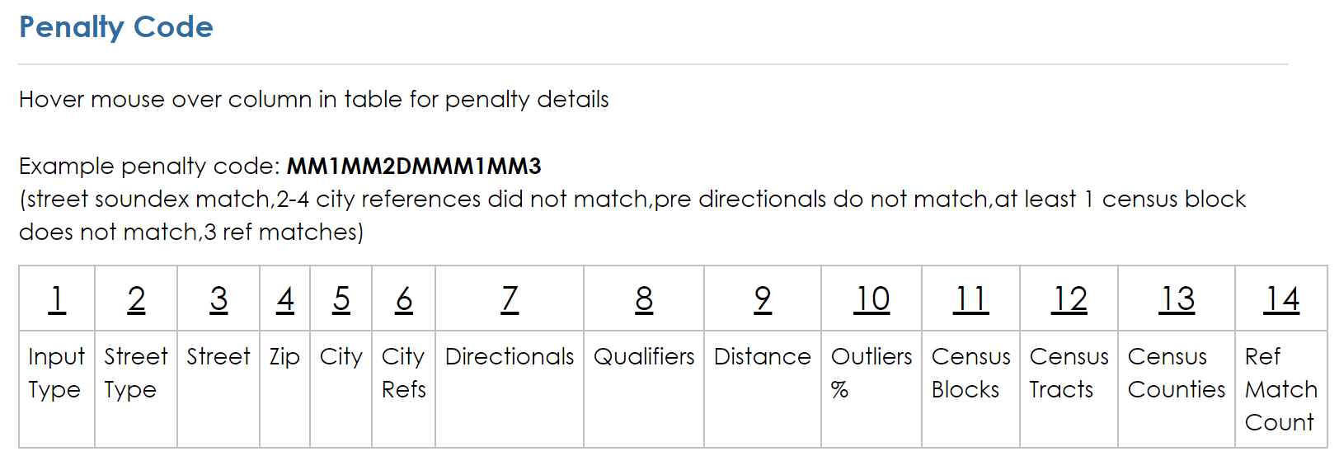
Penalty Codes
Purpose
Provide assessments of input/reference data agreement
Provide assessments of geographic accuracy
Provide assessments of available evidence
Provide assessment of micro-scale fitness-for-use (sub-county)

Slide 5
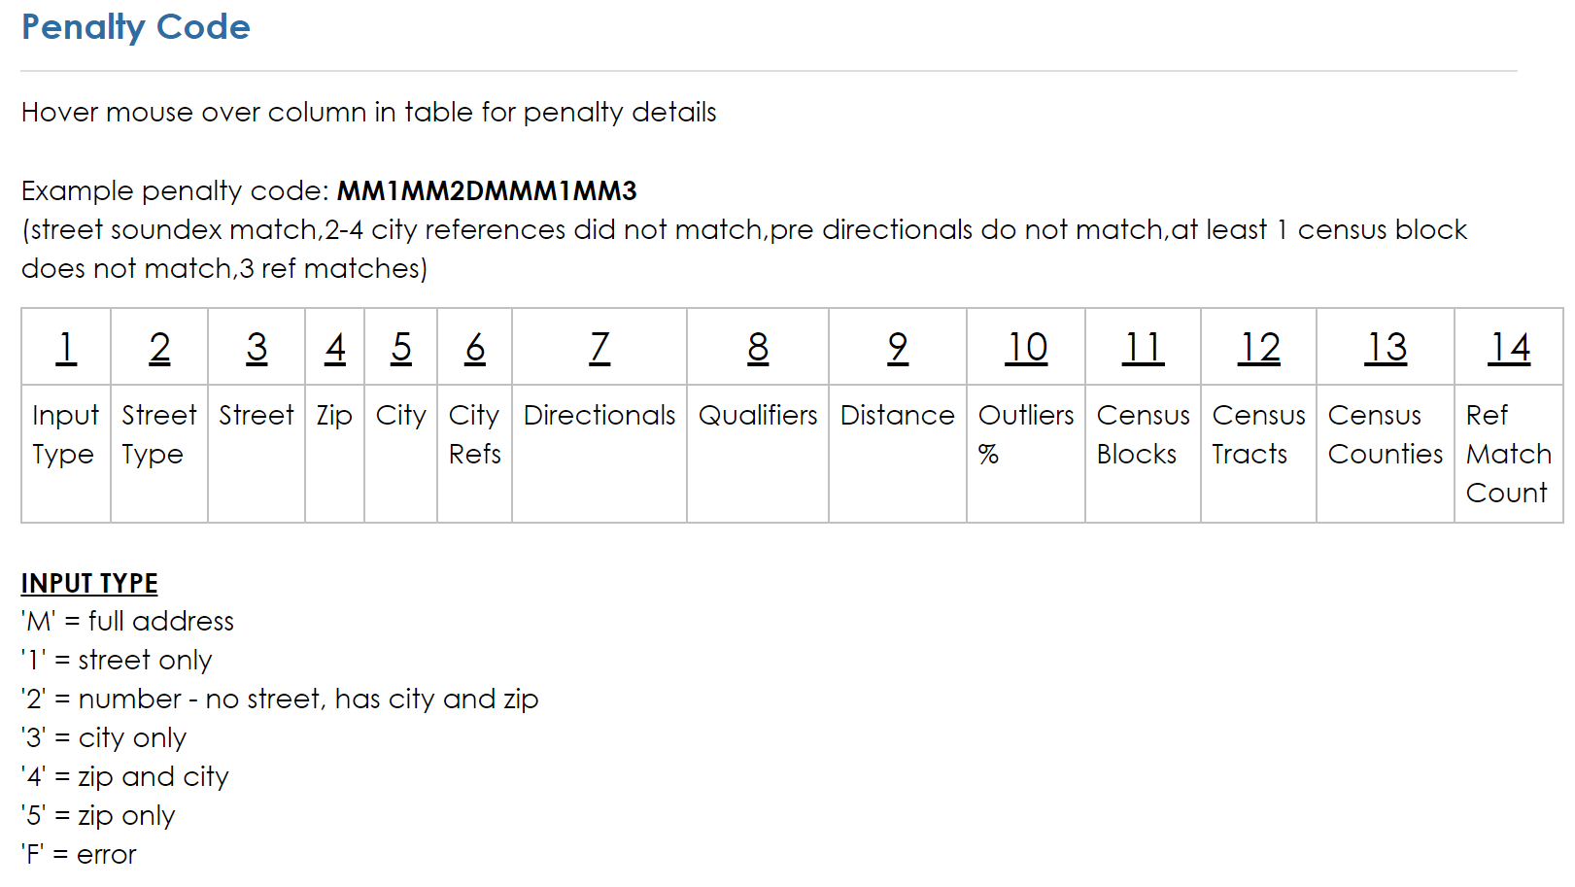
1211 Winding Road, College Station TX 77840
Winding Road, College Station TX 77840
College Station TX 77840
77840

Slide 6
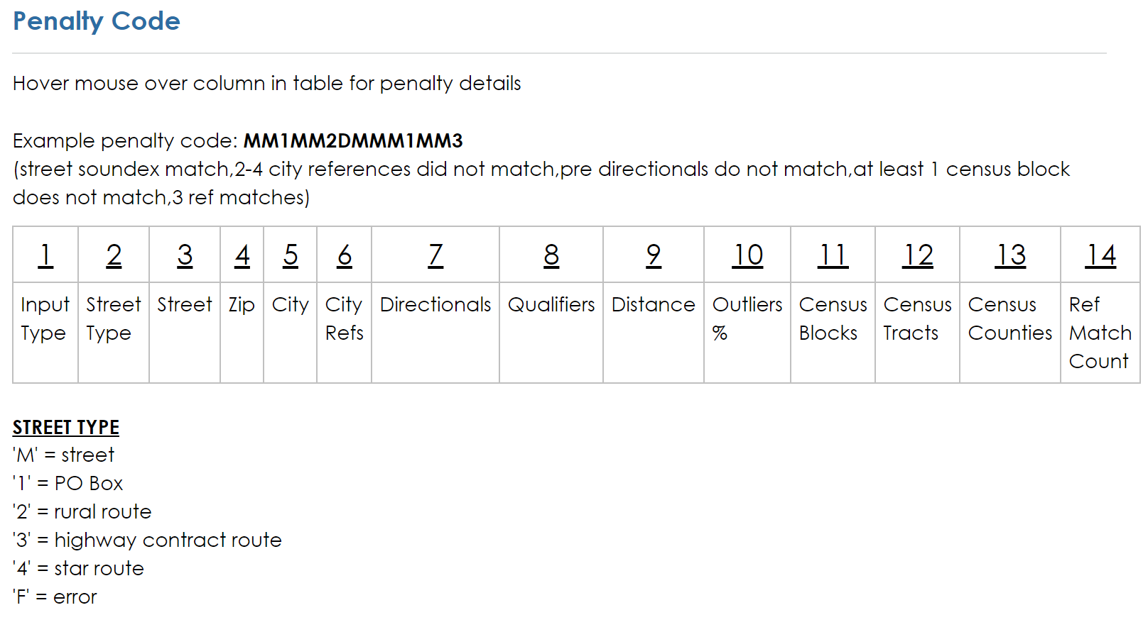

Slide 7
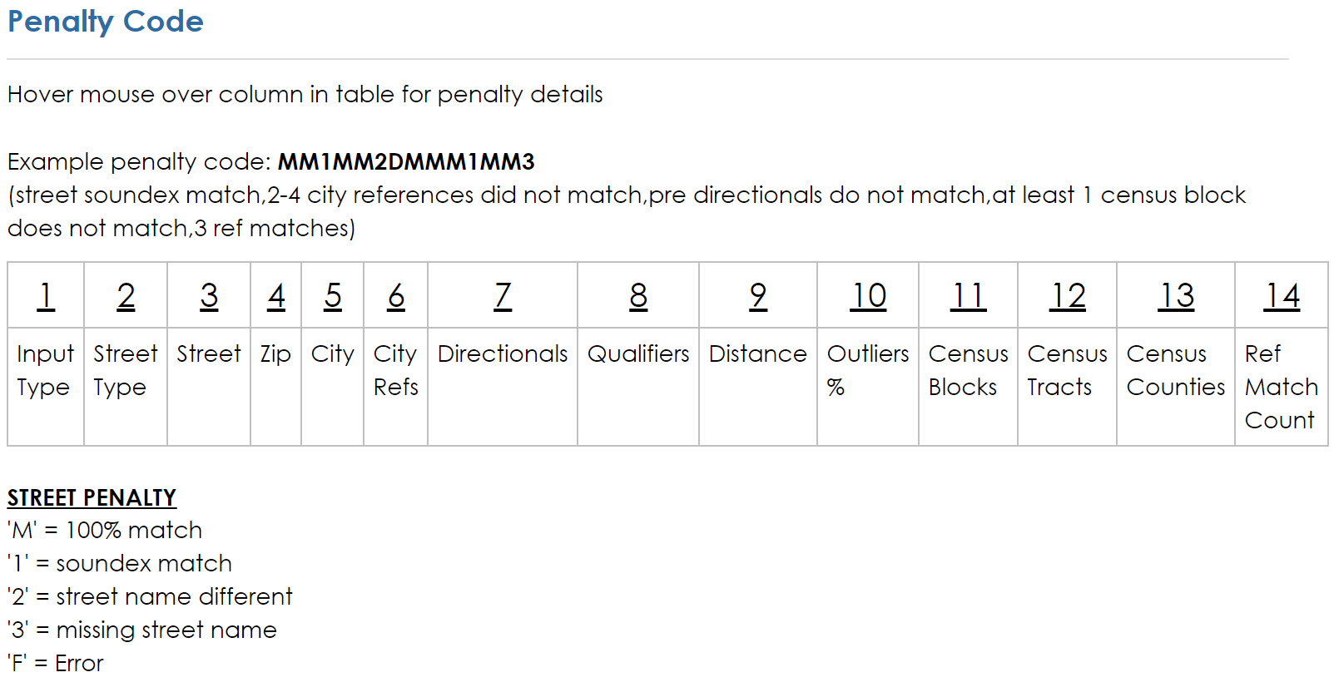
1211 Winding Road, College Station TX 77840
1211 Wiindiing Road, College Station TX 77840
1211 Welsh Road, College Station TX 77840

Slide 8
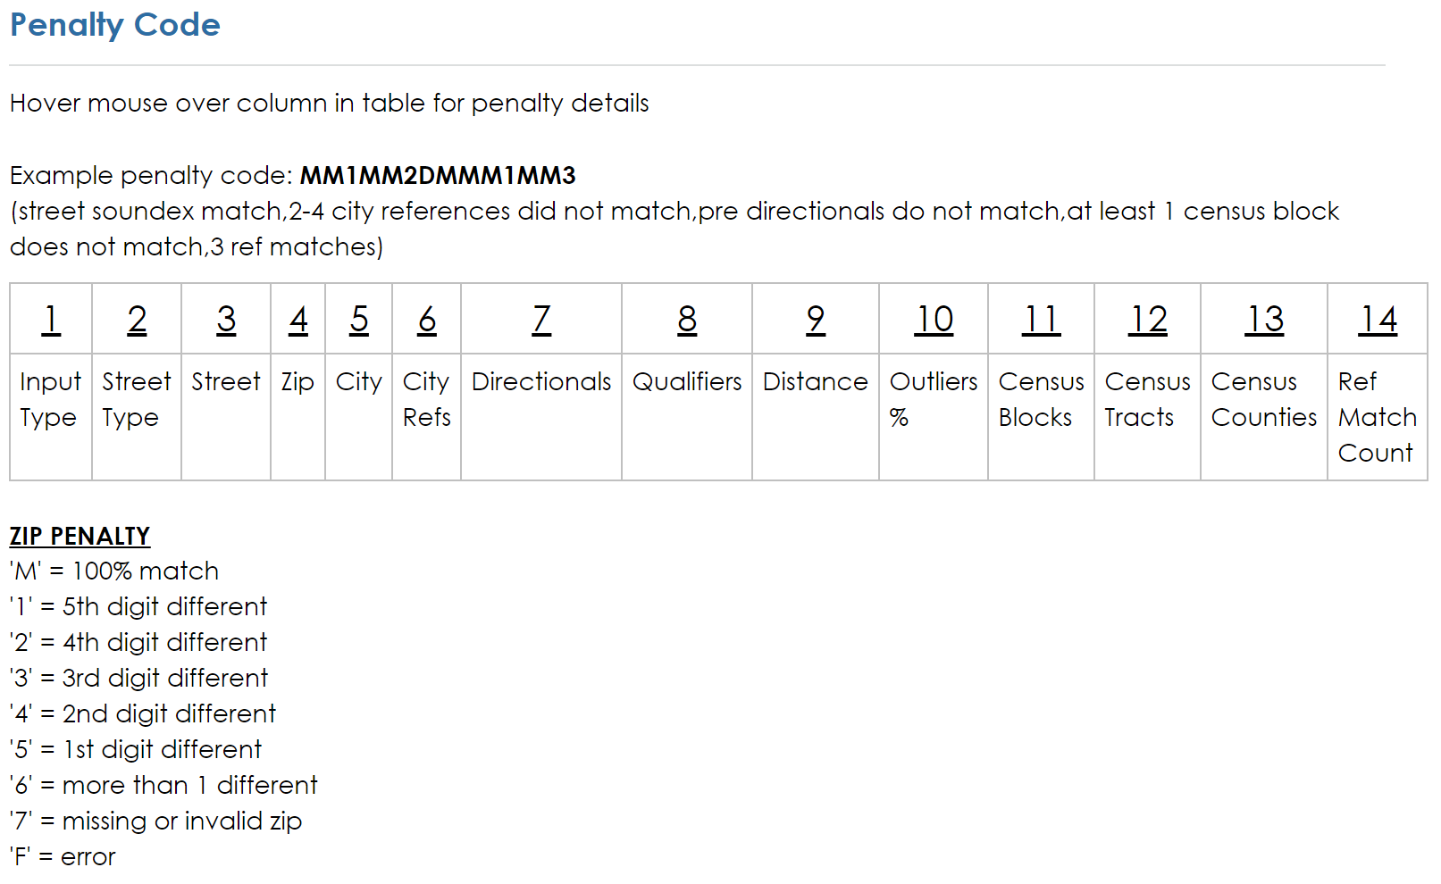
77840
77849
77850
77740
76840
87840
87841

Slide 9
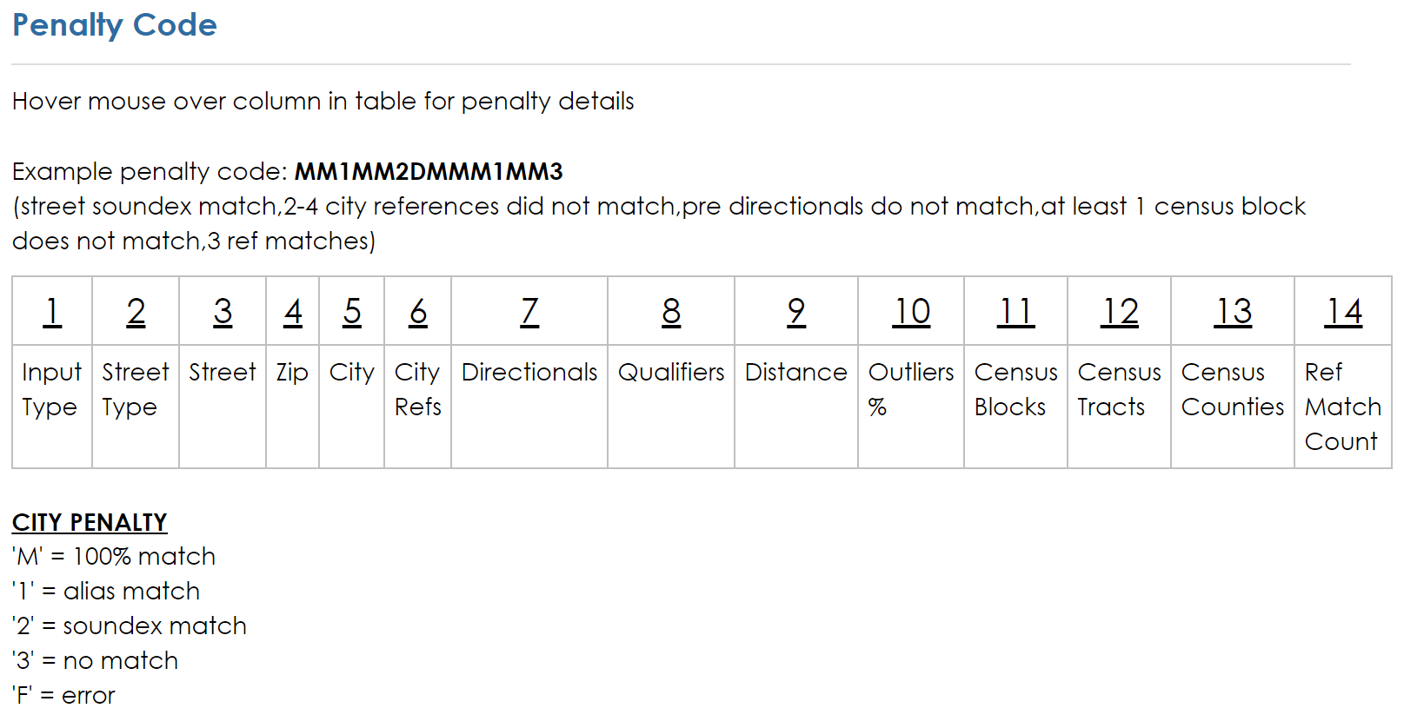
12 Briar Circle, Green Brook, NJ 08812
12 Briar Circle, Greenbrook, NJ 08812
12 Briar Circle, Dunellen, NJ 08812
12 Briar Circle, Dunelen, NJ 08812

Slide 10
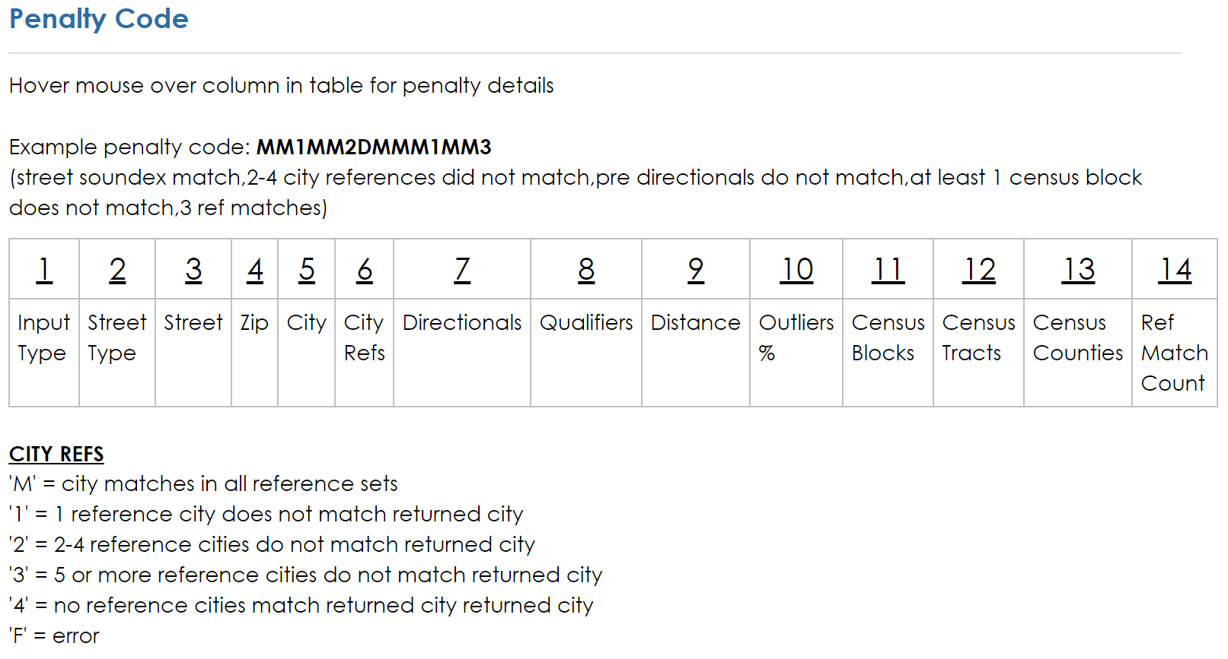
Green Brook ?= Dunellen
Green Brook ?= Green Brook
Green Brook ?= Green Brook
Green Brook ?= Dunellen

Slide 11
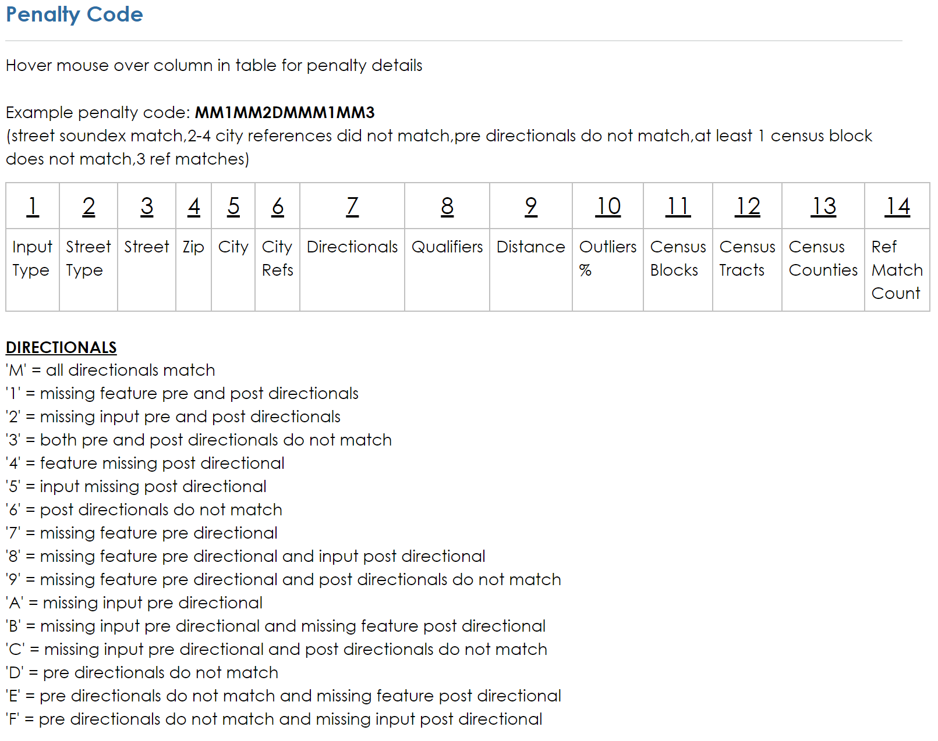
1211 South Texas Ave, College Station TX 77840
1211 Texas Ave, College Station TX 77840
1211 Texas Ave North, College Station TX 77840
1211 North Texas Ave, College Station TX 77840

Slide 12
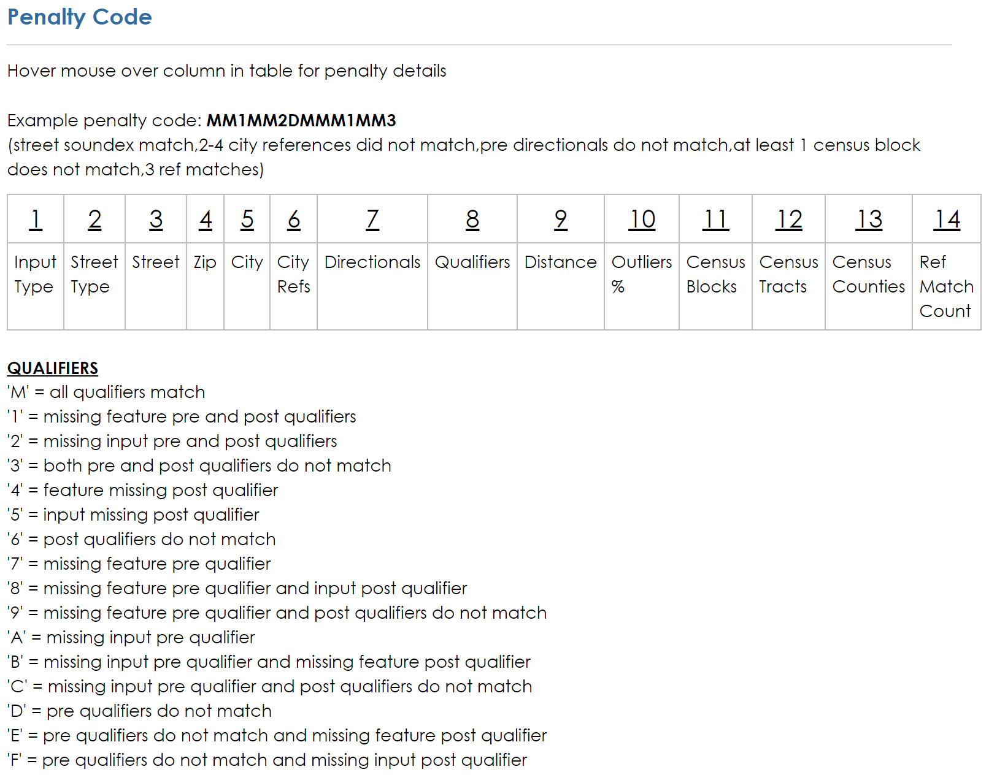
1211 Old College Main, College Station TX 77840
1211 College Main, College Station TX 77840
1211 College Main Old, College Station TX 77840
1211 New College Main, College Station TX 77840

Slide 13
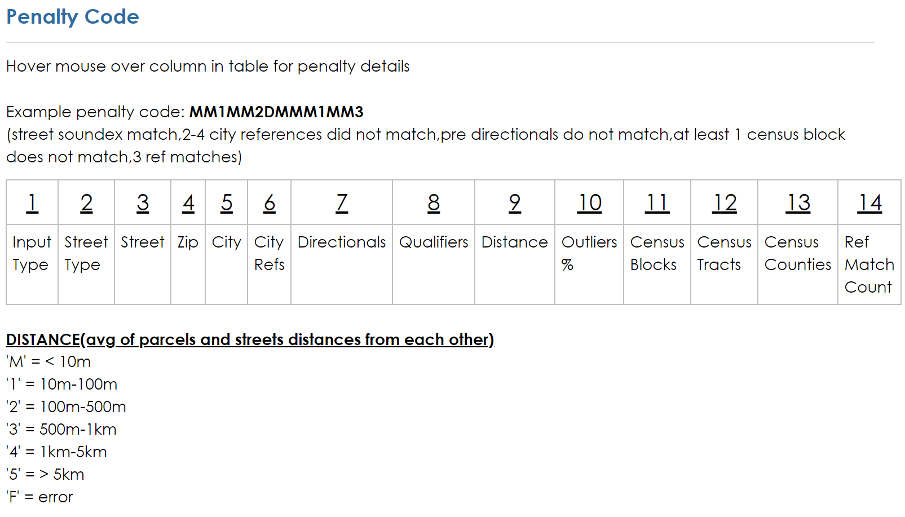

Slide 14
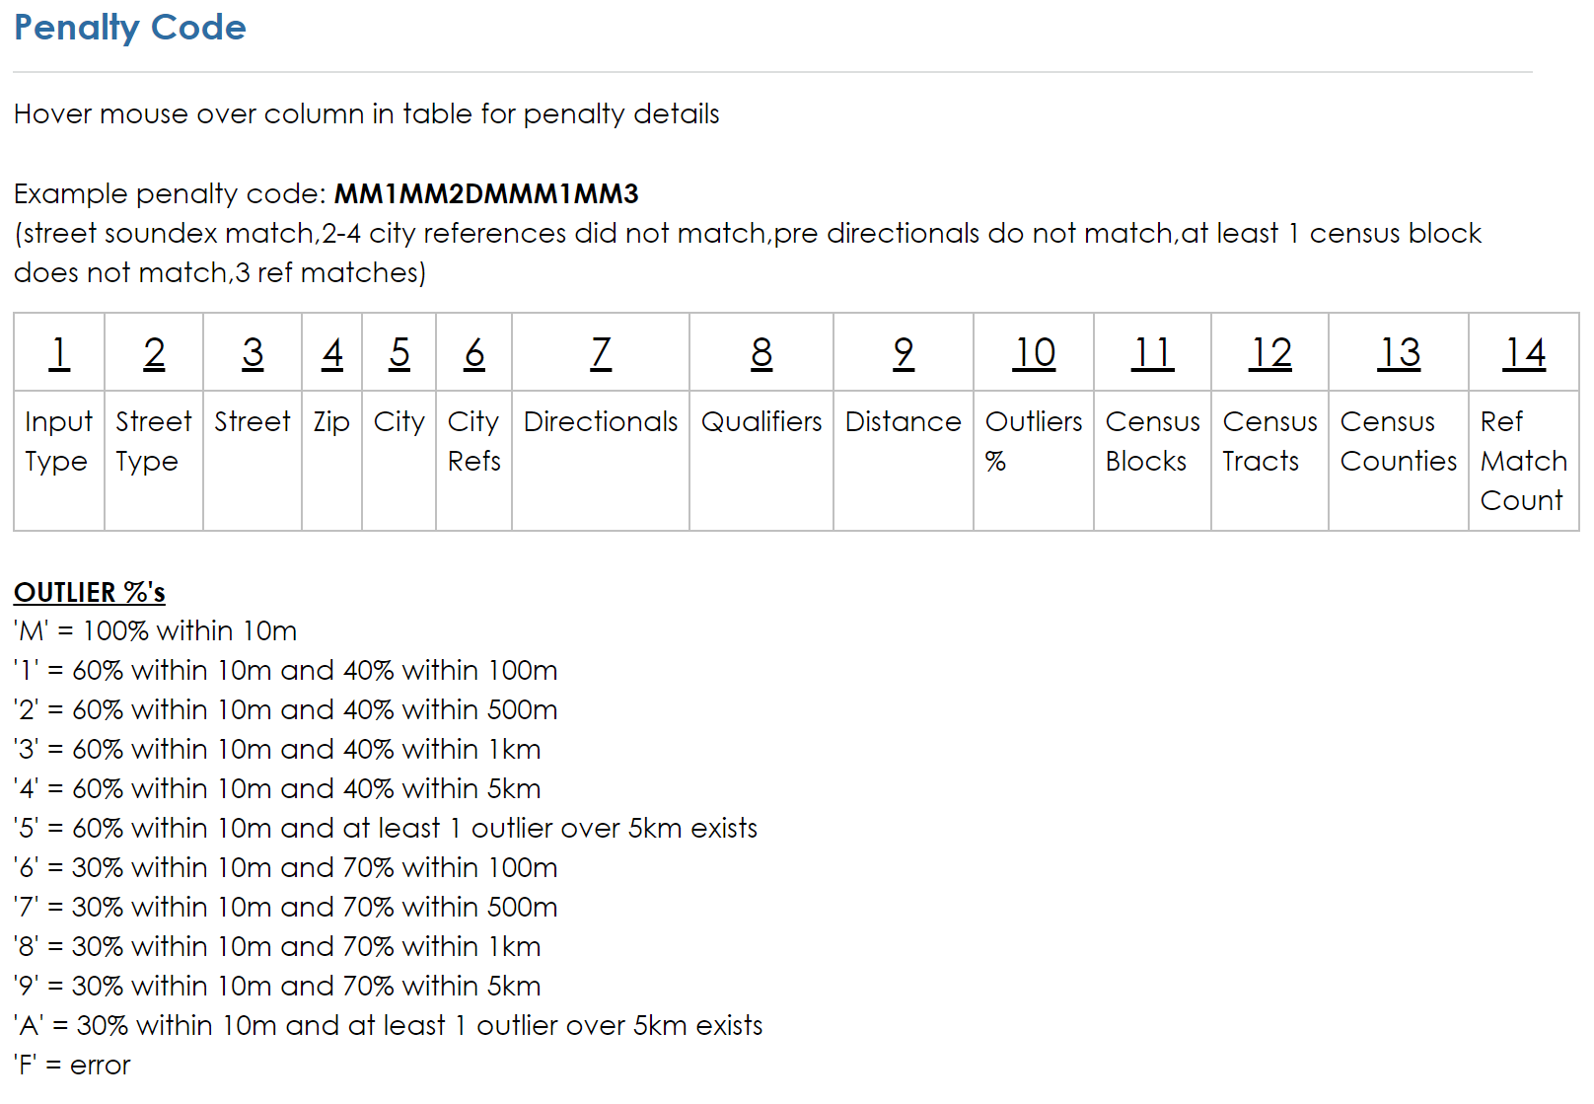
This one right here

Slide 15
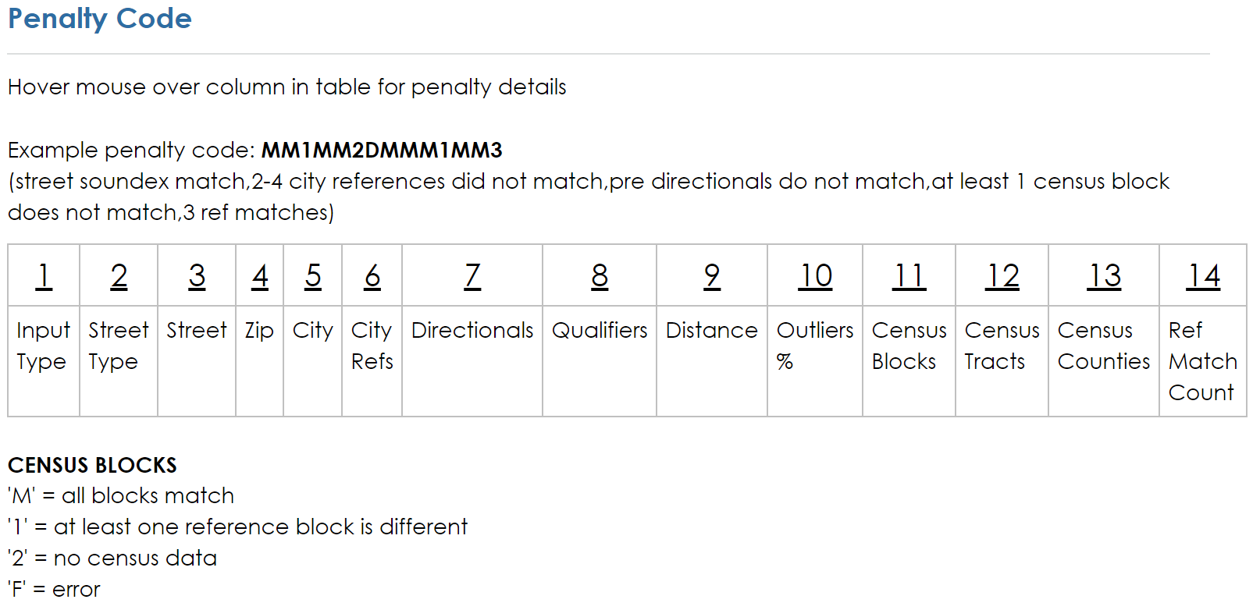
This one right here

Slide 16
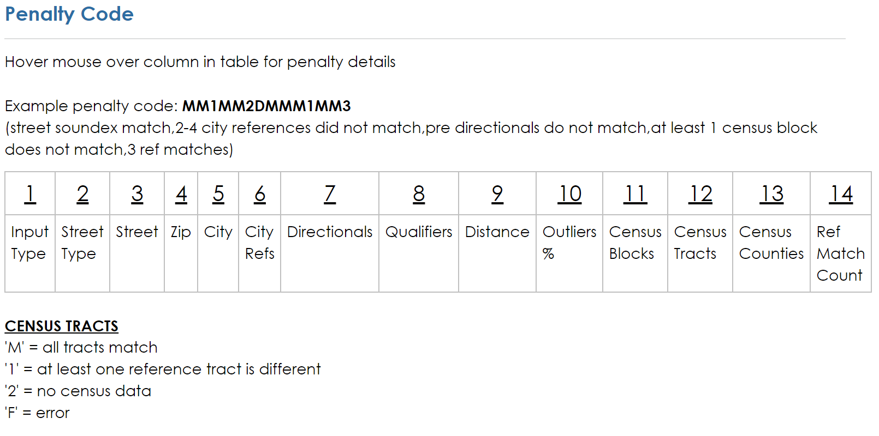
This one right here

Slide 17
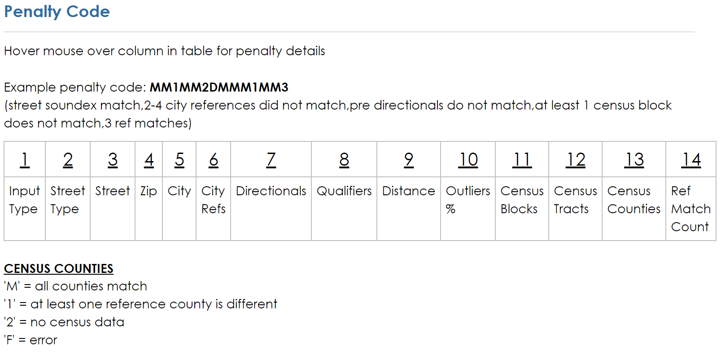
This one right here

Slide 19
Thanks & Questions?
Daniel W. Goldberg – daniel.Goldberg@tamu.edu Payton Baldridge – pbaldridge@tamu.edu
Department of Geography
Texas A&M University
Recinda Sherman– rsherman@naaccr.org
NAACCR

