Slide 1

SEER-Linked
Virtual Tissue Repository (VTR): Lessons Learned for Scaling
Alison L. Van Dyke, MD, PhD

Slide 2
Outline
Unmet Need & VTR Goal
VTR Concept & Pilot Program
Pancreatic Cancer Technical Pilot
  Findings & Lessons Learned
  Scale Up Planning
  Summary

Slide 3
Unmet Need & VTR Goal
Problem:
  Current tissue-based research often performed on limited population enrolled in clinical trials
  Community-based specimens that reflect larger cancer population are often not used in research
Objectives:
  Provide infrastructure for tissue & data collection on a population level
  Enable use of community-based tissue specimens for biomedical research

Slide 4
Rationale for SEER-Linked VTR
  Population-based
  Research on rare cancers/subtypes & rare outcomes
  Renewable resource >500,000 cases/year
  Cancer registries are uniquely positioned
    Collect & maintain identifiers for active longitudinal follow-up
    Established relationships w/ local hospitals & pathology labs
    Extensive experience in data collection
    Maintain clinical annotation
  Several SEER registries support biospecimen-based research through Residual Tissue Repositories (RTR)

Slide 5
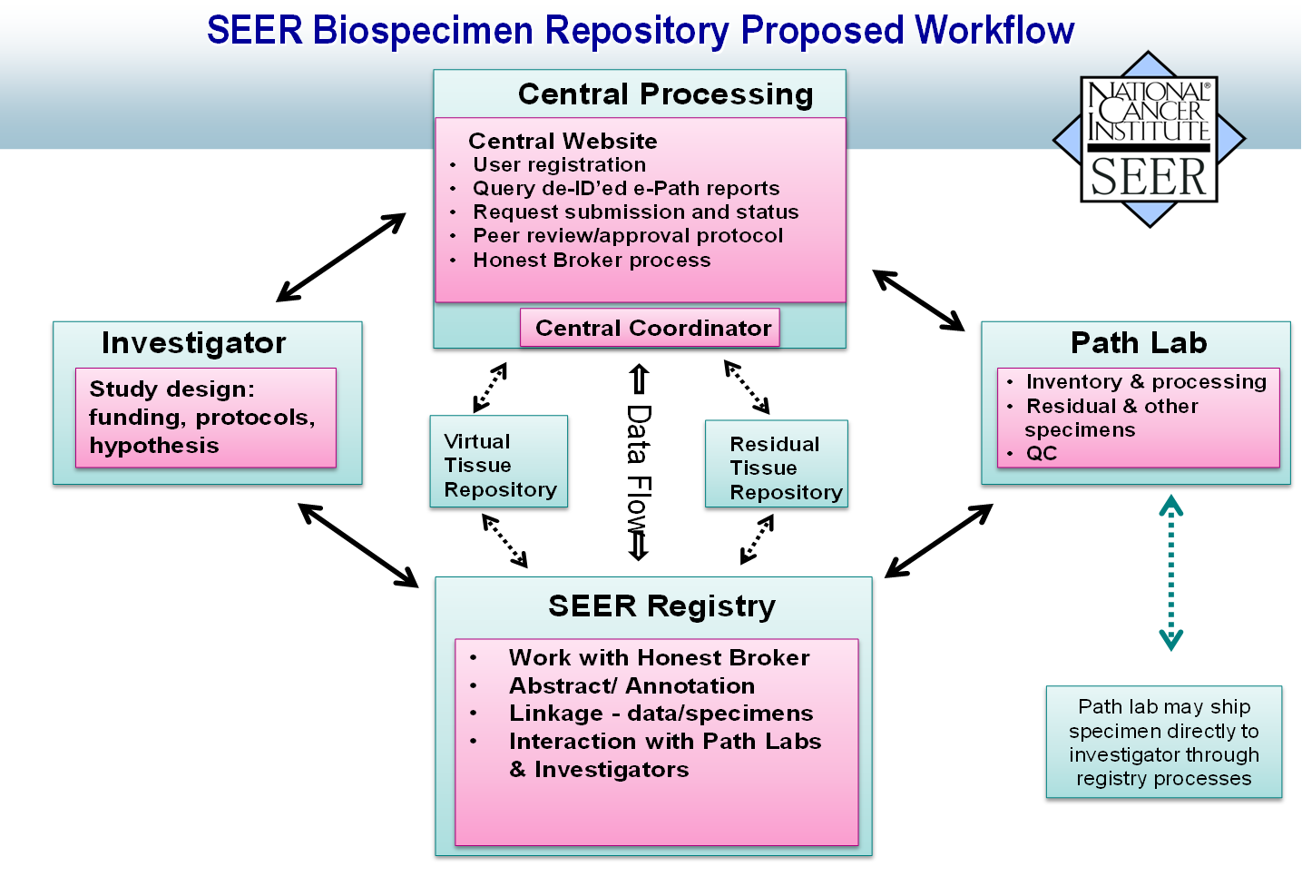
2
1
4
3

Slide 6
VTR Pilot Projects & Objectives
To establish best practices & feasibility of VTR
Pathology laboratory inventory
Whole slide imaging project
Two use-case projects of unusual outcomes
  Pancreatic ductal adenocarcinoma (PDAC)
  Breast cancer
  Molecular studies on DNA & RNA from archival FFPE
    Use of FFPE tissue for molecular studies controversial

Slide 7
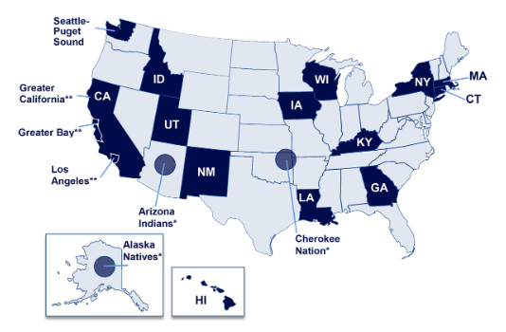
SEER Sites Participating in Pilot
Greater California
Connecticut
Hawaii
Iowa
Kentucky
Louisiana
Utah

Slide 8
Objectives of Molecular Studies
Feasibility & best practices for obtaining FFPE tissue for molecular studies via SEER program
Feasibility of molecular studies & quality of molecular data obtained using DNA/RNA from diagnostic, archival FFPE
Identification of factors associated w/ survival
  Genomic & transcriptomic signatures
  Clinical & treatment characteristics
Associations b/w molecular & clinical characteristics

Slide 9
VTR PDAC Pilot
Comparing 100 PDAC pairs
  Unusual survival (5 years)
  Usual survival (≤2 years)
VTR Technical Pilot
  Subset of 24 pairs
  Determination of tests for study on rest of pairs
Molecular Studies
  Tumor & Normal: WGS & WES
  Tumor: methylation studies & RNASeq

Slide 10
Tissue Age & DNA Quality
P <0.001

Slide 11
Sequencing Quality Summary
DNA & Whole Genome Sequencing
  Good quality achieved with DNA from archival tumor & normal/nontumor FFPE tissue
  Small decrease in WGS quality in specimens >10 yrs
RNA & RNA Sequencing
  High quantity & poor quality of tumor RNA obtained

Slide 12
VTR Pilot: Challenges Faced
Variability in laboratory policies for sharing tissue
Obtaining Tissue
  For cancer subjects pair-matched across registries
  Destroyed when CAP retention requirements met (after 10 yrs)
  Variability in registry’s relationships w/ labs
  Destruction by natural disaster (e.g., hurricane prone regions)
  Competing demands for tissue
  Laboratory fees for determining tissue availability

Slide 13
VTR PDAC Pilot: Challenges Faced
  Tissue-based sources of subject failure
  Tissue not available
  Tissue depleted for other purposes
  Tumor determined to not be PDAC by expert pathologist
  Too much necrosis
  Insufficient tumor cellularity

Slide 14
VTR Pilot: Lessons Learned
VTR Pilot essential for:
  Understanding best practices, barriers, & limitations
  Estimating realistic time frames
  Assessing cost to registries, pathology laboratories & investigators
  Evaluate usability of archival FFPE tissue blocks for molecular studies
  Understanding need to oversample
  Concurrent expansion of RTRs needed

Slide 15
Planning for Scaling the VTR
Project proposal review, approval, & tracking
    Proposal submission & review system
    Review board to include registries, NCI, scientists, & patient advocates/patients
Funding Mechanisms
  Partial support for VTR personnel at each registry
  Investigator support through grants
Investigator search, sample selection, & specimen requests

Slide 16
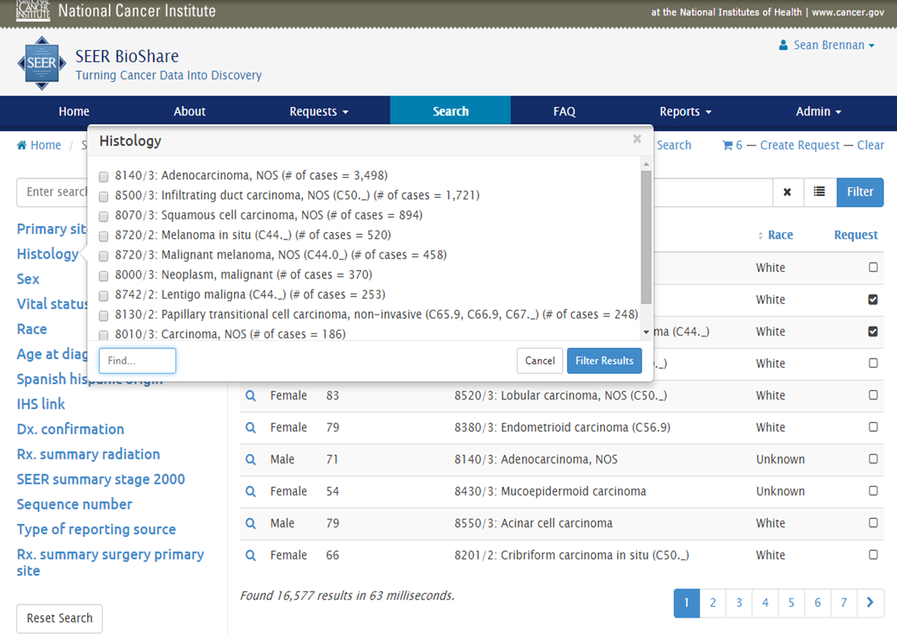

Slide 17
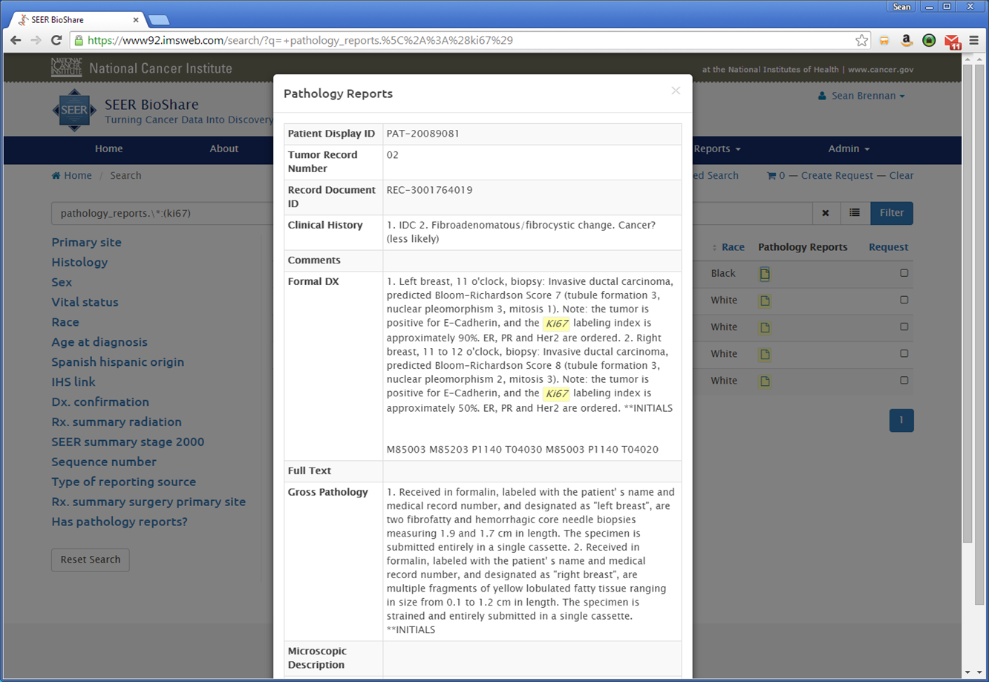
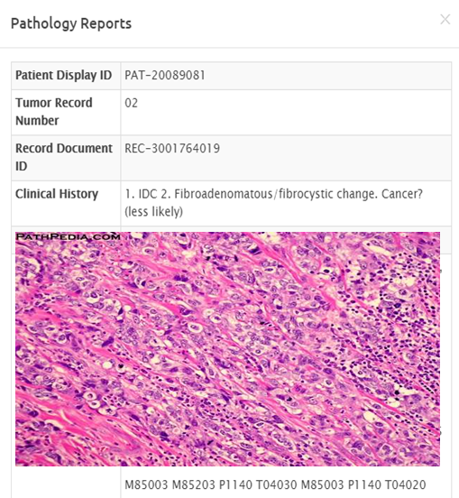

Slide 18
Summary
SEER well-suited for development of VTR
SEER-Linked VTR infrastructure is feasible
Archival, diagnostic FFPE tissue is obtainable & suitable for some molecular studies
Concurrent expansion of RTRs is critical to success of future VTR to capture discarded specimens
Notes:
1. this is doable
2. ffpe works
3. there are challenges and here they are
4. we are going to do it and here’s how

Slide 19
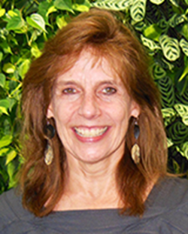
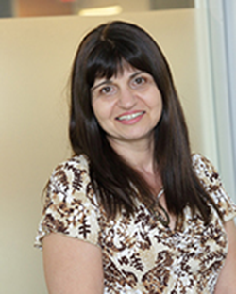
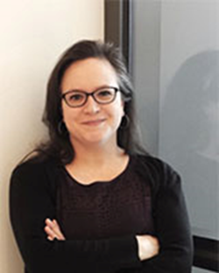
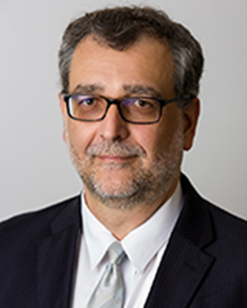
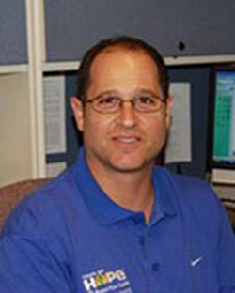
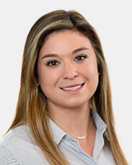
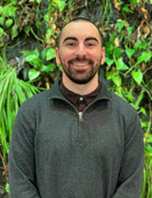
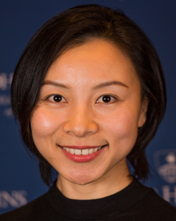
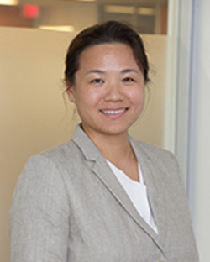
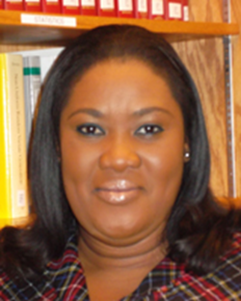
Current VTR Team
Lynne Penberthy
Valentina Petkov
Alison
Van Dyke
Serban Negoita
Steve Friedman
Sarah Hussey
Connor Valenzuela
Yao Yuan
Mandi Yu
Rose Mills

Slide 20
Acknowledgements
SRP SEER Registry PIs PanCAN
Lynne Penberthy Rosemary Cress Lynn Matrisian
Valentina Petkov Brenda Hernandez Lola Rahib
Sarah Hussey Charles Lynch William Hoos
Yao Yuan Lloyd Mueller
Connor Valenzuela Carol Sweeney Emory Univ.
Steve Friedman Tom Tucker Ashish Sharma
Rose Mills Xiao-Cheng Wu
Mandi Yu Stony Brook
Serban Negoita SEER Registry Staff Joel Saltz
Rajarsa Gupta
SRP Formerly Involved Other NCI Tahsin Kurc
Sean Altekruse Elizabeth Gillanders
Jessica Boten Danielle Carrick UPMC
Alyssa Wang Ed Helton Aatur Singhi
Radim Moravec Ulrike Wagner
Marina Matatova MD Anderson
Yun Wu

Slide 21


Contact:
Alison Van Dyke, MD, PhD
alison.vandyke@nih.gov

Slide 22
Tissue Age & RNA Quality
P <0.05

