Slide 1

Using the Kentucky Cancer Registry as a Population-based Virtual Tissue Repository to Advance the Science of Cancer Research
Presented by:
Thomas C. Tucker, PhD, MPH
Associate Director
Kentucky Cancer Registry
Rachel Maynard, BHS, CTR
VTR Project Director
Kentucky Cancer Registry
NAACCR/IACR Vancouver Canada
June 11, 2019

Slide 2
Topics to be discussed
Why is population-based data important?
What is a population-based Virtual Tissue Repository?
Things to consider when establishing a VTR
Example 1: Using the Kentucky Cancer Registry as a Virtual Tissue Repository

Slide 3
Why is Population-Based Cancer Data important for cancer research?
Two important concepts
Internal validity
External validity

Slide 4
Animal Studies
genetically identical mice | Developed Disease | Did not Develop Disease
Exposed Mice | A | B
Unexposed Mice | C | D
Time
Relative Risk = (A/A+B)/(C/C+D)

Slide 5
Randomized Clinical Trial
Randomized trial (Prospective) | Study Outcome Occurred | Did not Occur
Exposure or Intervention | A | B
No Exposure or Intervention | C | D
Random Allocation
Time
Relative Risk = (A/A+B)/(C/C+D)

Slide 6
Internal Validity
When differences between the experimental (exposed) group and the control group are completely accounted for, the study is said to have internal validity and causal inferences can be made.
In other words, it is possible to determine whether the exposure causes some outcome (disease, etc.).
Many have argued that “randomization” was the most important scientific advance of the 20th century.
Why is it that the findings from randomized clinical trials with internal validity almost never have the same effect when they are applied to general populations?

Slide 7
External Validity
When the findings from a research project or study can be generalized to some defined population, they are said to have external validity.
Epidemiology (population science) provides the tools to explore external validity and many argue that moving from studies with strong internal validity to studies with strong external validity is the next step in advancing our scientific understanding.
The continuum from research with strong internal validity to studies with strong external validity is also part of “Translational Research”.

Slide 8
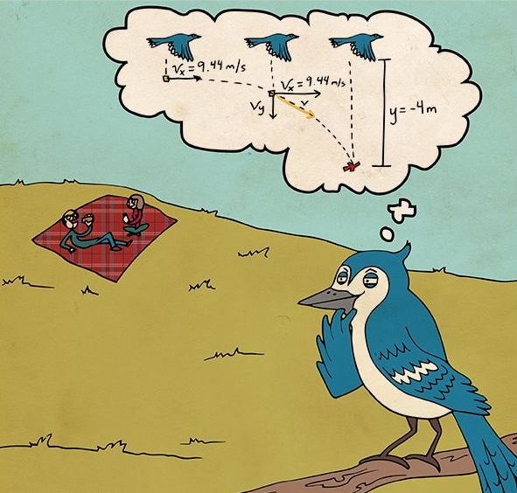
Translational Research: The trajectory of science from the conception of an idea through the research that leads to its impact on real people

Slide 9

The ultimate goal of translational research is to have an impact on the population we serve.

Slide 10
Population-based Cancer Surveillance Programs Can Enhance Cancer Research by Providing Tools that Lead to Studies with Strong External Validity

Slide 11

Using the Registry as a Population-Based Virtual Tissue Repository
Geographic Area Covered by the
Population-Based Cancer Registry
Cancer research with strong “external validity”
(the ability to generalize the findings to the underlying population)
Pathology Labs
The Population-Based
Cancer Registry
Formalin fixed paraffin imbedded tissue samples are collected from the labs by the Registry for a population-based sample of cases
A population-based sample of deidentified cancer case data and tissue are provided to the researcher

Slide 12
Things to Consider
Financial component
Labor Intensive
Central Processing Lab
Services available
Limitations
Notes:
As we have started to build our VTR infrastructure we have learned some key things to consider: the financial component, how labor intensive it can be, the benefits of using a central processing lab, the services that can be provided, and last we will discuss the limitations of the VTR.

Slide 13
Financial Component
Dedicated staff are vital to the infrastructure of the VTR
Pathology labs will charge to retrieve blocks and slides for the VTR
Pathologists may charge to screen cases to ensure they meet study criteria
Researchers need to be aware of potential cost in order to budget the VTR into their proposals
Notes:
Financial Component Lessons/Considerations
You must have funding for dedicated staff for the VTR in order to be successful
Pathology labs have to store their archival slides and blocks in off site storage locations and they will incur expenses to request those. So, they will charge the VTR for retrieving and shipping requested blocks and slides.
Pathologists will charge if they are asked to screen cases for things such as tumor cellularity and tumor necrosis.
Therefore, researchers need to be aware of these potential costs in order to budget the costs into their proposals

Slide 14
Labor Intensive
Clinical Pathology labs are extremely busy and often under staffed
Clinical care is the main priority for clinical pathology labs; not research
Staffing the infrastructure of the VTR requires a specialized skill set that can be difficult to recruit
Notes:
Let me first explain that the clinical pathology labs I am referring to are the stand alone and hospital pathology labs that have the archival slides and tissues. You must remain mindful that these clinical pathology labs are extremely busy, often understaffed, and experience high staff turnover.
Providing clinical care to their patients is their main priority; not research
Allow time in your proposals to allow them to work it into their already busy schedules, it will NOT be an overnight turnaround
Staffing the infrastructure of the VTR requires a specialized skill set that can be difficult to recruit (understanding of how the clinical labs function and how the registry functions)

Slide 15
Central Processing Laboratory
Clinical Pathology labs are more likely to participate in the study if they are not asked to process the Biospecimen
Utilizing a Central Processing Lab will improve your timeline for submitting biospecimen for analysis
Utilizing a Central Processing Lab allows you to have quality control
Establishing a Central Processing Laboratory for the VTR is necessary for success
Notes:
What do I mean by a Central Processing Laboratory? A Central Processing Laboratory is a research laboratory that you can partner with to perform the processing of the biospecimens for your studies. At the Kentucky Cancer Registry we have partnered with the Markey Cancer Center’s Biospecimen Procurement & Translational Pathology Lab to act as our Central Processing Laboratory.
You will have increased participation if clinical labs are not expected to process the biospecimen
Your timeline will be improved for submitted biospecimen
You will have better quality in the biospecimen
Having a central processing lab is efficient, inexpensive, and will provide quality control which makes it absolutely necessary for the success of the VTR.

Slide 16
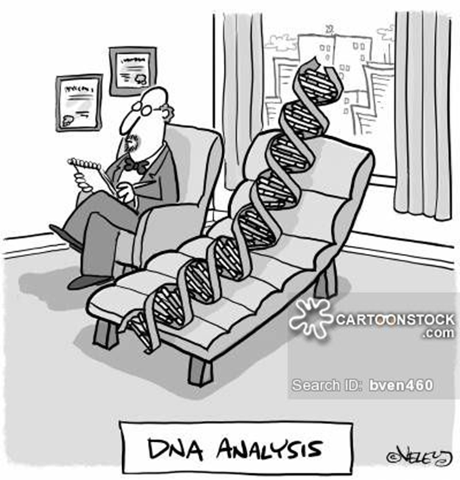
Examples of Biospecimens for VTR
FFPE tumor blocks
Histology Slides
Digital Images
Notes:
Some examples of biospecimen and testing that can be performed
Formalin-fixed paraffin embedded or FFPE tumor blocks (which are archival tissue blocks leftover from initial surgeries or biopsies)-- You can test protein expressions,
perform dna/rna extraction and analysis and Perform methylation studies
Another example is histology or H&E slides—these can be used for expert pathology review
Digital images can be used for both quality control as well as digital pathology research

Slide 17
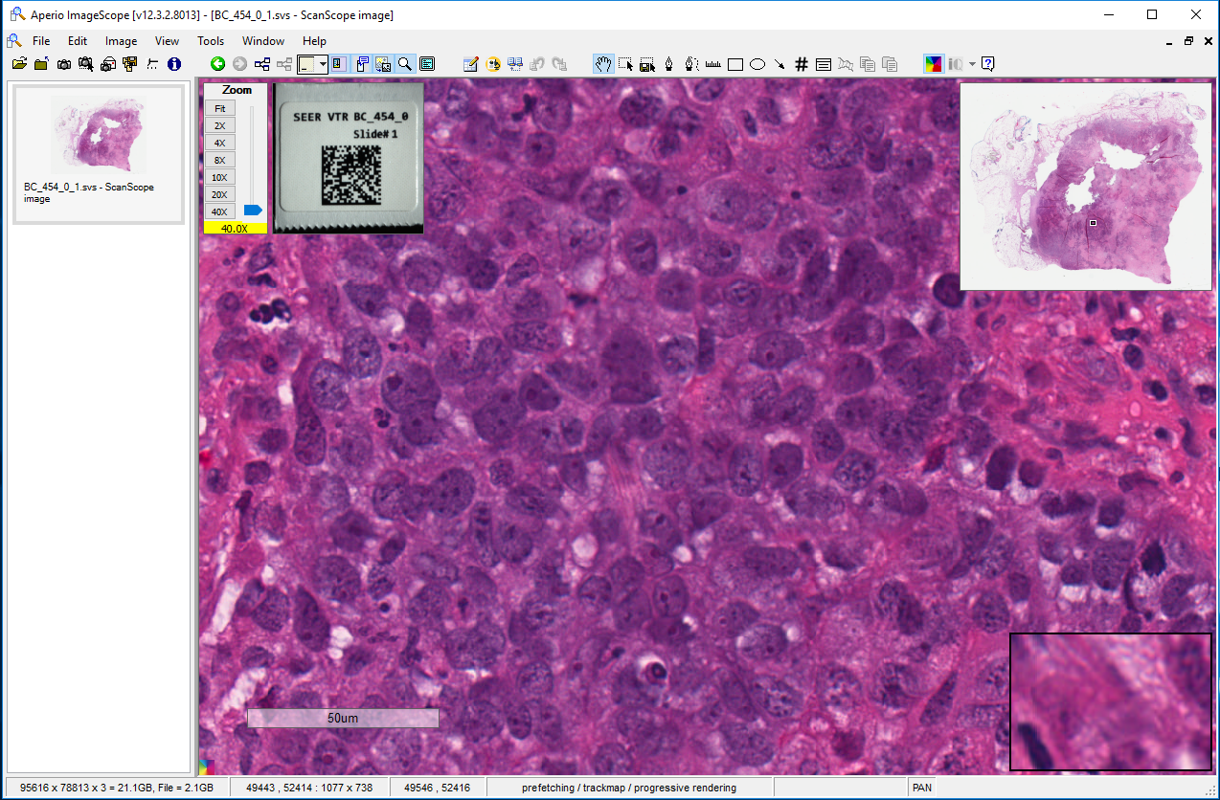

Examples of Biospecimens for VTR
Notes:
Example of how a whole slide image may look, the image to your left (click) is the original scanned image from the H&E slide and the image to your right (click) shows the area that you are zooming in on at 40x magnification.

Slide 18
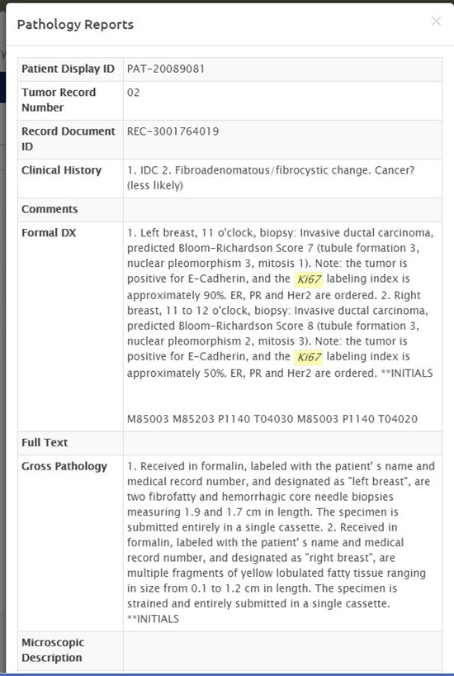
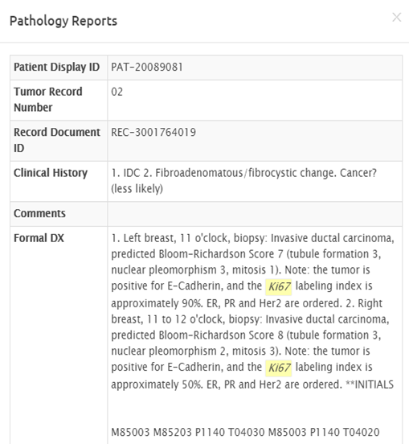

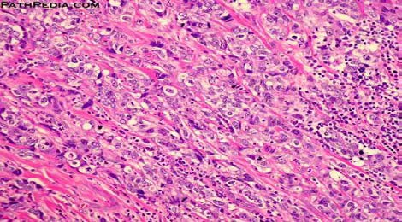
Examples of Biospecimens for VTR
Notes:
Example of how a de-identified record with a whole slide image may look. No patient identifiers (click) are listed, yet you have a clinical history (click) and a formal (click) diagnosis that can be reviewed as well as the gross (click) pathology to compare to the digital image.

Slide 19
Custom Clinical Annotation
Systemic therapy
Radiation treatment
Co-morbidities
Recurrence details
Biomarkers
Notes:
Another service of the VTR is the ability to obtain Custom Clinical Annotation specific to what the researcher is investigating. This may include specific details about systemic therapies such as exact dosages of chemo drugs, dosage changes or subsequent therapies because subsequent therapies are not always captured in central registry records.
*same thing on radiation therapy; not just first course but also subsequent therapies
*Co-morbidities--different studies ask for different things
*specific recurrence details over a specified period of time
*specific biomarkers for example CA19-9 for pancreas

Slide 20
Limitations
De-identified data sets and analysis of biospecimen
Timeframe for tissue availability, as labs destroy blocks after a set time period
Timeframe for custom clinical annotation and availability of records
Storage space for blocks and slides
Notes:
The VTR does have limitations
It is best suited to provided de-identified data sets and analysis of biospecimen
It involves a specific timeframe for tissue availability, as labs generally follow CAP protocol and destroy blocks after the required 10 year period due to space limitations
It involves a specific timeframe for custom clinical annotations for availability of medical records
It involves designated space at the central registry for storing and shipping blocks and slides
Now, Dr. Tucker will discuss an example of one study using the Cancer Registry as a VTR

Slide 21
The Five Proteins Study
One Example of using the Cancer Registry as a VTR
Par-4: pro-apoptotic tumor suppressor protein
downregulated during breast cancer recurrence
Wnt/β-catenin: signaling pathway
    induces epithelial-mesenchymal transition (EMT) and promotes metastasis
SNAIL, TWIST: transcription factors, promote EMT
  promote cancer progression (metastasis)
elevated in metastatic and recurrent tumors
c-Abl, Arg: tyrosine kinases, oncoproteins
promote survival, proliferation, and metastasis
activity levels measured by pCrkL activity

Slide 22
Causal Relationships
Direct
A D
Indirect
A B C D

Slide 23
Causal Relationships
A
B D (Necessary but not Sufficient)
C
&
&

Slide 24
A Retrospective Cohort Study
2000-2007 2012
Identify the study Population
Did Not Recur
Tissue at the time of recurrence
Recurred
Using the Registry, 479 female patients treated surgically for their 1st breast Ca. between 2000 and 2007 and determined to be disease free were identified. Tissue blocks from the initial surgery were obtained for these patients, TMAs were constructed and stained to determine activity levels for each protein. This cohort was then traced forward in time to determine which patients recurred and which did not.
Comparisons were made between activity levels of each protein among the primary tumors of recurrent patients (62) and non-recurrent patients (417).
For patients that recurred, comparisons were made between the tumor tissue at first surgery (the primary tumor) and the tissue taken at the time of recurrence. Tissue at the time of recurrence was only available for 22 patients.

Slide 25
Results
PROTEIN EXPRESSION IN PRIMARY TUMORS FROM RECURRENT VS. NON-RECURRENT PATIENTS
 |  | TWIST | SNAIL | PAR4 | β-catenin | pCrkL
Intensity | HER2+ (n=36)
 | HER2-/ER+/PR+ (n=282) | H |  |  |  | L
 | HER2-/ER-/PR+ (n=32)
 | HER2-/ER-/PR- (n=75)
Allred Score | HER2+
 | HER2-/ER+/PR+ | H |  |  |  | L
 | HER2-/ER-/PR+
 | HER2-/ER-/PR-
Intensity X Percent | HER2+
 | HER2-/ER+/PR+ | H |  |  |  | L
 | HER2-/ER-/PR+
 | HER2-/ER-/PR-
H: Significantly high in the primary tumor of recurrent patients
L: Significantly low in the primary tumor of recurrent patients

Slide 26
Results
PROTEIN EXPRESSION IN RECURRENT VS. PRIMARY TUMORS
 | TWIST | SNAIL | PAR4 | β-CATENIN | pCrkL
Intensity |  |  |  |  | H
Allred Score |  |  |  |  | H
Intensity x Percentage |  |  |  |  | H
H: Significantly high at the time of recurrence in the tissue sample of
patient who recurred compared to their primary tumors

Slide 27
Results
pCrkL EXPRESSION IN RECURRENT VS. PRIMARY TUMORS

Slide 28
Conclusions
Elevated levels of Twist, and low or not detectable c-Abl/Arg (pCrkL) in HER2⁻/ER⁺/PR⁺ breast tumors may potentially serve as a novel biomarker for the recurrence of breast cancer.
c-Abl/Arg was over expressed in the tumors of patients at the time of recurrence. Inhibiting c-Abl/Arg activation may potentially prevent recurrence.
It is difficult to imagine doing this study without using a population-based approach.
Reference: He C, Plattner R, Rangnekar V, Zhou B, Liu C, Stewart R, Huang B, Wang C, and Tucker T. Potential protein markers for breast cancer recurrence: a retrospective cohort study. Cancer Causes & Control. 2019 Jan;30(1):41-51.

Slide 29
CONTACT INFORMATION:
Thomas C. Tucker, PhD, MPH
Associate Director for Cancer Prevention and Control
Markey Cancer Center
University of Kentucky
tct@kcr.uky.edu
Rachel Maynard, BHS, CTR
VTR Project Director
Kentucky Cancer Registry
University of Kentucky
rmaynard@kcr.uky.edu
Questions

