Slide 1
Dual Primary Malignancy: A Primary Cause of Concern
Swarnima Jaitley , Rupal Tripathi; Shweta Sharma; Deepika Paliwal; Poonam Thakur; Anurag Mehta; Dinesh Doval
Notes:
Good Morning to all the dignitaries present and my dear colleagues. I am Swarnima Jaitley working as Research Administrator at Rajiv Gandhi cancer Institute & Research Center. The topic of my presentation is Dual Primary Malignancies: A primary cause of concern. I will begin my presentation by giving the world statistics on Cancer.

Slide 2
CANCER STATISTICS- WORLD
Cancer is the second leading cause of death globally
An estimated 9.6 million deaths in 2018. Globally,
Approximately 70% of deaths from cancer occur in low- and middle-income countries.
Around one third of deaths from cancer are due to the 5 leading behavioral and dietary risks: high body mass index, low fruit and vegetable intake, lack of physical activity, tobacco use, and alcohol use.
Tobacco use is the most important risk factor and is responsible for approximately 22% of cancer deaths.
Cancer causing infections, such as hepatitis and human papilloma virus (HPV), are responsible for up to 25% of cancer cases in low- and middle-income countries
The economic impact of cancer is significant and is increasing. The total annual economic cost of cancer in 2010 was estimated at approximately US$ 1.16 trillion
Only 1 in 5 low- and middle-income countries have the necessary data to drive cancer policy
Globocan- 2018
Notes:
Cancer brings an increasing health and economic burden worldwide, and the greatest impact it has on the most vulnerable populations. So we may say that 47% of the cancers are avoidable worldwide because either they are due to habits or infections.

Slide 3
Total population 7632819272
Number of new cases 18078957
Number of deaths 9555027
Number of prevalent cases (5-year) 43841302
Globocan- 2018
Notes:
This data is from Globocan 2018. It talks about the total number of New cases in the year 2018. Cancer is a disease of differences. It’s a global problem, but it is very different by region and country. It is also a disease of inequality. I will explain this in my next slide.

Slide 4
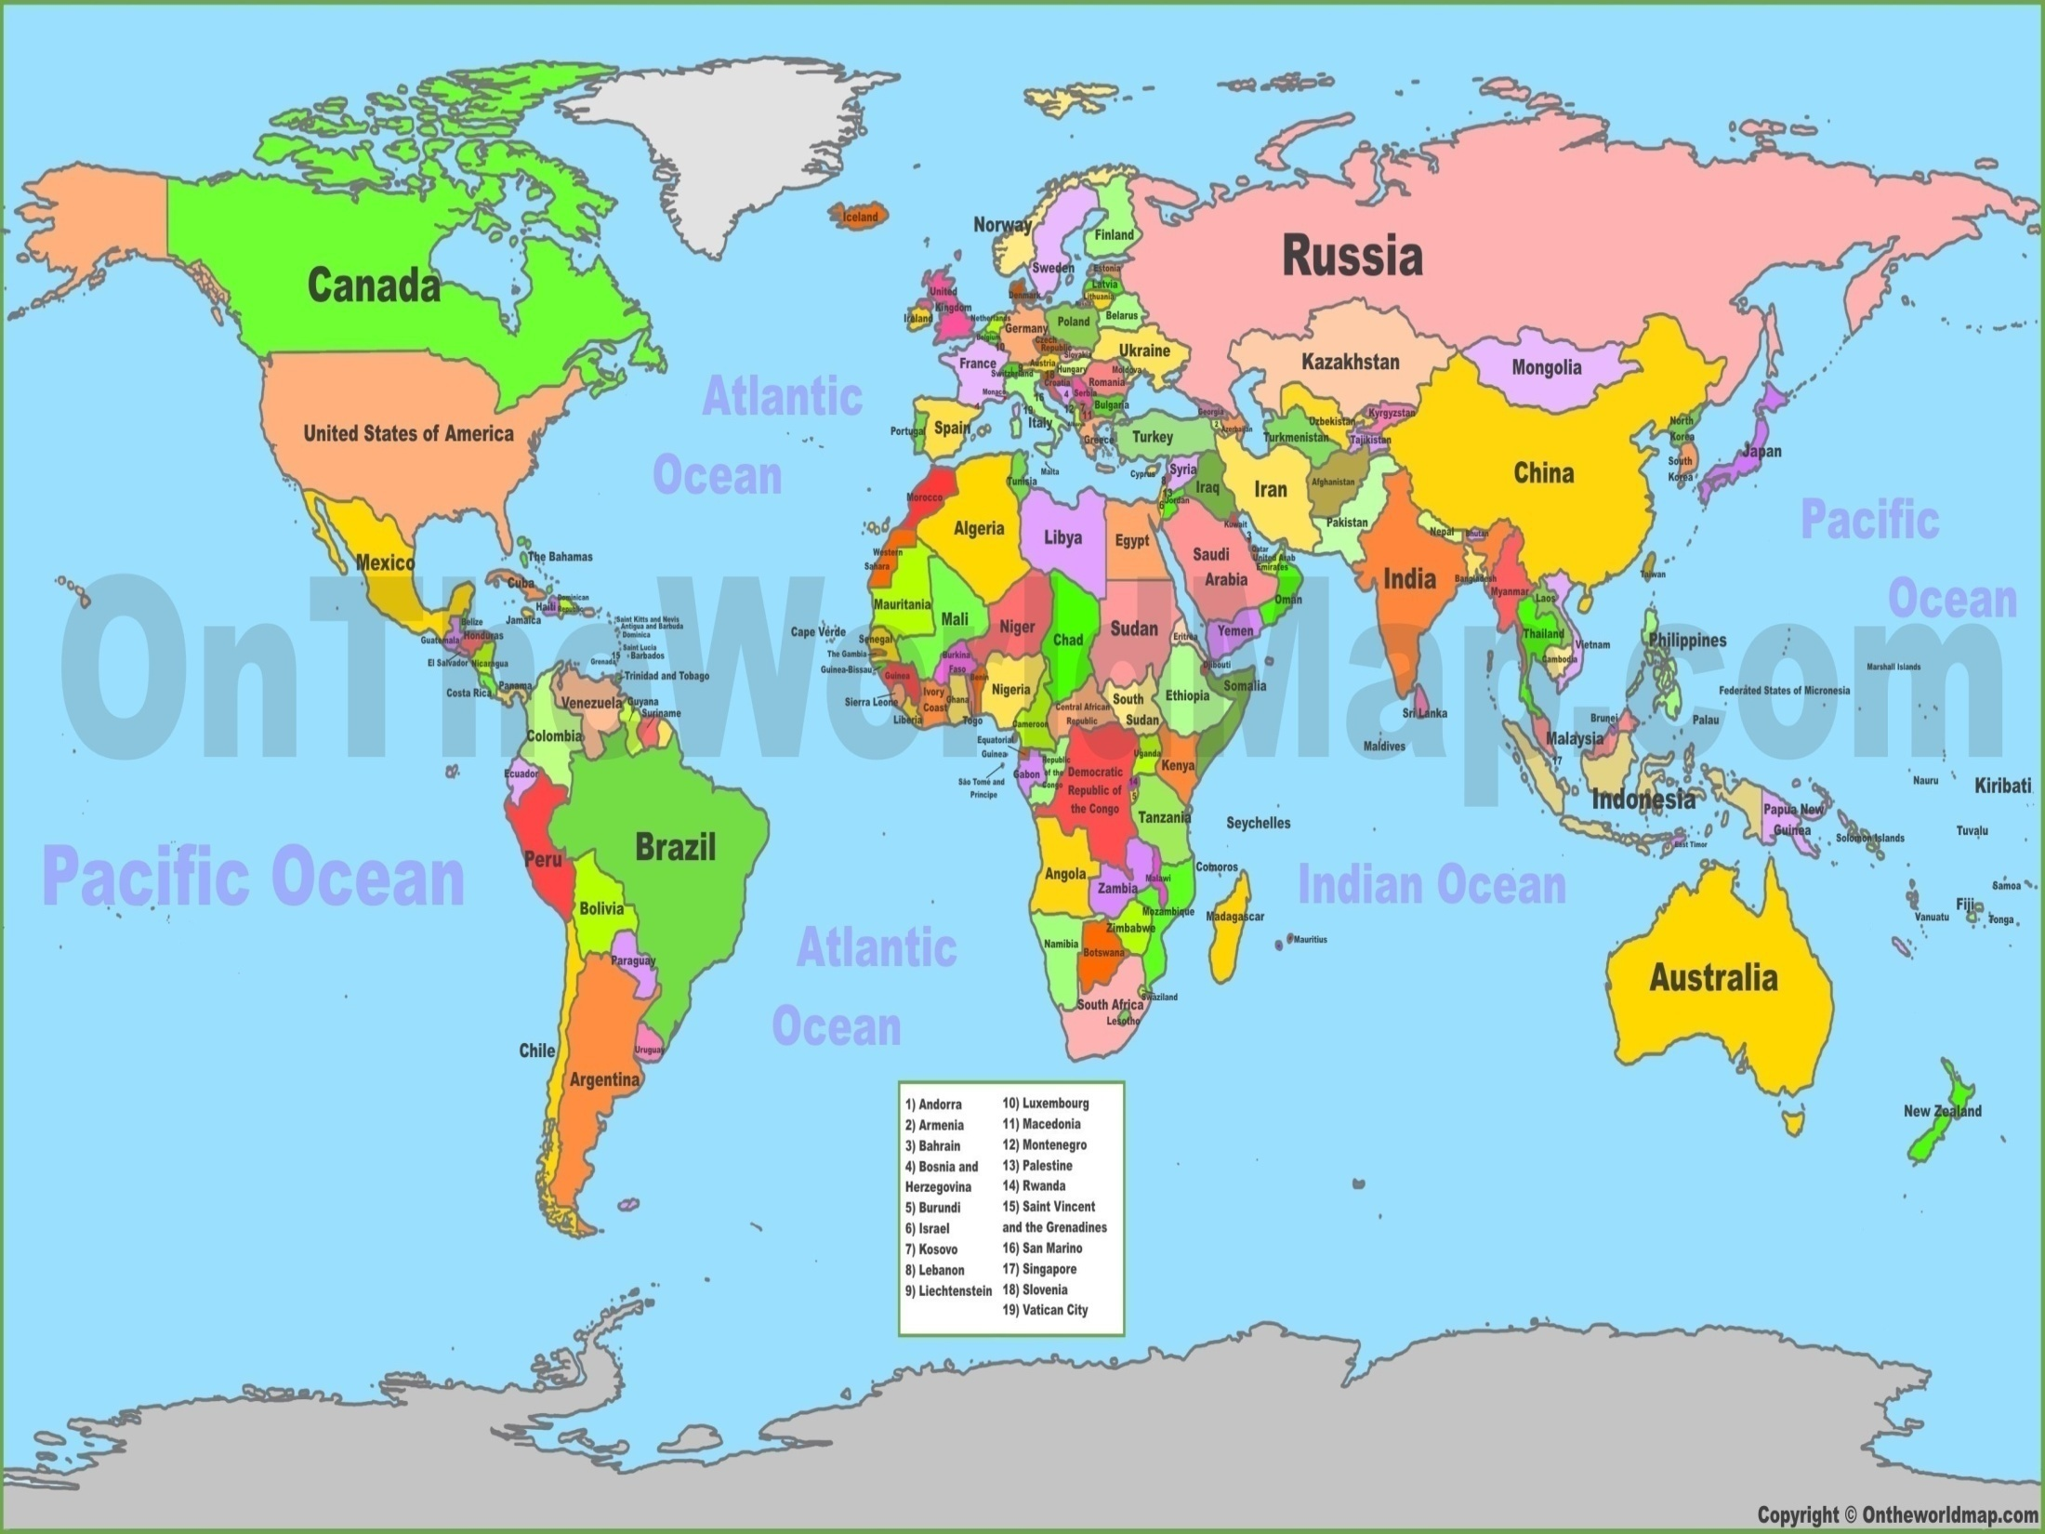
Notes:
World’s sixth largest economy , world’s largest democracy, 2nd most populous country. Population Growth rate is so high that we add the population of Australia every year to the current population.

Slide 5
5,000 year old civilization
419 Languages spoken
23 official languages
29 states, 7 union territories
Area – 3.28 million sq. kilometers
7th Largest country in the world
2nd most populous country in the world
Coastline- 7517 kilometers
133.92 crores people in 2017
Notes:
We may say that the tremendous and abstruse land of India is the only nation in the world with a diversity in culture, language, religions and races.

Slide 6
Total population: 1354051855
Number of new cases: 1157294
Number of deaths: 784821
Number of prevalent cases (5-year): 2258208
Globocan 2018
Notes:
This slide shows number cancer cases reported in India in the year 2018. The cancer of lip & oral cavity is not seen in western population this is usually attributed to indiscriminate usage tobacco and tobacco-related products, over a prolonged period of time, which leads to genetic damage. With respect to females, breast is no. one malignancy in the urban population but in rural population it is cancer of cervix.

Slide 7
CANCER STATISTICS- INDIA
The five most frequent cancers in India between men and women are breast, cervical, oral cavity, lung, and colorectal.
These top five account for 47.2 per cent of all cancers
Cancer is the second most common cause of death in India (after cardiovascular disease).
7. The average age for breast cancer in India is almost a decade lower than that in the west.
8. Cancers of major public health relevance such as breast, oral, cervical, gastric, lung, and colorectal cancer can be cured if detected early and treated adequately. One woman dies of cervical cancer every 8 minutes in India
4. As many as 2,500 persons die every day due to tobacco -related diseases in India.
5. More women in India die from cervical cancer than in any other country. Rural women are at higher risk of developing cervical cancer as compared to their urban counterparts.
6. Breast cancer is the most common cancer in women in India and accounts for about a quarter of all cancers in women in Indian cities
Globocan- 2018
Notes:
In India, 40% of cancers are tobacco related while 20 % are related to infections like hepatitis B and HPV infections. This means 60% of the cancers in India can be avoided and if detected in early stage they are curable.

Slide 8
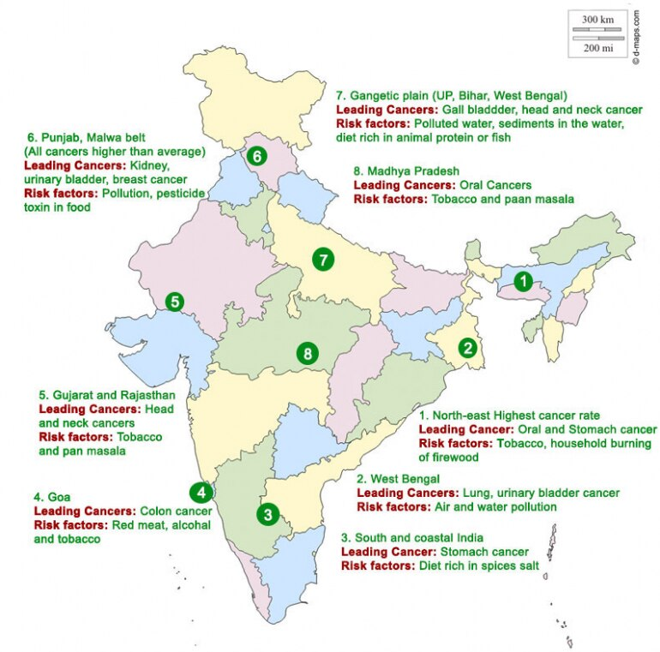
CANCER STATSTICTS- INDIA
Geographic distribution and burden of cancers in India. (Image: cancerindia.org)
Notes:
As mentioned before, India is a land of diversity and this can be further reiterated if we look at the Geographic distribution and burden of cancers in India regionwise. The current slide shows the leading site of cancer in different regions of India followed by the risk factor

Slide 9
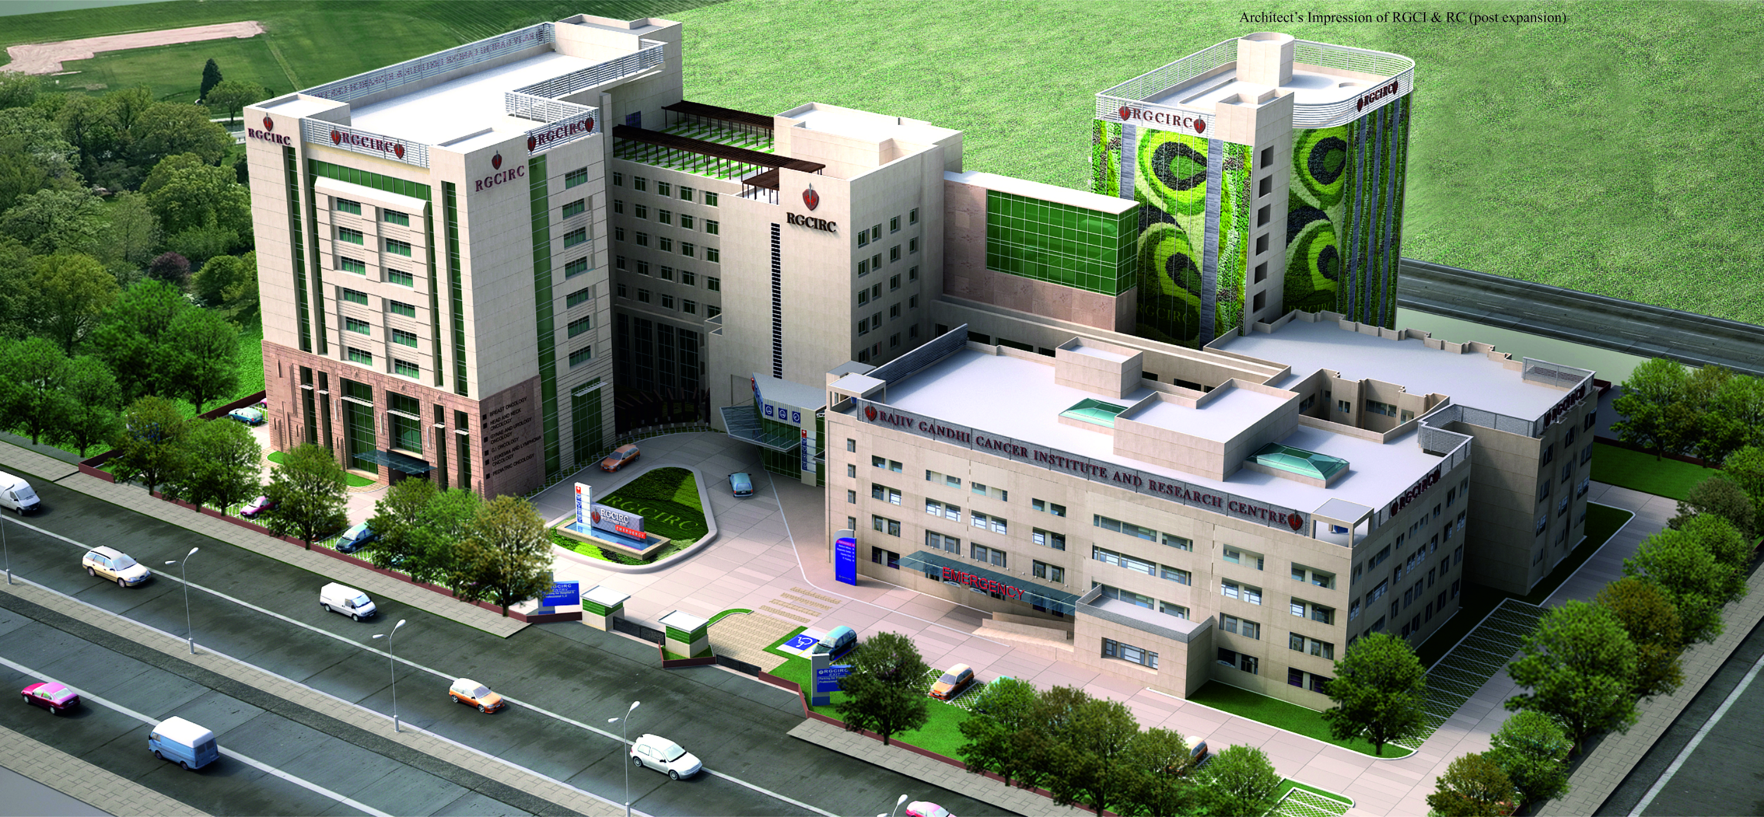
Notes:
I work as Research Administrator in Rajiv Gandhi Cancer Institute & Research Center. Rajiv Gandhi Cancer Institute & Research Centre is today counted amongst Asia’s premier exclusive cancer centres that offer the unique advantage of cutting edge technology, put to use by renowned super specialists.

Slide 10
PROFILE OF THE INSTITUTE
Owned by the Indraprastha Cancer Society and Research Centre.
Run on : “No Profit No Loss Basis”.
Managed by a Governing Council appointed by Indraprastha Cancer Society and Research Centre
Hospital started in July 1996 as a 152 Bedded Hospital
Total area of the hospital 5 acres.
Presently 498 Bedded NABH Accredited Hospital
Aims to Provide the Best Oncology Care
Registered almost 2.6 lacs patients in last 23 yrs
Notes:
In brief, I will present the profile of the Institute. What ever profit the Institute gets, it goes back to the Institute in terms of increasing the cutting edge facilities, no of beds, ancillary services and so on.

Slide 11
VISION
MISSION
To prevent and treat cancer by providing affordable oncology care of international standards in India
To be the largest cancer care provider in India by 2020
MISSION
Offering comprehensive services from prevention to palliation at an affordable price
MISSION
Based on core values of quality, ethics, compassion and respect for all
Notes:
Affordable: I would like to stress on this word. We would like to offer treatment at affordable prize.

Slide 12
SOME FACTS…
We practice multi-disciplinary site specific medicine – Tumor Boards for rarer cases
Every day about 800 patients are seen by Doctors in the OPD
About 26839 admissions in 2018
The Radiation department delivers 1200 radiation sessions every week
More than 622 BMT have been performed including India’s first MUD transplant
Nearly 2989 robotic surgeries have been performed for cancer patients
The only hospital in the country to have installed a Molecular Diagnostic Laboratory

Slide 13
FACILITIES
Medical Oncology with facilities for Day care
Surgical Oncology with 11 well equipped Operation theatres including Da Vinci Robot
Radiation oncology with 5 Linear Accelerators
Independent Bone Marrow Transplant Unit
True Beam, Rapid Arc IGRT system, SBRT and Brachytherapy
Pediatric Oncology Unit
Dedicated Research Department

Slide 14
ACADEMIC PROGRAMS
Post Graduate Program, DNB (Diploma of National Board) in Radiotherapy, Radiology, Anesthesiology, Surgical Oncology and Medical Oncology
2 year Fellowship Program in Pediatric Hemato Oncology
B Sc Medical Technology (Radiotherapy)
Diploma in
X-Ray & Imaging Technology (DXIT)
Operation Theatre Technology (DOT)
Medical Laboratory Technology (DMLT)
Medical Records Technology (DMRT)
One year on job training course in “MRI in Oncology” exclusively at RGCIRC
Fellowship in Uro – Oncology by SUI (Society Urology Internationale
Notes:
The Institute has a strong academic program

Slide 15
REGISTRATION AT RGCIRC
Medical Records Department – 1996
Total Registration- 226012
Notes:
The slide gives the no. of registration in RGCIRC from 1996 to 2017 that is 21 years and how the numbers are going up consecutively. It reflects the fact that the incidence of cancer is rising in India.

Slide 16
AGE WISE DISTRIBUTION OF ALL CANCERS 1996-2017
Total Registration- 226012
Notes:
Here we see that the maximum no of cases are registered in the age group of 50 – 65. The most productive years of a man’s life.

Slide 17
MAGNITUDE OF CANCER BY GENDER
Notes:
Here we are comparing the magnitude of cancer between male and female. Males have always outnumbered the females.

Slide 18
LEADING SITES OF CANCER – MALE (1996-2017)
Notes:
This reflects the pattern at RGCIRC and not India. This institute is located in the capital of India and caters more to the urban population of India.

Slide 19
LEADING SITES OF CANCER –FEMALE (1996-2017)
Represents Data of RGCIRC not India
Notes:
In rural areas ca cervix is the number one malignancy. The cancer Registry in India gives a different picture for urban and rural population

Slide 20
MULTIPLE PRIMARY MALIGNANCY
Primary malignant tumors of different histological origins in an individual is defined as Multiple Primary Malignancy.
An increase in trend of people with multiple primary malignancies as a result of :
Improved diagnostics techniques & treatment modalities
Prolonged Life span
Enhanced survival of patients with malignancy

Slide 21
MULTIPLE PRIMARY MALIGNANCY
Previous studies indicate the incidence of multiple primary cancers to be between 0.734% and 11.7%.
The occurrence of another malignancy of different organ in patients with known malignant tumor is known as double malignancy
Synchronous - in which the cancer occurs at the same time or within 6 months
Metachronous- in which cancer follows in sequence more than 6 months apart.

Slide 22
OBJECTIVE & METHDOLOGY
A retrospective study.
Patients with dual primary malignancy over a period of five years (2012-2016) were included in the study.
The demographic, clinical and survival profile of the patients was analyzed.
To analyze the demographic, clinical and survival profile of patients with dual primary malignancies.

Slide 23
Total no. of malignant cases over a period of five years (2012-2016)
41,000
Total no. of patients with dual primary malignancy, n=216

Slide 24
Gender-wise Distribution

Slide 25
Most Common First Primary Malignancy
Most Common Second Primary Malignancy
Notes:
The most common first primary malignancy is Head & neck followed by genito-urinary and GI Malignancy. While the most common second primary malignancy was genito-urinary followed by head & neck, GI Malignancies

Slide 26
Distribution on the Basis of Age Group
Notes:
The cases of dual primary malignancies were seen maximum in the age group of 41-60.

Slide 27
Distribution on the Basis of Time Interval of Occurrence
Notes:
60% of the dual Malignancies were metachronous while rest 40% were synchronous

Slide 28
Site of first primary malignancy- Results
Site of first primary malignancy | Male | Female | Total
Head & Neck | 61 | 7 | 68
Breast | 2 | 46 | 48
Lung | 2 | 1 | 3
Genitourinary | 26 | 32 | 58
Gastrointestinal | 20 | 11 | 31
Leukemia/ Lymphoma | 4 | 2 | 6
Bone | 2 | 0 | 2
Brain | 0 | 0 | 0
Total | 117 | 99 | 216
p-value <0.001
Notes:
In males, Head & neck is the first site of primary malignancy, while in female its is breast

Slide 29
Results
Site of second primary malignancy | Male | Female | Total
Head & Neck | 38 | 14 | 52
Breast | 0 | 13 | 13
Lung | 15 | 5 | 20
Genitourinary | 24 | 48 | 72
Gastrointestinal | 32 | 12 | 44
Leukemia/ Lymphoma | 6 | 5 | 11
Bone | 1 | 2 | 3
Brain | 1 | 0 | 1
Total | 117 | 99 | 216
p-value <0.001
Notes:
In males, second site of primary malignancy was again head & Neck closely followed by gastro-intestinal and genitourinary. While in females the second site of primary malignancy is genitourinary followed by head& Neck, breast with vast difference.

Slide 30
Male
Site of First Primary Malignancy
Site of Second Primary Malignancy
Notes:
This is the graphical representation of the table shown before. In males, head & neck is site of first as well as the second primary. Genitourinary is the second most common first malignancy while gastrointestinal is the second most common second primary malignancy.

Slide 31
Female
Site of First Primary Malignancy
Site of Second Primary Malignancy
Notes:
In females, first site of primary malignancy is breast and the second most common site of primary malignancy is genitourinary followed by head& Neck, breast with vast difference.

Slide 32
Characteristics | Age at first primary malignancy (years) | Age at second primary malignancy (years) | Overall survival (months) | Duration between diagnosis of first and second primary malignancies
Mean +std dev | 54.6+11.6 | 58.8+11.3 | 75.1+87.6 | 52.4+79.7
Median (Range) | 55 (23-88) | 59 (25-89) | 47 (0-502) | 19 (0-501)

Slide 33
SURVIVAL PROFILE
Alive: 32 (14.8 %)
Dead :78 (36.1%)
Lost to follow-up: 106 (49.1%)
Notes:
The medical records of all the patients were checked. If they were not at regular follow-up, the patients were telephonically contacted to know their status.

Slide 34
CONCLUSION
Early detection and treatment is the key to better management of patients with double primary malignancies.
In a developing country like India, regular screening and follow up visits may help in the early detection of both synchronous and metachronous double primary malignancies.

Slide 35
REFERENCES
Dhillon, Preet K., et al. "The burden of cancers and their variations across the states of India: the Global Burden of Disease Study 1990–2016." The Lancet Oncology 19.10 (2018): 1289-1306.
Vogt, Alexia, et al. "Multiple primary tumours: challenges and approaches, a review." ESMO open 2.2 (2017): e000172.
Dandona, L., et al. "India State-Level Disease Burden Initiative Collaborators. Nations within a nation: variations in epidemiological transition across the states of India, 1990–2016 in the Global Burden of Disease Study." Lancet390.10111 (2017): 2437-60.
Sullivan, Richard, et al. "Cancer research in India: national priorities, global results." The Lancet Oncology 15.6 (2014): e213-e222.
www.who.int/news-room/fact-sheets/detail/cancer
(2) GBD 2015 Risk Factors Collaborators. Global, regional, and national comparative risk assessment of 79 behavioural, environmental and occupational, and metabolic risks or clusters of risks, 1990-2015: a systematic analysis for the Global Burden of Disease Study 2015. Lancet. 2016 Oct; 388 (10053):1659-1724.
(3) Plummer M, de Martel C, Vignat J, Ferlay J, Bray F, Franceschi S. Global burden of cancers attributable to infections in 2012: a synthetic analysis. Lancet Glob Health. 2016 Sep;4(9):e609-16. doi: 10.1016/S2214-109X(16)30143-7.
https://www.indiatoday.in/education-today/gk-current-affairs/story/cancer-rate-india-stats-cure-treatment-1386739-2018-11-12
Dual malignancies: Do they have a worse prognosis than their individual counterparts TVA Chowdary, SM Sivaraj, GV Rao, S ThirunavukkarasuDepartment of Surgical Gastroenterology, Narayana Medical College, Chintareddipalem, Nellore, Andhra Pradesh, India

