Slide 1
Navigating through the Meaningful Use Stage 2 journey

Slide 2
Agenda for this Segment
Progress to Date
Journey of MU2 Data
Transport Mechanism
Testing and Validation Process
Processing MU2 data
Experiences
Future Plans

Slide 3
Progress to Date
Over 2000 EPs registered on the NC-CCR MU2 portal.
Actively testing with 43 different physician offices
Collaboration with 5 EHR vendors
Successful data submission from 6-7 dermatology offices
Successfully tested the parsing of MU2 data into the registry system

Slide 4
Active EHRs
Modernizing Medicine
Nextgen/TSI Healthcare
Nextech
Flat Iron (Previously Altos Solutions)
Athena Health
Notes:
As you see all the Cancer Diagnosis specific information is neatly mapped and automatically filled in the boxes as you see here.
Also the TNM staging we received is mapped correctly in the right field.
We really thank CDC especially, both Wendys, Shailendra and all other staff behind the scenes for their continued support.

Slide 5
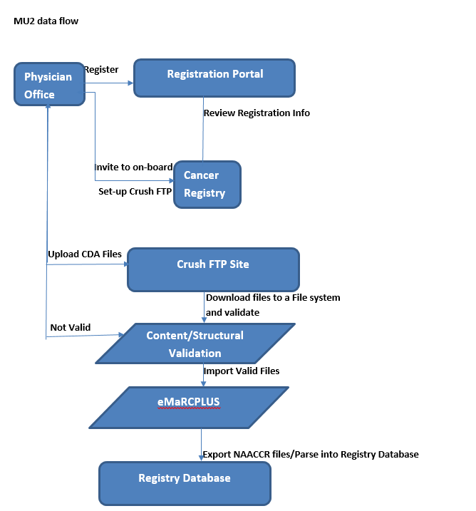
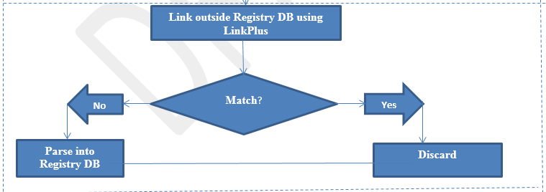
MU2 Onboarding process
Current Process to test MU2 files
Future plan to process MU2
Notes:
The first step for eligible professionals is to register their intent to report cancer for MU2 to the public health agency.
Information will be reviewed and contacted if anything is missing.
Based on the EPs EHR’s readiness, we send the invite to onboard and request EHRs and/or practices to fill out the sFTP request forms which is required by our IT team to set up an account.
We assist them with the relevant document to download/install required software to connect to our secure FTP site to test the connection and upload files.
Once we receive files we do both structural and content validation using NIST as well as CDC’s CDA Validation Plus tools.
Then we work closely with the practice if we find any errors and work with them to assist during the process, this includes visiting the practice to understand the EHR.
Once the files are compliant we process them using eMaRC Plus application.
We have successfully received complete cases from 5 dermatology offices and here is how we processed them in our current registry database.

Slide 6
Testing and Validation Process
Receive New Files
Check for NIST errors
Check for Content errors
MU2 team provide feedback
EP Office makes required fixes and re-sends the files.
Notes:
As you see all the Cancer Diagnosis specific information is neatly mapped and automatically filled in the boxes as you see here.
Also the TNM staging we received is mapped correctly in the right field.
We really thank CDC especially, both Wendys, Shailendra and all other staff behind the scenes for their continued support.

Slide 7
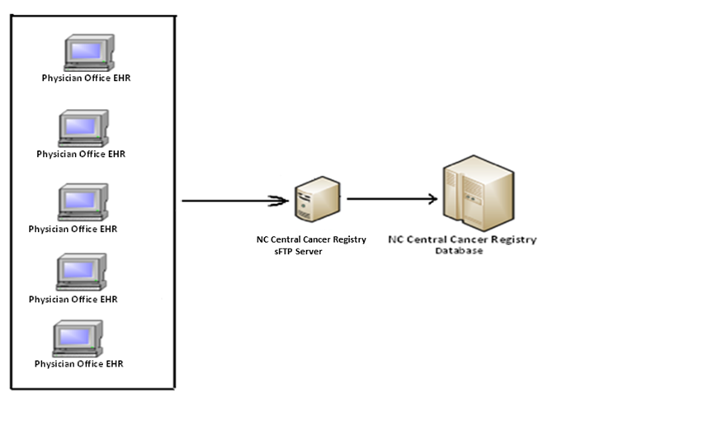
Transport Mechanism
Notes:
SFTP- enables secure data transfer of cancer cases from the physician offices.

Slide 8
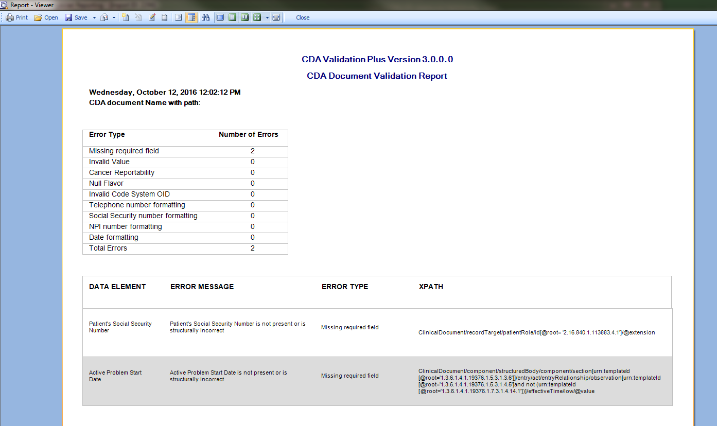
Testing and Validation Process – CDA Validation Plus
Notes:
- ability to support parallel MU stages across many clients)- new versions of EHR have to be reconciled with older versions- one EHR with address issue, another with consistent structure issues

Slide 9
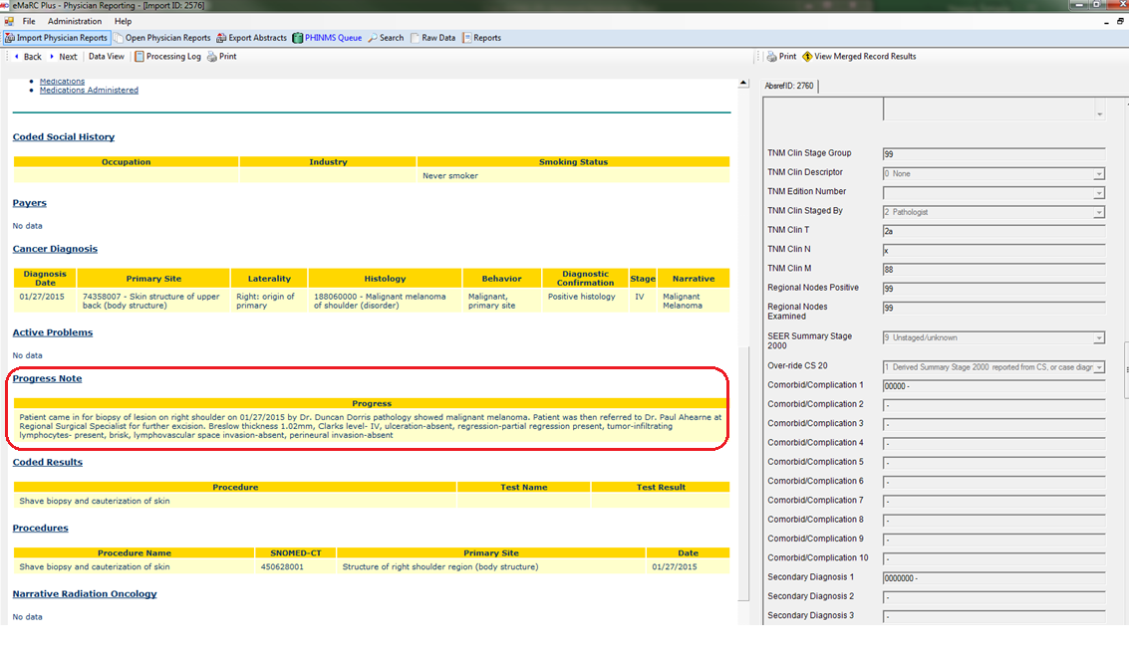
Testing and Validation Process - eMaRCPlus
Notes:
- ability to support parallel MU stages across many clients)- new versions of EHR have to be reconciled with older versions- one EHR with address issue, another with consistent structure issues

Slide 10
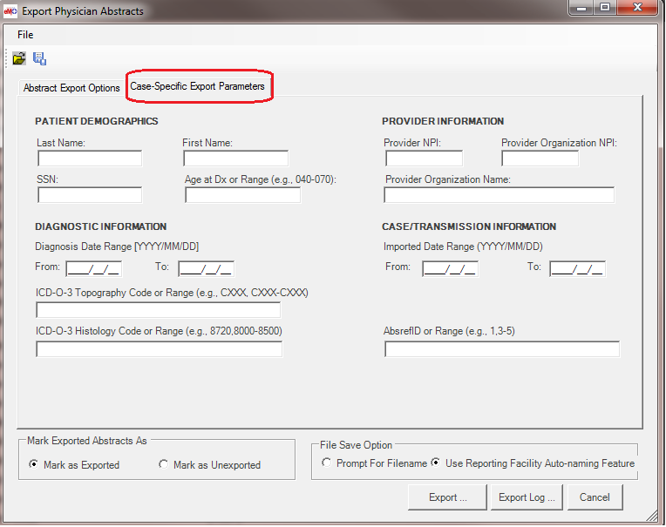
Exporting MU2 data

Slide 11
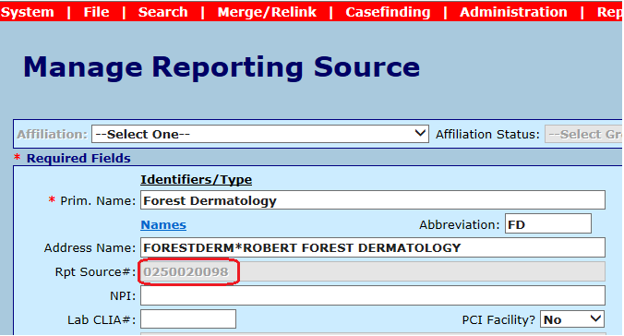
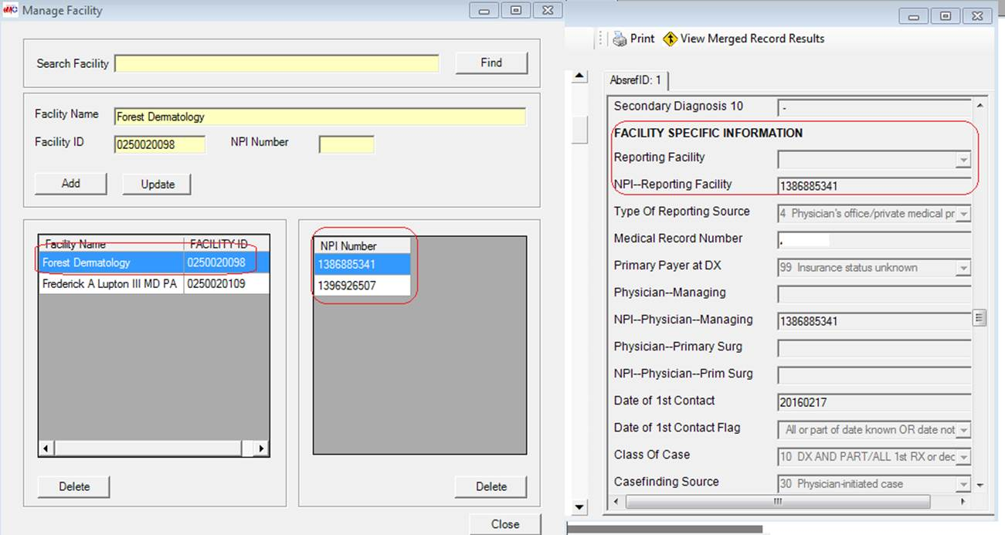
Adding Reporting Facility Number
Eureka - Reporting Source Management System
eMaRc – Manage Facility eMaRc – Abstract screen
Notes:
Once we onboard a practice, we have to add that reporting source to our registry database and our system generates the reporting source number which can be used as the Facility Identification Number in eMaRC PLUS.
Before importing any CDA files we set up the facility mappings using Manage Facility in eMaRC Plus application.
When we parsed those 5 practices’ successful MU2 data into our registry database, we had to do a lot of manual manipulation as eMaRc was not pulling the Reporting Facility Information into the Abstract screen as shown in the screen shot. CDC is aware of this issue and is working to fix it.
For the registry system we use currently, Reporting Facility is one of the required data item without which we cannot upload or parse the files into it.

Slide 12
Processing Dermatology case in the registry system
Following manipulation needed before uploading.
Adding Facility Identification Number (FIN) manually
Making sure that all the data fields are according to NAACCR layout.
Notes:
- We did manual manipulation after exporting the file from eMaRC to make it compliant to parse into our registry system.
So, after export, we manually find the NAACCR Column number for Reporting Facility number which is Column# 701-710 and added the Reporting Facility number that our registry system generated and uploaded the file in our registry system for further processing.
And here is what we see after we parse it in the system

Slide 13
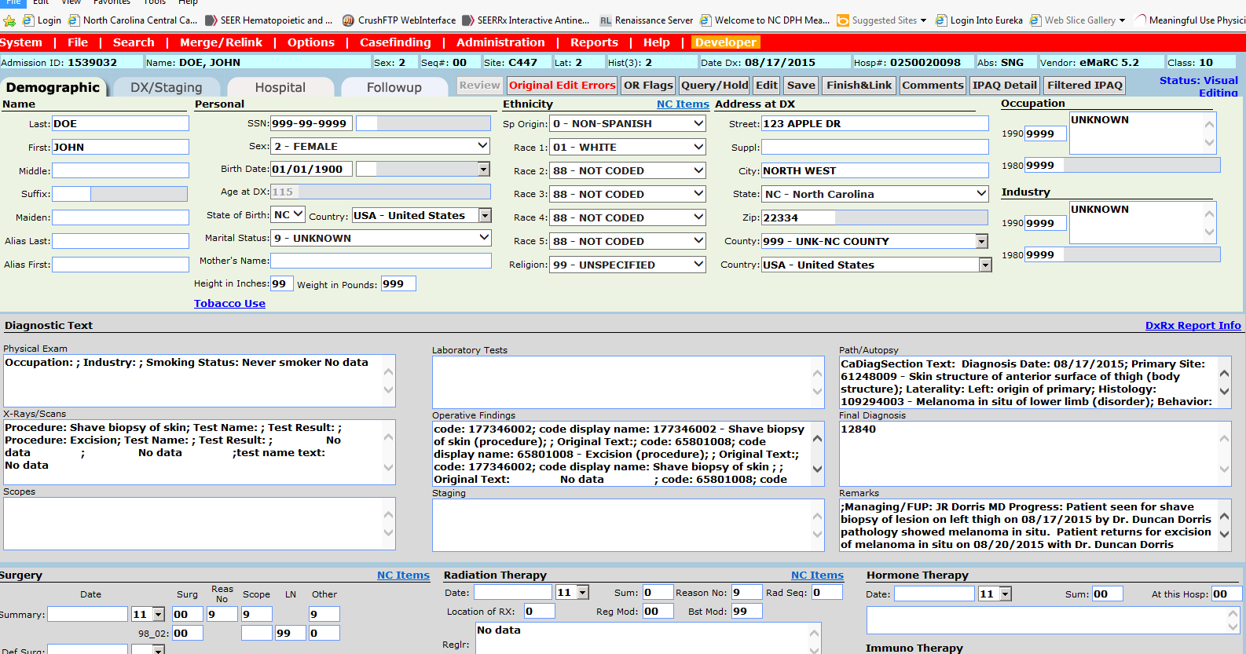
Processing Dermatology case in the registry system (Cont.)
Notes:
This is how we see it in our registry system after parsing.
We do see a lot of extra texts, for example labels right next to each value in the text boxes. This needs a lot f cleaning up before saving it and further processing it.

Slide 14
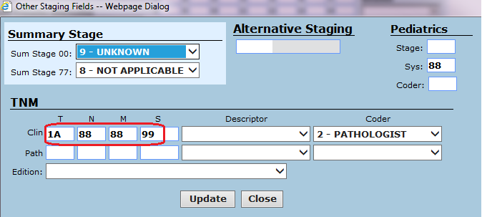
Staging in the Registry System
Notes:
As you see all the Cancer Diagnosis specific information is neatly mapped and automatically filled in the boxes as you see here.
Also the TNM staging we received is mapped correctly in the right field.
We really thank CDC especially, both Wendys, Shailendra and all other staff behind the scenes for their continued support.

Slide 15
Our Experiences
Vendor capability for data exchange remains varied.
Missing key data items in the cancer record.
Helpful to engage with the appropriate personnel from the physician office.
Onsite physician office walkthroughs and webinars to alleviate training issues.
Providing periodic data reviews through consolidated reports for feedback.
Comparing MU data to the data received through Registry reporting.
Linking MU2 cancer cases outside the registry database to reduce redundancy.
Notes:
- ability to support parallel MU stages across many clients)- new versions of EHR have to be reconciled with older versions- one EHR with address issue, another with consistent structure issues

Slide 16
Future Plans
Comparing MU data to the data received through Registry reporting.
Linking MU2 cancer cases outside the registry database to reduce redundancy.
Notes:
- ability to support parallel MU stages across many clients)- new versions of EHR have to be reconciled with older versions- one EHR with address issue, another with consistent structure issues

Slide 18
Meaningful Use Contacts
Nigar Salahuddin-
nigar.salahuddin@dhhs.nc.gov
Sumana Nagaraj-
sumana.nagaraj@dhhs.nc.gov
Notes:
As you see all the Cancer Diagnosis specific information is neatly mapped and automatically filled in the boxes as you see here.
Also the TNM staging we received is mapped correctly in the right field.
We really thank CDC especially, both Wendys, Shailendra and all other staff behind the scenes for their continued support.

Slide 19
Thank you!

