Slide 1
Recoding Audit Module (RAM)
Kyle L. Ziegler, CTR
Quality Control Specialist
Audit Coordinator
NAACCR: June 13-19, 2009, San Diego, CA

Slide 2
Recoding Audit Background
What is a Recoding Audit?
Verify codes match the text documentation
Original code must match the recode by the auditor
A discrepancy results if these codes do not match
260 cases recoded per audit
Consolidated Record
Single Admission

Slide 3
Recoding Audit Background
PEER Review Method of Auditing
Two auditors audit case blindly and independent of each other
Identify Trends in Discrepancies
Identify Educational Needs
Presentations
On-line modules
DSQC Memos
Volume I revisions

Slide 4
Recoding Audit Module (RAM) Objectives
Increase audit efficiency
Versatile audit parameters
Ability to change audited data items
Allows audits to be conducted on current data
Reduce time intervals between education and training efforts

Slide 5
Terms
EUREKA | California State Data Management System
Recoding Audit Module (RAM) | Application program within Eureka that provides an interface between auditors and data.
RAAQ | Recoding Audit Action Queue (Individual Work List)
Primary Auditor | Performs the audit first
Secondary Auditor | Performs the audit after the primary auditor
Reconciliation Process | The process where the Primary and Secondary Auditor negotiate an agreement on discrepant data items. This process is conducted in the Reconciliation Screen at the end of the recoding process. The reconciliation screen demonstrates differences between the two auditors and the original admission.

Slide 6
Recoding Audit Model

Slide 7
Recoding Audit Model
Audit Coordinator | Responsible for Audit design, organization, and execution of audit. Manages auditors, monitors audit progress, addresses issues and provides audit final report to CCR administration.
Primary Auditor | Select case from the RAAQ, recodes the case and “saves and finishes” the case.
System | Transfers the case out of the Primary Auditors RAAQ to the Secondary Auditors RAAQ.
Secondary Auditor | Selects case from the RAAQ, recodes the case and “saves and finishes” the case.
System | Transfers the case out of the Secondary Auditors RAAQ to the Primary Auditors RAAQ and names it “Reconciliation 1”.
Primary Auditor | Selects case from the Reconciliation screen and resolves differences between the auditors.

Slide 8
Orientation and Features of the
Audit Recoding Screen

Slide 9
Orientation to the Recoding Queue

Slide 10
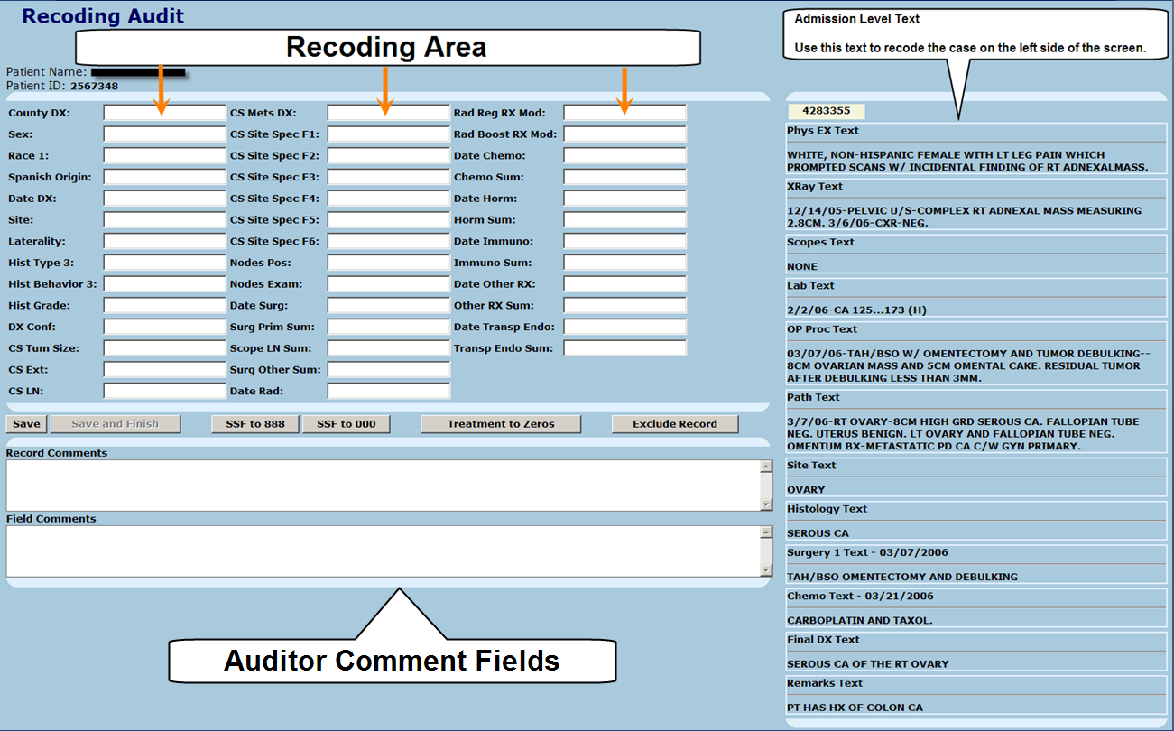
Recoding Screen Orientation
Admission Level Text
Notes:
There are three main areas of the recoding screen:
The Recoding Area
Admission Level Text
Auditor Comment Fields
The Recoding Area:
This is the area in which recodes that are deemed appropriate by viewing the text located to the right of the screen (the Admission Level Text)
The Admission Level Text:
This is the text from the admission that is being used to audit. Use this text to code the data items located in the Recoding Area.
Auditor Comment Fields:
There are two separate “comment” fields; The “Record Comments” and “Field Comments.” These are discussed further on slide…Slide 11.

Slide 11
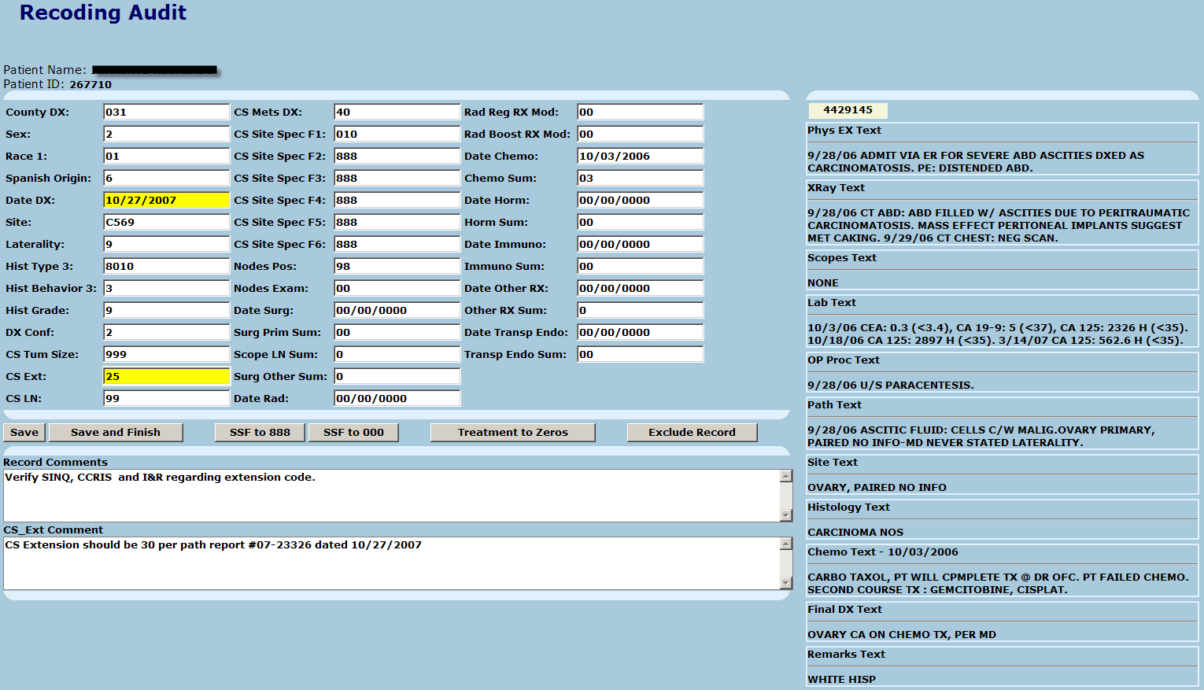
Primary Auditor Recoding Screen
Notes:
This is an example of what a typical recoding screen will look like.
When the auditor enters a code that is the same as the original code the field remains white.
When the auditor enters a code that is different from the original code the field highlights in yellow after tabbed out of the field. This is a signal to the auditor to make sure that what they entered is accurate and if so place a comment in the Data Comment sections of the screen. In the above example, the discrepancy just occurred in the CS Extension field, therefore the comment is placed into the CS Extension Comment field.
TAKE NOTE: Every code that is entered is being complied in a complex equation that eventually tallies:
how many cases were recoded
how many cases had discrepancies
how many cases did not have discrepancies
how many discrepancies there were total
and then randomizes each data item according to VE status (VE’d or not VE’d)
and calculates these rates individually
This is why it is important to make sure that only cases that get the “Save and Finish” button clicked are those that are to remain in the audit. If for some reason a case needs to be excluded then that feature can be used but only as a last resort.

Slide 12
Secondary Auditor

Slide 13
Secondary Auditor
This queue will populate only when the primary auditor has completed a case
Notes:
The secondary auditor opens a case in the same fashion as the primary auditor, by clicking on the “Secondary Recode” link to the right of any patient.
NOTE: Unlike the primary auditor, the secondary auditor does not have to do the cases in any particular order.

Slide 14
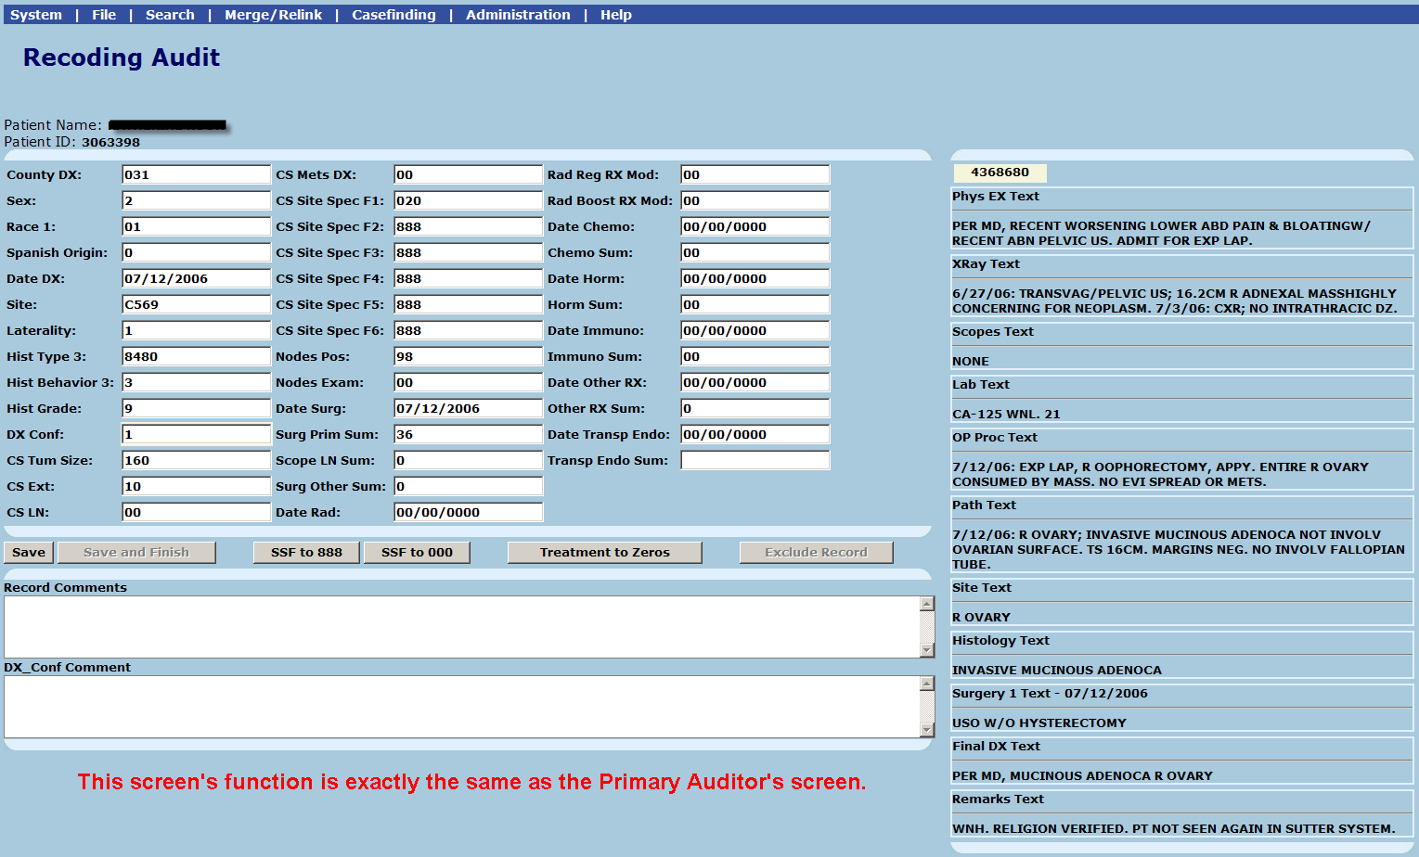
Secondary Auditor Recoding Screen
Notes:
The secondary auditor recodes the case the same way the primary auditor recodes the case.

Slide 15
Orientation and Features
of the
Reconciliation Screen

Slide 16
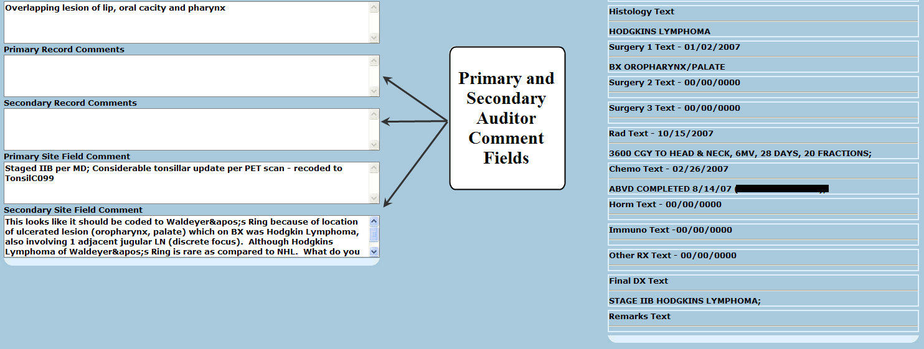
Reconciliation Screen

Slide 17
RAM Reports
Disposition Report
Discrepancy Rate
Data Item
Overall Accuracy Rate
Spreadsheet
Simple excel spreadsheet that dynamically documents audit results

Slide 18
RAM Reports – Disposition Report

Slide 19
Future RAM Development
Educational Tool
Training Visual Editors
Training New CTR’s
Central Registries
Hospitals
Visual Editing
Special Studies

Slide 20
Kyle L. Ziegler, CTR
kziegler@ccr.ca.gov

