Slide 1
NAACCR 101 2010 Annual Conference Quebec City, Quebec, Canada
Shannon Vann, CTR
Jim Hofferkamp, CTR

Slide 2
What is NAACCR?
A collaborative umbrella organization
Established in 1987
Interested in improving quality and increasing use of cancer registry data
Includes all provincial/territorial and state cancer registries in Canada and the U.S.
Notes:
It is a collaborative, umbrella organization established in 1987 that includes central registries, governmental agencies, professional organizations, and private groups in North America that are interested in the improved quality and increased use of cancer registry data.

Slide 3
NAACCR Structure
Membership categories
Full
Sponsoring
Sustaining
Individual
Notes:
Full – Central registries which are or have the potential to become population-based registries
Sponsoring – national professional or national government organizations involved in cancer epidemiology, patient care, cancer control, cancer registration, professional education, research, or biostatistics; entitled to 1 vote in matters submitted to membership for a vote; reps of sponsoring member organization may be a member of and chair a committee; only one rep of a sponsoring member organization can vote on a committee
Sustaining – organizations interested in promoting the purposes of NAACCR; not entitled to vote and their reps can’t hold office but they may be members or chairs of committees
Individual – persons not currently working in a member organization but they have career and professional interests consistent with those of NAACCR; they may be a committee, subcommittee, or workgroup member but they may not chair a committee or vote or hold office

Slide 4
NAACCR Structure Sponsoring Member Organizations (SMO)
American Cancer Society*
American College of Surgeons Commission on Cancer *
American Joint Committee on Cancer*
Canadian Cancer Registry (Statistics Canada)
Canadian Partnership against Cancer
Centers for Disease Control & Prevention’s National Program of Cancer Registries
College of American Pathologist
National Cancer Institute
National Cancer Registrars Association
Public Health Agency of Canada
*Sponsors with distinction

Slide 5
NAACCR Structure
Governed by Board of Directors
President
President-elect
6 representatives at large
Sponsoring members representative
Treasurer
Immediate past-president
Executive director (ex officio)
Notes:
Anyone who has been a rep in NAACCR of a full member organization for 1 year prior to nomination is eligible to hold office
Eligibility
President – 1 year on BOD or as a committee chair
Representative at large or treasurer – served as a committee member
Sponsoring member rep is elected by the sponsoring member organizations
Terms of office – 2 years
President – elect & past-president – 1 year
Reps at large elected on a rotating basis
Limit of 4 consecutive years

Slide 6
NAACCR Structure Standing Committees
Bylaws
Communications
Data Evaluation & Certification
Data Use & Research
Education
Information & Technology
Nominating
Program
Registry Operations
Uniform Data Standards
Notes:
The work of NAACCR is completed by NAACCR committees.
President appoints chairs and BOD liaison to committee
Each committee rep may vote on committee actions and may designate an alternate if absent for any reason; if there is more than 1 member rep on a committee, only one rep can vote

Slide 7
NAACCR Structure
Ad-hoc committees
GIS
Interoperability
Other special committees
Cancer Registration Steering Committee
Institutional Review Board (IRB)
Scientific Editorial Board
Notes:
Ad hoc committees are created by the BOD as deemed necessary.
Interoperability - NAACCRs number one priority is to achieve syntactic and semantic interoperability of cancer registration standards with national standards by 2010. There are two work groups under the Interoperability Ad Hoc Committee (Syntactic Interoperability WG and Semantic Interoperability WG). There are two works groups under the Syntactic Interoperability WG (Clinical Data WG and Pathology Data WG).
Cancer registry steering committee – validates/introduces/announces proposed changes to field of cancer registration very early in the process

Slide 8
NAACCR Committee Membership
Open to all NAACCR members
No term limits for committee membership
Full, sponsoring, or sustaining members may chair a committee
Notes:
Committees appointments are made after the annual meeting
Contact the Committee Chair or NAACCR President to be appointed to a committee
Chairs will notify all prospective members when they have been added to the committee roster

Slide 9
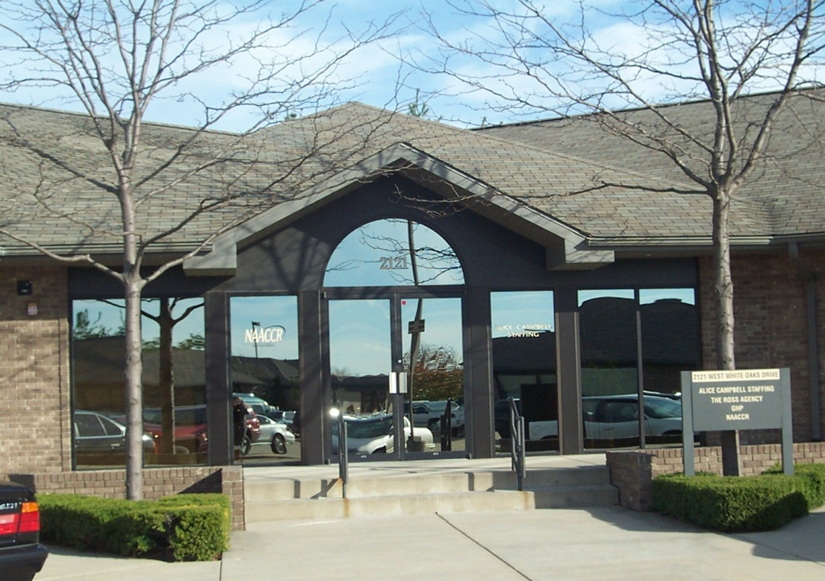
NAACCR Executive Office 2121 W. White Oaks Dr. Springfield, IL 62704 Phone: (217) 698-0800 Fax: (217) 698-0188
Notes:
9 full-time staff
Incorporated as a legal, business entity
Operates as a non-profit 501 c(3)

Slide 10
What does NAACCR do?
Establish and maintain consensus on standards
Train and educate registry professionals
Certify registries by assessing data quality
Evaluate, aggregate, and publish data
Promote the use of registry data
Notes:
The mission of NAACCR is to develop and promote uniform data standards for cancer registration; provide education and training in cancer registry operations and surveillance; certify population-based registries that have achieved high quality for producing an incidence rate; aggregate and publish data from central cancer registries throughout the U.S. and Canada; and promote the use of cancer surveillance data and systems for cancer control and epidemiologic research, public health programs, and patient care to reduce the burden of cancer in North America.

Slide 11
What does NAACCR do? Standards
Standards for data definition, use, and presentation
Volume I: Data Exchange Standards & Record Description
Volume II: Data Standards & Data Dictionary
Volume III: Standards for Completeness, Quality, Analysis, Management, Security, & Confidentiality of Data
Volume IV: Standard Data Edits
Volume V: Pathology Laboratory Electronic Reporting
NAACCR Implementation Guidelines
Registry Operations Guidelines
Death Clearance Manual
Notes:
Consensus on standards for data elements

Slide 12
What does NAACCR do? Education and Training
Live webinars
Cancer Registry and Surveillance Webinar Series
CTR Exam Preparation and Review Webinar Series
NAACCR Annual Conference
Customized training
Mentor Fellowship Program
Process Improvement Program

Slide 13
What does NAACCR do? Certification
Data Evaluation & Certification Committee (DECC)
Evaluates annually cancer incidence data submitted by members for most recent year
Evaluates data based on pre-determined certification criteria
Purpose of certification
To identify member registries with complete, accurate, and timely data to compute incidence statistics
Notes:
In 1997, NAACCR instituted a program that annually reviewed member registries for their ability to produce complete, accurate, and timely data. Each year, members of the Data Evaluation and Certification Committee (DECC) evaluate cancer incidence data for the most recent data year, based on pre-determined registry certification criteria established by the DECC. Following an evaluation by members of the Registry Certification Subcommittee (Subcommittee of the DECC), registry staff receive a report containing the results of registry certification evaluation for the most recent data year. In 2006, cancer incidence data from 73 population-based cancer registries were evaluated as part of the certification program and 7 Canadian and 56 U.S. registries were certified for their 2003 data. The percentage of the population that is reflected by certified registries for 1999-2003 data is approximately 82%.
Registry Certification is conducted annually for the most recent year of incidence data, to identify registries that have complete and accurate data to compute complete and accurate incidence statistics. In 1997, the North American Association of Central Cancer Registries, Inc. (NAACCR) instituted the program to independently and annually review the data from member registries for their completeness, accuracy, and timeliness. The registry certification metrics are pre-determined and established by NAACCR. The sole purpose of the review is to indicate that the data from the year are of sufficiently high quality to use in the calculation of standard incidence statistics (i.e., for specific cancer types and for sub-state/province area (county) by sex, race, and age within the registry jurisdiction). Cancer registries are recognized annually for their accomplishment in reaching either a silver or gold standard.
Level of recognition: gold or silver

Slide 14
Certification Criteria for 2010 Call for Data
Data Year | 2007
Completeness | 90% Silver 95% Gold
% Passing EDITS | 97% Silver 100% Gold
Death Certificate Only (DCO) Cases | <=5% Silver <=3% Gold
Timeliness | Received by 12/1/2009
Duplicate Reports | <=2/1,000 Silver <=1/1,000 Gold
Missing Data Field Sex, Age, County | <=3% Silver <=2% Gold
Missing Data Field Race | <=5% Silver <=3% Gold
Notes:
Level of recognition: gold or silver

Slide 15
Certification Results: 2007 Data
67 submissions
Certification Levels
52 Gold
11 Silver

Slide 16
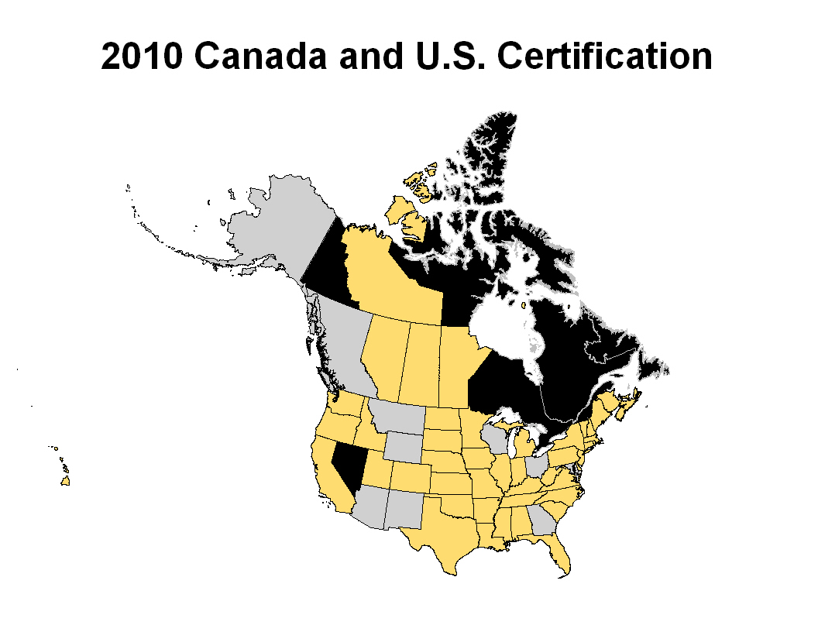

Slide 17
What does NAACCR do? Evaluate, Aggregate, & Publish Data
Cancer in North America (CINA) 2003-2007
Volume I: Combined Cancer Incidence for the United States and Canada
Volume II: Registry-specific Cancer Incidence in the United States and Canada
Volume III: Mortality
Notes:
NAACCR has an annual call for data in which NAACCR members (central registries) participate voluntarily. The call for data results in a multi-registry, aggregated data resource that can be used for cancer surveillance and research. Through the 2010 call for data, 2003-2007 data were evaluated and aggregated.
The current monograph is organized into three volumes. Volume One presents the aggregated cancer incidence data from high quality registries in the United States. This year, less than 50% of the Canadian population is represented by provincial registries, and thus incidence statistics for Canada and North America are suppressed in Volume One. The cancer incidence statistics for the United States are also described by race and Hispanic/Latino ethnicity, with special sections on American Indian/Alaskan native and pediatric cancer data.
Volume Two describes the registry specific cancer incidence rates by cancer site, sex, race, and ethnicity for all NAACCR members in good standing that submit data and elect to be included in the monograph (excludes only the Nevada and the US territories).
Volume Three, which will be published soon after data on 2007 US mortality and 2006 Canadian mortality becomes available, presents the registry-specific, cancer death rates by cancer site, sex, race, and ethnicity.
Volumes One through Three, along with population data, supporting appendices, and cancer rates age-adjusted to the US, Canadian and World population standards are available free of charge from the NAACCR website. Site specific bar graphs comparing rates by sex and race across all registries are also available online. This is the first edition to include data on cancer incidence among Asian and Pacific Islanders in each Volume.

Slide 18
What does NAACCR do? Evaluate, Aggregate, & Publish Data
CINA + Online
Online database for public queries regarding cancer incidence
CINA Deluxe analytic file
Discretionary research data set
Annual Report to the Nation
ACS Cancer Facts and Figures
Notes:
Additionally, the CINA data resource is used to create an online database, CINA+ Online, for public queries regarding cancer incidence for the most recent 5 years.
CINA Deluxe is a discretionary research data set that includes data to facilitate analytic studies conducted by epidemiologists and other qualified researchers.

Slide 19
Data Quality Criteria for 2010 Call for Data
Criteria | Fitness of Data for CINA Combined Rates | Fitness of Data for CINA Deluxe File
Data Year | 2003-2007 | 1995-2007
Completeness | Silver (90%) or better | Silver (90%) or better
% Passing EDITS | No errors on CINA variables | No errors on CINA variables
DCO Cases | Silver (<=5%) or better | Silver (<=5%) or better
Timeliness | Received by 12/1/2009 | Received by 12/1/2009
Duplicate Reports | Silver (<=2/1,000) or better | Silver (<=2/1,000) or better
Missing Data Field Sex, Age, County | Silver (<=3%) or better | Silver (<=3%) or better
Missing Data Field Race | Silver (<=5%) or better | Silver (<=5%) or better
Inter-record EDITS | No errors on CINA variables affecting incidence stats | Registries with inter-record edit errors excluded from multiple primary studies
Notes:
Data submitted by NAACCR member registries are evaluated using the criteria on this slide before being included in the listed CINA products.
Data quality feedback is provided to the member registries that submit data for certification and inclusion in the CINA products.

Slide 20
What does NAACCR do? Promote Data Use
Town hall meetings with researchers
Research program information on the website
Webinar on July 8, 2010
Using CINA Data in Cancer Surveillance Activities
Working on ways to improve membership’s access to NAACCR data
Developing new tools to access CINA data online
Working with Comprehensive Cancer Control National Partners to develop better ways of using surveillance data for cancer control

Slide 21
The Value of NAACCR to the Membership
Produces tools for the entire cancer surveillance community
Provides uniform data standards for data collection
Brings together a highly trained workforce
Produces useful population-based information
Focuses beyond individual programs or agencies

