Slide 1
Using Scanners and Optical Character Recognition for Pathology Report Collection
Donna Morrell, CTR
NAACCR 2014 Annual Conference
Ottawa, Ontario, Canada
June 25, 2014

Slide 2
Using Scanners and Optical Character Recognition for Pathology Report Collection
Background
Plan
Method
OCR Process
Results
Conclusion

Slide 3
Using Scanners and Optical Character Recognition for Pathology Report Collection
A hallmark of the Los Angeles Cancer Surveillance Program (CSP) is 100% pathology report collection since 1972
65% of pathology reports are received electronically through ePath
35% are obtained as paper pathology reports from the hospitals or labs
In this presentation we describe a new approach to obtaining the paper pathology reports

Slide 4
Background
Pathology reports are used for:
casefinding - assuring a complete cancer case report is received for every reportable pathology report
research studies
quality assurance visual editing

Slide 5
Background
Paper pathology reports were stapled to paper copies of the reported case abstract
For all cases 1972-2010
Even though abstracts were received electronically and ePath was implemented at some facilities
All 1972-2010 paper documents have been digitized, capturing an image of the pathology report
Key identifiers (regional admission and tumor numbers) have been captured for easy retrieval of the pathology report image
Images of abstracts and pathology reports are available for use by researchers and registry staff

Slide 6
Plan
Realizing the importance of a more secure method for capturing the non-ePath pathology reports, in 2010 we began development of a “paperless” process
Replaces insecure transportation of paper pathology reports containing personal health information from hospitals and labs to the CSP office
Replaces storage of paper pathology reports at the registry office
Added benefits:
Decreases both field staff and in-house staff effort in acquiring and processing and storing paper pathology reports
Eliminates the need to digitize the reports

Slide 7
Plan
Create the capacity to electronically capture key data elements using Optical Character Recognition (OCR) technology
Patient name, birthdate, pathology report number, pathology report date and originating facility
Create and electronically store an image of the original pathology report
Ultimately, merge the OCR data and images with the ePath pathology reports for use by researchers and registry staff

Slide 8
Methods
Software was created to allow on-site scanning of pathology reports by registry field staff into an encrypted laptop
Replaced photocopying pathology reports and transporting paper copies to the registry office
Staff have 2 scanners and a laptop
Heavy duty scanner that can scan 80 pages per minute and weighs a bit under 7 pounds
Light scanner that scans 15 pages per minute and weighs 2.2 pounds
Depending on the volume of pathology reports at a facility, the staff has a choice between the two scanners

Slide 9
Field Tech Equipment

Slide 10
Methods
Pathology report templates were created for over 120 unique pathology report formats
Labor-intensive process
Never-ending, as formats change constantly, often with minor changes, such as insertion or deletion of a comma – or a space, which severely impacts the OCR process

Slide 11
Methods
The software used is Abbyy Flexi-Layout 10 for the template creation and Flexi-Capture for the OCR process
The software can be programed to recognize the specific data items to be captured for OCR process
The next slide shows capture of patient name, medical record number, birthdate, pathology report date, and pathology report number

Slide 12
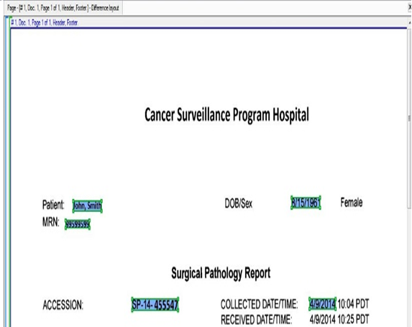
Creating a Template for an Individual Hospital

Slide 13
OCR Process
Divider pages are manually inserted to identify each individual pathology report
Purpose of divider page is so the OCR program can identify the beginning page for each individual pathology report
Boring, monotonous process performed by non-CTR staff person
We originally had CTR field staff inserting dividers (not a good use of their skills) and are still investigating a more automated process

Slide 14
USC Divider Page

Slide 15
OCR Process
Files with divider pages inserted are electronically run through the OCR process, using Flexi-Capture software
The OCR process runs at night, without human intervention
After the OCR process, the software will electronically split the pathology reports into two parts:
If no data items need to be reviewed, the pathology reports will be exported to a CSP server
If a problem(s) is detected, the pathology report will be exported to a verification process

Slide 16
Verification Process
Verification process is for pathology reports identified as needing review of data item(s)
Questionable items are highlighted by OCR system
examples:
0 vs O; l vs 1; c vs e, etc
spacing on scanned report moves a data item out of identified space on template
Non-CTR CSP staff review the highlighted data item(s) and manually make corrections

Slide 17
OCR Problems

Slide 18
OCR Problems
Aligned Scan
Non Aligned Scan

Slide 19
Verification
The red check indicates this pathology report has a problem that needs review

Slide 20
Verification
Example of an opened pathology report needing verification. The left view shows the pathology report, the right view shows the field in red that needs to be verified.

Slide 21
Verification
Once all corrections have been made, a green “Verified” will appear
After all pathology reports in the batch have been corrected, the OCR process automatically exports all of the pathology reports to a CSP server

Slide 22
OCR Process
Finally, both the problem-free pathology reports and verified pathology reports are processed through a final “checker” program
The checker program identifies additional incorrect information that was not identified by the OCR process or verification process
duplicate pathology reports
problems with the captured data items, such as dates with too few characters
missing data items
problems with patient name and/or age
This program requires registry staff to manually review and correct the problems
After this final check, all pathology reports are made available for viewing and research uses
Are also available for linkage to full case reports

Slide 23
Checker Program

Slide 24
Results
All pathology reports from 2011-forward are being processed through the OCR system
The security of pathology reports and the patient PHI is vastly improved
The 2-step verification achieves near 100% accuracy

Slide 25
Lessons Learned
Changes and enhancements are continually improving the entire process
The OCR process is not error-proof
Implementing the process has taken more time than envisioned and has been very labor-intensive

Slide 26
Lessons Learned
Even those reports indicated as problem-free by the OCR process may contain errors
We are still discovering errors and defining processes to both correct the errors and to prevent them from occurring in the future
The “checker” program has greatly enhanced accuracy

Slide 27
Lessons Learned
Continual staff interaction is needed to assure accuracy
pathology report templates constantly need monitoring for changes
the verification of data items and final check process must be completed
continual monitoring that all files are processed in a timely manner is important

Slide 28
Conclusions
We are encouraged that use of this technology has increased security, minimized duplicative data entry and eliminated the redundant digitizing of already-electronic reports compared to our previous paper-based processes
It has not been easy, but it has been worthwhile!

Slide 29
Acknowledgements
Moses Villa, OCR Specialist
John Casagrande, DrPH
Meryl Leventhal, MA, CTR
Dianne Kerford, CTR
Dennis Deapen, DrPH
Please feel free to contact Moses Villa with any further questions: Mosesvil@usc.edu

